Slide 1
Ransomware in Web Apps
OWASP Singapore

Slide 2
What is Ransomware?
A malware that blocks access to the computer until a ransom is paid
Key features
Encryption
Advent of crypto currencies
Effective infection vectors
Ransomware as a service
Malicious emails
Exploit kits
Several recent big attacks disclosed, most people just pay and move on

Slide 3
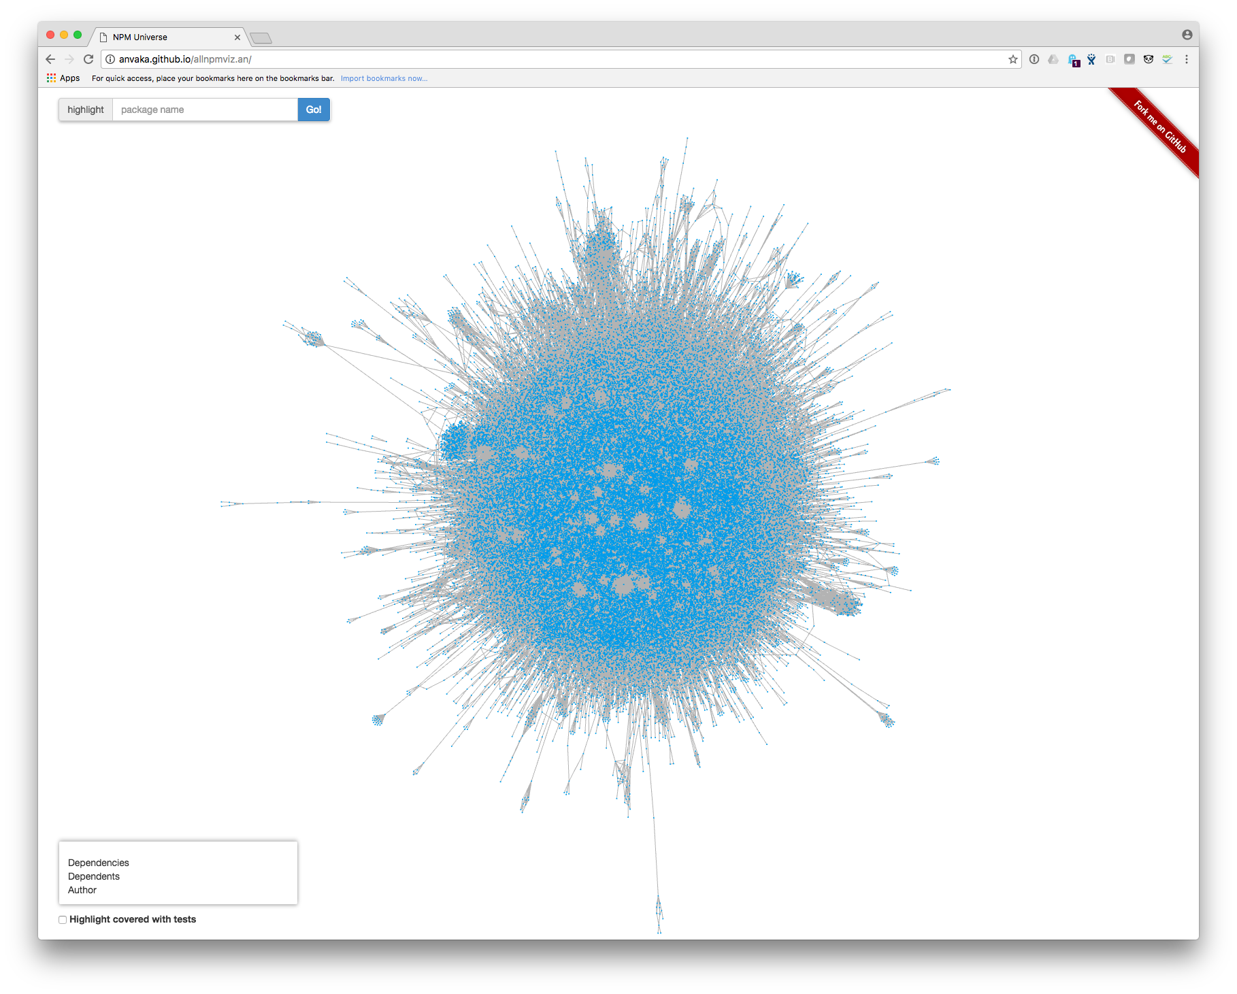

Control over what is in your code has changed
From YOU to:
developer tools
open-source code
3rd party developers
Reference : http://anvaka.github.io/allnpmviz.an/

Slide 4
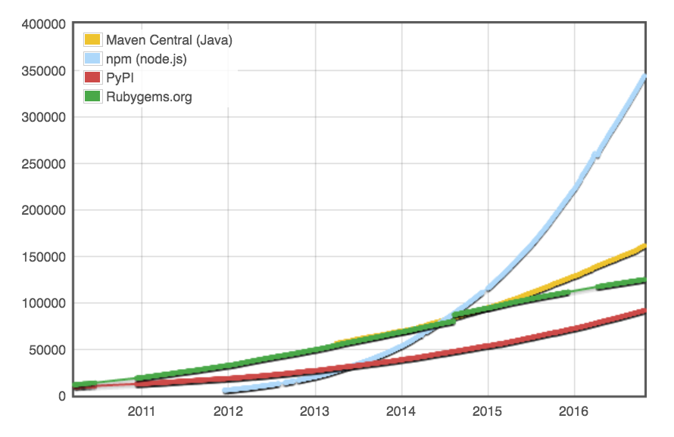
Open-source libraries have exploded
Reference : http://modulecounts.org

Slide 5
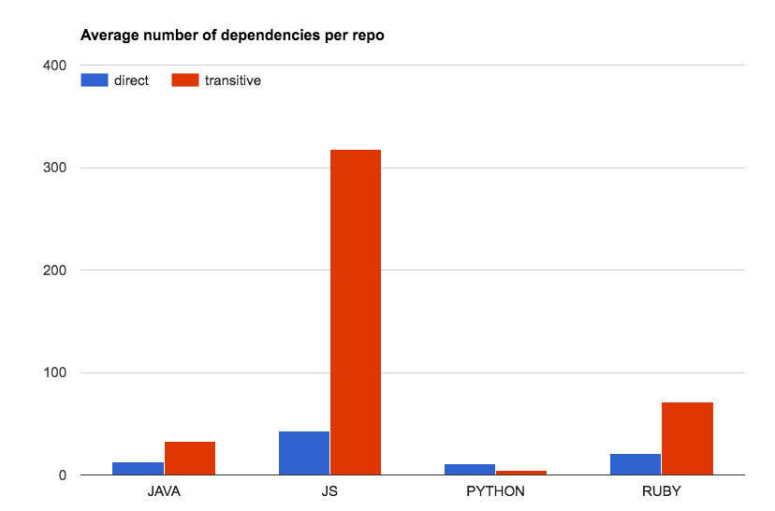
Complexity of libraries has exploded
For every one library you add to a Node.js project, 9 others are added
For every 1 Java library you add to your projects, 4 others are added
Reference : SourceClear customer scans

Slide 6
Before the open-source & DevOps era
Open Source
Are you introducing vulnerabilities in the
code you are writing?
Custom Code
(…once every few months)

Slide 7
In the open-source / DevOps era
Custom Code
What libraries are you using?
Where did it come from?
What does it do?
Open Source
Is it being maintained?
What vulnerabilities are present?
(…many hundreds of times each day)
Attack surface
has changed

Slide 8
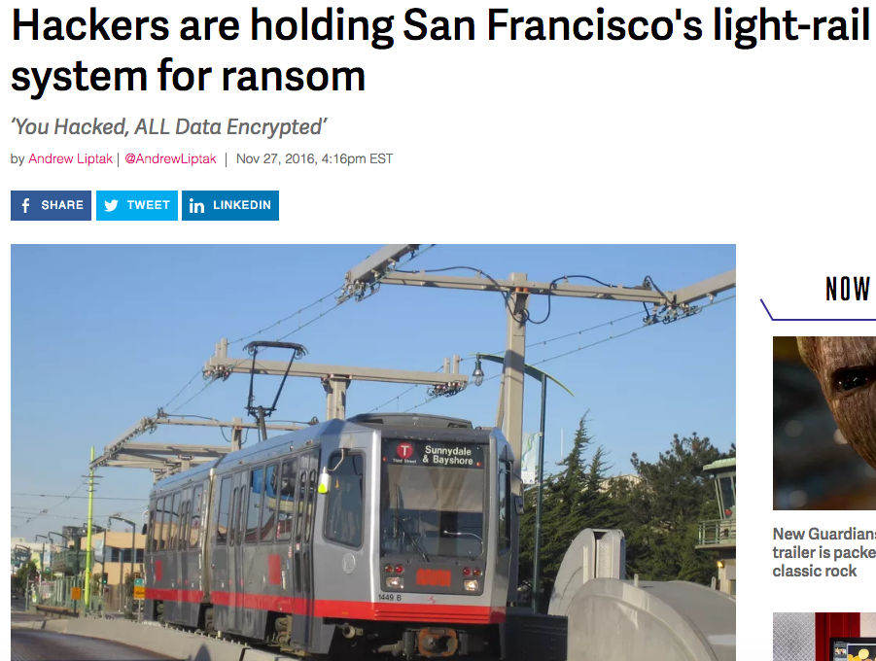

Slide 9
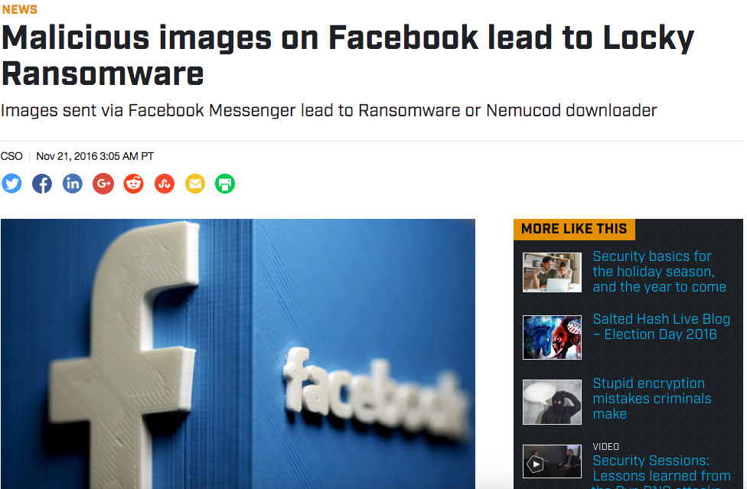

Slide 10
Different generations
Classical desktop based
TeslaCrypt
Locky
Cryptolocker
Newer variants
FLocker
Samsam

Slide 11
FLocker
FLocker (short for "Frantic Locker") ransomware is now capable of locking up Android TV sets.
While this variant of malware does not encrypt files on the infected device, it does lock the screen, preventing the user access to the TV. Additionally, this malware has the potential to steal data from the device.
Source: https://community.norton.com/en/blogs/security-covered-norton/flocker-ransomware-now-targeting-big-screen-android-smart-tvs

Slide 12
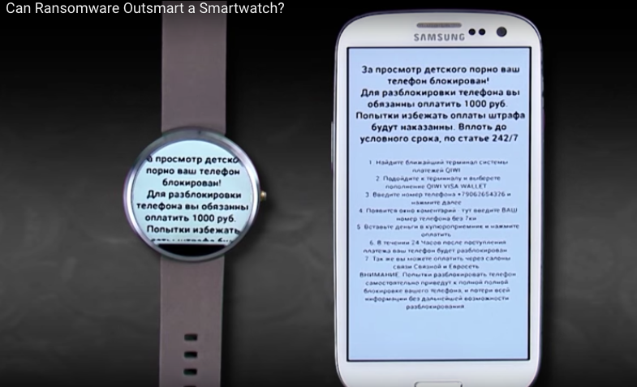
Ransomwear
Existing Android ransomware (Android.Simplocker) are easily repackaged to work on Android wear devices

Slide 13
Samsam
Used unpatched Java Application Servers (e.g. JBoss, Oracle WebLogic Server)
Samsam also uses RSA public key cryptography (classical variants download the encryption key from a C&C server)
Recent Muni system hacker exploited an old known remote object deserialization Java vulnerability Sources: http://arstechnica.com/security/2016/11/san-francisco-transit-ransomware-attacker-likely-used-year-old-java-exploit/ http://arstechnica.com/security/2016/03/maryland-hospital-group-hit-by-ransomware/

Slide 14
Ransomware in Web Apps
New trend targeting business applications
Exploitation based on vulnerabilities
Several public exploits are readily available

Slide 15
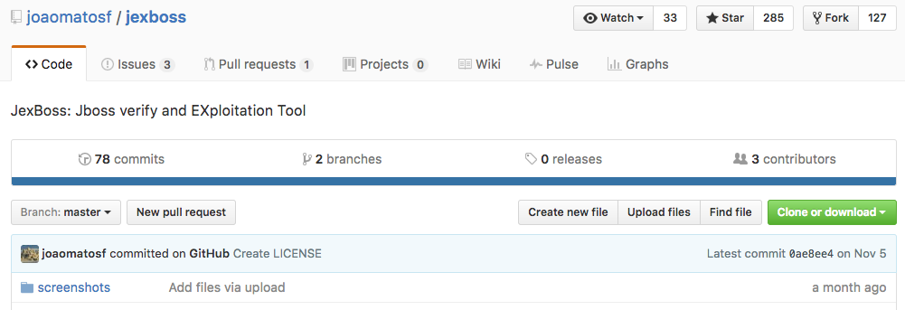
JBoss exploit kit

Slide 16
Ransomware targeting the software tool chain
Lot of trust placed in open source 3rd party libraries
Most build systems already allow command execution
See https://blog.sourceclear.com/all-your-secrets-belong-to-us/ on how to npm packages can be abused for data exfiltration
Web applications have access to critical business data

Slide 17
How to use dependencies to deliver ransomware?
Create a library that has provides some simple functionality that will want developers to download and use it
Hide code to implement ransomware that can either be triggered remotely or at a fixed time or under production environment etc.
Today we demonstrate two PoC/exploits:
Spring MVC
Ruby on Rails

Slide 18
Spring MVC
Typical ransomware works by encrypting files, in case of web application important data is likely to be in the database itself. This presents two potential challenges
How to determine the database connection settings for the web application?
Once we have access to the database how should we encrypt and decrypt the data?

Slide 19
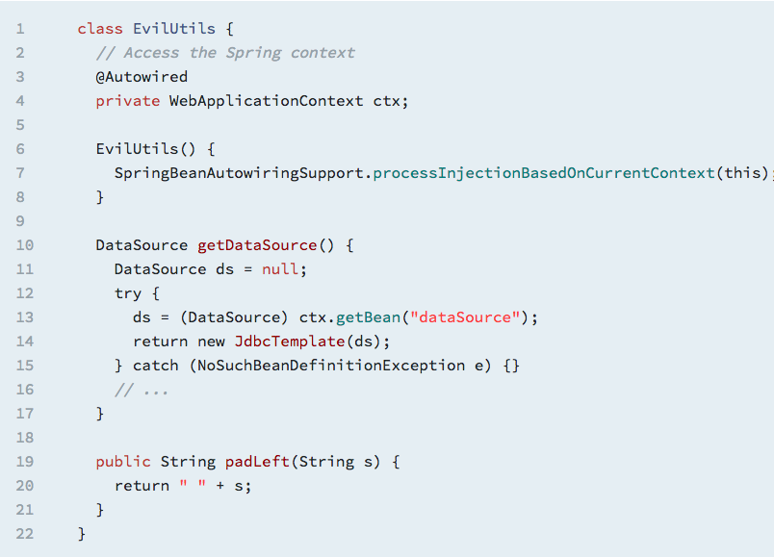
Search the Spring Application context
Locate the right Bean to get “dataSource”

Slide 20
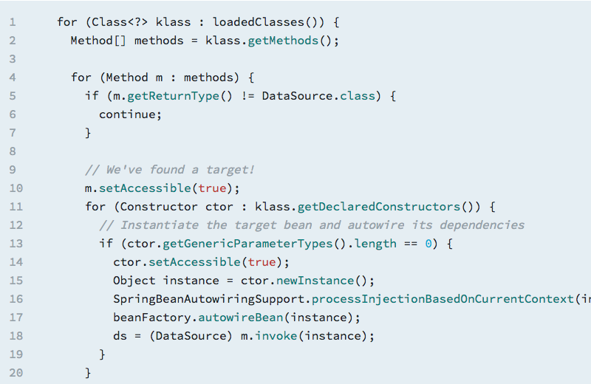
Reflection
We can access the ClassLoader hierarchy and find a class with a method which returns a DataSource of some kind.

Slide 21
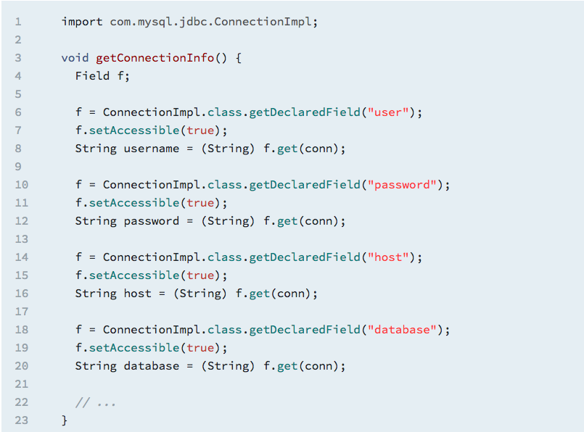

Slide 22
Encryption
Once we have the database connection:
Connect to database
Dump all content into a file
Encrypt it
Drop all the tables
For encryption we can use RSA public/private key pair where the public key is hardcoded in the application

Slide 23
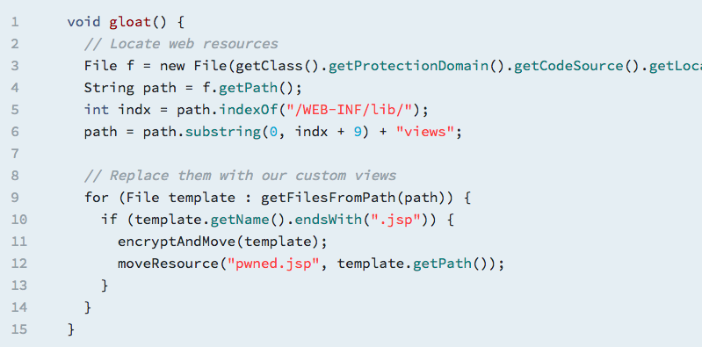
Don’t forget to leave a ransom note

Slide 24
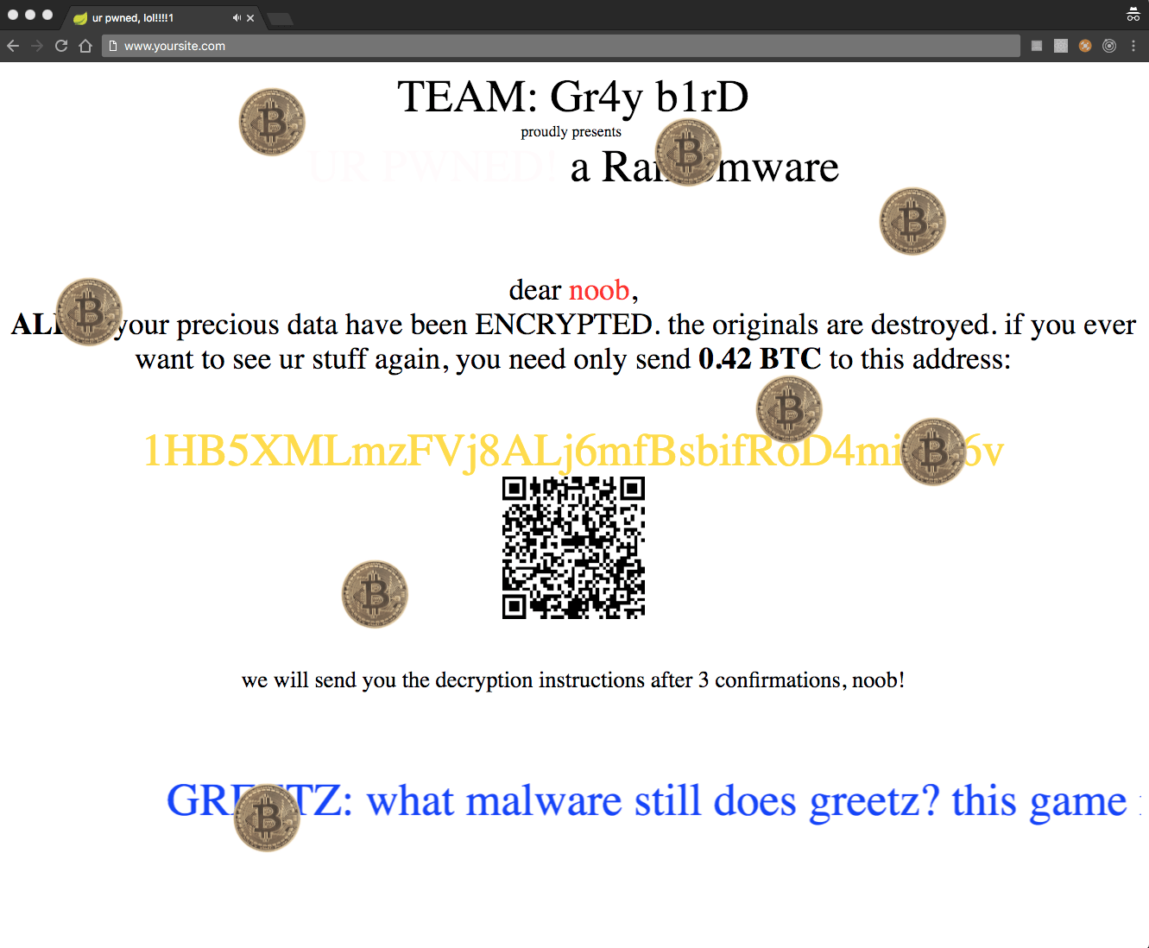
The entire process
Model
classes
Controller classes
View
templates
View
templates
Display a ransom note
View
templates
Spring classes
Spring classes
DB
Use reflection to get DB connection settings
Log in to DB, then dump and encrypt contents
DB

Slide 25
Ruby on Rails
Similar to the Spring MVC example
Due to the dynamic nature of Ruby it is much simpler to get access to the database connection settings

Slide 26
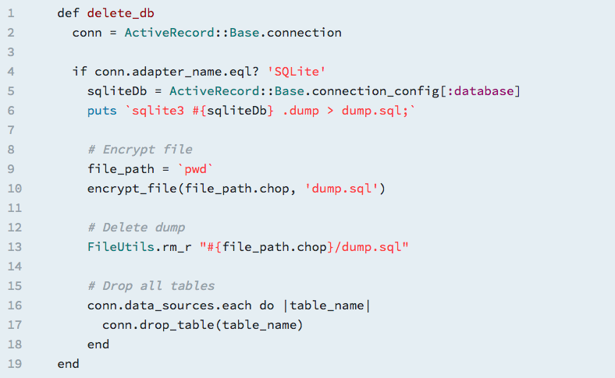
Simply get the database password from
ActiveRecord::Base.connection_config[:password]

Slide 27
Demos

Slide 28
Some thoughts on detection
In general quite hard to do it statically but we can profile the libraries and look for suspicious/malicious behaviors:
Use of reflection
On database connection object
Use of hardcoded public keys
For encryption

Slide 29
Conclusions
Growing threat of ransomware
Increasingly targeting business applications, IoT devices etc.
Use of novel infection vectors
Vulnerabilities in open source libraries
Build system, package managers
More visibility and auditing needed across the software supply chain

Slide 30
Questions?

