Slide 1
Secure Software Development
Dr. Asankhaya Sharma
SIT

Slide 2
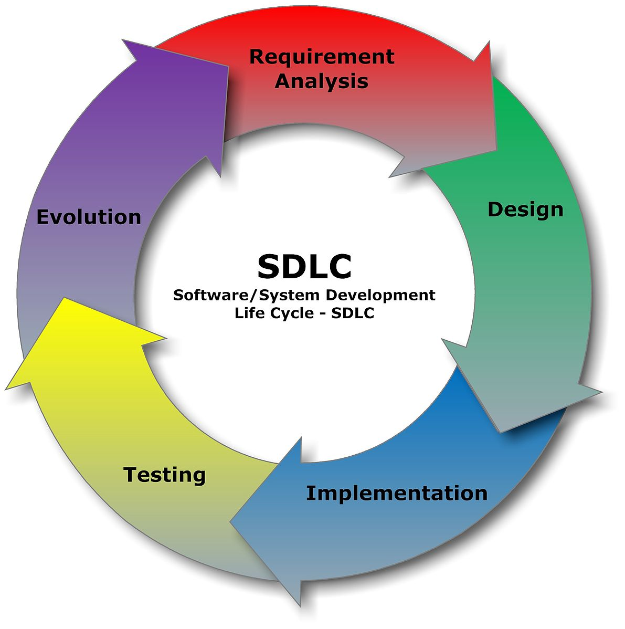

Slide 3
Secure Software Development
Consider security throughout the software development lifecycle
Requirements
Design
Implementation
Testing
Deployment

Slide 4
Requirements
Identify sensitive data and resources
Define security requirements for them
Confidentiality
Integrity
Availability
Consider threats and abuse cases that violate these requirements

Slide 5
Application Specific
Generic
Architectural Risk Analysis
Attack Patterns
Abuse/Misuse Cases
Legal
IT
Development
Threat Models
Attacks
Assets
Underlying Framework
Ambiguity Analysis
Fundamental Weakness
Historical Risks
Vulnerabilities
Common Best Practices

Slide 6
Design
Apply principles for secure software design
Prevent, mitigate and detect possible attacks
Security principles
Favor Simplicity
Trust with Reluctance
Defend in Depth

Slide 7
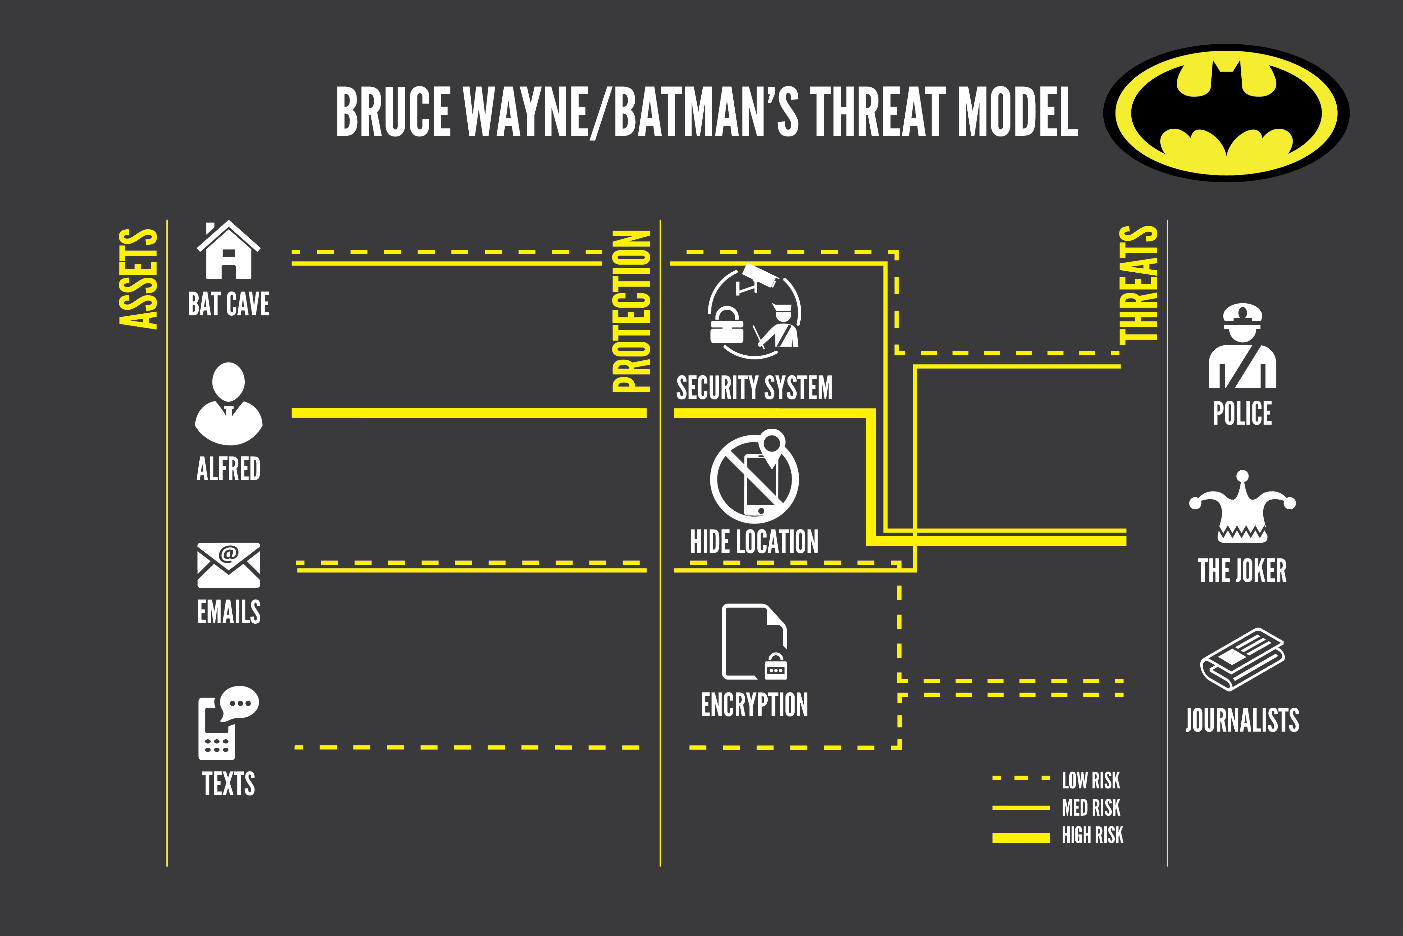

Slide 8
Implementation
Apply coding rules that implement secure design
Use automated code review techniques to find potential vulnerabilities components
Static Analysis
Symbolic execution

Slide 9
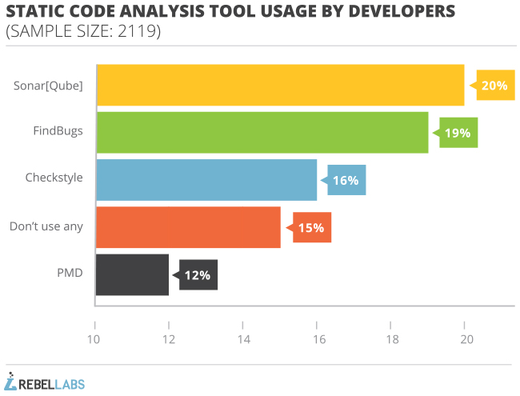

Slide 10
Testing
Penetration Testing to find potential flaws in the real system
Fuzz testing
Employ attack patterns

Slide 11
Different methodologies
BSIMM (Building Security In – Maturity Model)
http://bsimm.com
Microsoft Security Development Lifecycle
https://www.microsoft.com/en-us/sdl/
OpenSAMM Software Assurance Maturity Model
http://opensamm.org

Slide 12
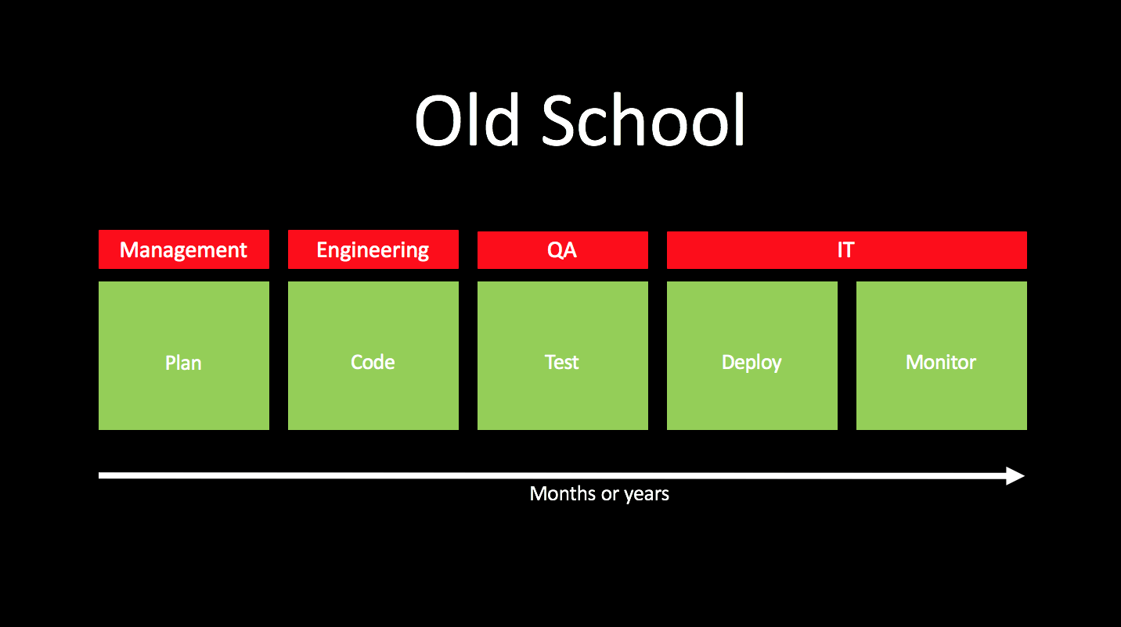

Slide 13
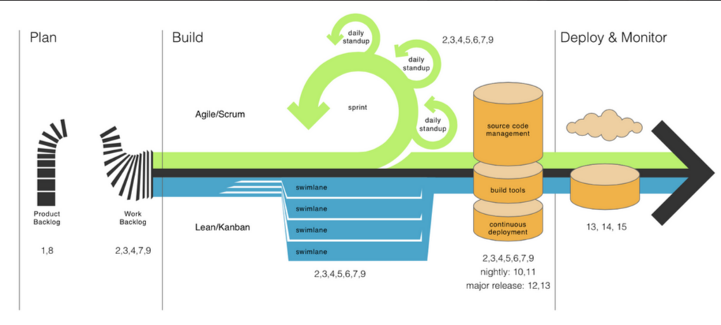
Continuous Delivery of Software

Slide 14
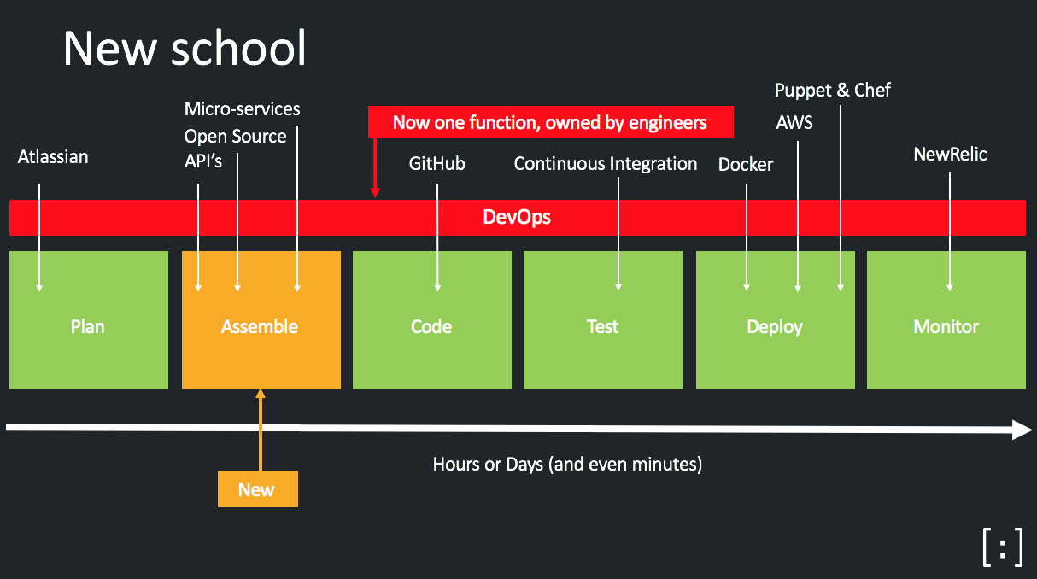

Slide 15
Continuous Security
Requires security automation
Integrate into CD environment and tools
Source code management systems
GitHub, Bitbucket etc.
Build systems
Travis CI, Jenkins etc.
Audit third party component and open-source library usage

Slide 16
Takeaways
Security practices should be built in during the software development process
Continuous delivery needs continuous security

Slide 17
Thanks!
Questions?
Contact
@asankhaya

