Slide 1
Specifying Compatible Sharing in Data Structures
Asankhaya Sharma, Aquinas Hobor, Wei-Ngan Chin SourceClear & National University of Singapore
ICFEM 2015

Slide 2
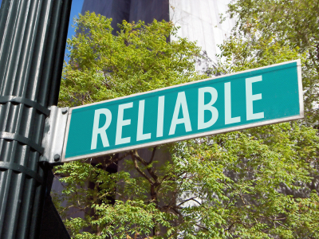
Building Reliable Software
Formal Verification
Proving correctness of programs
Testing
Discovering bugs in programs

Slide 3
Automated Verification with SL
Hoare Logic
Specify pre and post conditions for each method
Separation Logic
Heap manipulating programs
Separating conjunction “*” denotes disjoint heaps
Using the HIP/SLEEK Verification System

Slide 4
Overview
Code
Pre/Post
Predicates
Lemmas
separation
logic prover
(SLEEK)
code verifier
(HIP)
range of pure provers …
Omega, MONA, Isabelle, Coq, SMT, Redlog, MiniSAT, Mathematica

Slide 5
An Example – List Length
struct node{ int val; struct node* next; }; int length(struct node* p) { if(p == NULL) return 0; else return 1 + length(p->next); }

Slide 6
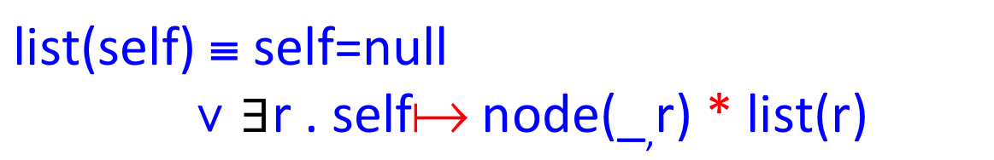
List Predicate
Example of Acyclic List : list(x)
x
null
list(self) ≡ self=null
∨ $∃$r . self node(_,r) ∗ list(r)
pointer to memory
spatial conjunction

Slide 7
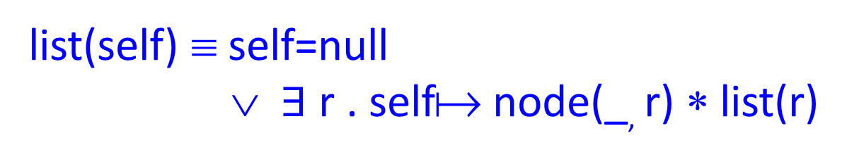
Syntactic Abbreviation (ASCII)
list(self) ≡ self=null
∨ $∃$ r . self node(_, r) ∗ list(r)
list⟨⟩ == self=null
or self::node⟨_, r⟩ ∗ r::list⟨⟩
implicit existential instantiation

Slide 8
Verify with Shape Property
struct node{ int val; struct node* next; }; /*@ list<> == self=null or self::node<_,q>*q::list<>; */ int length(struct node* p) /*@ requires p::list<> ensures p::list<>; */ { if(p == NULL) return 0; else return 1 + length(p->next); }
Predicate Definition
Method Pre and Post condition
Memory Safety

Slide 9
With Size
parameter on length of linked list
list⟨n⟩ == self=null & n=0
or self::node⟨_, r⟩ ∗ r::list⟨n-1⟩
inv n >= 0
predicate invariant
x::ll⟨5⟩
x
null

Slide 10
Verify with Shape and Size
int length(struct node* p) /*@ requires p::list<n> ensures p::list<n> & res=n; */ { if(p == NULL) return 0; else return 1 + length(p->next); }
Memory Safety
Length of the List

Slide 11
Frame Rule
P
P * R
R
Frame Rule
P {c} Q
-------------------
P * R {c} Q * R
Notes:
None of the free variables in R are modified in c

Slide 12
From Separation to Sharing
Disjoint Heaps (*)
x::node<a,b> * y::node<c,d>
Aliased Heaps (&)
x::node<a,b> & y::node<c,d>
Overlaid Heaps (&*)
x::node<a,_> &* y::node<_,d>

Slide 13
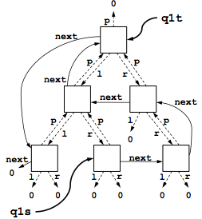
Overlaid Data Structures

Slide 14
Compatible Sharing
Disk IO Scheduler
List of Nodes (ll) and Tree of Nodes (tree)
The linked list and tree represent multiple views over same set of nodes
struct node{ int val; struct node* next; struct node* parent; struct node* left; struct node* right;};

Slide 15
Related Work
 | Expressivity | Entailment Procedure | Program Analysis | Local Reasoning | Certified Proof | Properties
[Lee 2011] | List and Tree | ✗ | ✓ | ✗ | ✗ | Shape
[Drăgoi 2013] | Only Lists | ✗ | ✓ | ✓ | ✗ | Shape
HIPComp | User Defined Predicates | ✓ | ✗ | ✓ | ✓ | Shape, Size and Bag
Oukseh Lee, Hongseok Yang and Rasmus Petersen. "Program analysis for overlaid data structures." Computer Aided Verification. Springer Berlin Heidelberg, 2011.
Cezara Drăgoi, Constantin Enea, and Mihaela Sighireanu. "Local Shape Analysis for Overlaid Data Structures." Static Analysis. Springer Berlin Heidelberg, 2013.
Notes:
Se-zera Si-here-nu

Slide 16
Key Contributions
Specification mechanism for arbitrary user defined overlaid data structures
Entailment procedure to reason about compatible sharing with overlaid data structures
HIPComp Tool
http://loris-7.ddns.comp.nus.edu.sg/~project/HIPComp/
Certified proof of soundness in Coq

Slide 17
LL &* Tree
Field Annotations @A – Absent @I – Immutable
ll<S> == self = null & S = {} or self::node<_@I,p,_@A,_@A,_@A>
* p::ll<Sp> & S = Sp U {self}
tree<p,S> == self = null & S = {} or self::node<_@I,_@A,p,lt,rt>
* lt::tree<self,Sl> * rt::tree<self,Sr>
& S = Sl U Sr U {self}
x::ll<S> &* t::tree<_,S>
Memory Footprint S – Set of Addresses

Slide 18
Memory Specifications
A memory specification of a predicate is of the form
S->L
S is the set of addresses and
L is the list of field annotations
x::ll<S> &* t::tree<_,S>
XMem(x::ll<S>) =
S->(node<@I,@M,@A,@A,@A>)
XMem(t::tree<_,S>) =
S->(node<@I,@A,@M,@M,@M)
XMem(P) = {}->() XMem(H & P) = XMem(H) XMem(H1 * H2) = XMem (H1) DU XMem(H2)
XMem(H1 &* H2) = XMem(H1) U XMem(H2)
…
XMem(x::node<v@I,p>) = {x}->(node<@I,@M>)
Compatible Fields
@A | @M
@M | @A
@I | @I
@A | @A

Slide 19
Compatible Frame Rule
Compatible(P,R)
Compatible(Q,R)
P {c} Q
-----------------------------------
P &* R {c} Q &* R
Same memory and compatible field annotations

Slide 20
DISK IO Scheduler Example
void move_request(node q1s, node q2, node q1t) requires (q1s::ll<S> &* q1t::tree<_,S>) * q2::ll<T> ensures (q1s::ll<S_{u}> &* q1t::tree<_,S_{u}>) * q2::ll<T_{u}> & S = S_{u} U {q1s} & T_{u} = T U {q1s}; {
node c; c = list_remove_first(q1s); if (c == null) return; tree_remove(c,q1t); list_add_first(q2,c); c = null;
}
Compatible Frame Rule
Compatible Frame Rule
Frame Rule

Slide 21
Implementation
Developed an entailment procedure using memory specification and compatible sharing
HIPComp Tool and Coq Proofs
A prototype in Objective Caml http://loris-7.ddns.comp.nus.edu.sg/~project/HIPComp/
Based on HIP/SLEEK verification system
Benchmark of Programs with Sharing
Examples from papers and system software

Slide 22
Coq Development
Coq File | Proof | Time (s) | Description
PA.v | 355 | 2.40 | Syntax and Semantics of PA
SLPA.v | 416 | 3.38 | Reducing Separation Logic to PA
SLSET.v | 169 | 7.32 | Reducing Separation Logic to MONA
 | 940 | 13.10 | Total Coq
Certified functions XPure (SLPA.v) and XMem (SLSET.v) are required to show the soundness of the compatible frame rule

Slide 23
Coq Development
Found two soundness issues
In the paper pen proof of XPure function given in [Chin 2012] a condition was missing (p!=0) in one of the cases
Certifying XMem function helped uncover a soundness bug in the implementation where the order of Matching and Splitting rules was wrong
Chin, Wei-Ngan, et al. "Automated verification of shape, size and bag properties via user-defined predicates in separation logic." Science of Computer Programming 77.9 (2012): 1006-1036.

Slide 24
Experiments
Program | LOC | Timing (Seconds) | Sharing (%) | Compatibility(%)
PLL (Shape, Size) | 30 | 0.28 | 100 | 11
Compatible Pairs | 12 | 0.09 | 100 | 25
LL &* SortedLL (Shape, Bag) | 175 | 0.61 | 22 | 22
LL &* Tree (Shape) | 70 | 0.24 | 16 | 7
Process Scheduler (Shape) | 70 | 0.47 | 33 | 23
Disk IO Scheduler (Shape) | 88 | 1.30 | 16 | 27
Doubly Circular List (Shape) | 50 | 0.41 | 50 | 32

Slide 25
Conclusions
Specification Mechanism for Overlaid Data Structures
Entailment Procedure for Verifying Programs with Compatible Sharing
Future work
Eliminate explicit Set constraints
Unrestricted sharing

Slide 26
Thank You!
Questions?
Contact
asankhaya@u.nus.edu
Twitter
@asankhaya

