Slide 1


Crafting a Successful Engineering Career
- Asankhaya Sharma

Slide 2

Engineering as a Career
What is your Goal in life ?
Why did you join Engineering ?

Slide 3
Some reasons for joining Engineering
“Parents wanted me to be an engineer”
“After 12th either you become doctor or Engineer I was not cut out for doctor so I choose engineering . Nor did I want to do BSc.”
Challenges, Curiosity, Excitement
Money, Travel, Status
To make a difference in the world, to change the way things work
Want a job in big company
“I want to start something of my own (entrepreneurship)”

Slide 4
How do YOU define Success ?
Do you want to get rich ?
Do you just want a job with decent pay ?
Do you want to change the world ?
You may go 10-20 years without answering these questions but eventually you have to
Set yourself for Success according to your own metrics from the start

Slide 5
No one formula for Success
Engineering is a field that requires many people with different skills to work together to solve complex problems in a simple way.
Like best engineering problems, there’s no single algorithm to follow
  But there are “Best Practices”
  There are Things To Avoid
Do not make all mistakes yourself
  Learning from other’s errors is much better

Slide 6
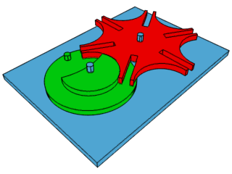
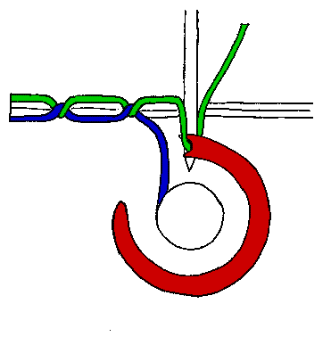
Getting Started
What are you passionate about? Do that.
  Mere competence will never trump real passion
  Match your skills, interest to what world wants
Your answers will change with time
  Let career evolve
  You can find career value in any job
    Just do outstanding work no matter the task
    It is mostly the choice you make not talent or IQ

Slide 7
Which Job to Take ?
Look 20 years out & place your career as a bet
  Which technologies or business domains are most powerful/promising?
  Biotech, IT, Clean Energy, Health Care, Telecom, Micro Finance
Which line up with your personal belief system?
  Defense, medicine, consumer, corporate, academia

Slide 8



Startups v/s Big Corporates
Good idea to do both over course of your career
Startups are easier when you’re young
  More time, more energy, less to lose
  Startups can sometimes change world explosively
    But most fail
    Less overall stability
Big companies have more opportunities to change world incrementally
  Remember that those increments can add up over time
  More stable, but sometimes that also means boring
Both can be exhilarating, and both can be very frustrating

Slide 9

Getting Hired
Where to work
  Weight these factors heavily:
    Do you believe in the mission
    How outstanding is the team
    How well-run is the company
    Would this position leverage your strengths yet demand intellectual growth
    Geography, local culture, educational opportunities
Then consider salary, bonuses, stock, benefits

Slide 10


Your First Job
@
No matter what it is, become best in world at it
  Plan on 2-3 years to get really comfortable & productive
Work as hard as you can
  You are setting your own reputation & trajectory
  Only Top Performers have choice of options for next project
  Find mentors & role models (don’t struggle in silence)
Don’t Let Your Team Down
  Know when to stand your ground v/s which battles aren’t worth fighting
Settle for nothing less than outstanding work.

Slide 11

Building your Career
Focus on YOU
  Know your career path
    Individual Contributor v/s Management
  Technology changes rapidly, keep yourself updated
    Look for trainings, attend workshops
Focus on the Company
  Align your career to what the company cares about

Slide 12

Building your Career - Resources
Your Alma Matter – stay connected
IEEE/ACM – Participate and Network
Books – Read outside your specialty
Balancing Work and Home

Slide 13
Getting Ahead in Your Job
Communications = Influence = Promotions
  Writing
  Presentations
Corporate/team culture
  Overpromising v/s over delivering
  Team play v/s getting what’s yours
  Detecting /avoiding burnout
  Use existing solutions where possible, innovate where necessary
Legal Stuff
  Take patents, IP very seriously; wording matters

Slide 14

Getting Ahead in Your Career
Do outstanding work and trust that rewards will follow
  How ?Work with people who do outstanding work
Be visible outside your own company
  Good for company, good for industry, good for you
  Write papers, attend conferences, do peer reviews
  Be active in IEEE/ACM

Slide 15

Technical Leadership
Take on hard challenging problems at work
Be a go-to person
Gain depth in technology / business domain at your job

Slide 16
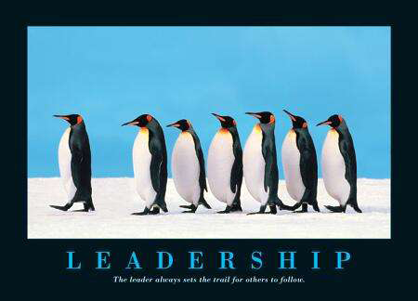
Leadership
360 degree Leadership
  Leading above, below and at your level
Know your strengths and weakness
  Leverage strengths
  Fill in weaknesses

Slide 17

Dealing with Failures
If you never fail you aren’t trying hard enough
Not all failures equally forgivable
  Well-conceived risks: good
Learn from your failures
  Do not blame others
  Own up and take responsiblity

Slide 18

Education
B.Tech, M.Tech/MBA, PhD
  PhD required for research
Stay viable & current
  Ongoing education/training
  Go to conferences, monitor what universities are working on
  IEEE membership & participation
    Review papers, submit papers, attend conferences, be active in local organizations (networking & cont. educ.)
Don’t give up your non-engineering interests
  They will inform your engineering
  They’ll keep you connected to the non-techie world
  They’ll keep you from burning out

Slide 19

Successful Engineering Career

Slide 20

Thank You !
Q & A
Contact Info
  Twitter : @asankhaya
  Email : asankhaya@yahoo.com

