Slide 1
Cloud-based Document Delivery Service for Emerging Markets
Sakhee Dheer
Asankhaya Sharma

Slide 2
Emerging Markets - Needs
One of the major requirements of a Developing world is Education, more so Higher Education
Higher Education Depends mainly on 4 major pillars:-
Good Course Structure
Good Infrastructure(labs, internet)
Good Teachers
Good Research Data and Journals
Access to good research data is something which excited us and we began searching for ideas to be able to provide data to the less privileged students of the Emerging markets

Slide 3
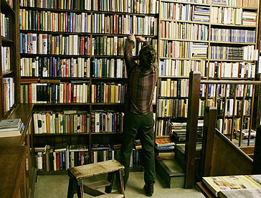
What difference will it make???
There are 5 million students in India alone who do not have access or even awareness about the vast repository of research findings and related publications.
An emerging economy needs more and more entrepreneurs.
With globalization and the growing idea of the world as one big market place, it is highly unfair to have budding entrepreneurs completely unaware of research, inventions, trends, and market values
What we need is to extend the research already done rather than reinvent.

Slide 4
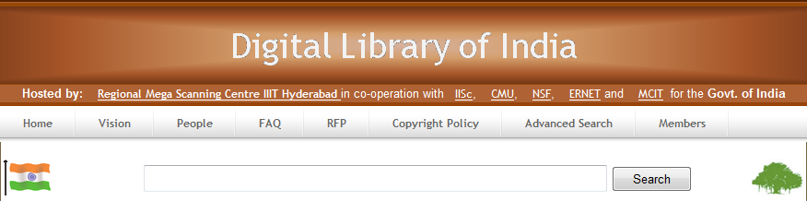
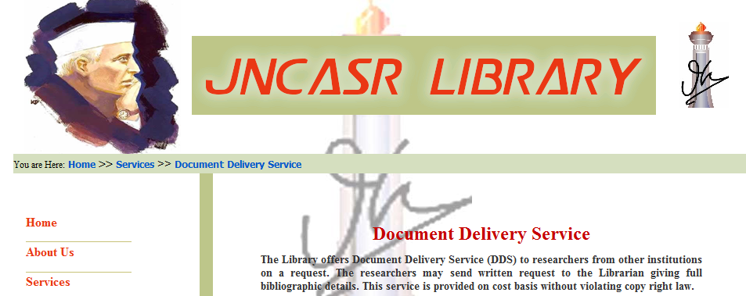
How is it done now?
Using the Classic Document Delivery Service.
It is the transfer of document from one source to another. The sources may be two libraries or a library and an end user.

Slide 5
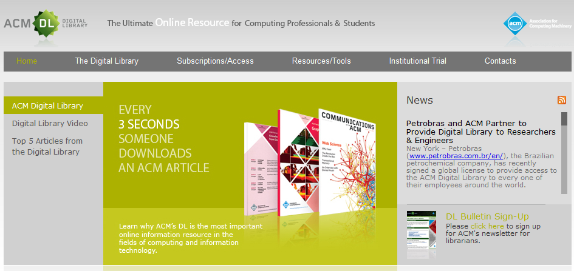
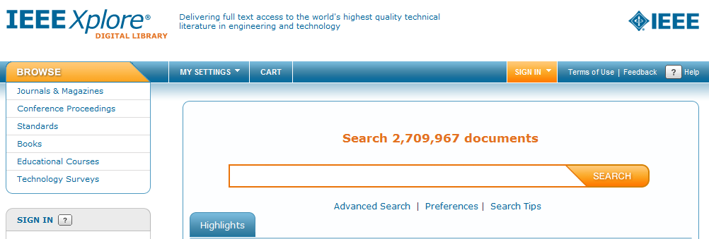
How is it done now?
Using the digital avatar of ‘Classic Document Delivery Service’ like the subscription services provided by IEEE/ACM in form of ‘IEEE Xplore’ and ‘ACM digital library’.

Slide 6
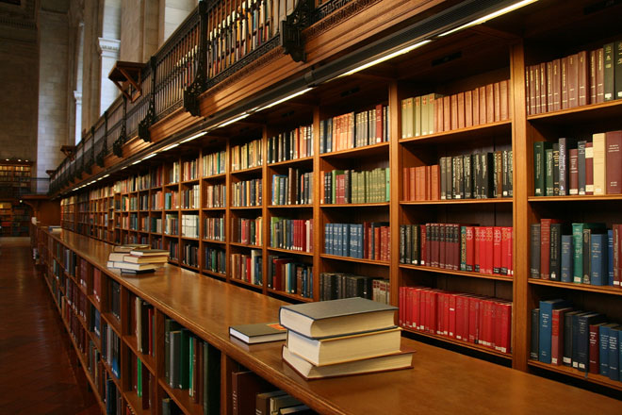
Related Research
A lot of research has been done on how to digitize libraries.
Microsoft released Windows Multipoint Server 2010 for schools in emerging markets that don’t have the money to buy a PC for every student.
HP has launched their Multi-Seat Computing Solution for schools in emerging markets.
As far as we know still not much has been done in the field of higher education to enable students to access vast repositories of publications and journals online.

Slide 7
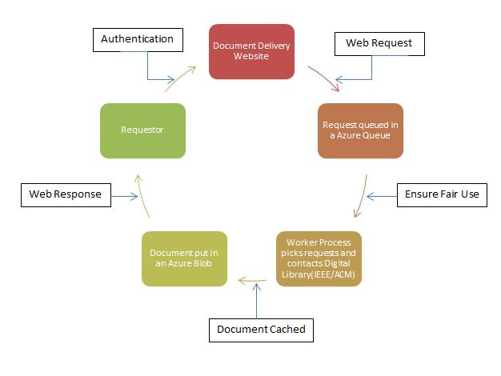
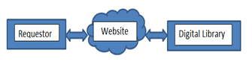
What Solution do we propose??
What we propose is providing easy and economic access to existing digital libraries (like ACM/IEEE’s digital library).
We propose to leverage cloud computing to make the Document Delivery Service website accessible to all the educational institutions without them having to care about its supportability in their environment in any way.

Slide 8

What is Cloud Computing?
“Software as a Service”
“Infrastructure as a service”
“Platform as a service”

Slide 9
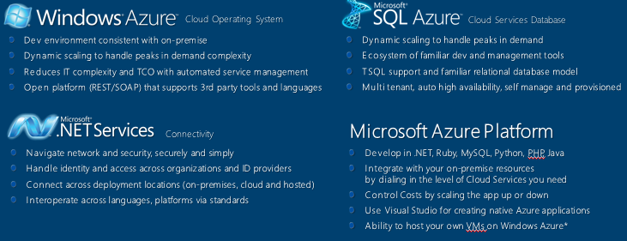
How can you get in the Cloud??
Using one of the below, we can host applications in the Microsoft’s data centers and get in the CLOUD.
We plan to leverage Window’s Azure on demand application instance where we can host the web application in Microsoft’s datacenters without having to worry about its supportability and maintenance.
As far as we know, the Cloud Based Document Delivery Service for the students in emerging markets is the first attempt to explore the use of cloud technologies in this context.

Slide 10
Cloud Based Document Delivery Service
1. Authentication:
Each requestor is authenticated using the registered username and password provided during registration.
2. Web Request:
When an authenticated user requests for a documents from the digital libraries.
3. Ensure Fair Use:
A white list is maintained which will contain all the allowable domains, preferably only the links of the digital libraries which can be accessed using the cloud-based website.
the requests from the queue and ensure that we do not unnecessarily bombard the digital libraries with sudden traffic.

Slide 11
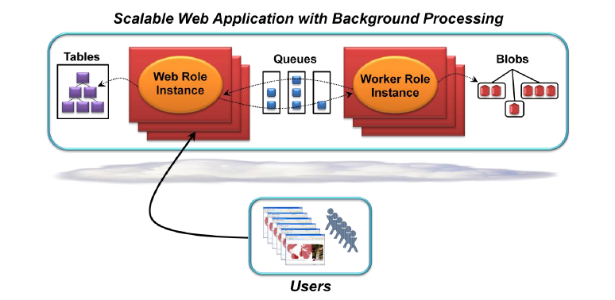
Cloud Based Document Delivery Service
A logged in user can now issue web requests to get the required document, these requests are handled by our web proxy and put in a queue.
A worker role instance reads the queue of pending web requests for documents, retrieves the document and then the response is sent back to the web role to display to the user.
4. Document Cache and Web Response
Once a web response is received typically in form of the required document (say a .pdf file) we cache this response and store it in from of the blob structure in Azure

Slide 12
Cost Effective:- Designed for Emerging Markets
Current membership cost of IEEE Computer Society digital library is: - $17,595.
Current membership cost of ACM digital library ranges from $2000 to $15,165 (depending on the size of the consortium).
Cost per college(assuming 10 are grouped together) | $1.7k
One Windows Azure Compute Instance | $80

Slide 13
Cost Effective:- Designed for Emerging Markets
The cloud services that we will be using to make our framework functional would fall under 2 categories:-
Windows Azure Content Delivery Network(CDN)
Windows Azure Storage
The above services cost 0.01/10k transactions.
So for every request to fetch a document:-
Cost of using the above two Azure services(assuming 10 million transactions) | $20
Cost per Institution ($1700+($80+$20)/10) | $1710

Slide 14
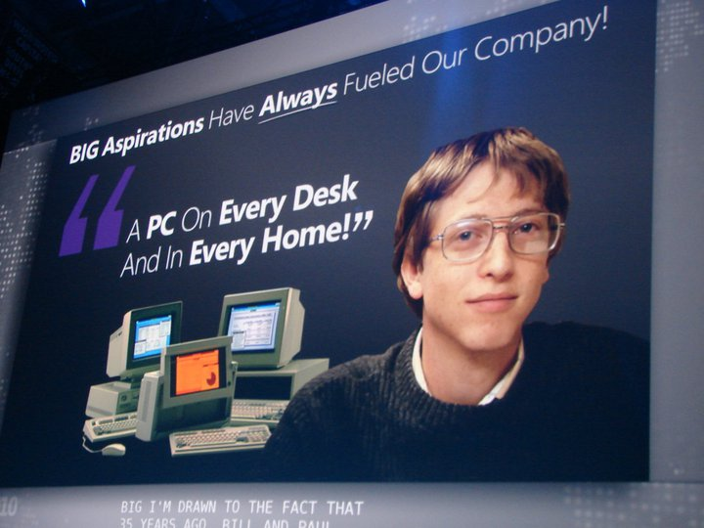
Dare to Dream!!
As seen, the total cost to use the Document Delivery Service on the cloud is minimalistic.
We believe that this service effectively enables the educational institutions to get access to digital libraries which they would not have otherwise, due to economic constraints.

Slide 15

Thank you!!

Slide 16
Legalities and Fair usage
Linking to IEEE. The IEEE and many affiliated societies provide publication and society information via Internet servers. Links to society servers are encouraged and prior consent is not required.
Third-Party Rights to Reuse IEEE-Copyrighted Material. Licenses and permissions to use electronic versions of IEEE-copyrighted material (abstracts, full text, etc.) for commercial or other non-IEEE-related purposes may be granted under terms approved by the IEEE Publication Services and Products Board.
Fees for the reuse of IEEE material are appropriate for contributing to the cost of original publication, especially where the reuse involves a license to copy, or allows resale, or is of a magnitude that would tend to reduce subscription or other sales income.

Slide 17
Legalities and Fair usage
Fair usage is guaranteed through the architectural implementation of the service.
White Lists through Window’s Azure Tables: We ensure that the Document Delivery Service will accept requests only for White Listed websites. This will enable restrictive browsing through our service and negative misuse.
Ensuring regulated traffic through Window’s Azure Queues: We make sure that heavy flow of requests through our service system will not simultaneously bombard the host digital libraries.

Slide 18
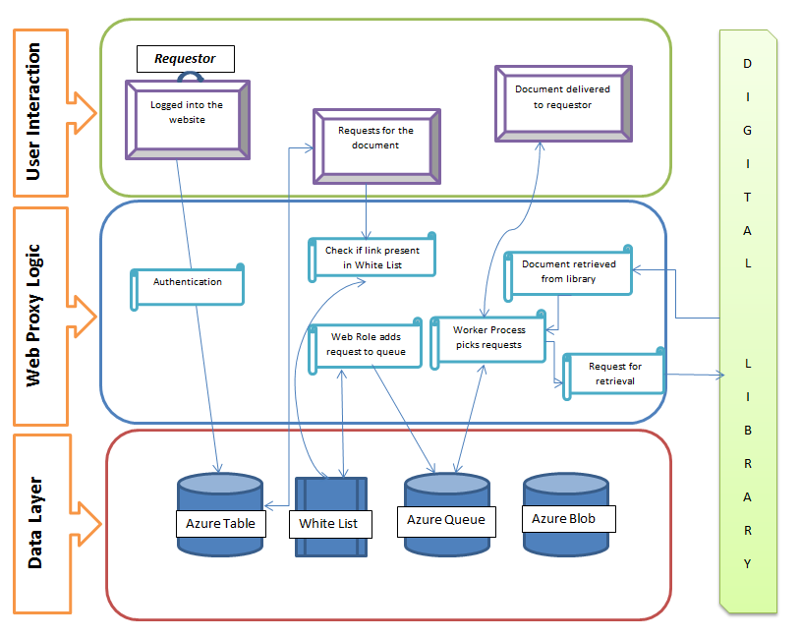
Components of the Service

