Slide 1
DIDAR – Database Intrusion Detection with Automated Recovery
Prof. DVLN Somayajulu
Asankhaya Sharma
Govindarajan S
Srivatsan V

Slide 2
An Overview
The objective of Intrusion Tolerant Database is to build a self healing system that can survive attacks
Detection, Isolate, Contain, Assess and Repair
What is an Intrusion?
-Malicious Transactions that spread damage
Intrusions can affect
-Availability
-Data Integrity

Slide 3
The problem: Database Intrusion Tolerance
Attacks can succeed -> Intrusions
Intrusions can seriously impair data integrity and availability
connect
Authentication
SQL
Commands
Access control
Integrity control
DBMS
Database

Slide 4
Handling Intrusions
Using Data Mining Techniques to classify Malicious Transactions
Two kinds of analysis techniques
-Signature Based
-Anomaly Based
Intrusion detection works in two phases
-Learning Phase
-Detection Phase

Slide 5
DIDAR Algorithm
Learning Phase
Detection Phase
Isolation Phase
Recovery Phase
Blocking Phase
Data Warehousing Phase
Data Mining Phase

Slide 6
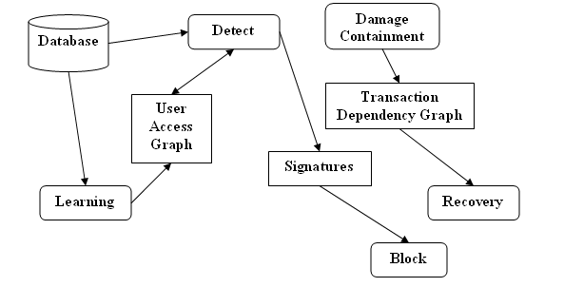
The general representation of the system

Slide 7
Learning Phase
Build a model of legitimate queries using supervised learning
Associate a quadruple <t,R,A,C> for each query which represents
the fingerprint of the query
where
t’ stands for the type of query (SELECT, UPDATE or DELETE)
’R’ stands for the number of relations in the query
’A’ stands for the number of Attributes in the query
’C’ stands for the number of Conditions in the query

Slide 8
Learning Phase
For each user in the database create a user access graph G (V, E) such that, V is the set of quadruples and E represent the access pattern of the queries in the database
Thus in learning we read all the queries executing in the database, fingerprint them and convert them into a quadruple and add a node in the user access graph.

Slide 9
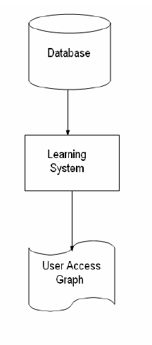
Learning Phase

Slide 10
Building SQL-Query Models
Once the learning is finished the user access graph looks like something below.
<1,3,1,3>
<0,2,1,1>
<2,1,2,3>
<0,2,3,2>
<0,2,4,3>
<0,2,3,1>
<1,2,3,2>

Slide 11
Detection Phase
Traverse the user access graph and look for a matching node (say u) with same quadruple.
If such a node is not found the transaction is labeled malicious or else proceed again with the next transaction.
For the next transaction simply check all the nodes ‘v’ such that there is an edge between ‘u’ and ‘v’. This way malicious transactions can be identified

Slide 12
Detection Phase
Provide a feedback mechanism, i.e if while in the detection phase some legitimate transaction is identified as malicious the user can give feedback and based on that insert a new node in the user access graph with the quadruple representing the fingerprint of the current transaction
<1,3,1,3>
<0,2,1,1>
<2,1,2,3>
<0,2,3,1>
<0,2,4,3>
<0,2,3,2>
<1,2,3,2>
New Node
<2,1,2,3>

Slide 13
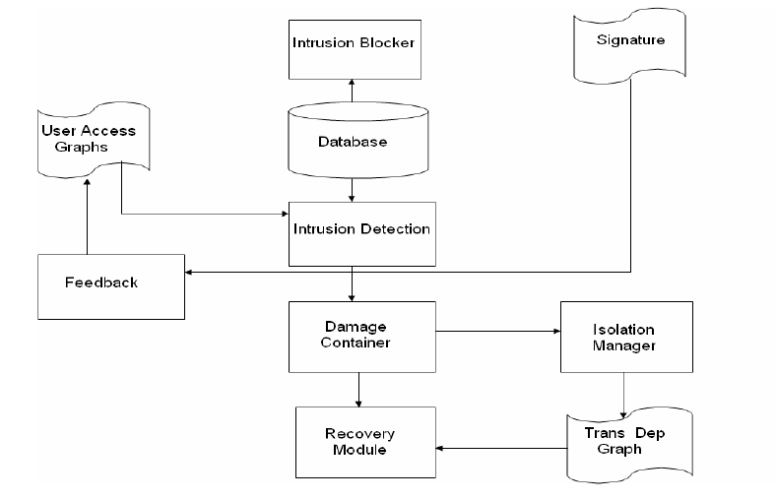
Detection Phase

Slide 14
Security Levels
Low
Only identifies the intrusions with the feedback mechanism.
There is no damage containment or recovery.
Allows user to formulate a proper security perimeter with all possible transactions listed in the user access graph while also been aware of the security.

Slide 15
Security Levels
Medium
Low level of security plus damage containment is provided.
Damage Containment Phase
    -Take a lock manually on all the tables accessed in the malicious transaction.
    By taking a lock it can be ensured that no other transaction can execute which can read data from the infected tables thus effectively containing the damage.
    The user can release the lock by rollback or commit the transaction after preparing for manual recovery.

Slide 16
Security Levels
High
In addition to the medium level of security, even the recovery can be automated.
Recovery Phase
    In automated recovery rollback the database to the state just before the intrusion.
    Create a transaction dependency graph beginning from the malicious transaction.
    Use this graph to redo all the benign transactions. No malicious transactions are executed and hence the database heals itself to a consistent state.

Slide 17
Security Levels
Paranoid
Block Phase
For every intrusion that is detected successfully we build a signature.
Now for each user in the database there is a list of signatures also associated.
Use this list of signatures to directly block a transaction without the need to go through the detection phase

Slide 18
How to decide the Levels?
At regular intervals (say daily) store the user access graph into a data warehouse.
Based on the history of intrusions for each user build a classifier with the help of data mining.
Specify the security level based on the attacks attempted on user data.

Slide 19
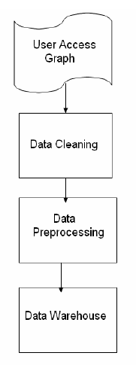
Data Warehousing Phase

Slide 20
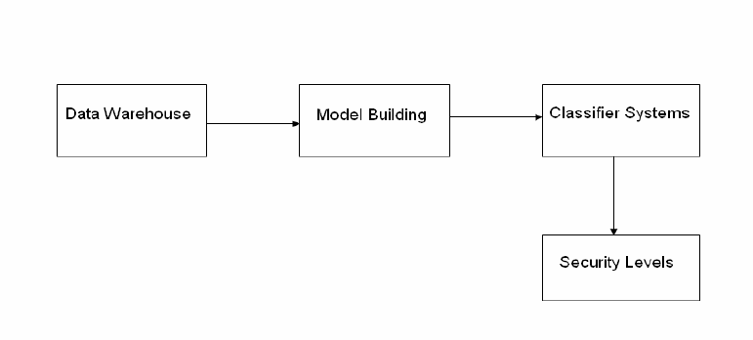
Data Mining Phase

Slide 21

Thank You !!!

Slide 22
References
Pramote Luenam, Peng Liu, The Design of an Adaptive Intrusion Tolerant Database System, Proceedings of the Foundations of Intrusion Tolerant Systems, 2003.
Yi Hu, Brajendra Panda, A Data Mining Approach for Database Intrusion Detection, Proceedings of ACM Symposium on Applied Computing, 2004.
Wai Lup LOW, Joseph LEE, Peter TEOH, DIDAFIT detecting intrusions in databases through fingerprinting transactions, Proceedings of International Conference on Enterprise Information Systems, 2002.
Bertino, E. Terzi, E. Kamra, A. Vakali, A, Intrusion Detection in RBAC-administered Databases, Proceedings of 21st Annual Computer Security Applications Conference, 2005.

