Slide 1
HIP/SLEEK :Automatic Verification and Specification Inference System
Wei-Ngan Chin &
Asankhaya Sharma
Dept of Computer Science
National University of Singapore
HIP/SLEEK

Slide 2
Proposition
Design and build software that is correct by construction
(with respect to specification)
Type System ➔ Separation Logic
HIP/SLEEK

Slide 3
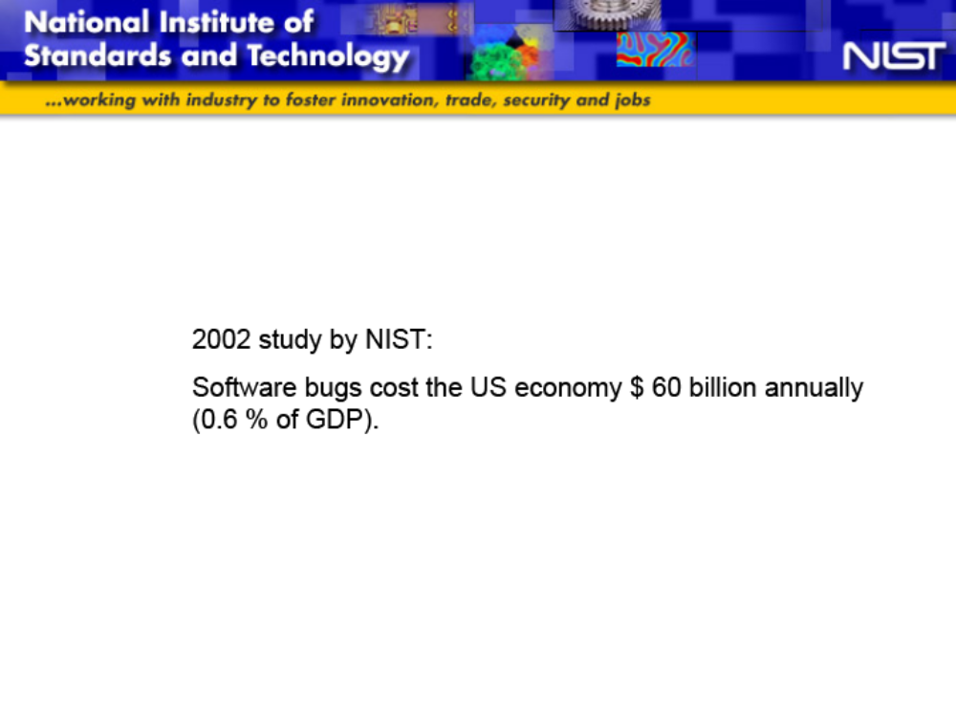
HIP/SLEEK

Slide 4
Features of HIP/SLEEK
Can specify complex data structures to support symbolic verification.
expressive (shapes+size, term)
automation (with inference)
(iii) modular (better reuse)
(iv) scalable (proof slicing)
HIP/SLEEK

Slide 5
Overall System
Under development since 2006 (180K lines of Ocaml).
Predicates
Code
Pre/Post
Lemmas
separation
logic prover
(SLEEK)
code verifier
(HIP)
range of pure provers …
Omega, MONA, Isabelle, Coq, SMT, Redlog, MiniSAT, Mathematica
HIP/SLEEK

Slide 6
Topics
Expressivity
  Separation Logic (VMCAI07,POPL08)
  Immutability (OOPSLA11)
  Structured Spec (FM11)
  Termination & Resources
  Concurrency
Automation
  Specification Inference
HIP/SLEEK

Slide 7
Expressivity
HIP/SLEEK

Slide 8
Acyclic Linked-List
data node { int val; node next }
Example of Acyclic List : list(x)
x
null
list(self) ≡ self=null
∨ 9 r . self node(_,r) ∗ list(r)
pointer to memory
spatial conjunction
HIP/SLEEK

Slide 9
Syntactic Abbreviation
list(self) ≡ self=null
∨ 9 r . self node(_, r) ∗ list(r)
list⟨⟩ ≡ self=null
∨ self::node⟨_, r⟩ ∗ r::list⟨⟩
implicit existential instantiation
HIP/SLEEK

Slide 10
Method – append two lists
void append(node x, node y)
{
if (x.next==null) x.next=y;
else append(x.next,y);
}
requires x::list<> * y::list<> & x!=null
ensures x::list<> ;
Shape Specification
for memory safety
HIP/SLEEK

Slide 11
A different append of two lists
void append(ref node x, node y)
{
if (x==null) x=y;
else append(x.next,y);
}
requires x::list<> * y::list<>
ensures x’::list<> ;
HIP/SLEEK

Slide 12
.. with Size
parameter on length of linked list
ll⟨n⟩ ≡ self=null Æ n=0
∨ 9 r . self node⟨_,r⟩ ∗ r::ll⟨n-1⟩
inv n¸0
x::ll⟨5⟩
x
null
HIP/SLEEK

Slide 13
Method – append two lists
void append(node x, node y)
{
if (x.next==null) x.next=y;
else append(x.next, y);
}
requires x::ll<a> * y::ll<b> & x!=null
ensures x::ll<a+b> ;
HIP/SLEEK

Slide 14
… with Size & Bag
list⟨n,B⟩ ≡ self=null Æ n=0 Æ B={ }
∨ 9 v,r,B1 . self::node⟨v, r⟩ ∗ r::list⟨n-1,B1⟩
Æ B={v} [ B1
inv n ¸ 0 & n=|B|
HIP/SLEEK

Slide 15
… with Bag & Sortedness
lsort⟨n,B⟩ ≡ self=null Æ B={ } Æ n=0
∨ 9 r . self::node⟨v, r⟩ ∗ r::lsort⟨n-1,B1⟩
Æ B={v} [ B1 Æ 8 x 2 B1 . v · x
inv n¸0
Other properties, such as sequences, maps, may also be
used if they can be handled by automated prover.
HIP/SLEEK

Slide 16
Append Method
void append(node x, node y)
{
if (x.next==null) x.next=y;
else append(x.next,y);
}
requires x::list<n1,B1> * y::list<n2,B2> & x ≠ null
ensures x::list<n1+n2, B1∪B2> ;
requires x::lsort<n1,B1> * y::lsort<n2,B2> & x ≠ null
& 8 a 2 B1 . 8 b 2 B2 . a · b
ensures x::lsort<n1+n2, B1∪B2> ;
HIP/SLEEK

Slide 17
Termination
Specifications
Ongoing Work
HIP/SLEEK

Slide 18
A Loop
What spec to give to this loop?
while (x>0)
{ x=x+y; }
First, convert it to a tail-recursive function:
void loop(ref int x, int y)
{ if (x>0) {
x = x+y;
loop(x,y); }
}
what spec to give?
HIP/SLEEK

Slide 19
Use of Case Spec
Three scenarios :
void loop(ref int x, int y)
{ if (x>0) {
x = x+y;
loop(x,y); }
}
base case
case {
x ≤ 0 -> ensures
x > 0 -> case {
y≥0 -> ensures
y<0 -> ensures
}
x’=x ;
non-terminating
false;
y < x’ ≤ 0 ;
recursive but
terminating
HIP/SLEEK

Slide 20
.. with temporal annotations
Three scenarios :
void loop(ref int x, int y)
{ if (x>0) {
x = x+y;
loop(x,y); }
}
case {
x ≤ 0 -> requires Term[] ensures x’=x;
x > 0 -> case {
y≥0 -> requires Loop ensures false;
y<0 -> requires Term[x] ensures y < x’ ≤ 0;
}
temporal constraints
HIP/SLEEK

Slide 21
Specification
Inference
Ongoing Work
HIP/SLEEK

Slide 22

Modular Shape Inference
int length(node x)
infer [H,G]
requires H(x)
ensures G(x)
{ if (x==null)
return 0;
else
node p = x.next;
return (1 + length(p)); }
HIP/SLEEK

Slide 23

Modular Shape Inference
//POST (1)
H(x) & x= null => G(x)
//BIND (2)
H(x) & x!= null => x::node<_,p> * HP(p)
//PRE-REC (3)
HP(p) => H(p)
//POST (4)
x::node<_,p> * G(p) => G(x)
HIP/SLEEK

Slide 24

Modular Shape Inference
H(x) == emp * x= null \/ x::node<_,p> * H(p)
G(x) ==emp * x= null \/ x::node<_,p> * G(p)
HIP/SLEEK

Slide 25
Automation
SLEEK + Demo
HIP/SLEEK

Slide 26
Automated Verification
int length(node x)
requires x::ll<n>
ensures x::ll<n> & res=n
{
if (x==null)
return 0;
// x=null & n = 0 & res = 0 |- x::ll<n> & res = n
else
node p = x.next; // x::ll<n> & x!=null |- x::node<val,nxt>
// x::node<_,q> * q::ll<n-1> & x!=null & p = q |- p::ll<m>
return (1 + length(p));
// x::node<_,p> * p::ll<n-1> & x!=null & res = 1 + n – 1
|- x::ll<n> & res = n
}
HIP/SLEEK

Slide 27
SLEEK : SL Entailment chEcKer
checkentail x=null |- x::ll<n>.
checkentail x::node<_,q>*q::ll<2> |- x::ll<n>.
checkentail x::ll<n> & n>2 |- x::node<_,q>.
n=0
n=3
q::ll<n-1> & n>2
HIP/SLEEK

Slide 28
May and Must Errors
checkentail x::ll<n> |- x::node<_,q>.
➔ may failure
checkentail x::ll<n> & n>2 |- x=null.
➔ must failure
Demo
HIP/SLEEK

Slide 29
Desired Targets
Verify/Analyze your favorite programs
  Imperative Programs
  Heap-based Data Structures
  Recursion
  Concurrency
  Generic and Higher-Order Programs
HIP/SLEEK

Slide 30
Conclusion
Hardware community has accepted verification.
Verified software is our future for high-assurance and reliable software.
Many challenges still on scalability, automation, expressivity, concurrency and inference, higher-order programs.
http://loris-7.ddns.comp.nus.edu.sg/~project/hip/index.html
HIP/SLEEK

