Slide 1
All You Ever Wanted to Know About Dynamic Taint Analysis and Forward Symbolic Execution (but might have been afraid to ask)
IEEE S&P 2010

Slide 2
Overview
Two Main Contributions
Precisely describe the algorithms for dynamic taint analysis and forward symbolic execution as extensions to the run-time semantics of a general language
Highlight implementation choices, common pitfalls, other considerations in security context

Slide 3
Motivation
Dynamic Taint Analysis and Forward Symbolic Execution (or a mix of the two) are important for
Unknown Vulnerability Detection
Automatic Input Filter Generation
Malware Analysis
Test Case Generation

Slide 4
Summary of the Paper
A general language for formalization
SIMPIL (Simple Intermediate Language)
Operational Semantics
Assembly like
Missing high level language constructs
Functions, buffers etc.
Dynamic Taint Analysis Semantics
Dynamic Taint Policies
Semantics of Forward Symbolic Execution
Challenges and Opportunities

Slide 5
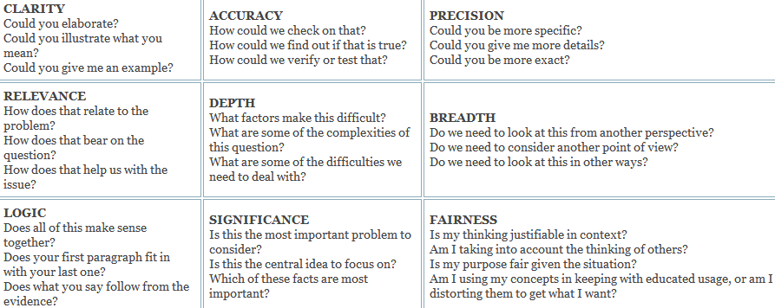
Universal Intellectual Standards
Clarity
Accuracy
Precision
Relevance
Depth
Breadth
Logic
Significance
Fairness

Slide 6
Clarity
Clear Explanation of Operational Semantics
Many examples throughout the paper
The challenges are mentioned clearly in the paper but little clarity on how to proceed to solve them
Section III-D does not elaborate on how to avoid time of detection vs time of attack problem

Slide 7
Accuracy
Refers to prior work and provides a framework to explain it
There are no results on soundness or completeness
Dynamic Taint Policies (Under Tainting vs Over Tainting)
Forward Symbolic Execution (Path Selection)

Slide 8
Precision
Based on Operational Semantics of SimpIL
Precise taint policies
Better taint checking
Explains symbolic execution in detail
Not enough details on practical heuristics
Handling difficult language features
Path Exploration
Symbolic Memory

Slide 9
Relevance
Helps explain and understand taint analysis as used in practice from a theoretical perspective
Does not add on much to the state of the art in actual algorithms or heuristics that can be used

Slide 10
Depth
Focusses on operational semantics of SimpIL in depth to establish a common framework
Does not expands on some of the practical ideas
Sanitization problem
Handling library and system code

Slide 11
Breadth
Good coverage of all the aspects of taint analysis
Some more information about use of static verification techniques as used in security analysis
Symbolic Jumps
Balakrishnan, G. and Reps, T., WYSINWYX: What You See Is Not What You eXecute. In ACM Trans. on Program. Lang. and Syst. 2009

Slide 12
Logic
Step by step progression from operational semantics to taint checking and symbolic execution
Lot of evidence in paper in form of references
Not sufficient evaluation to see the benefit in using a operational semantics based approach to security analysis

Slide 13
Significance
Explains practical security analysis from a theoretical framework
Does not advance the state of art in taint analysis
A survey of existing techniques
No new uses of the operational semantics beyond what is already there in prior work

Slide 14
Fairness
Good study on applying operational semantics in a security context
From a programming language theory perspective
Different taint policies should not create new operational semantics
Semantics used to enforce policies

Slide 15
Thank You !
Questions ?
Contact
Asankhaya Sharma (A0068216E)
asankhaya@nus.edu.sg

Slide 16
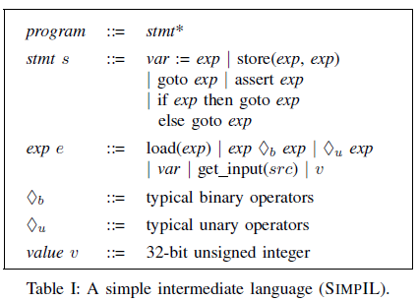
Appendix

Slide 17
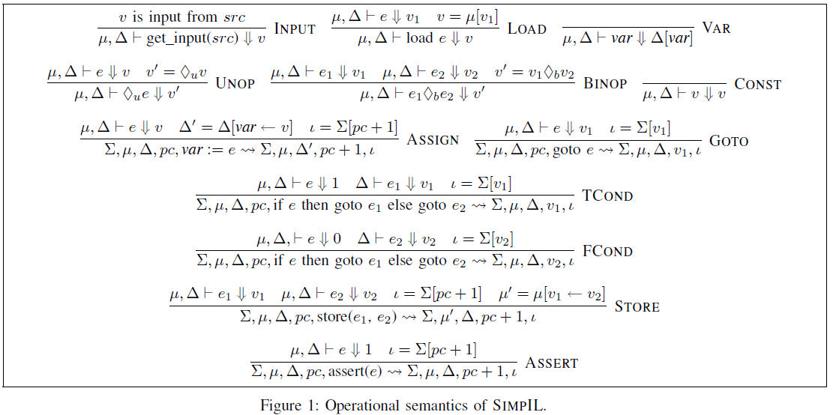

Slide 18
