Slide 1
Subscribers Galore: Exploring World’s Top Youtube Channelsss
INTRODUCTION
1.1 Overview
In this project, we are exploring the current state of social media. The world’s most downloaded application is YouTube, which has more than 40 million subscribed channels. This project aimsto clearly express the present highly subscribed channels. The ability to subscribe to users wasintroduced in October 2005, and YouTube began publishing a list of its most-subscribedchannels in April 2006. An early archive of the list dates back to May 2006.

Slide 2
1.2 Purpose :
The purpose of the project “Subscribers Galore: Exploring World’s Top YouTube Channels” is to analyze the most subscribed YouTube channels and provide insights into the most popularcontent creators on the platform 1. The project aims to clearly express the present highly subscribed channels and offer valuable insights into the online audience’s trends and preferences 1. The project also provides a list of the 50 most-subscribed YouTube channels, as well as the primary language and content category of each channel. The channels are ordered by number of subscribers; those whose displayed subscriber counts are identical are listed so that the channel whose current growth rate indicates that its displayed subscriber count will exceed that of the other channel is listed first.

Slide 3
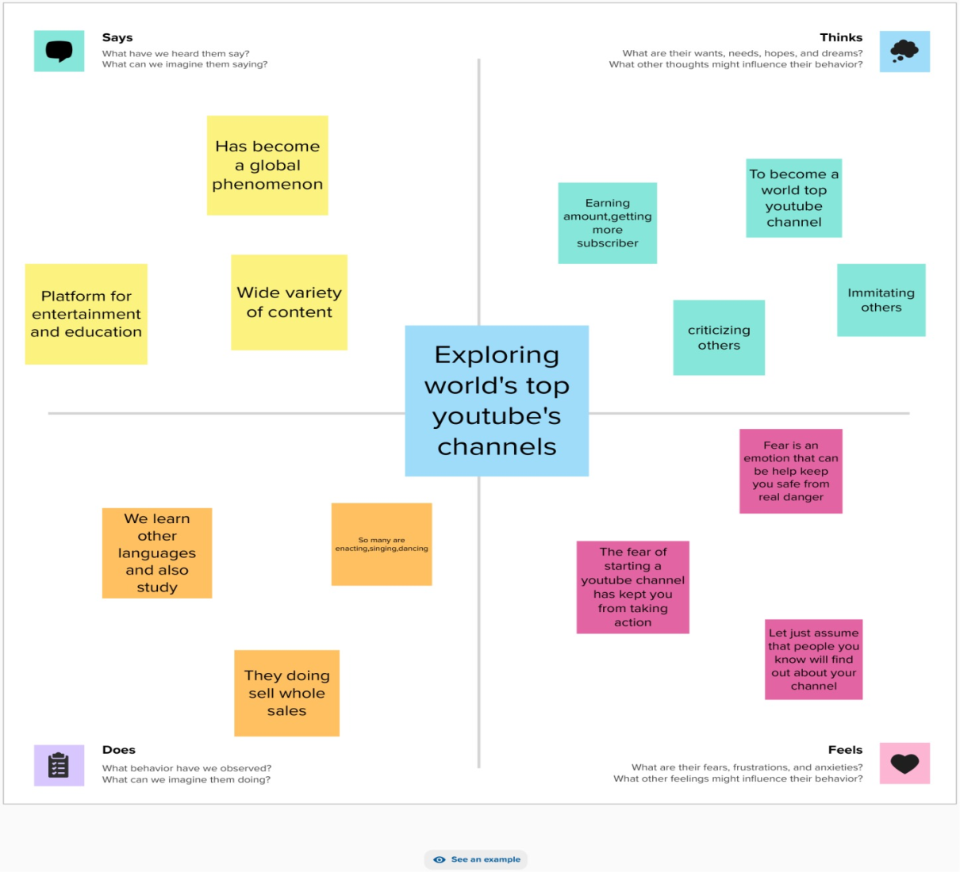
2. Problem Definition & Design Thinking :
2.1 Empathy Map:

Slide 4
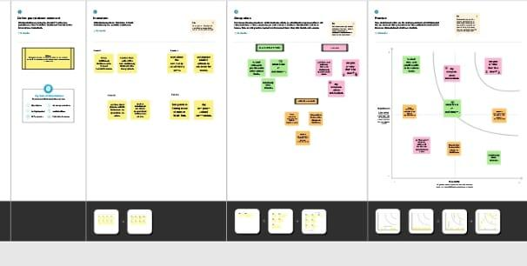
2.2 ideation & brainstorming Map:

Slide 5
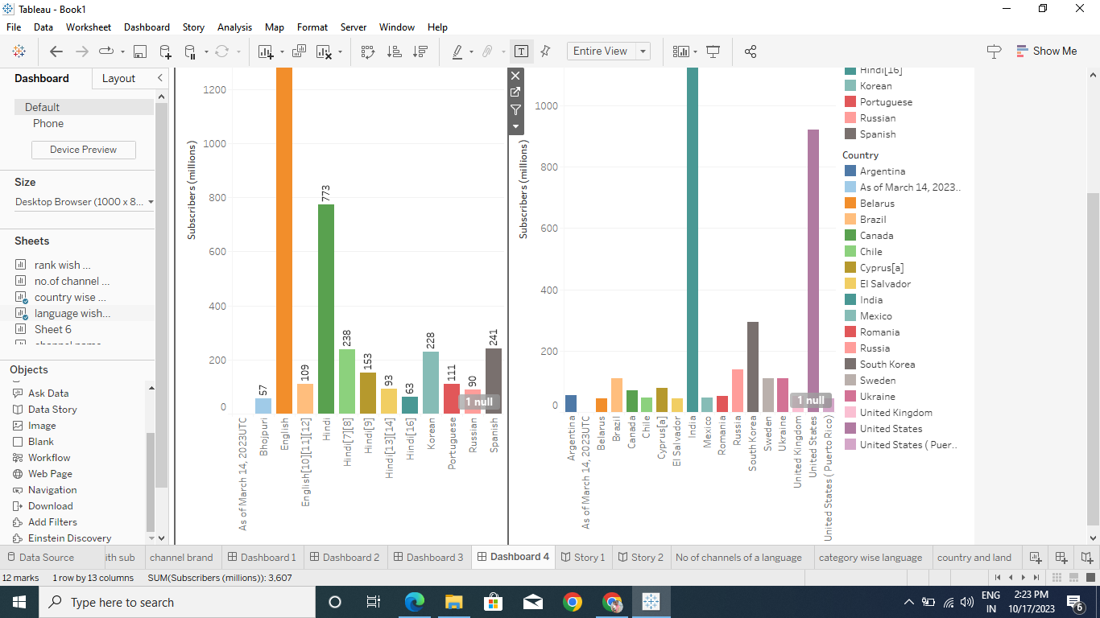
3. Result :
Dashboard screen shot :

Slide 6
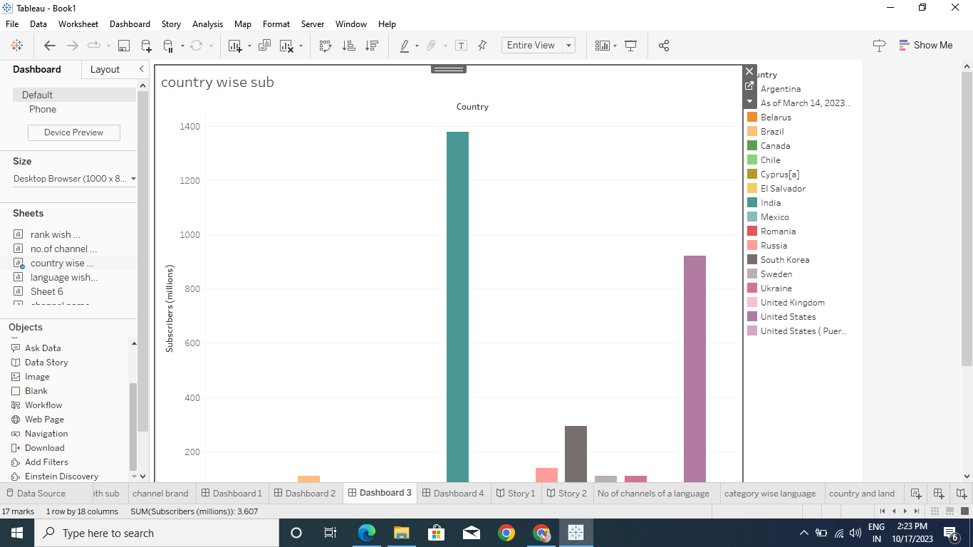

Slide 7
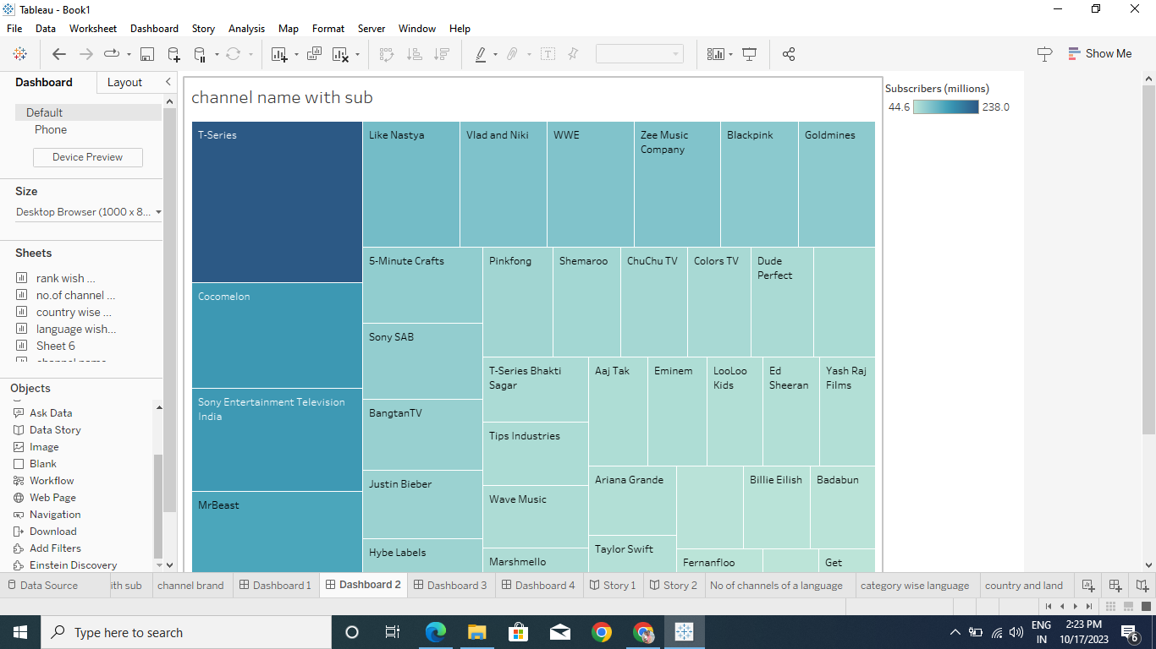

Slide 8
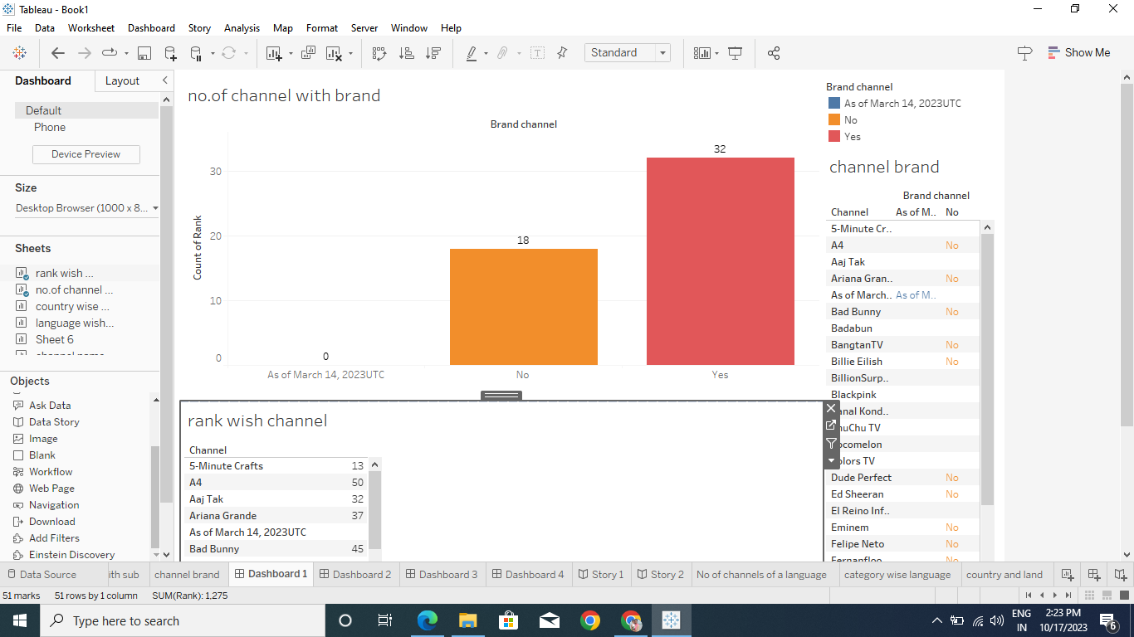

Slide 9

Brain storming :
Empathy Map :

Slide 10
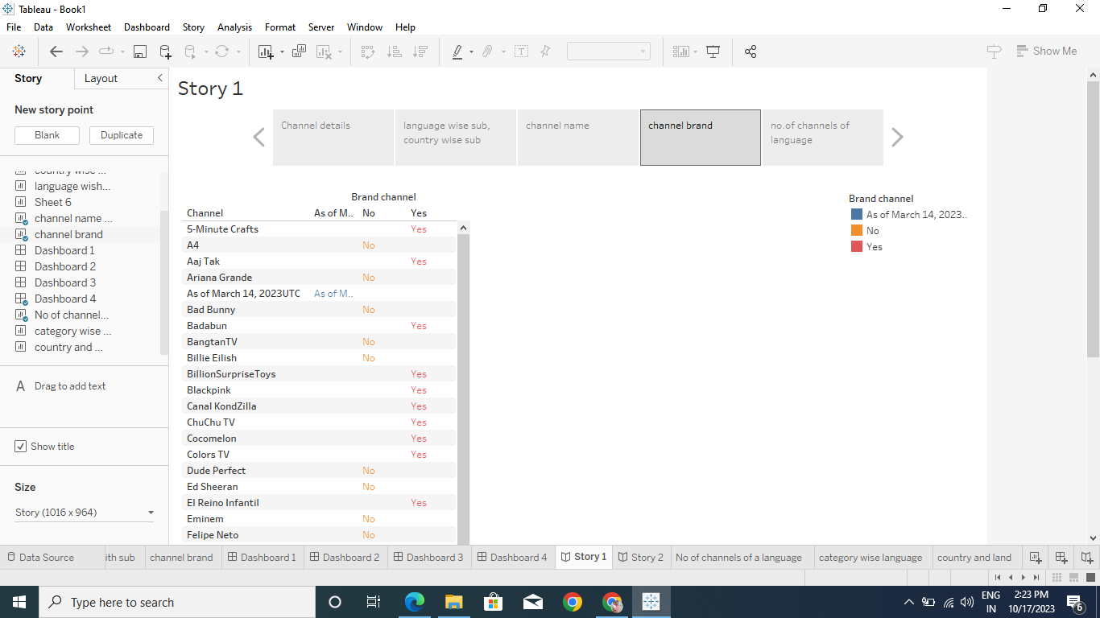
Story screen shot :

Slide 11
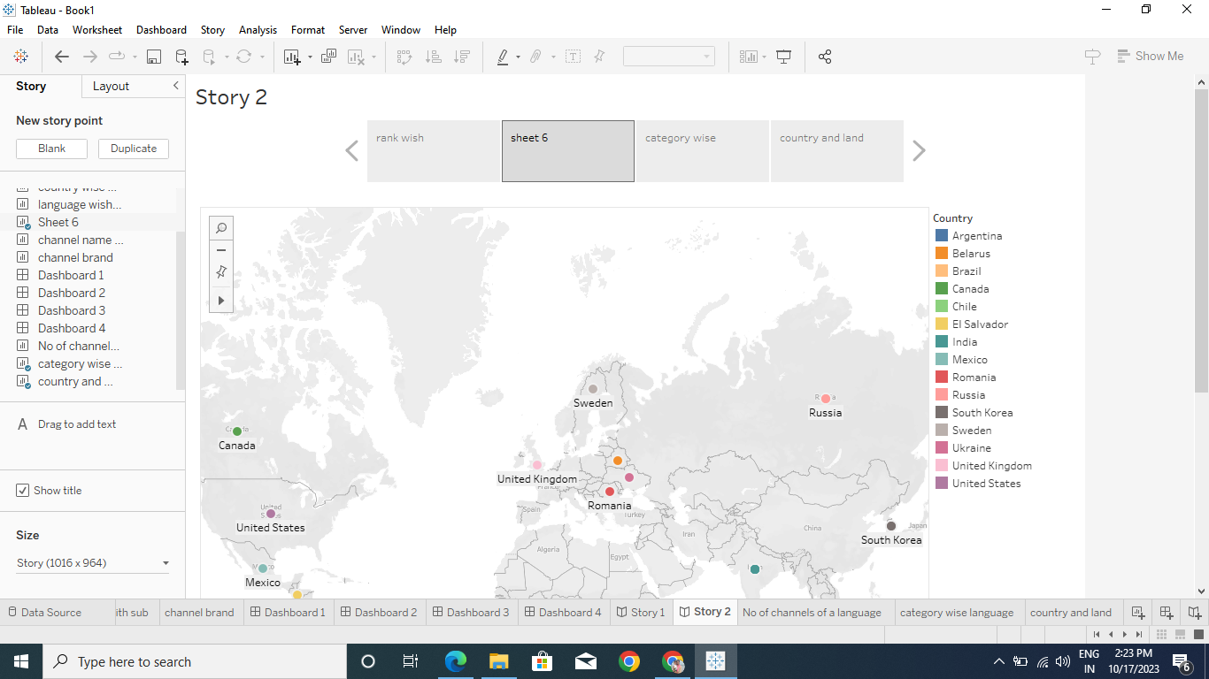

Slide 12
4 . ADVANTAGES & DISADVANTAGES :
Advantages:
▪ Increased visibility: Channels with a high number of subscribers are more likely to appear in search results and recommendations, which can lead to increased visibility and exposure for the channel
▪ Monetization opportunities: Channels with a large subscriber base can monetize their content through ads, sponsorships, and merchandise sales
▪ Increased credibility: Channels with a high number of subscribers are often perceived as more credible and authoritative than those with fewer
subscribers

Slide 13
Disadvantags:
▪ Pressure to maintain quality: Channels with a large subscriber base may feel pressure to maintain the quality of their content, which can be stressful and time-consuming
▪ Risk of burnout: Creators with a large subscriber base may experience burnout due to the demands of creating content on a regular basis
▪ Risk of negative feedback: Channels with a large subscriber base are more likely to receive negative feedback and criticism, which can be demotivating for creators

Slide 14
5. Application ;
▪ Marketing: Brands can collaborate with popular YouTubers to promote their products or services to a large audience
▪ Research: Researchers can analyze the content and engagement of top subscribed YouTube channels to gain
insights into audience behavior and preferences
▪ Content creation: Creators can study the content and
production quality of top subscribed YouTube channels
to improve their own content and grow their audience
▪ Entertainment: Viewers can watch the videos of top
subscribed YouTube channels for entertainment and
leisure purposes

Slide 15
6.Conclusion :
Some advantages of having a large subscriber base include increased visibility, monetization opportunities, community building, and increased credibility. However, there are also some disadvantages such as pressure to maintain quality, risk of burnout, and risk of negative feedback 4.
The data on top subscribed YouTube channels can be used in various ways
such as marketing, research, content creation, and entertainment 4. For
example, brands can collaborate with popular YouTuber to promote their
products or services to a large audience, researchers can analyze the
content and engagement of top subscribed YouTube channels to gain
insights into audience behavior and preferences, creators can study the
content and production quality of top subscribed YouTube channels to
improve their own content and grow their audience, and viewers can
watch the videos of top subscribed YouTube channels for entertainment
and leisure purposes.

