Slide 1
Asian American Identities and Portrayals in Modern Media
A Topic-Modeling Analysis of US News Articles since 2022
Arav Santhanam
Saheli Youth Fellowship Program - 2024

Slide 2
The Goal – Guiding Questions and Purpose
How have Asian American identities been portrayed in US media in the last 2 years? How has the narration evolved?
What broader contexts/social issues are we most often associated with?
What words describe us and tell our stories to the US audience?
What commonalities/experiences do Asian Americans and other minorities share? How do we differ?
Why news? News/media is a vital avenue to focus on and share our struggles, triumphs, and larger collective experiences in the US

Slide 3

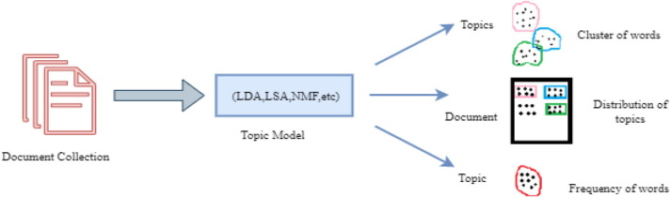
Conceptual Basics
Natural Language Processing (NLP) sub-field of AI that allows machines to interact with, manipulate, and understand human language (speech, text)
Topic Modeling algorithms that group words into topics based on semantic patterns/relationships and classify text by topic
(News Articles)

Slide 4
Algorithms Explained (Simply)
NMF Tries to "recreate" input articles by discovering patterns linking words and their importance in explaining a topic
LDA "Reads" the documents and iteratively updates the probabilities of various words/articles being in certain topics
Two different approaches but a similar result!

Slide 5
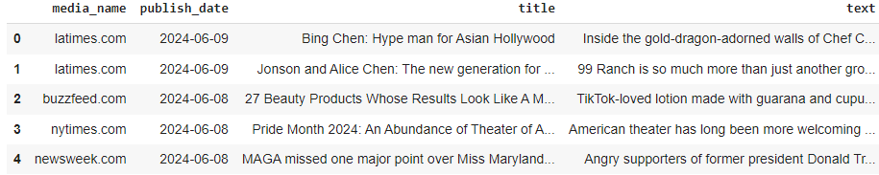
The Data and Approach
Gathered ~ 12,000 articles by keywords "Asian American", "AAPI" since Jan 1, 2022
Wide variety of US media outlets, magazines, newspapers, etc. to capture diverse perspectives

Slide 6
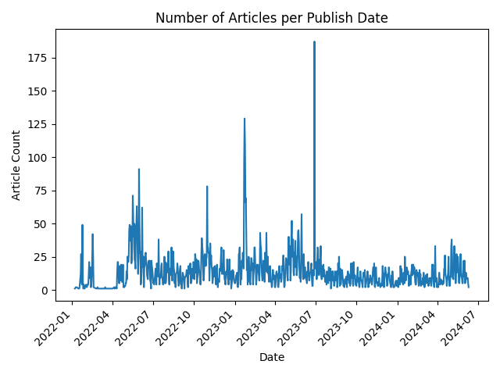
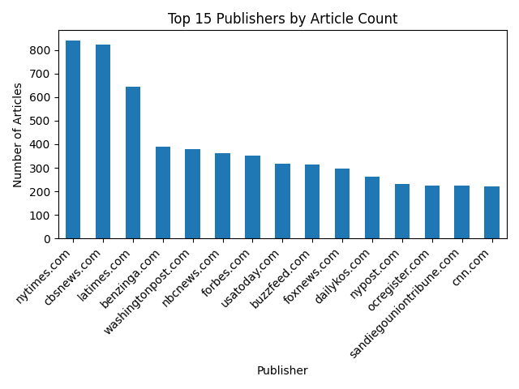
A Visual Look at the Data

Slide 7
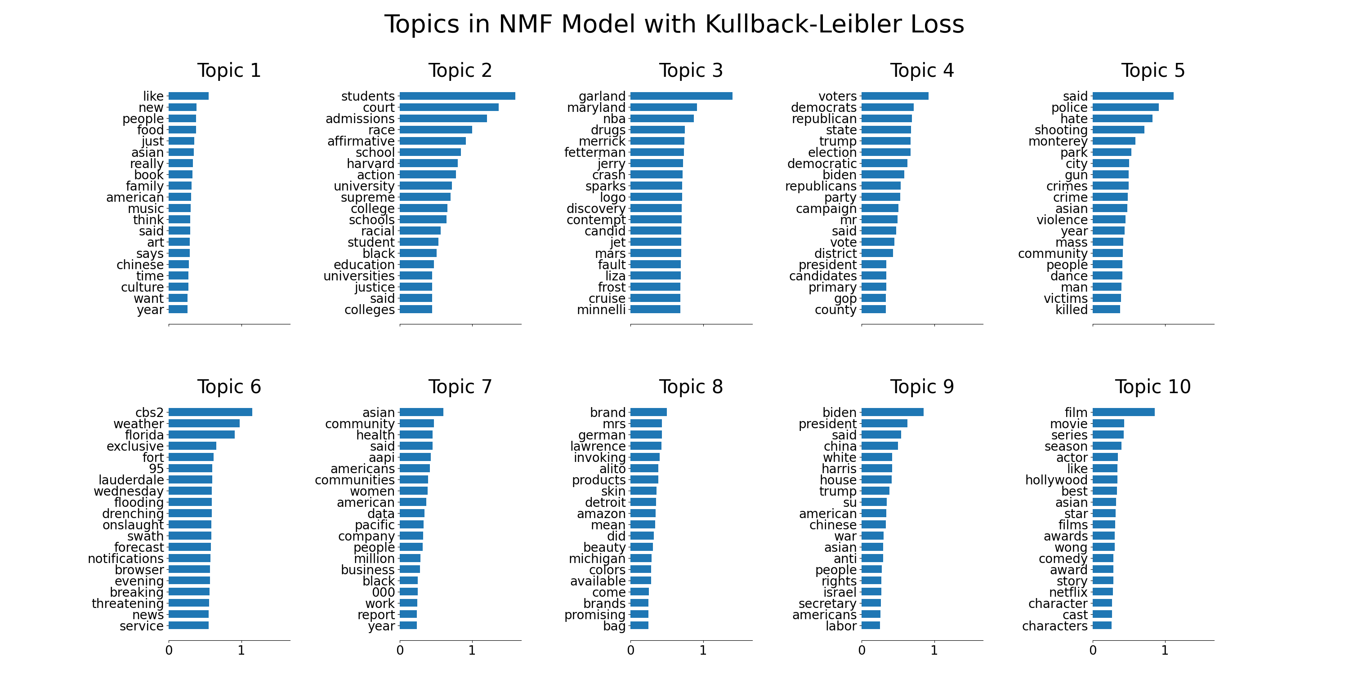

Slide 8
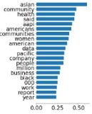
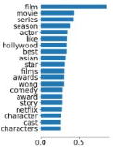
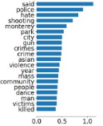
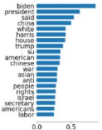
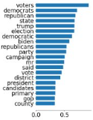
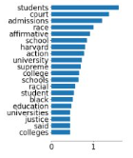
NMF Topic Analysis
Communities and Economy
Film and Entertainment
Violence and Hate Crime
Politics, Govt and Foreign Policy
Affirmative Action

Slide 9
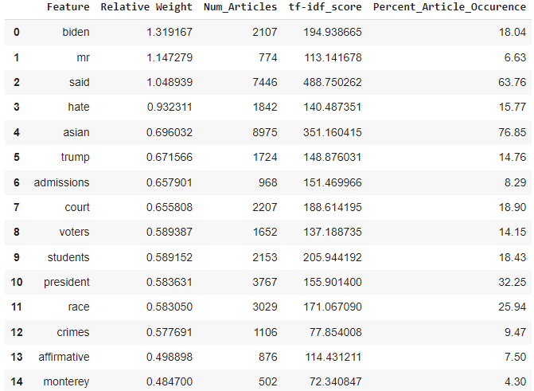
Word Importance
Many important themes are referenced in the most relevant words across all articles
Which words are more important in defining topics relative to others?

Slide 10
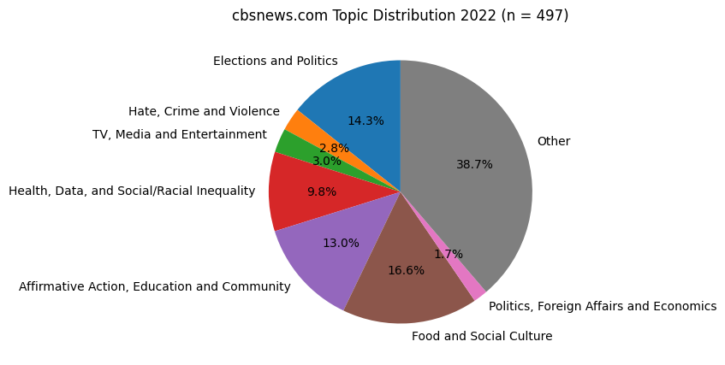
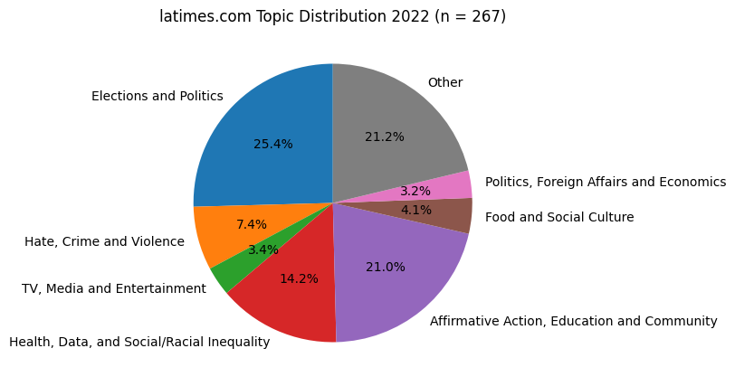
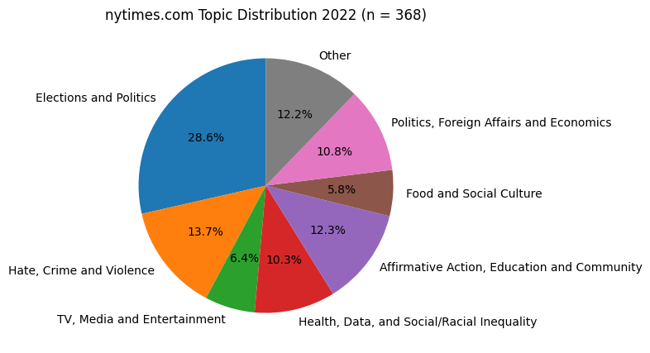
LDA Results: Asian American - 2022
CBS → Food/Social Culture
NYT → Elections/Politics, FA/Economics, Hate/Violence
LA Times → Affirmative Action, Health/Inequality
Not much on media/entertainment… a lot on politics

Slide 11
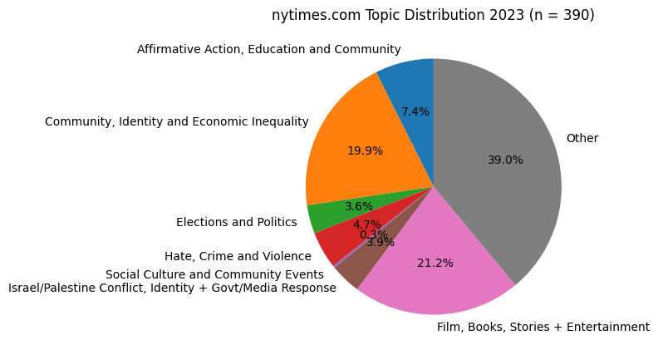
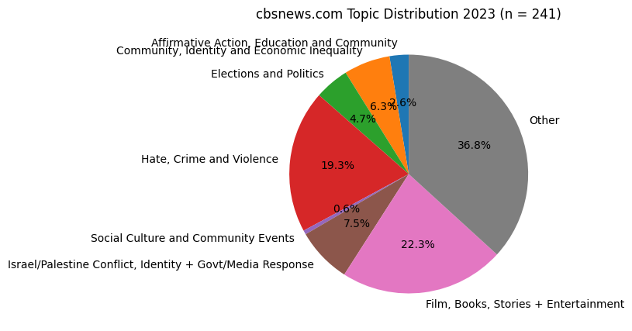
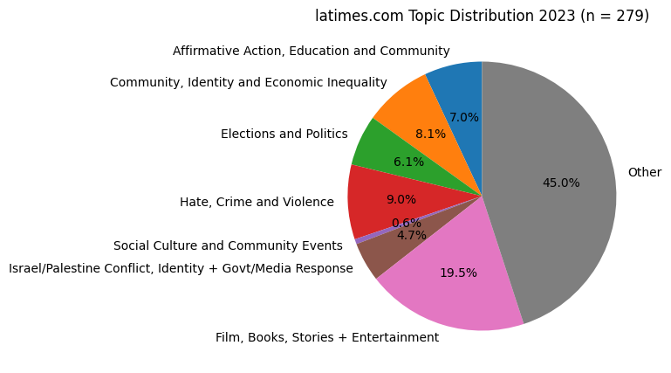
LDA Results: Asian American - 2023
NYT → Identity/Economic Inequality
LA Times → Hate/Violence
CBS → Hate/Violence, Film/Entertainment
Not much on affirmative action or social culture…

Slide 12
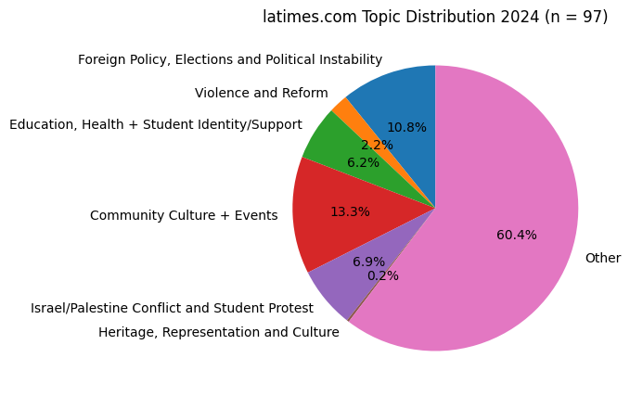
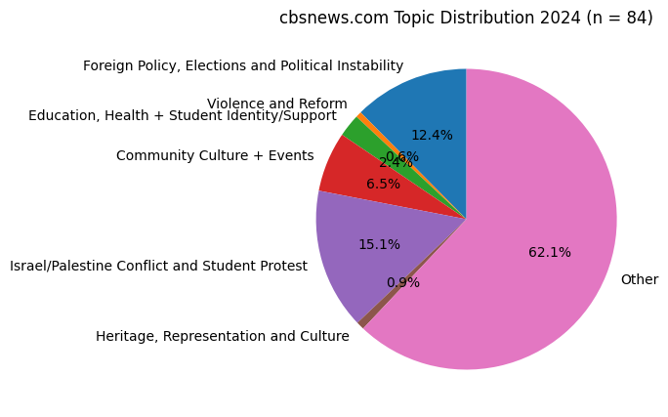
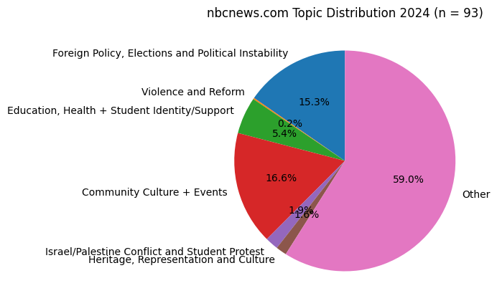
LDA Results: Asian American - 2024
LA Times → Israel/Hamas Conflict, Education/Health and Identity
NBC → Community Culture, Politics/Elections/FA
CBS → Israel/Hamas Conflict/Protests
Not much on violence/reform or heritage/culture…

Slide 13
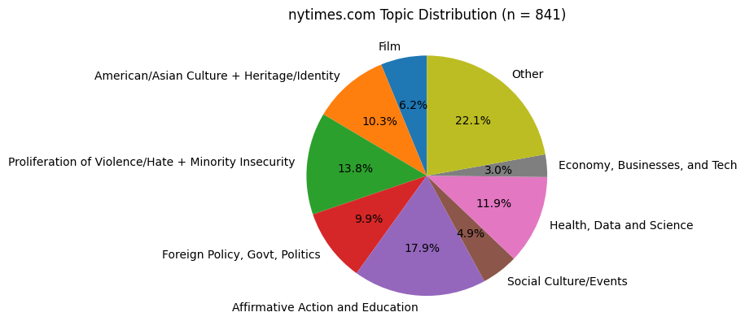
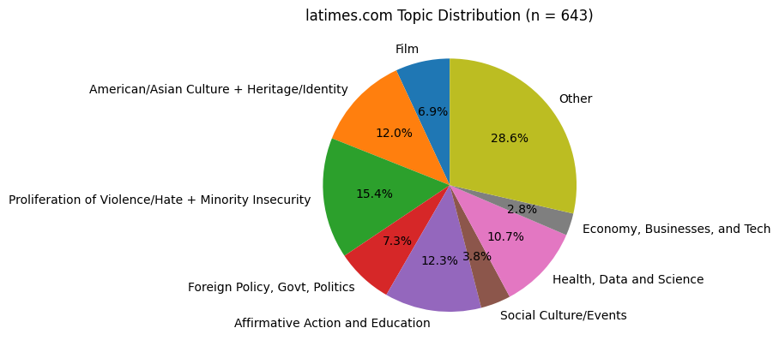
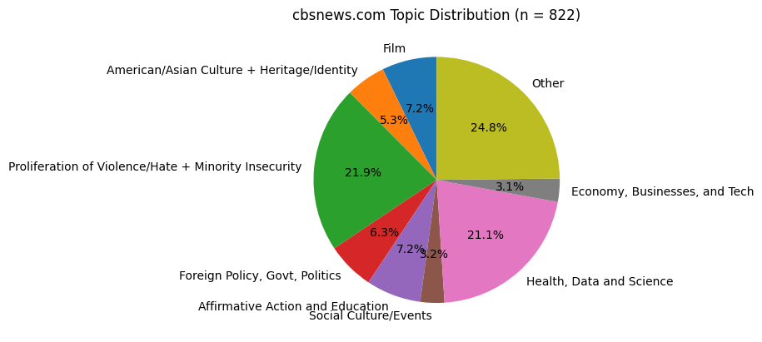
LDA Results: Asian American Overall
NYT → Affirmative Action, Foreign Policy/Govt/Politics
CBS → Violence/Minority Insecurity, Health/Data/Science
LA Times → Culture and Heritage
Not much on social culture/events or businesses/tech…
A lot on hate/violence (relatively)

Slide 14
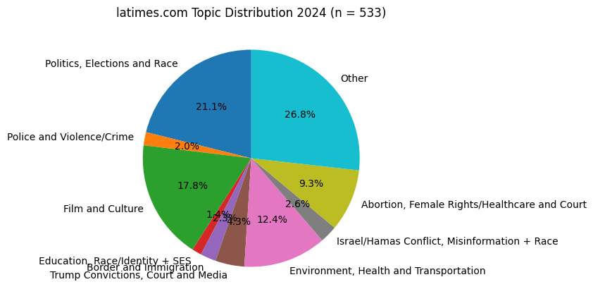
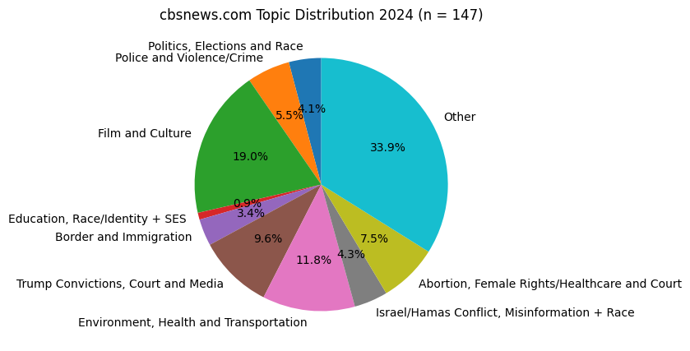
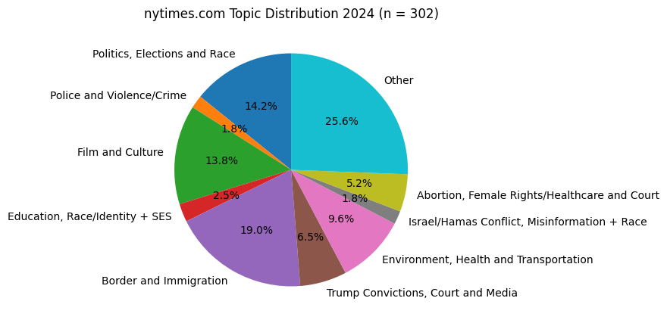
LDF Results: Hispanic
LA Times → Politics/Race, Health/Environment, Film
NYT → Border/Immigration
CBS → Film/Culture
Not much on violence/crime, female healthcare/rights, education/race/SES…

Slide 15
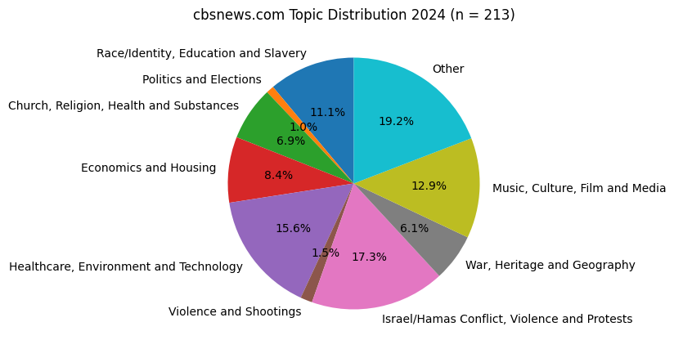
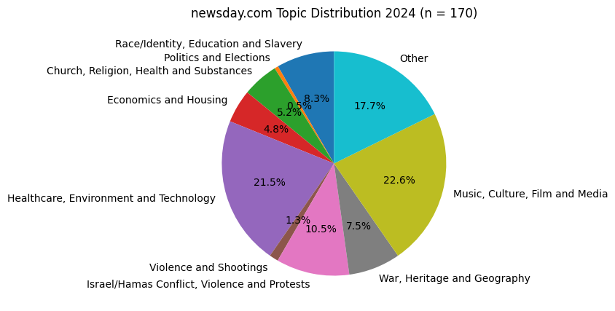
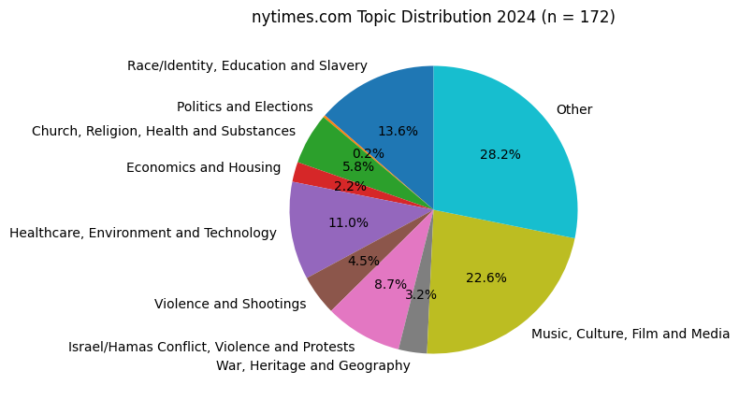
LDA Results: Black
CBS → Israel/Hamas Violence
NYT + Newsday → Healthcare/Tech, Music/Culture/Media
Surprising amount on race/identity/education/slavery…
Not much on heritage/geography, violence, econ/housing, politics…

Slide 16
Compare and Contrast: Asians vs. Other Minorities
Race/Ethnicity | US Population Proportion | PRESENT | ABSENT | Patterns
Asian American | ~ 5.9% | Hate, Politics, Affirmative Action, FA | Culture, Inequality, Identity, Heritage… | HUMANIZING, POSITIVE, CREATIVE PERSONALITIES + CULTURE IGNORED
Hispanic/Latino | ~ 18.9% | Film/Culture, Politics | Violence/Crime, Race/SES, Female Rights | SYSTEMIC ISSUES IGNORED
Black | ~ 12.6% | Healthcare, Tech, Music/Media | Heritage, Geography, Housing

Slide 17
Key Takeaways: What is Talked About and What Isn’t?
Negative experiences/suffering/ways that we operate in a system (education, politics, etc.)
Talked About
Hate/violence, Health/Data/Science (Overall)
Politics/Affirmative Action (2022)
Film/Media/Entertainment (2023)
Political Instability/Elections/FA (2024)
NOT Talked About (as much)
Food/Social Culture, Business/Economy/Tech (Overall)
Media/Entertainment, Food/Culture (2022)
Social Culture, Education, Identity + Inequality (2023)
Heritage, Violence/Reform, Education/Student Identities (2024)
Lack of awareness/education about our diverse identities, communities, inequality, heritage, businesses…

