Slide 1
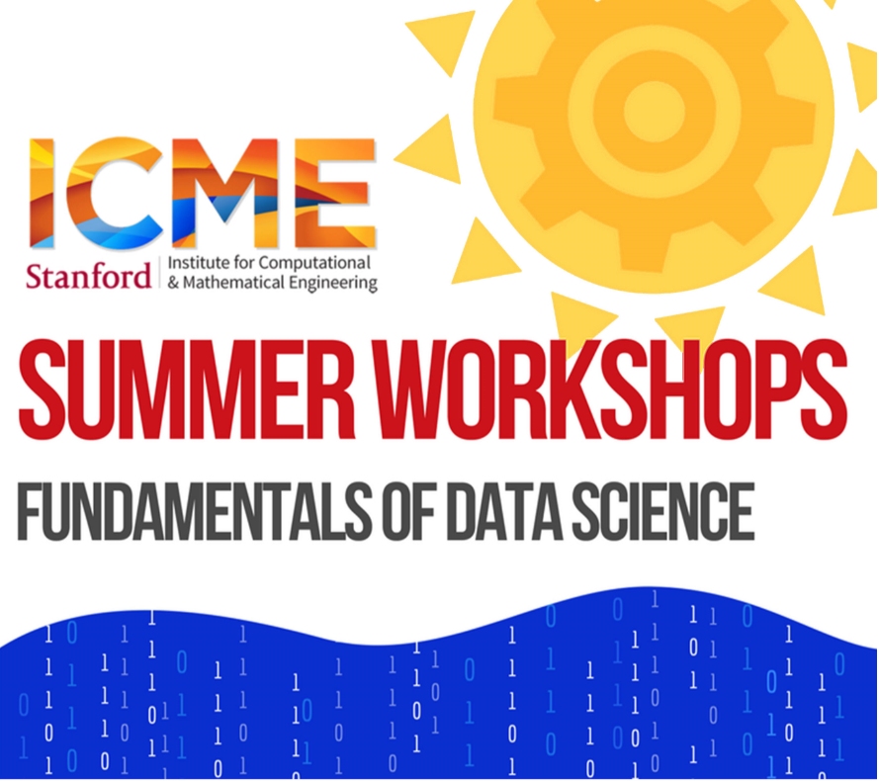
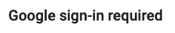


Welcome to Introduction to Python!
(We start at 8am)
Python on Google Colab
shorturl.at/gAJX5
Interactive polls (no account needed)
pollev.com/andreassantucci359
Slides
shorturl.at/aMQRW
No Colab? Download Anaconda and code from
www.anaconda.com/products/individual
shorturl.at/qAJY1
Open Python.ipynb in Jupyter (Anaconda Navigator → Jupyter → Select file)
1.
Open link in web browser
2.
Ready !

Slide 2


Introduction to Python
Andreas Santucci
santucci@stanford.edu
ICME Summer Workshops
Fundamentals of Data Science
August 4-5, 2021

Slide 3
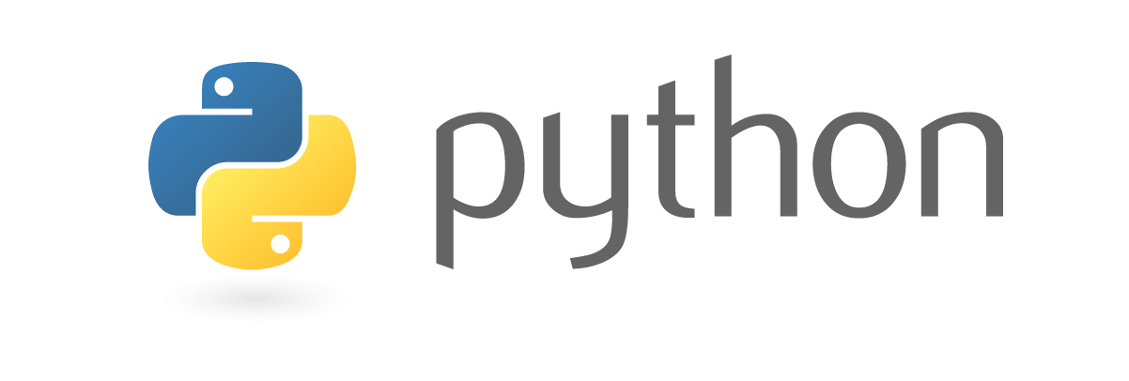
The class
Day 1 block A | 8:00-9:30 | “Basic” Python
Day 1 block B | 9:45-11:00
Day 2 block A | 8:00-9:30 | Numerical Python + Pandas
Day 2 block B | 9:45-11:00
Python
Variables, control-flow, containers, I/O
Functions, iterables
Classes and basic OOP
A little bit about modules
Numpy + Matplotlib
Pandas
Appendix: Scikit-learn

Slide 4
First and Foremost
Workshop is recorded (audio & video)
If you are OK, turn on your camera :-)
Ask questions in chat.
Rui, our awesome TA, is answering.
Stay muted unless you are actively talking

Slide 5
Some questions for you first!
pollev.com/andreassantucci359
Mandatory to participate :-)
Laptop or phone (keep the tab open for later)
No account needed, anonymous
The more the better.

Slide 6
Some info about me
Data Scientist at Google, Lecturer at Stanford
Interest in Machine Learning and Recommendation Systems
Learned to code after college!

Slide 7
Python
A very popular programming language
Web applications
Scientific computing
Data science and machine learning
General purpose applications

Slide 8
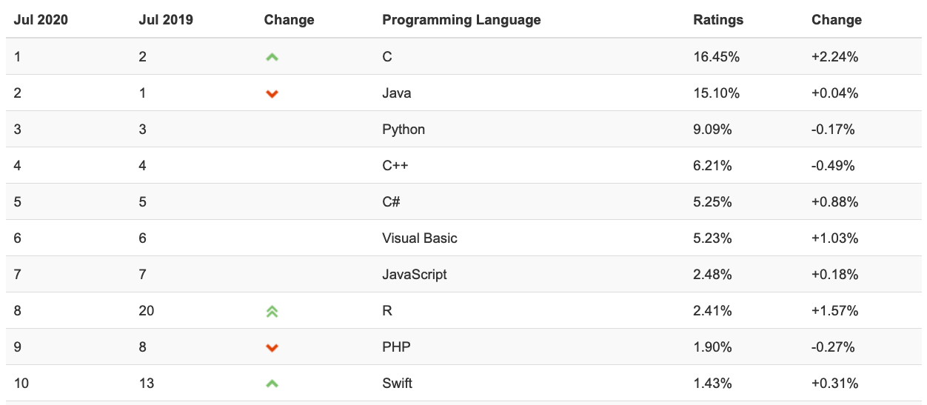
Python www.tiobe.com

Slide 9
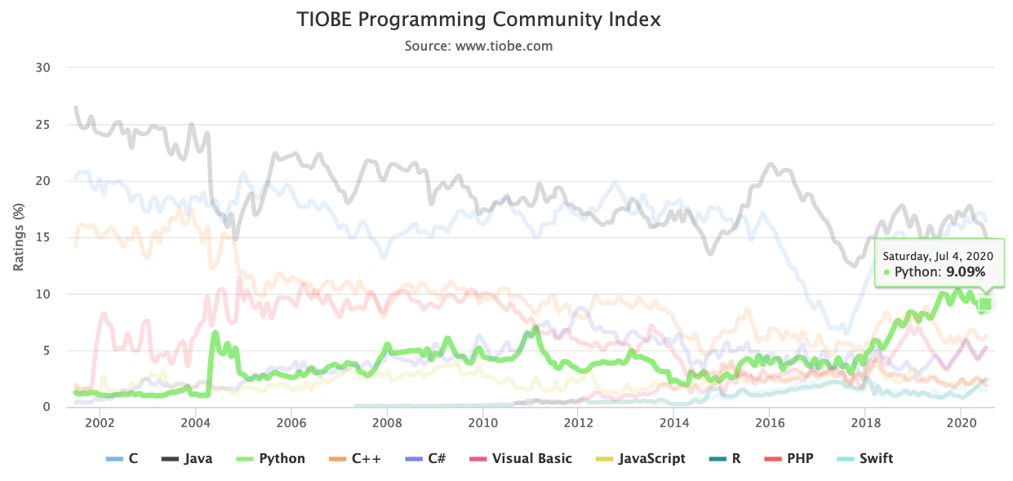
Python www.tiobe.com

Slide 10
The class
We will go through code together.
Ask questions in the chat
Many exercises.
Goal:
Good enough basic Python knowledge to explore on your own.
Exposure to various tools used in science. Won’t be an expert.

Slide 11
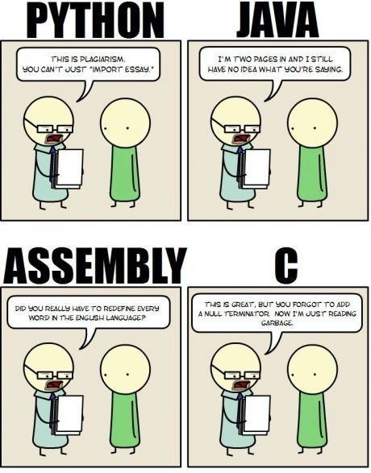
Python
This is plagiarism. You can’t just “import essay.”
I’m two pages in and I still have no idea what you’re saying.
High-level
Portable
Interpreted
Extensible
Object-oriented
Dynamically typed
Garbage collected
Did you really have to redefine every word in the English language?
This is great, but you forgot to add a null terminator. Now I’m just reading garbage.

Slide 12
Python 2 vs Python 3
Really no reasons to learn Python 2 in 2021 :-)

Slide 13
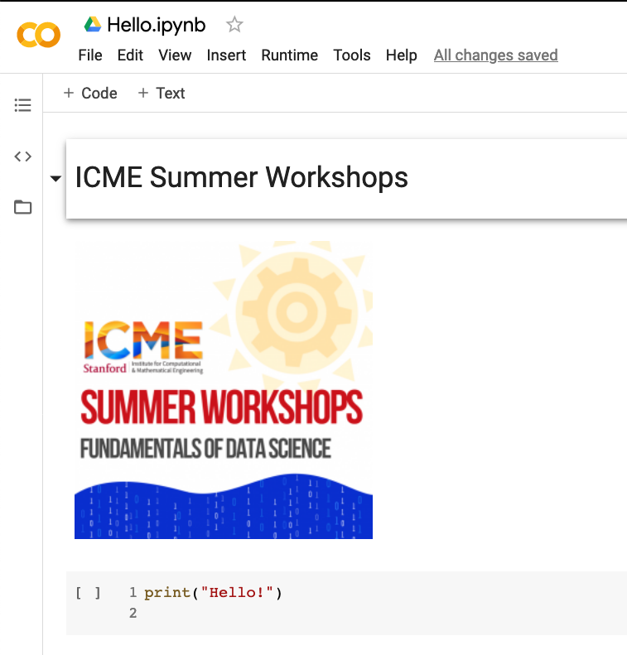
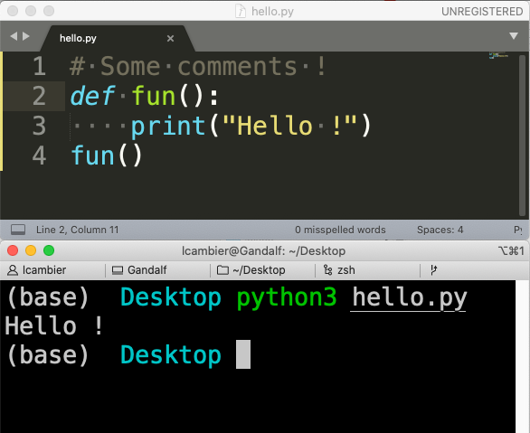
How to use Python ?
Scripts and Python text files
(in a text editor, offline, usually)
Notebooks (text + viz + code)
(in web browser, online or offline)
Notes:
Python scripts
Standard way
Jupyter notebooks
Good for interactive use
Good for teaching
Can use Google Colab
Not good for large complex programs

Slide 14
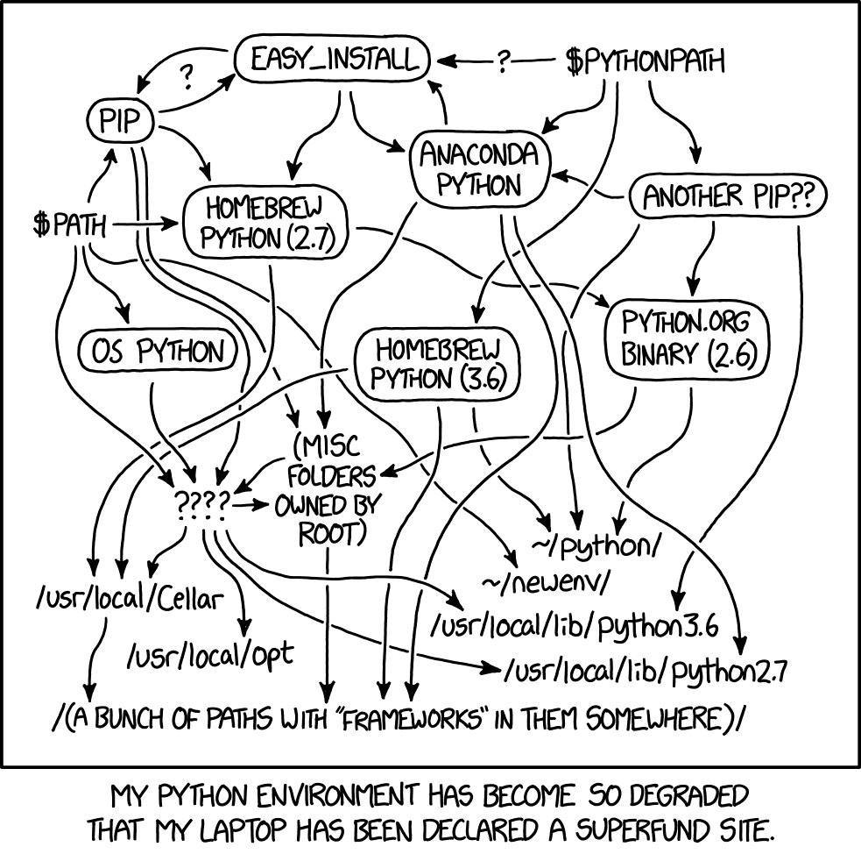
Running on your laptop
Download Anaconda
https://www.anaconda.com/products/individual
Comes with all you need
Many modules preinstalled
Can use for scripts from terminal
Can use for Jupyter notebooks from browser

Slide 15
Let’s open the first Notebook!

Slide 16
Strings indexing
s = “abcdefgh”
0 | 1 | 2 | 3 | 4 | 5 | 6 | 7
a | b | c | d | e | f | g | h
-8 | -7 | -6 | -5 | -4 | -3 | -2 | -1

Slide 17
Everything is a reference (1)
a = 2
a = 3

Slide 18
Everything is a reference (2)
a = "Stanford"
b = a
a = "ICME"
print(b)

Slide 19
Everything is a reference (3)
a = [1, 2, 3]
b = a
a[0] = "ICME"
print(b)

Slide 20
Everything is a reference (4): check out shorturl.at/oF346 for a graphical representation of what’s going on!
a = [1, 2]
t = (a, 1, "String")
a[0] = [3, 4]
print(t)

Slide 21

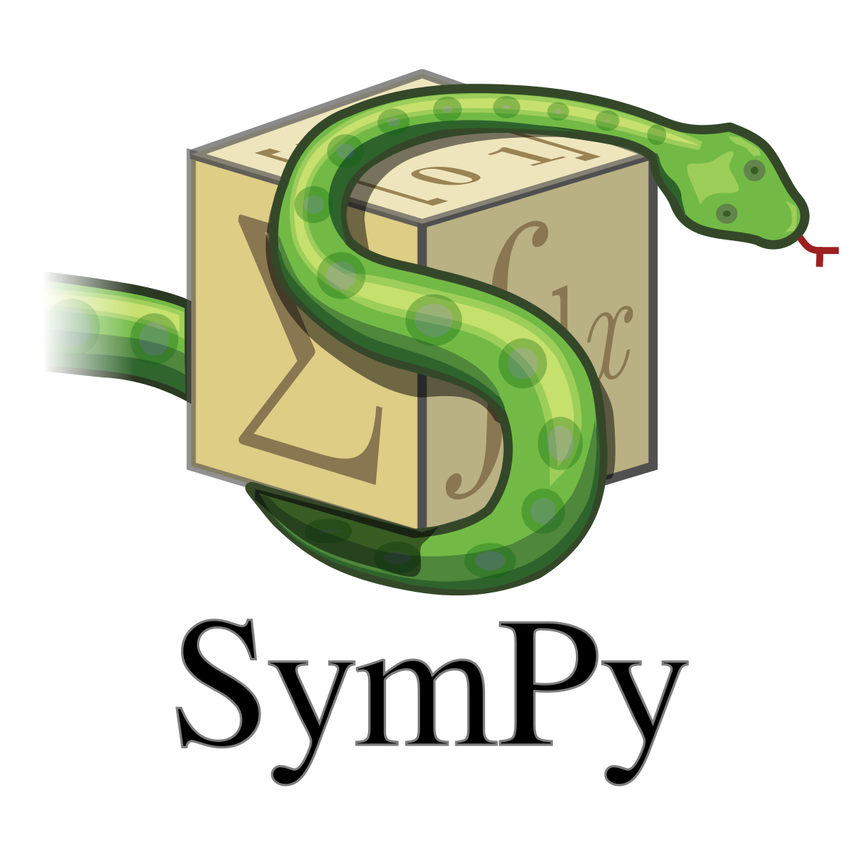
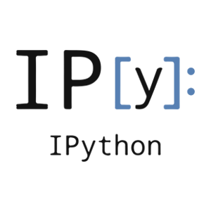
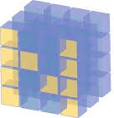



SciPy
An ecosystem for Scientific Computing and Data science in Python
Includes many packages

Slide 22
Numpy: arrays
1-D arrays
2-D array
3+-D array

Slide 23
Reshaping
5 x 4
2 x 10
.reshape((2, 10)) =

Slide 24
Broadcasting
3 x 2-array
3 x 2-array
3 x 2-array
2-array (vector)
a | b
a | b
a | b
+
=
+
a | b

Slide 25
Axis
axis=1
axis=0
a.mean(axis=0)

Slide 26
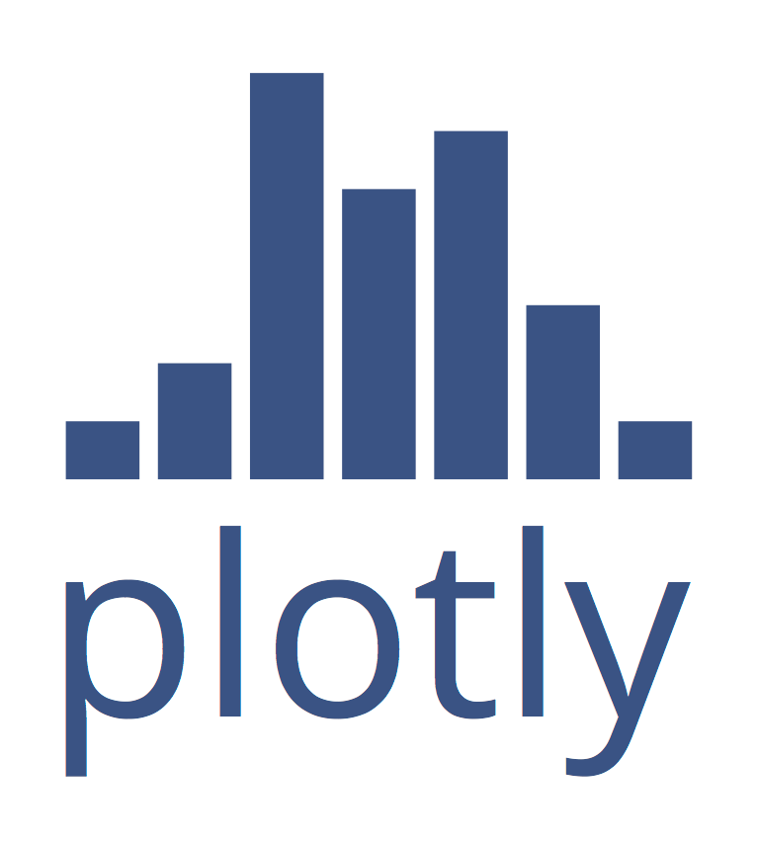
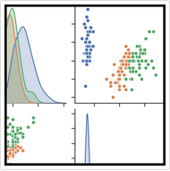
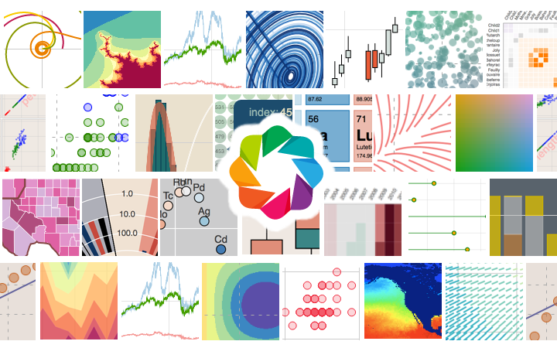
Plotting Ecosystem
Seaborn
Bokeh

Slide 27
Scipy
Linear Algebra (scipy.linalg)
Optimization (scipy.optimize)
Statistics (scipy.stats)
Many more

Slide 28
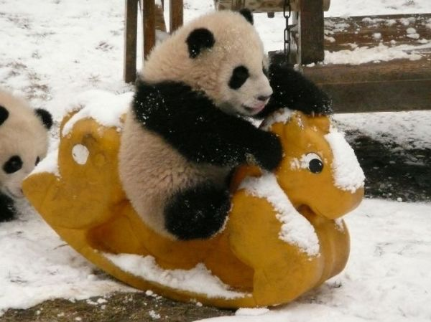
Pandas
Open-source, high-performances & easy-to-use data structures
DataFrame objects
Aggregation, grouping, reductions, statistics, etc.
Powerful dates support
All kinds of read/write functions (csv, HDF5, etc.)

Slide 29
Accessing a DataFrame
By Labels
df[column] # Get one column
df[rows] # Get multiple rows
df.loc[cols,rows] # End-points INCLUDED
By position
df.iloc[cols,rows] # End-points NOT INCLUDED w/ `:`

Slide 30
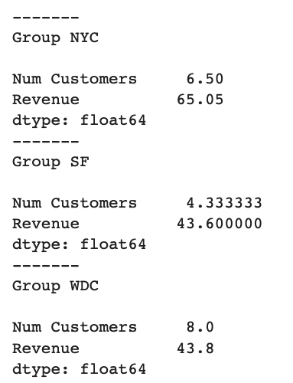
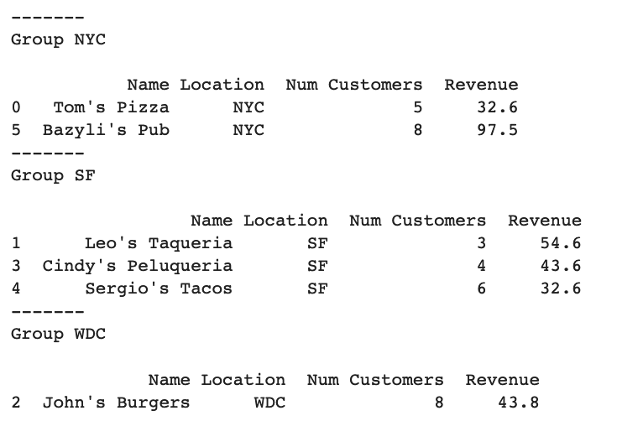
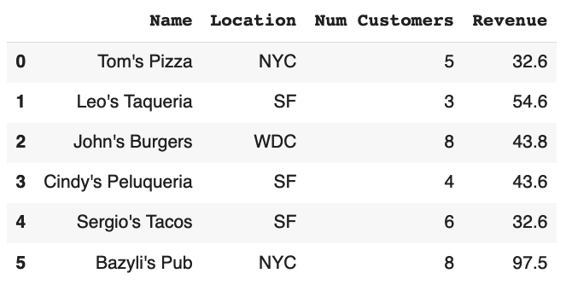
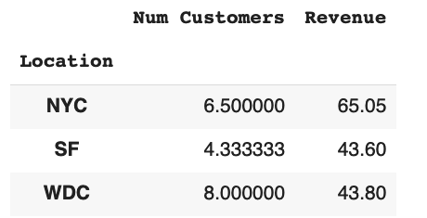
Groupby
Transform
Split
df.groupby('Location’).mean()
Combine

Slide 31
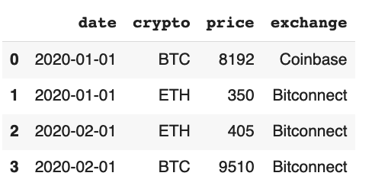
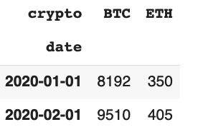
Pivot
df.pivot(index=’date’,columns=’crypto’,values=’price’)

Slide 32
Scikit-learn
A package for machine learning
Supervised learning
Classification
Regression
Unsupervised

Slide 33
Scikit-learn
A typical supervised learning problem
Given a dataset
S = {x_{i}, y_{i}}
Learns a function (mapping)
y = F(x)
Lots of kinds of models !
https://scikit-learn.org/stable/supervised_learning.html
https://scikit-learn.org/stable/unsupervised_learning.html
https://scikit-learn.org/stable/model_selection.html
… https://scikit-learn.org/stable/user_guide.html

Slide 34
Scikit-learn
# Pick a model
from sklearn import model
m = model.somemodel
# Train
m.fit(X_train, y_train)
# Predict
y_pred = m.predict(X_pred)

Slide 35
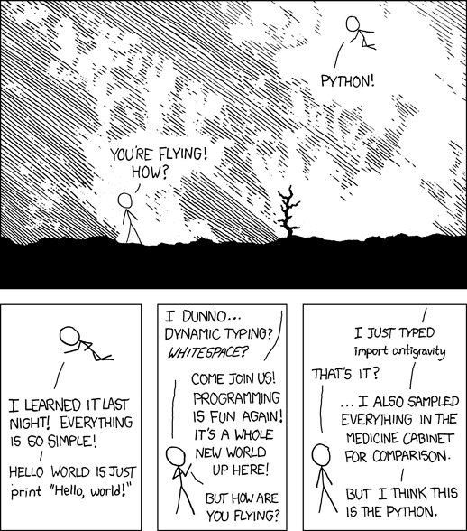
Recap
import antigravity
# Try it on your laptop,
# In a Python interpreter
(https://xkcd.com/353/)

Slide 36
More easter eggs
Try those in a Python interpreter
>> from __future__ import braces
>> import this
>> import __hello__

Slide 37
Recap: What did we learn?
Basic Python
Numpy for arrays
Scipy for linear algebra, optimization, statistics
Matplotlib for simple plotting
Pandas for data analytics
Scikit-learn for machine learning

Slide 38
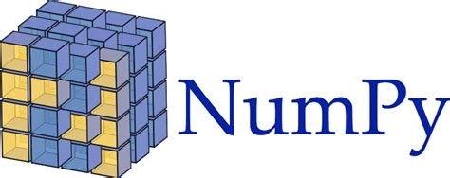





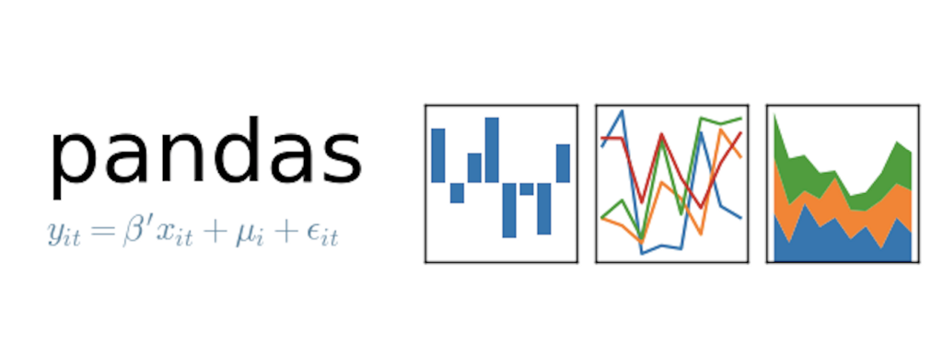



The Python Ecosystem (a tiny subset)
Seaborn
And many, many more (mpi4py, numba, joblib, …)

Slide 39
References
Python
Google & Stackoverflow
https://docs.python.org/3/
https://developers.google.com/edu/python/
https://www.learnpython.org
http://www.practicepython.org/
https://dabeaz-course.github.io/practical-python/Notes/Contents.html
Numpy & Scipy
https://docs.scipy.org/doc/numpy/user/quickstart.html
Pandas
https://pandas.pydata.org/pandas-docs/stable/10min.html
https://github.com/jvns/pandas-cookbook
Scikit-learn
http://scikit-learn.org/stable/tutorial/basic/tutorial.html

Slide 40
At Stanford
CME211
Software Development for Scientists and Engineers
CS106AP
Programming Methodology in Python
CS102, CS131, CS230, CS231N, CS375: Machine Learning (using Python)
CME302: Numerical Linear Algebra (using Python)
Best class at Stanford! Really!

Slide 41
Any question after the class?
lcambier@stanford.edu
-> Stanford Continued Education

