Slide 1

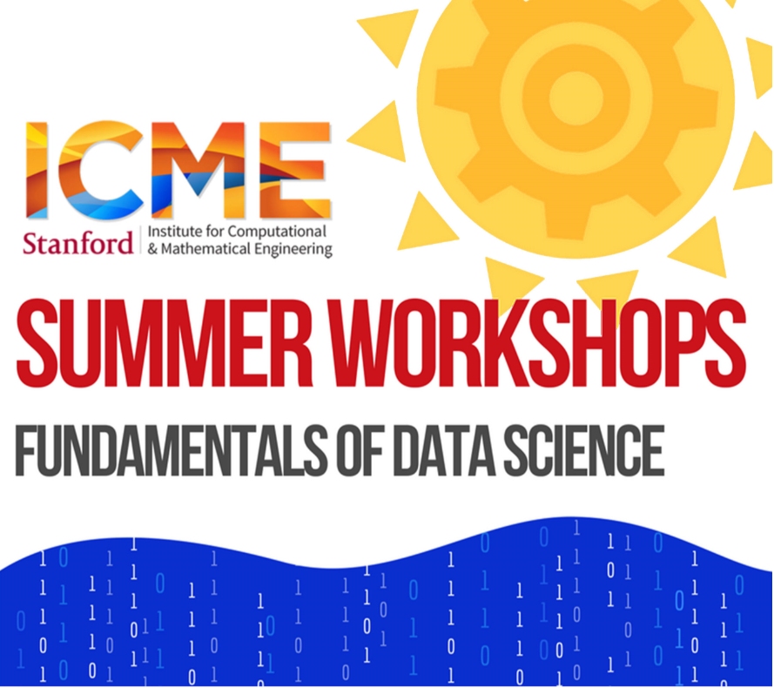
Welcome to Introduction to Python!
(We start at 8am)
Slides
https://github.com/asantucci/Python-Workshop/blob/main/slides.pptx

Slide 2


Introduction to Python
Andreas Santucci
santucci@stanford.edu
ICME Summer Workshops
Fundamentals of Data Science
August 4-5, 2021

Slide 3
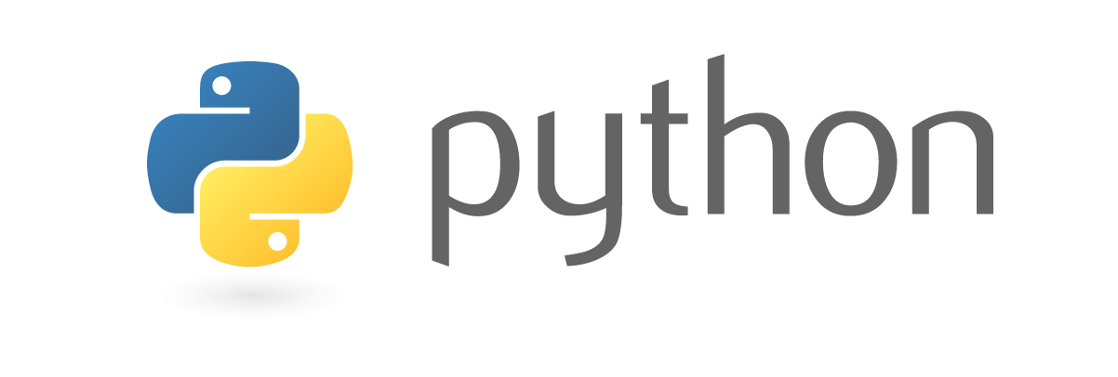
The class
Day 1 block A | 8:00-9:30 | “Basic” Python
Day 1 block B | 9:45-11:00
Day 2 block A | 8:00-9:30 | Numerical Python + Pandas
Day 2 block B | 9:45-11:00
Python
Variables, control-flow, containers, I/O
Functions, iterables
Classes and basic OOP
A little bit about modules
Numpy + Matplotlib
Pandas
Appendix: Scikit-learn

Slide 4
First and Foremost
Workshop is recorded (audio & video)
If you are OK, turn on your camera :-)
Ask questions in chat.
Rui, our awesome TA, is answering.
Stay muted unless you are actively talking

Slide 5
Some questions for you first!
pollev.com/andreassantucci359
Mandatory to participate :-)
Laptop or phone
No account needed, anonymous
The more responses, the better!

Slide 6
Some info about me
Data Scientist at Google, Lecturer at Stanford
Interest in Machine Learning and Recommendation Systems
Learned to code after college!

Slide 7
Python
A very popular programming language
Web applications
Scientific computing
Data science and machine learning
General purpose applications

Slide 8
The class
We will go through code together.
Ask questions in the chat
Many exercises.
Goal:
Good enough basic Python knowledge to explore on your own.
Exposure to various tools used in science.
But, you won’t be an expert overnight!

Slide 9
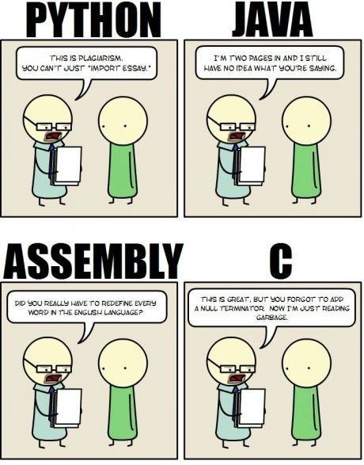
Python
This is plagiarism. You can’t just “import essay.”
I’m two pages in and I still have no idea what you’re saying.
High-level
Portable
Interpreted
Extensible
Object-oriented
Dynamically typed
Garbage collected
Did you really have to redefine every word in the English language?
This is great, but you forgot to add a null terminator. Now I’m just reading garbage.

Slide 10
Python 2 vs Python 3
Really no reasons to learn Python 2 in 2021 :-)

Slide 11
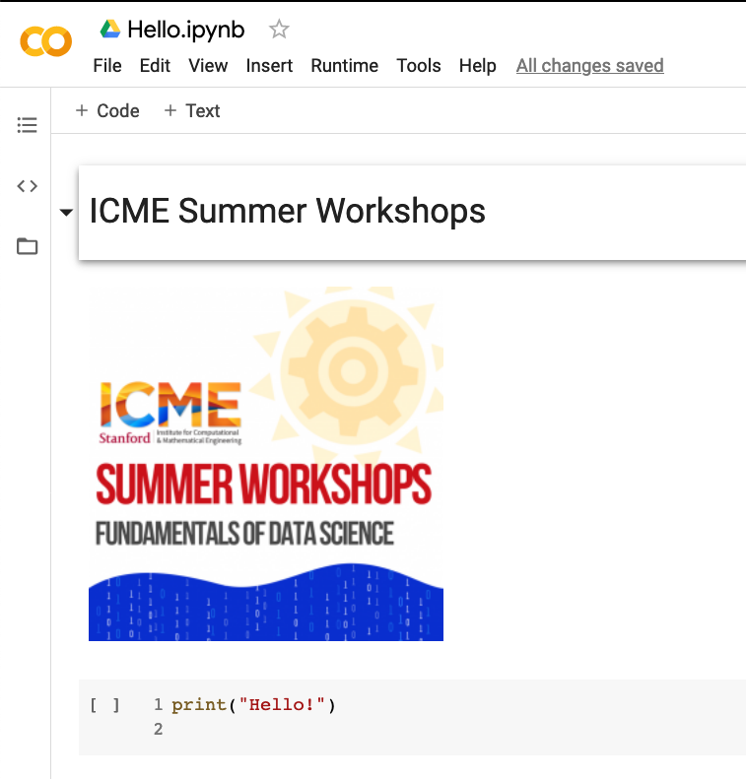
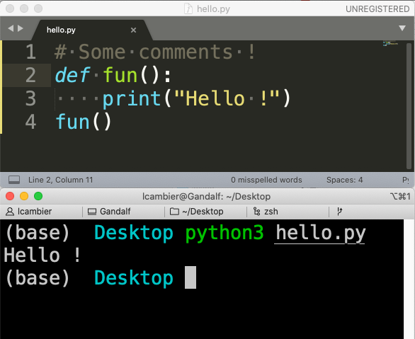
How to use Python ?
Scripts and Python text files
(in a text editor, offline, usually)
Notebooks (text + viz + code)
(in web browser, online or offline)
Notes:
Python scripts
Standard way
Jupyter notebooks
Good for interactive use
Good for teaching
Can use Google Colab
Not good for large complex programs

Slide 12
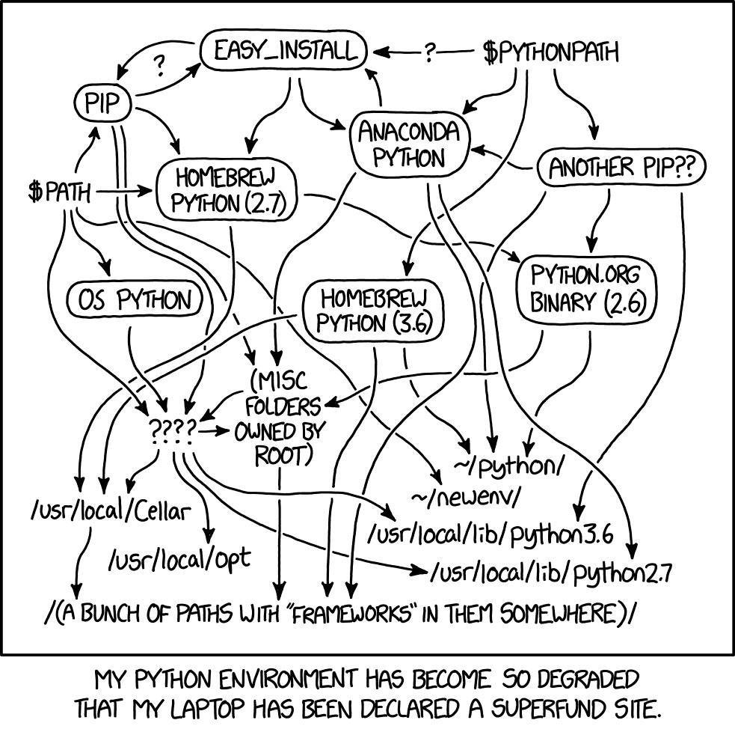
Running on your laptop
Download Anaconda
https://www.anaconda.com/products/individual
Comes with all you need
Many modules preinstalled
Can use for scripts from terminal
Can use for Jupyter notebooks from browser

Slide 13
Let’s open the first Notebook!

Slide 14
Strings indexing
s = “abcdefgh”
0 | 1 | 2 | 3 | 4 | 5 | 6 | 7
a | b | c | d | e | f | g | h
-8 | -7 | -6 | -5 | -4 | -3 | -2 | -1

Slide 15
Everything is a reference (1)
a = 2
a = 3

Slide 16
Everything is a reference (2)
a = "Stanford"
b = a
a = "ICME"
print(b)

Slide 17
Everything is a reference (3)
a = [1, 2, 3]
b = a
a[0] = "ICME"
print(b)

Slide 18
Everything is a reference (4), see: http://pythontutor.com/visualize.html#code=a%20%3D%20%5B1,%202%5D%0At%20%3D%20%28a,%201,%20%22String%22%29%0Aa%5B0%5D%20%3D%20%5B3,%204%5D%0Aprint%28t%29&cumulative=false&curInstr=0&heapPrimitives=nevernest&mode=display&origin=opt-frontend.js&py=3&rawInputLstJSON=%5B%5D&textReferences=false
a = [1, 2]
t = (a, 1, "String")
a[0] = [3, 4]
print(t)

Slide 19

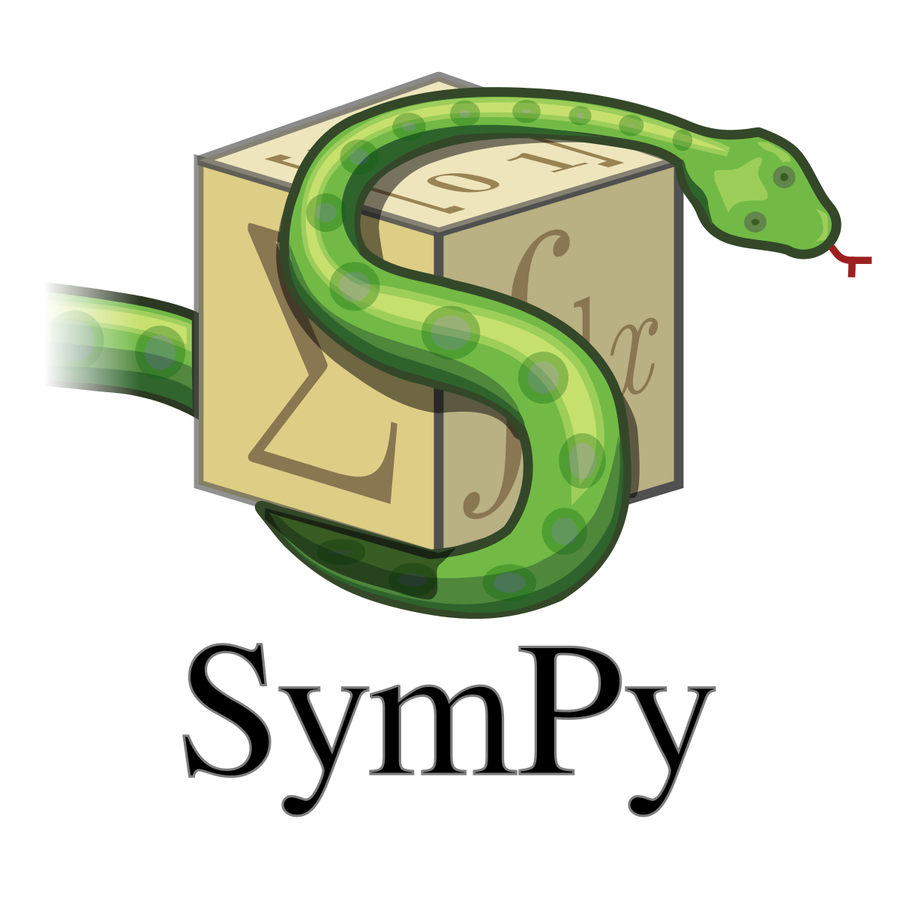
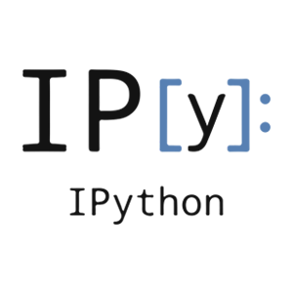
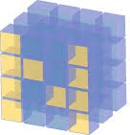


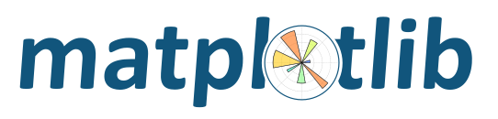
SciPy
An ecosystem for Scientific Computing and Data science in Python
Includes many packages

Slide 20
Numpy: arrays
1-D arrays
2-D array
3+-D array

Slide 21
Reshaping
5 x 4
2 x 10
.reshape((2, 10)) =

Slide 22
Broadcasting
3 x 2-array
3 x 2-array
3 x 2-array
2-array (vector)
a | b
a | b
a | b
+
=
+
a | b

Slide 23
Axis
axis=1
axis=0
a.mean(axis=0)

Slide 24
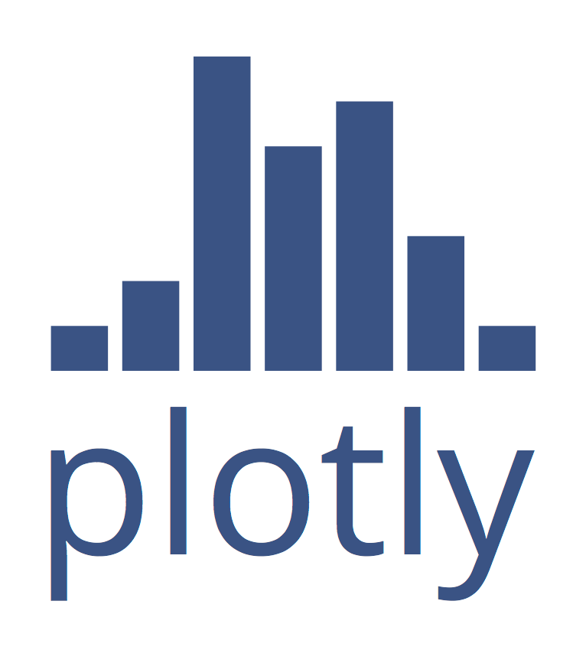
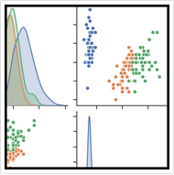
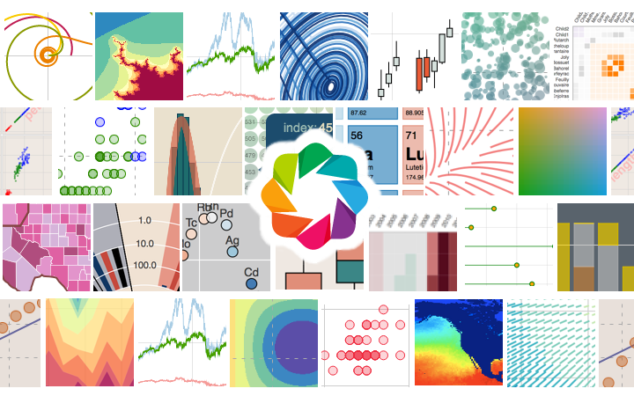
Plotting Ecosystem
Seaborn
Bokeh

Slide 25
Scipy
Linear Algebra (scipy.linalg)
Optimization (scipy.optimize)
Statistics (scipy.stats)
Many more

Slide 26
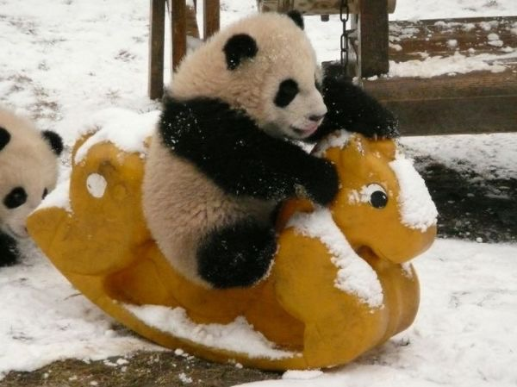
Pandas
Open-source, high-performances & easy-to-use data structures
DataFrame objects
Aggregation, grouping, reductions, statistics, etc.
Powerful dates support
All kinds of read/write functions (csv, HDF5, etc.)

Slide 27
Accessing a DataFrame
By Labels
df[column] # Get one column
df[rows] # Get multiple rows
df.loc[cols,rows] # End-points INCLUDED
By position
df.iloc[cols,rows] # End-points NOT INCLUDED w/ `:`

Slide 28
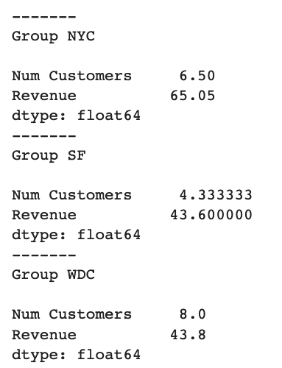
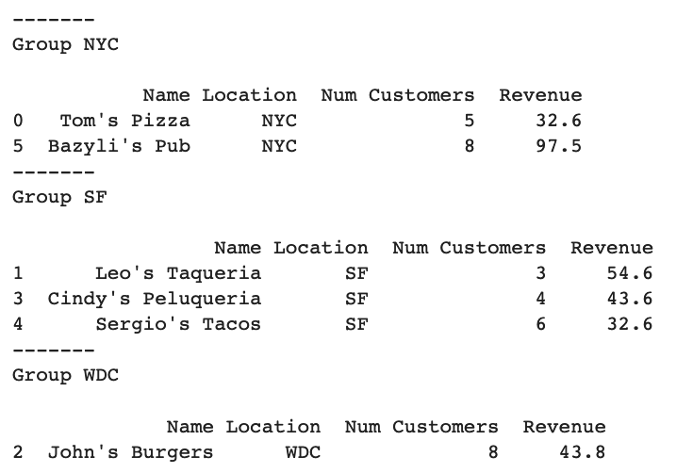
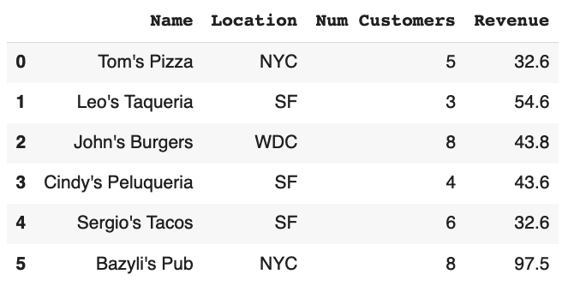
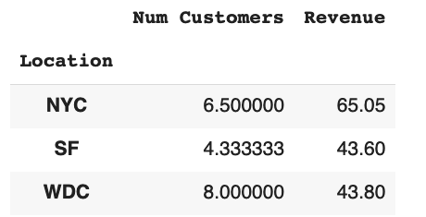
Groupby
Transform
Split
df.groupby('Location’).mean()
Combine

Slide 29
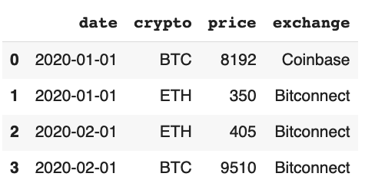
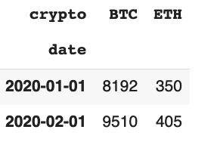
Pivot
df.pivot(index=’date’,columns=’crypto’,values=’price’)

Slide 30
Scikit-learn
A package for machine learning
Supervised learning
Classification
Regression
Unsupervised

Slide 31
Scikit-learn
A typical supervised learning problem
Given a dataset
S = {x_{i}, y_{i}}
Learns a function (mapping)
y = F(x)
Lots of kinds of models !
https://scikit-learn.org/stable/supervised_learning.html
https://scikit-learn.org/stable/unsupervised_learning.html
https://scikit-learn.org/stable/model_selection.html
… https://scikit-learn.org/stable/user_guide.html

Slide 32
Scikit-learn
# Pick a model
from sklearn import model
m = model.somemodel
# Train
m.fit(X_train, y_train)
# Predict
y_pred = m.predict(X_pred)

Slide 33
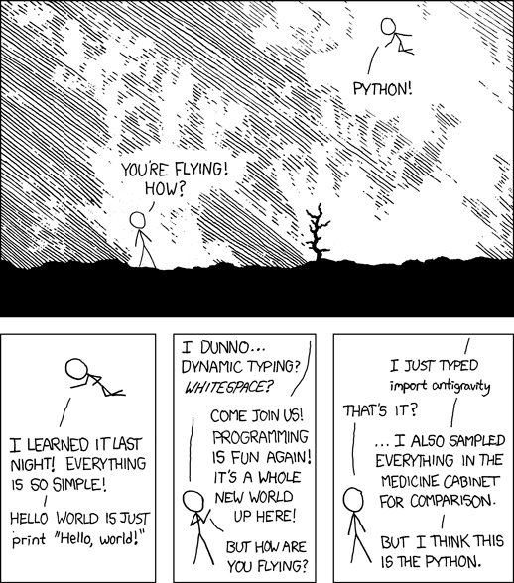
Recap
import antigravity
# Try it on your laptop,
# In a Python interpreter
(https://xkcd.com/353/)

Slide 34
More easter eggs
Try those in a Python interpreter
>> from __future__ import braces
>> import this
>> import __hello__

Slide 35
Recap: What did we learn?
Basic Python
Numpy for arrays
Scipy for linear algebra, optimization, statistics
Matplotlib for simple plotting
Pandas for data analytics
Scikit-learn for machine learning

Slide 36
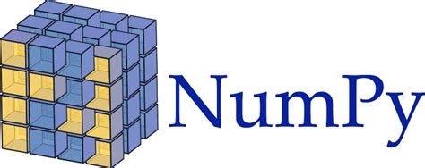





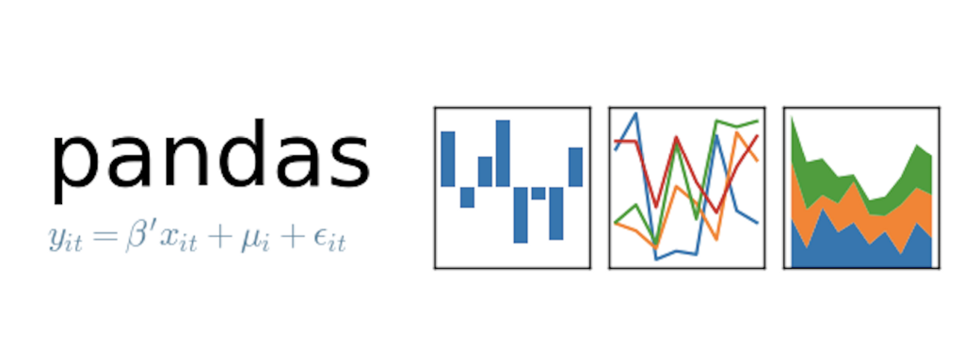



The Python Ecosystem (a tiny subset)
Seaborn
And many, many more (mpi4py, numba, joblib, …)

Slide 37
References
Python
Google & Stackoverflow
https://docs.python.org/3/
https://developers.google.com/edu/python/
https://www.learnpython.org
http://www.practicepython.org/
https://dabeaz-course.github.io/practical-python/Notes/Contents.html
Numpy & Scipy
https://docs.scipy.org/doc/numpy/user/quickstart.html
Pandas
https://pandas.pydata.org/pandas-docs/stable/10min.html
https://github.com/jvns/pandas-cookbook
Scikit-learn
http://scikit-learn.org/stable/tutorial/basic/tutorial.html

Slide 38
At Stanford
CME211
Software Development for Scientists and Engineers
CS106AP
Programming Methodology in Python
CS102, CS131, CS230, CS231N, CS375: Machine Learning (using Python)
CME302: Numerical Linear Algebra (using Python)

Slide 39
Any question after the class?
santucci@stanford.edu

