Slide 1
Markdown Slides [EN]
Adolfo Sanz De Diego

Slide 2
About

Slide 3
What is it?
MarkdownSlides is a Reveal.js and PDF slides generator from MARKDOWN files, that also generate HTML, EPUB and DOCX documents.
The idea is that from a same MARKDOWN file we can get slides and books without worrying about style, just worrying about content.

Slide 4
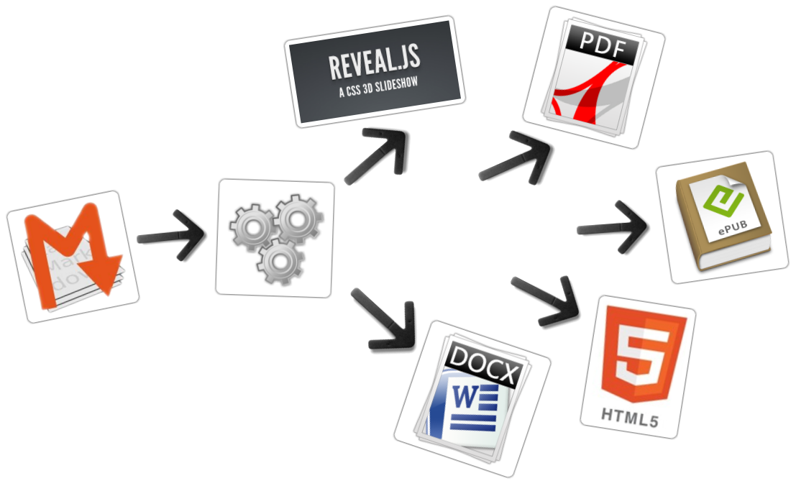

Slide 5
Samples (I)
From a MARKDOWN file generate:
reveal-slides
reveal-slides-pdf
epub-book
html-book
docx-book
pdf-book

Slide 6
Samples (I)
From this same MARKDOWN file “plus” files can be generated:
reveal-slides-plus
reveal-slides-pdf-plus
epub-book-plus
html-book-plus
docx-book-plus
pdf-book-plus

Slide 7
Contributors
Cesar Seoane: https://github.com/cesarseoane
Rubén Gómez García: https://github.com/kaneproject
Raul Jimenez Ortega: https://github.com/hhkaos
Pablo J. Triviño: https://twitter.com/p_trivino
Marcos Chavarría: https://twitter.com/chavarria1991

Slide 8
Licence
This work is licensed under a:
Creative Commons Attribution 3.0
The program source code are licensed under a:
GPL 3.0

Slide 9
Instalation

Slide 10
Dependencies
It needs to be installed:
Pandoc
DeckTape
TeX Live
It is automaticaly downloaded:
Reveal.js

Slide 11
Requirements
Now, only works in Linux (may be on MacOS)
It can works with Docker, but is in beta.

Slide 12
Download
https://github.com/asanzdiego/markdownslides/archive/5.0.zip

Slide 13
Docker
Your installation with docker is still under testing.
Any feedback is welcome.

Slide 14
Building docker image
It will be at dockerhub soon:
$ docker build -t asanzdiego/markdownslides .

Slide 15
Launch the container
Launch the container:
docker run -it -v "${PWD}":/home/markdownslides-master/"${PWD##*/}" \ asanzdiego/markdownslides ./build.sh [clean] [mode] [folder]

Slide 16
How to use

Slide 17
Creation
First copy the doc folder and rename it as you like. This is not necessary but helps you organize your documents.
Create the md files that you want to generate in the md folder. The md files are Markdown files which are nothing more than plain text files with extension md, and a lightweight markup (we should know it but it is very simple).

Slide 18
Imports (I)
We can add a file with @import import/NOMBRE_FICHERO [startLine=NUMERO] [endLine=NUMERO] [showNumberLines]
Firt example:
@import import/import-2.md
Line 1 of import-2.md
Line 2 of import-2.md
Line 3 of import-2.md
Line 4 of import-2.md

Slide 19
Imports (II)
Second example:
@import import/import-1.md endLine=4
Line 1 of import-1.md
Line 2 of import-1.md
Line 3 of import-1.md
Line 4 of import-1.md

Slide 20
Imports (III)
Third example:
@import import/import-1.md startLine=6
- Line 1 of import-2.md - Line 2 of import-2.md - Line 3 of import-2.md - Line 4 of import-2.md

Slide 21
Imports (IV)
Fourth example:
@import import/import-1.md startLine=2 endLine=3 showNumberLines
2 - Line 2 of import-1.md 3 - Line 3 of import-1.md

Slide 22
Notes
We can add notes that will be visible in book mode or if you press the letter ‘s’ on the slides with @start-notes and @end-notes.
@start-notes This is only visible in book mode or if you press 's' on the slides. @end-notes
Notes:
This is only visible in book mode or if you press ‘s’ on the slides.

Slide 23
Plus notes
We can create notes with @plus that will be only visible in “plus” files as long as in the build.properties we have GENERATE_PLUS_VERSION=‘yes’
@plus the lines below will only be available in the plus version @plus @import import/import-2.md
the lines below will only be available in the plus version
Line 1 of import-2.md
Line 2 of import-2.md
Line 3 of import-2.md
Line 4 of import-2.md

Slide 24
MathJax
We can use the MathJax lib.
So this:
$$x = {-b \pm \sqrt{b^2-4ac}}.$$
Will be converted to:
$$x=−b±\sqrt{b^{2}−4ac}.$$

Slide 25
Code
function helloWorld() { alert('Hello world'); }

Slide 26
Levels
You can have as many levels as you want. Example:
# Level 1 (on slides and book) ## Level 2 (on slides and book) ## Level 3 (in book but stays level 2 in slides)
But only in books. In slides you can only have 2 levels.

Slide 27
Numbering
You can name several slides with (I), (II), etc. But only the first one will be exported to the book. Example:
## Foo Bar (I) ## Foo Bar (II)
In the book will be:
## Foo Bar

Slide 28
Configuration (I)
We can configure the files that we want to generate from the file build.properties
#GENERATION_MODE='min|med|max' DEFAULT_GENERATION_MODE='min' GENERATE_PLUS_VERSION='yes' BUILD_REVEAL_SLIDES='min' BUILD_REVEAL_SLIDES_PDF='med' BUILD_HTML_BOOK='min' BUILD_PDF_BOOK='med' BUILD_DOCX_BOOK='max' BUILD_EPUB_BOOK='max'

Slide 29
Configuration (II)
We can also configure some other stufs from the file build.properties
CLEAN_LIB_FOLDER='no' COPY_IMG_FOLDER='no' ZIP_EXPORT_FOLDER='no' NUMBER_SECTIONS='no' NUMBER_OFFSET='no' CURRENT_NUMBER_OFFSET=1 REMOVE_GENERATE_MD_FILES='yes'

Slide 30
Configuración (III)
We can also configure some other stufs aboout reveal.js from the file build.properties
#THEME='black|white|league|sky|beige|simple|serif|blood|night|moon|solarized' REVEAL_JS_THEME='beige' REVEAL_JS_SHOW_TITLE_FOOTER='yes' REVEAL_JS_DEFAULT_TITLE_FOOTER='yes' REVEAL_JS_TITLE_FOOTER="'MarkdownSlides by @asanzdiego :-)'" REVEAL_JS_SHOW_MENU='yes' REVEAL_JS_SHOW_CHALKBOARD='yes' REVEAL_JS_ONLINE='no'

Slide 31
Build
In the root folder you have to execute:
./build.sh [mode] [folder]
[mode] can take the next values: min, med o máx.
[folder] folder wher to find the md files. If no folder name, it will convert all md files of all the folders.

Slide 32
Releases notes

Slide 33
Relese 1.0 (I)
Export slides to:
reveal-slides
reveal-slides-pdf
beamer-slides
deck-slides

Slide 34
Relese 1.0 (II)
Export books to:
html-book
docx-book
odt-book
pdf-book

Slide 35
Relese 1.0 (III)
Added generation modes ‘min’, ‘med’ and ‘max’.
Automatic download the external libraries.
Numbering (I), (II), (III) …

Slide 36
Relese 2.0 (I)
Export slides to:
reveal-slides
reveal-slides-pdf
reveal-slides-online

Slide 37
Relese 2.0 (II)
Export books to:
html-book
docx-book
epub-book

Slide 38
Relese 2.0 (III)
Deprecated:
beamer-slides
deck-slides
odt-book
pdf-book

Slide 39
Relese 2.0 (III)
Added menu thanks to Raul Jimenez Ortega.
Added dockerfile thanks to Rubén Gómez García.
Clean zip files from libraries thanks to Cesar Seoane.
Added type ‘online’ thanks to Cesar Seoane.
Fixed bug HTTPS images thanks to Cesar Seoane.
Loading the online libraries with HTTPS thanks to Cesar Seoane.
Configuration PDF resolution thanks to Cesar Seoane.

Slide 40
Relese 2.0 (IV)
New format ‘epub’.
Added ‘bash strict mode’.
Added ‘build.properties’ to configure file generation.
Added the command ‘clean’ to clean the lib folder.
Download a specific version of external library.
Added notes only visible in book mode or if you press ‘s’ on the slides.
Normalization of images in slides.

Slide 41
Relese 3.0
Clean the code.
Remove deprecated exportation files.
Improve de configuration in build.properties file.
Update Reveal.js dependencies.
Export to PDF with DeckTape.
Book creation from some md files with enumeration.
Possibility of adding a footer to the slides.

Slide 42
Relese 4.0
Fix some bugs.
Add bookmarks to the slides.
Improve file names.
Add MathJax/ lib thanks to Pablo J. Triviño.

Slide 43
Relese 5.0
Clean the code.
Fixed some bugs.
Removed the command ‘clean’ to clean the lib folder because it can be done via properties file.
Added again the option to export to PDF in book format.
Added the possibility to import files or fragments from an external file.
Added the plugin chalkboard thanks to Marcos Chavarría.
Added the possibility to create a ‘plus’ version with extra information in slides and books.

Slide 44
Version 6.0
Added the possibility to export to PowerPoint.
Updated all the libraries to the latest version.
Updated the templates.
Updated the Dockerfile.

Slide 45
Adolfo Sanz De Diego Author

Slide 46
Adolfo Sanz De Diego
Old JEE web developer.
Now I’m Tecnical Teacher Advaisor in the TIC service of the General Direction of Infrastructure and Services of the Ministry of Education and Youth of the Community of Madrid.
In addition I work as trainer specialized in development technologies.

Slide 47
Some projects
Hackathon Lovers Hackathon Lovers: a group created for entrepreneurs and developers who loves hackathons.
Password Manager Generator: an online password manager.
MarkdownSlides: a script to create slides from MD files.

Slide 48
Where to find me?
My nick: asanzdiego
Blog: asanzdiego.com
GitHub: github.com/asanzdiego
Twitter: twitter.com/asanzdiego
LinkedIn: linkedin.com/in/asanzdiego
SlideShare: slideshare.net/asanzdiego

