Slide 1
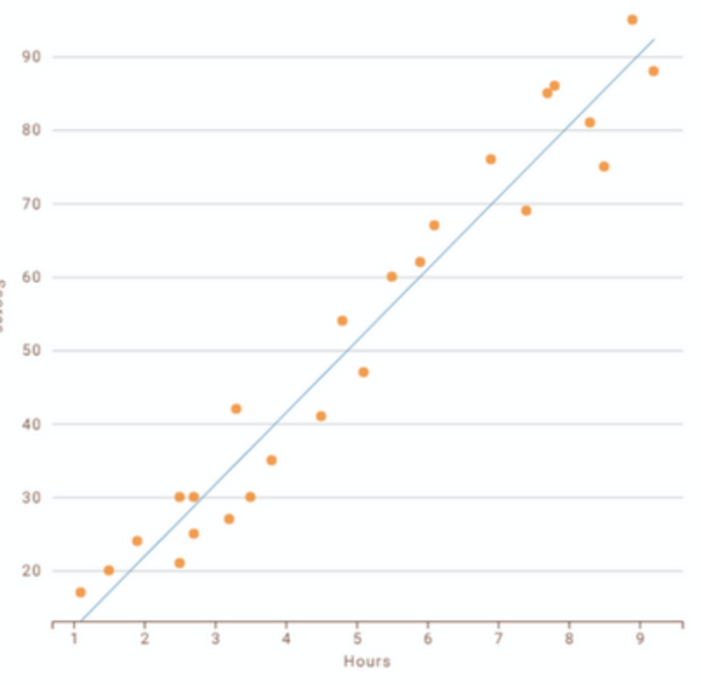
Simple Linear Regression
Step 1. Preprocess the Data
We will follow the same steps as in previous section.
Import the libraries
Import the dataset
Check for missing data
Split the dataset
Feature Scaling
What is Linear Regression?
It is a method to predict dependent variable (Y) based on values of independent variable (X). It is assumed that the two variables are linearly related. Hence, we try to find a linear function that predicts the response value (y) as accurately as possible as a function of the feature or independent variable (x).
Step 2. Fitting Simple Linear Regression
Model to the Training Set
To fit the dataset into the model we will use LinearRegression class from sklearn.linear_model library. Then we make an object regressor of Linear Regression Class. Fit the regressor object into our dataset using fit() method.
How to find best fit line?
min{SUM(y_{i}-y_{p})2},
y_{i} – observed value
y_{p} – predicted value
y = b₀ + b₁*x₁
y – dependent variable
y_{p} – independent variable
In this regression model, we are trying to minimize the errors in prediction by finding the “best fit line” – regression line from the errors would be minimal. We are trying to minimize the length between the observed value (Y_{i}) and the predicted value from our model (Y_{p}).
Step 3. Predicting the Result
Predict the observations from our test set saving it as vector Y_pred. To predict the result we use predict method of Linear Regression Class on the regressor we trained in the previous step.
Step 4. Visualization
The final step is to visualize the results. We will use matplotlib.pyplot library to make Scatter plots of Training set results and Test set results;

Slide 2
Multiple Linear Regression
What is Multiple Linear Regression?
Dummy Variables
1. Preprocessing the data
Using categorical data in Multiple Linear Regression Models is a powerful method to include non-numeric data types into a regression model. Categorical data refers to data values which represent categories – data values with a fixed and unordered number of values, for instance, gender (male/female). In regression model these values can be represented by dummy variables – variables containing values such as 1 or 0 representing the presence or absence of the categorical value. (to avoid dummy variables trap of multicollinearity, drop_first = True, to keep less features in the model).
Import the Libraries.
Import the Dataset.
Check for Missing Data.
Encode Categorical Data.
Make dummy variables if necessary and avoid trap.
Feature Scaling.
Multiple Linear Regression attempts to model the relationship between two or more features and response by fitting a linear regression to observed data. The steps to perform multiple linear regression are almost similar to that of simple linear regression. The difference lies in the evaluation. You can use it to find out which factor has the highest impact on the predicted output and different variables relate to each other.
2. Fitting our model to the training set
To fit the dataset into the model we will use LinearRegression Class from sklearn.linear_model library. Then we make an object regressor of LinearRegression Class. And then fit the regressor object into our dataset using fit() method of LinearRegression Class.
y = b₀ + b₁*x₁ + b₂*x₂ +…….+ b_{n}*x_{n}
y – dependent variable
x_{i} – multiple independent variable
Gender
Male
Female
Male
Male
1
0
1
3. Predicting the Test results
Assumptions!
Now we will predict the observations from our test set. We will save the output in a vector Y_pred. To predict the results we use predict() method of LinearRegression Class on the regressor we trained before.
For Successful Regression Analysis, it’s essential to validate these assumptions.
Linearity – The relationship between dependent and independent variables should be linear.
Homoscedasticity – (constant variance) errors are almost similar all along the values of y.
Multivariate Normality – Multiple regression assumes that the residuals are normally distributed.
Lack of Multicollinearity – It is assumed that there is little or no multicollinearity in the data.

Slide 3
Multiple Linear Regression
Note
Having too many variables could potentially cause our model to behave less accurate, especially if certain variables have no effect on the outcome or have a significant on other variables. There are various methods to select the appropriate variables like –
Forward Selection
Backword Elimination
Bi-directional Comparison
y = b₀ + b₁*x₁ + b₂*x₂ +…….+ b_{n}*x_{n}
y – dependent variable
x_{i} – multiple independent variable

