Slide 1
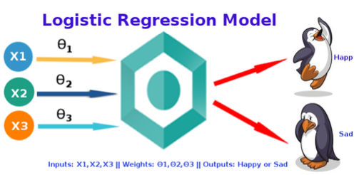
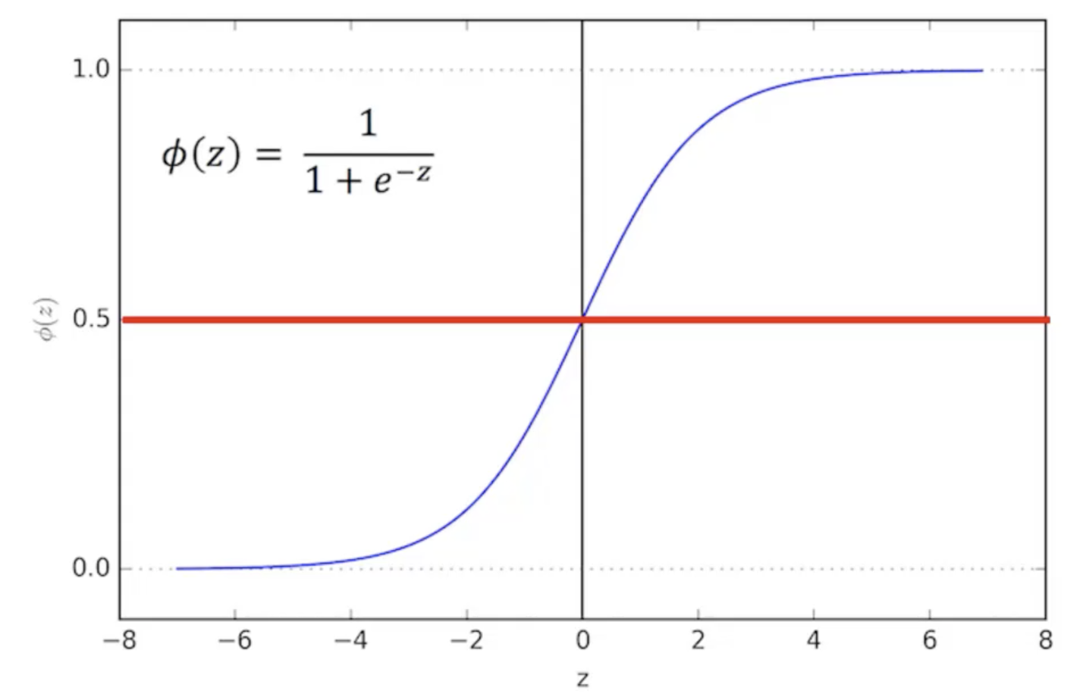
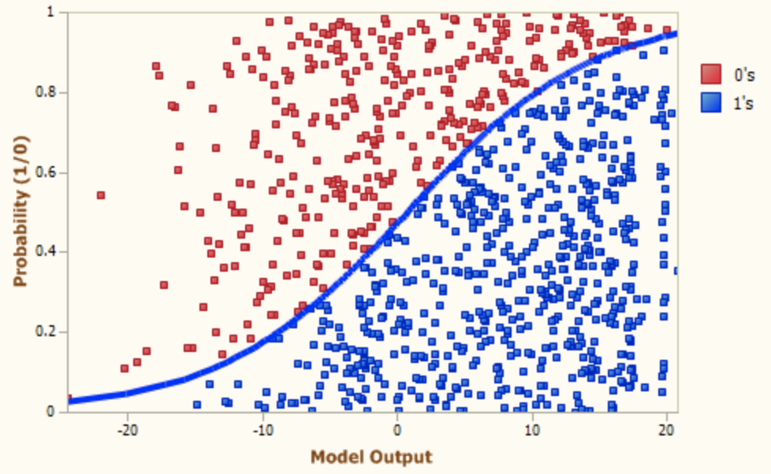
Logistic Regression
What is Logistic Regression?
Sigmoid Function
The logistic regression technique involves the dependent variable, which can be represented in the binary (0 or 1, true or false, yes or no) values, which means that the outcome could only be in either one form of two. For example, it can be utilized when we need to find the probability of a successful or fail event.
Sigmoid Function is an S-shaped curve that can take any real-valued number and map it into a value between the range of 0 and 1, but never exactly at those limits.
Making Predictions
These probabilities must then be transformed into binary values in order to actually make a prediction. This is the task of the logistic function, also called sigmoid function. This values between 0 and 1 will then be transformed into either 0 or 1using a threshold classifier.
How does it work?
Logistic Regression measures the relationship between the dependent (our label, what we want to predict) and the one or more independent variables (our features), by estimating probabilities using it’s underlying logistic function.
Logistic vs Linear
Logistic gives discrete outcome, while linear gives continuous.

