Slide 1
Preprinting and Publishing in the Life and Biomedical Sciences
IV: The communicating scientist: How
to effectively and responsibly communicate scientific research

Slide 2
Prior knowledge
Students should be aware of the major social media platforms and how to use them
Students should understand what the different types of a scientific paper are
Students should be aware of the basic scientific process and the publishing pipeline (as covered in earlier lessons in this series)

Slide 3
What is sci-comm?
The practice of informing, educating, sharing wonderment, and raising awareness of science-related topics
Reliably
Including correcting misinformation
Of both scientific findings and the scientific process
Effective sci-comm will be tailored to the specific audiences and platforms used

Slide 4
Why do it (as a scientist)?
Benefits:
increased visibility of research, publications
Raise your own, independent, profile
Enjoyment and engagement with other scientists and the general public
Moral / funder responsibility
Part of being a scientist is sharing knowledge
Different measure of impact (Check out Altmetric.com or ImpactStory)

Slide 5
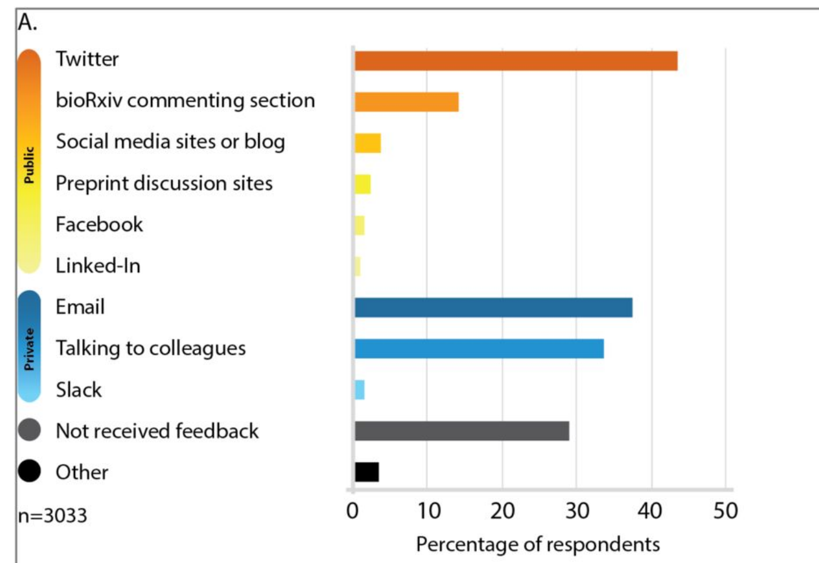
Feedback for your work
In a survey of bioRxiv users, most respondents said that feedback on papers posted on bioRxiv came from Twitter.
https://www.biorxiv.org/content/10.1101/833400v1.full

Slide 6
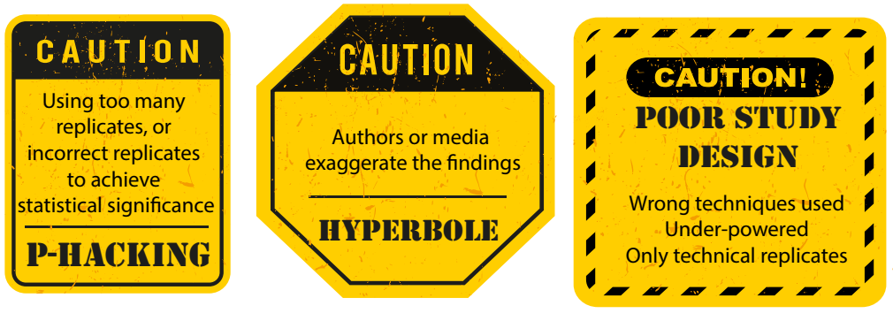
Share responsibly!

Slide 7
Whose responsibility is sci-comm?

Slide 8

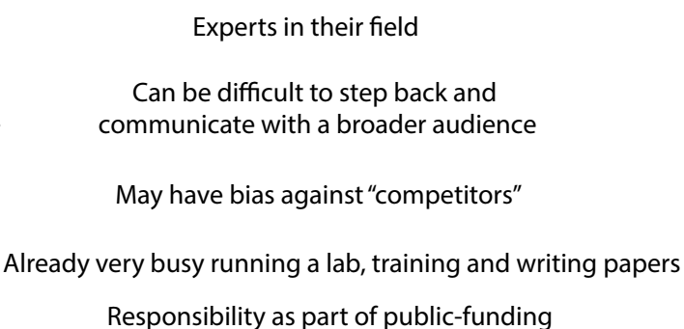
Scientists

Slide 9

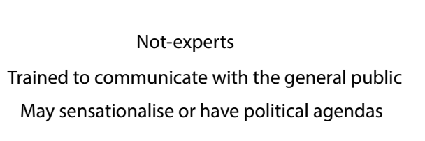

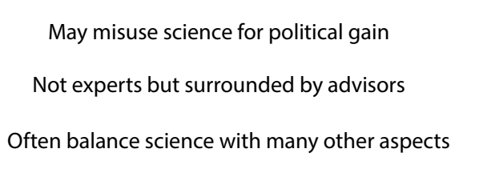
Journalists
Politicians

Slide 10

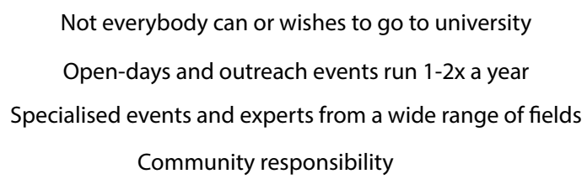

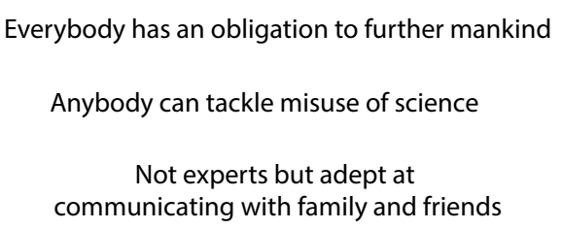
Universities
General public

Slide 11
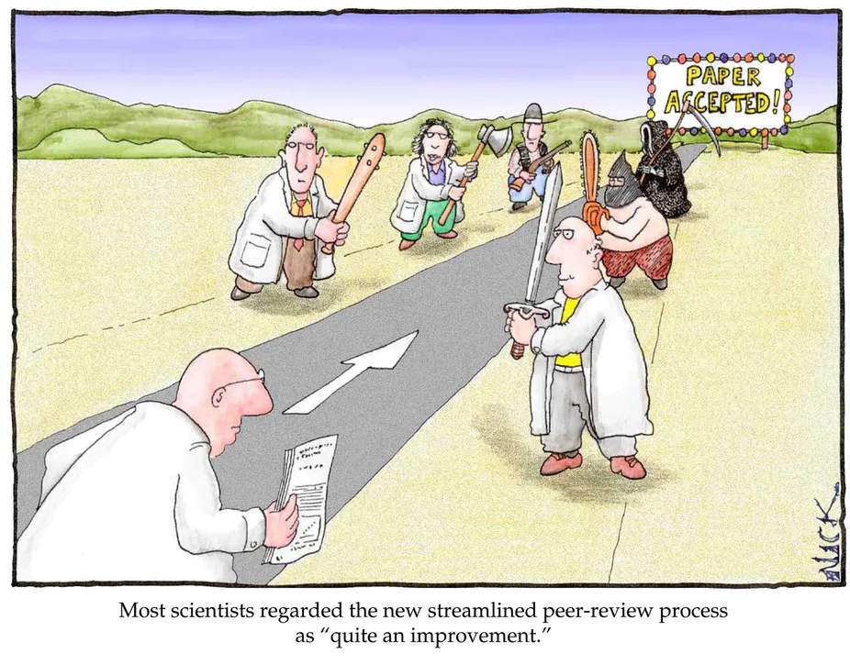
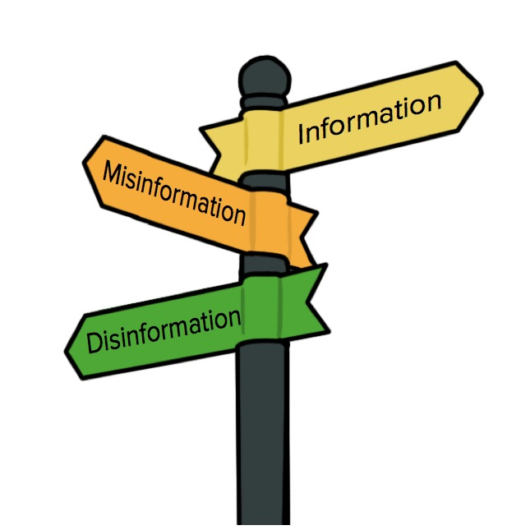

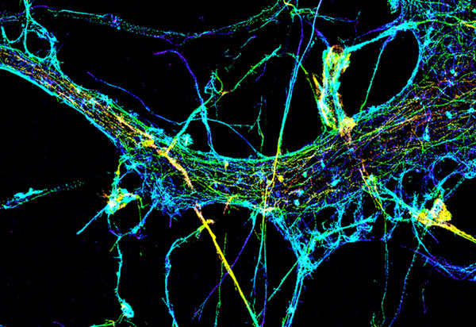
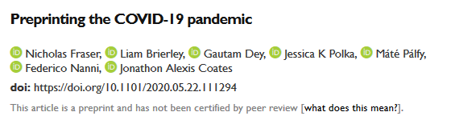
When to sci-comm
Posting a preprint
Paper accepted
Combat misinformation
Read a cool paper you want to share
Share a cool image/movie of your research
Notes:
Preprints -> Sharing on Twitter or other platforms helps to raise the awareness of preprints and also increase readership of the shared work.

Slide 12
How to sci-comm
Include images / videos
Share responsibly
Avoid getting into arguments or interacting with “trolls”
Tailor your content to the platform
Avoid scientific jargon, instead using language that can be easily understood by non-scientists

Slide 13






Platforms
Notes:
Introduce each and briefly overview the positives and negatives of each.
When would you each the different platforms?

Slide 14
Platform for Early Career Researchers who write News & Views type articles to highlight interesting preprints
For example; https://prelights.biologists.com/highlights/the-effect-of-biorxiv-preprints-on-citations-and-altmetrics/
Recruits new ECRs 1-2x a year (or upon enquiry)
Good platform for raising your profile and demonstrating wider writing skills
More formal than some other sci-comm platforms

Slide 15
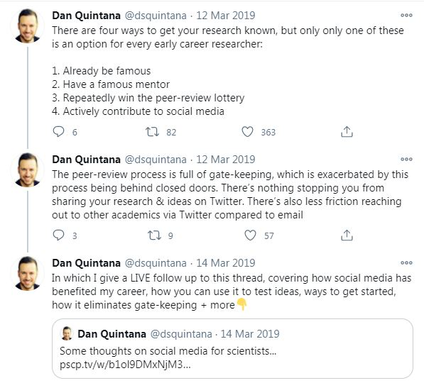
Twitter
Popular platform for scientists and sci-comm
Can be formal or informal, depends on the personality of the user or have multiple accounts
Character count can be limiting, though overcome with threads
Very useful for sharing newly published work or interesting images/movies
Useful tools – Tweetdeck (for scheduling tweets, multiple accounts), gif creator, etc…

Slide 16
Exercise
Take recent preprint and write a thread to share the key findings. What did you choose to include?

Slide 17
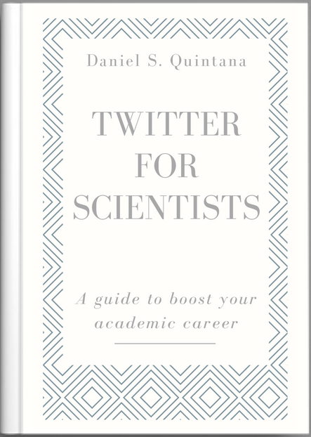
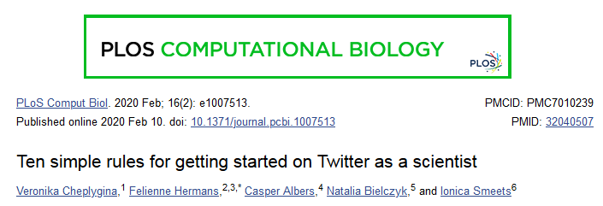

Name your collaborators and co-authors (tag them if they have Twitter)
Link to your preprint or paper directly (bit.ly is useful for this)
Include key results in individual tweets, use images and figures if possible – consider making a gif of the paper figures if allowed
Tag those who helped but may not be authors and any relevant societies or people who would be interested in the work
https://www.natureindex.com/news-blog/ten-tips-tweeting-research-academic
https://www.ncbi.nlm.nih.gov/pmc/articles/PMC7010239/
https://t4scientists.com/

Slide 18
Youtube
Increasingly used following journal acceptance
Often in the form of “whiteboard” time lapse videos
Requires a camera, high-quality audio and some artistic skill
Tools are available (doodly.com or animaker.com) although these are not tailored towards scientists

Slide 19
Exercise
Create a graphical/whiteboard summary on an A3 sheet of paper for a given preprint / your research (discuss what everyone likes about the different summaries)

Slide 20
Youtube exercise tips
Make a script and ensure that it is accessible to non-experts or your target audience
Plan out the final whiteboard image
Keep videos concise (5 minutes max)
Maintain quality throughout, removing distracting background audio and avoiding low quality editing or transitions
Some good examples
https://www.youtube.com/watch?v=frsYEt3GAhA&feature=emb_title
https://www.youtube.com/watch?v=soWx_tuJm_g <- A particularly creative approach

Slide 21

Outreach events
Pint of science / Taste of science
University run outreach events or “discovery” days
These events can be quite varied and creative
Often aimed at people with an interest in science but not experts
Most often in person talks with some questions afterwards

Slide 22
Exercise
Prepare a pint of science talk (5-10 mins) that should be aimed at the general public. Did you convey your message in an easy to understand manner?

Slide 23
Specific points for communicating a preprint
Always communicate that the work has not been peer-reviewed
Link to the full text - preprints are always free to access - and encourage others to read the full article
Utilise hashtags associated with preprints (#preprint), such as the server (#biorxiv)
Ensure you include any necessary caveats to the data, such as limitations to the experiments
If you’re an expert offer critical, but fair and respectful, feedback to the authors
Don’t share if the findings are dubious or if the authors have serious conflicts of interest

Slide 24
Miscommunication and challenging incorrect beliefs/conspiracy theories
First try to understand the root of the conspiracy theory
Focus your counter-argument on the root of the person's belief, not the specific details
Remain calm and do not get personal. Make sure to always be respectful
Sometimes it is simply better to not engage, particularly if the person is trolling or looking for an argument
Use questions to help the other person probe their own beliefs
Always use reliable sources, don’t over-state your position or expertise

Slide 25
Conclusion
Choose the most appropriate platform for sharing
When you post a preprint / paper create a twitter thread of the key points and behind-the-scenes extras
Ensure you share responsibly
Tag any experts or people/groups who might be interested
If you’re comfortable then, respectfully, tackle misinformation

