Slide 1
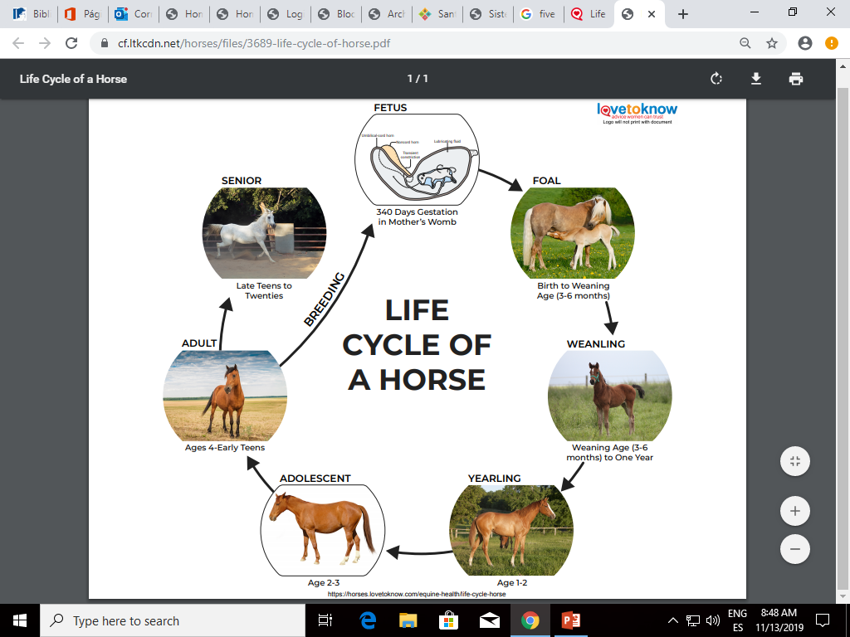
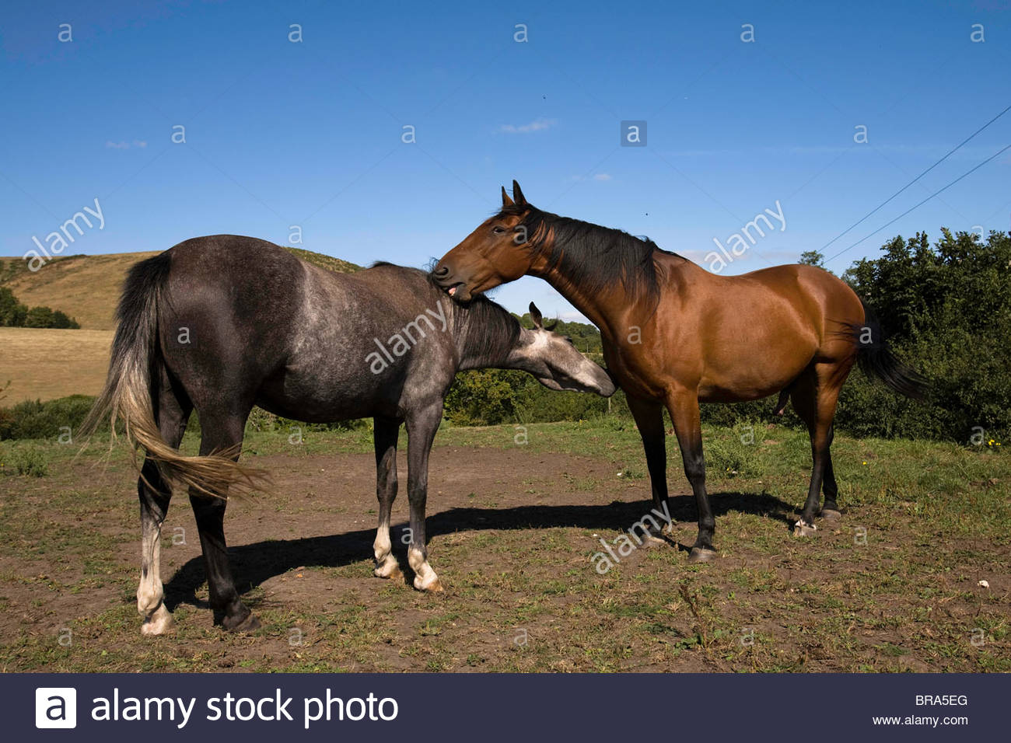
Animals` and human`s life cycle
Name:___________________________________________
Investigate and write 5 short sentences about life cycle of ______________, and study for oral presentation. Bring a set of play dough. Each student has to create his or her investigated animal in class with the play dough and present it in class.
Example:
A horse was born from mother’s womb.
A horse dies when
it is too old.
A horse drinks her mother’s milk.
An adult horse can reproduce and have calves.
A yearling horse doesn’t have his hair, yet.

