Slide 1


Slide 2
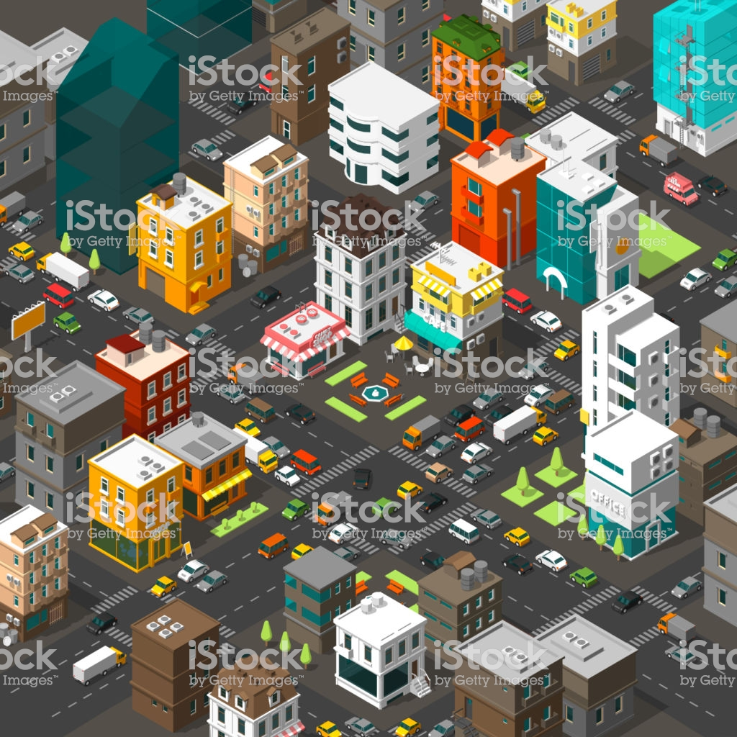
DISTRICT

Slide 3

Government

Slide 4
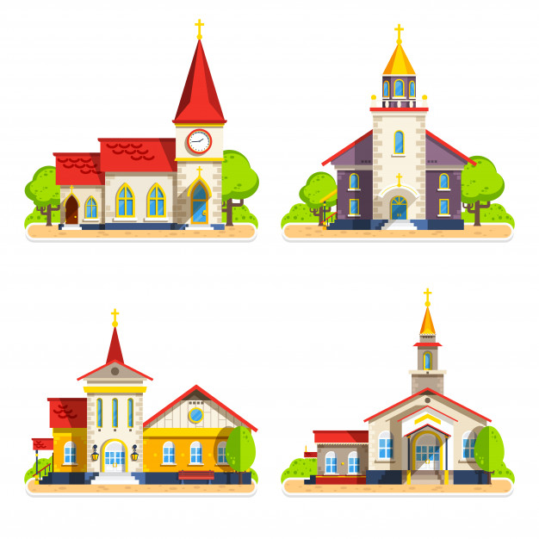
Parish

Slide 5
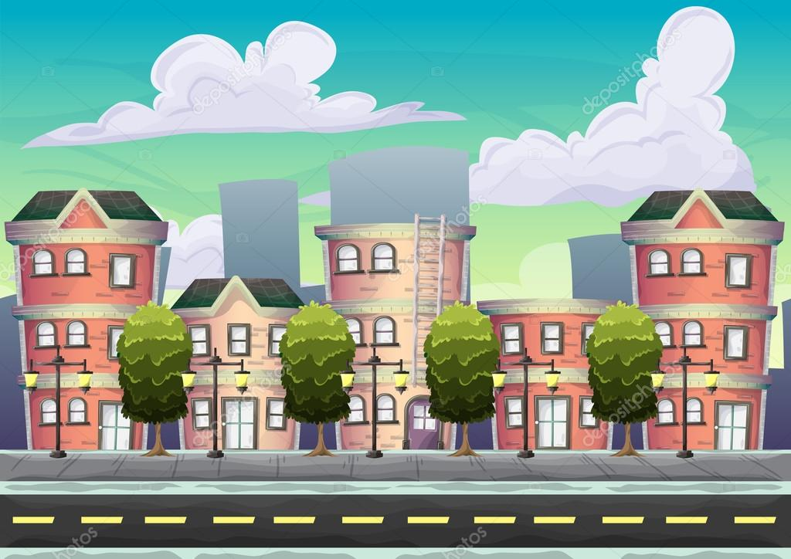
Urban

Slide 6

Rural

Slide 7
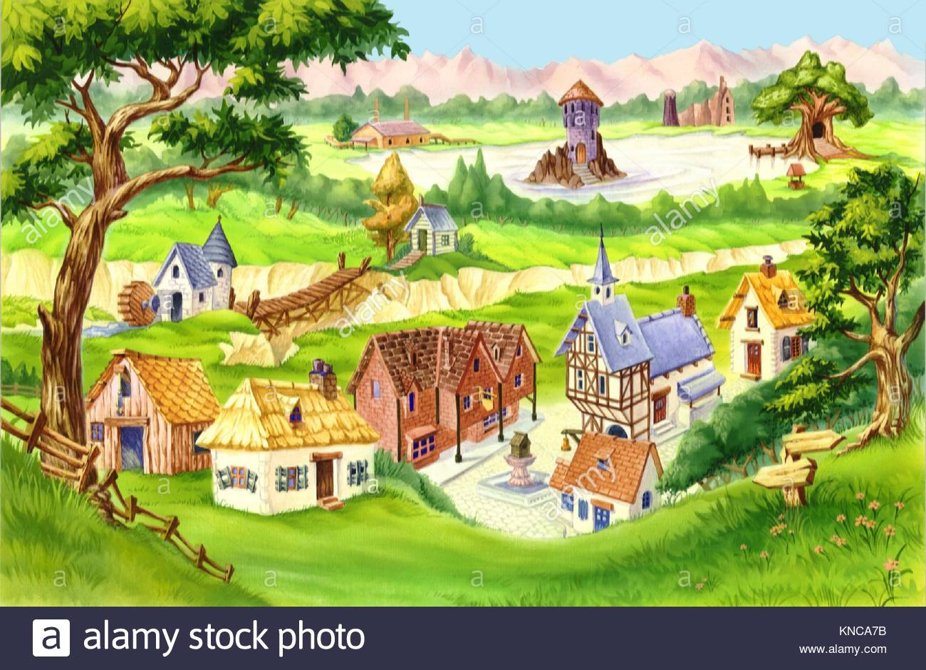
Village

