Slide 1


CodeMind

Slide 2

Call for Code 2019 Challenge
Atul Sarpotdar
Nikhil Chaudhari
Mohini Gonawala

Slide 3

CHALLENGE
More than 70% of India’s population depends on farming to earn their livelihood and 22% of all damage inflicted by natural disasters such as droughts, floods & storms occur in Agri sector.
Disasters jeopardize agricultural production and development and often have cascading negative effects across national economies
More than 80 percent of the damage and losses caused by drought is to agriculture, especially livestock and crop production
challenges we see at high level: (i) improving information systems at the national and local levels; and (ii) further strengthening resilience in agriculture
Notes:
A description of the problem statement you are trying to resolve.

Slide 4
CHALLENGE
Disaster Preparedness & Building Back Better Aftermath –
As mentioned, better information systems are necessary for better disaster preparedness for Agricultural Sector.
Apart from that a protection scheme that would mitigate the risks to the farmers’ yield(s) is critical to sustaining their livelihood. Crop Insurance is a critical risk mitigation tool for the agricultural economy. However in India the penetration and awareness is not there for govt schemes which is hindering efforts for providing cushion and risk coverage for farmers against the various natural disasters.
The challenge is how to address –
Better Disaster Preparedness for Farmers through Weather/ Disaster Alerts
Better Awareness and Outreach for Crop Insurance Schemes
Recovery of Farmers after Natural Disasters and getting their life back to normal as early as possible
Notes:
A description of the problem statement you are trying to resolve.

Slide 5
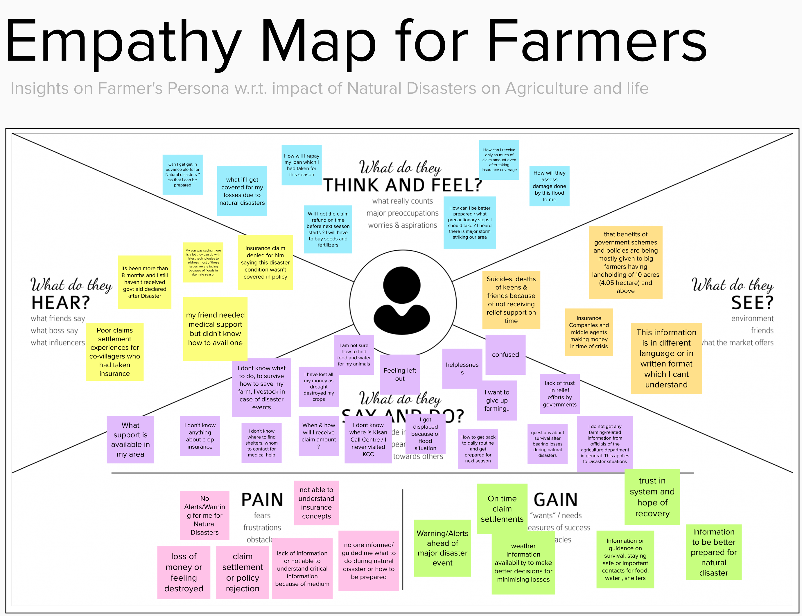
Notes:
Add your digital empathy maps here
Duplicate this slide as needed

Slide 6
TECHNOLOGY SUGGESTIONS
IBM Watson (AI Platform) – for deploying cognitive virtual assistant i.e. ChatBot to interact with customers
IBM Speech to Text and Text to Speech Services to convert audio and voice into text and vice versa.
IBM Discovery Service offers a cognitive search and content analytics engine to applications to identify patterns, trends and actionable insights that drive better decision-making. Securely unify structured and unstructured data with pre-enriched content, and use a simplified query language to eliminate the need for manual filtering of results.
IBM Blockchain Platform helps to accelerate blockchain network with tools to develop, govern & operate decentralized ecosystems
Hyperledger Fabric - Hyperledger Fabric allows components, such as consensus and membership services, to be plug-and-play. Hyperledger Fabric leverages container technology to host smart contracts called “chaincode” that comprise the application logic of the system
IBM Weather Data – to provide weather alerts/notifications and forecasting
IBM Cloudant – A distributed database based on Apache CouchDB for storing documents etc.
IBM Cloud Platform for providing high availability, more security and scalability for this ecosystem
Node.js
IBM Push Notifications - to popup alerts on the mobile & web
Notes:
A raw list of technology that can be used to implement the solution, as well as alternatives. Mention any base code pattern, IBM Cloud service offerings, open source technologies, infrastructure etc.

Slide 7
Why we need a better SOLUTION ?
A quick summary of gaps for current Disaster Preparedness and Recovery for Farmers –
Dependency on Govt officials for basic information related to Disaster Preparedness and Recovery/Response measures such as (financial, Livestock Related, shelters & store room locations etc. during disaster event)
Overall lack of awareness about Crop Insurance concept and Adoption of same
Absence of an efficient ecosystem across the entire insurance process
State govt and Central Govt not paying their part of Insurance Premiums on time resulting in further delays of claim settlement
Lack of transparency and speed in claims administration which is hindering efforts of Farmer’s recovery post disaster and in building trust in overall ecosystem
Notes:
Depict the journey of the persona

Slide 8
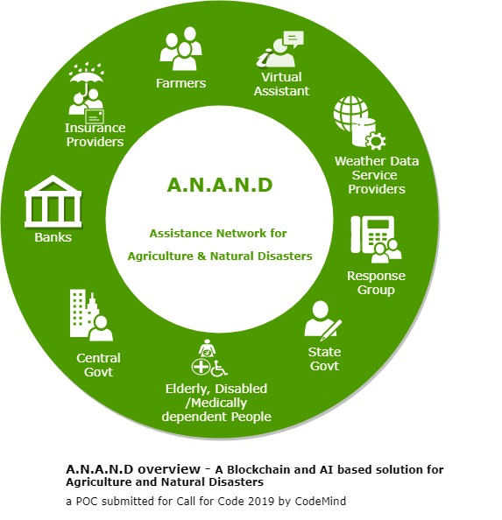
HOW A.N.A.N.D. CAN HELP US ?
Assistance Network for Agriculture and Natural Disaster i.e. A.N.A.N.D. builds an ecosystem/network with combined use of multiple technology platforms available today and provides a technical solution we are looking for
Notes:
Describe the approach of resolving the challenge identified & the outcomes

Slide 9
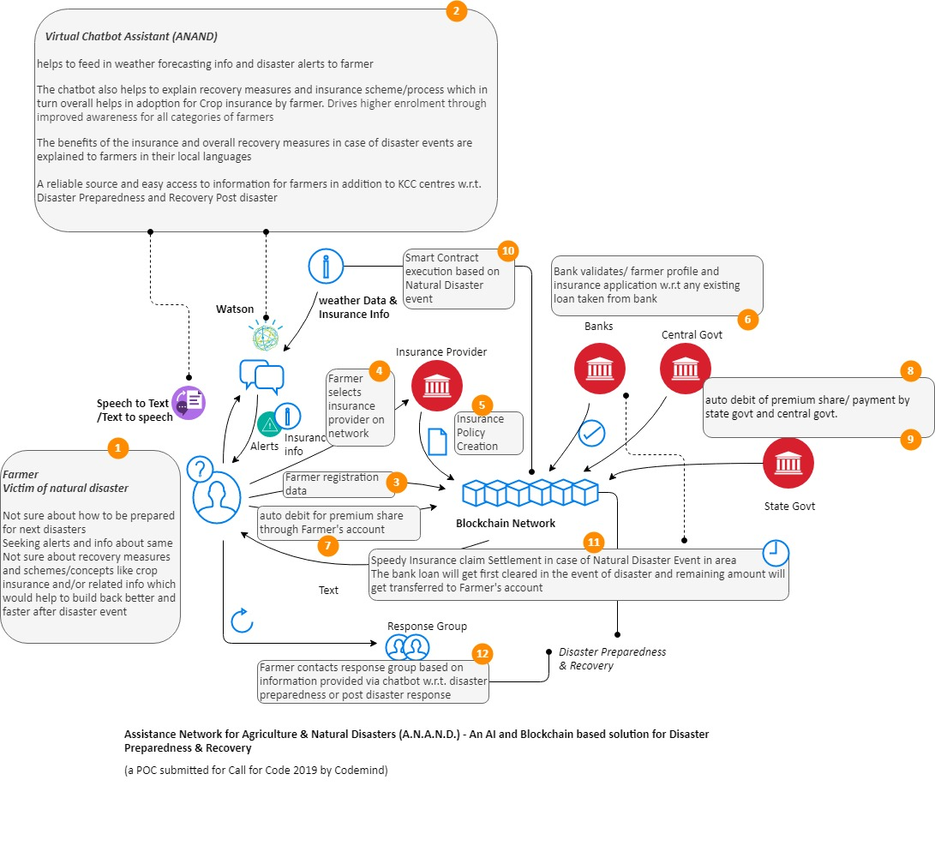
SOLUTION APPROACH TO-BE FLOW
Notes:
Describe the approach of resolving the challenge identified & the outcomes

Slide 10
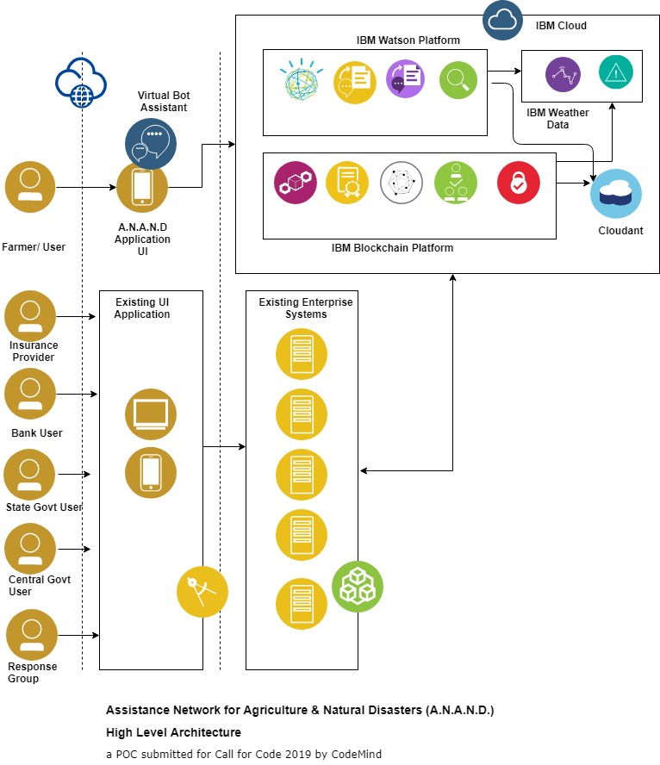
High Level Architecture
Notes:
Add architecture diagrams as applicable, e.g. – overall architecture, sequence, deployment etc.

Slide 11
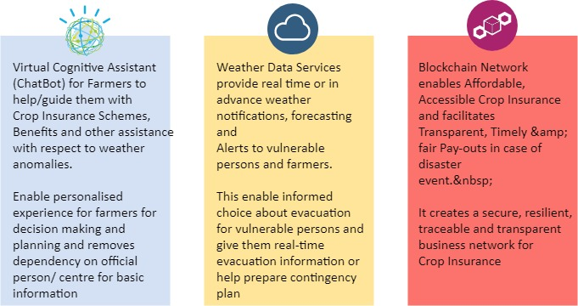
A.N.A.N.D. FEATURES
virtual assistant (Bot) can assist with respect to any required insurance related or weather-related information/alerts for overall enablement and confidence building AND
Blockchain can create that trust in the process
They don’t have to understand insurance; they just need to know they are protected and taken care of when disaster strikes.
Notes:
Drive higher enrolment through improved awareness for all categories of farmers

Slide 12
KEY FEATURES
Key Features
Better Disaster Preparedness through cognitive services and weather alerts and forecasting.
Drive higher enrolment for govt schemes like PMFBY through improved awareness via ChatBot for all categories of farmers which will eventually help them recover and build back faster.
The cognitive assistant will also help farmers with info w.r.t. shelters, store room locations, disaster preparatory/recovery kits via Response Groups.
The platform will facilitate automatic, speedy and accurate claim settlements through Smart Contracts as soon as the incidence is triggered into the Blockchain (not requiring the claims to be registered).
All payments to be directly credited to the farmer’s bank accounts. Also premium payment can be automatically triggered from Farmer’s bank account. UPI payment interface can be used for these transactions.
Personalized experience through Speech To Text & Text to Speech services for easy and effective access to information
Notes:
Describe the approach of resolving the challenge identified & the outcomes

Slide 13
SOURCE CODE
Source Code - https://github.com/asarpotdar/cfc-anand
ChatBot Preview Link –
https://assistant-chat-eu-gb.watsonplatform.net/web/public/f9f61995-57d6-4490-b37e-9f2a3a75a746
Demo Link –
https://www.youtube.com/watch?v=L_xqOwT2QTg
Notes:
Add GIT link

Slide 14
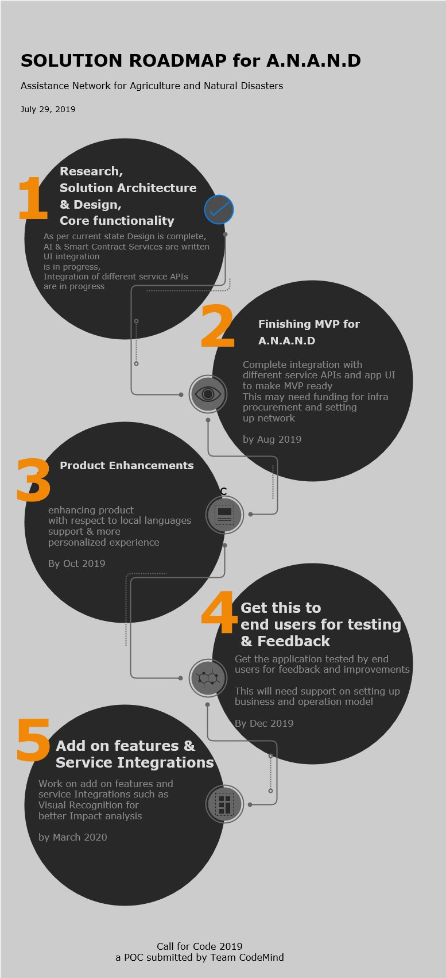
WHERE TO GO FROM HERE ? Here is solution roadmap
Notes:
Add GIT link

Slide 15
RECOMMENDED RESOURCES
Documents
https://www.linkedin.com/pulse/blockchain-potential-game-changer-indias-crop-insurance-das
http://www.fao.org/3/a-i5128e.pdf
https://economictimes.indiatimes.com/news/economy/agriculture/why-crop-insurance-schemes-fail-poor-farmers-when-they-are-needed-the-most/articleshow/47052185.cms?from=mdr
Notes:
Add GIT link

