Slide 1

Institut für Maschinelle Sprachverarbeitung
Understanding
how speaker recognition systems break anonymisation
Author: Sergei Ukhov
Supervisors: Ünal Ege Gaznepoglu, Sarina Meyer
Examiners: Prof. Dr. Thang Vu, Dr. Antje Schweitzer

Slide 2
Motivation

Slide 3
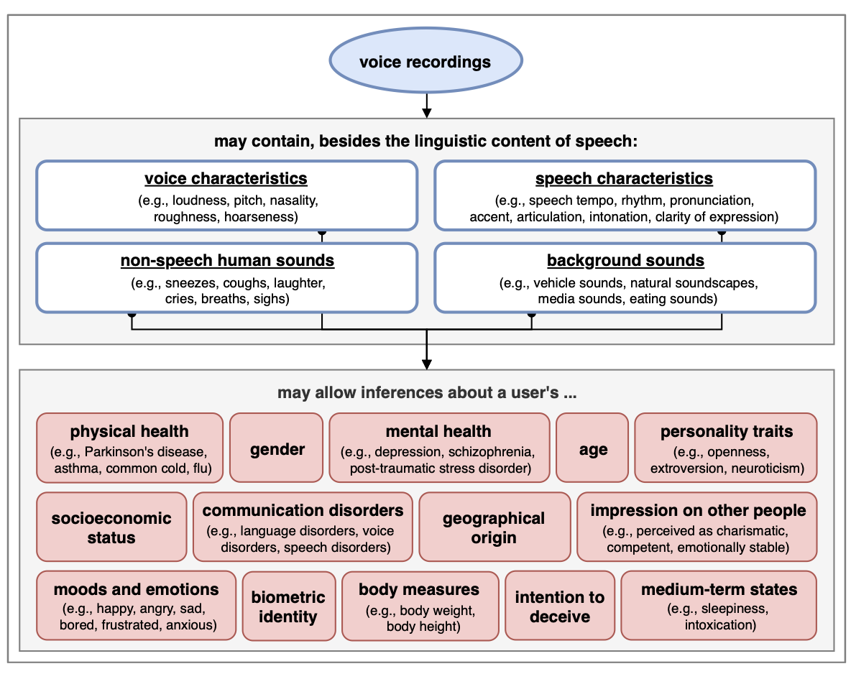
Voice as a Biometric Identifier
Overview of some sensitive attributes discernable from speech data (Kröger et al., 2019).

Slide 4
Voice Anonymisation
The altering of the speaker’s voice to conceal their identity, while leaving all other content (e.g. linguistic, emotion) intact.
Formalised as a task through a series of biennial VoicePrivacy Challenges.

Slide 5
Anonymised Speech ≠ Guaranteed Privacy (for all)
Despite the progress made in developing voice anonymisation systems, speaker identity leakage persists even in the best anonymisation systems to date.
Some speakers are easier to deanonymise than others.
Little work has focused on developing a deep understanding of how anonymisation fails.
Recent work (Gaznepoglu et al., 2025) has shown the feasibility of using semantic information to deanonymise speakers via text-based attackers.
Is this also the case of audio-based attacks?

Slide 6
Methodology

Slide 7
Research Objective: to use Integrated Gradients (Sundararajan et al., 2017) to investigate linguistic-based voice privacy vulnerabilities by examining two architecturally different ASV systems, i.e. ECAPA-TDNN (Desplanques et al., 2020) and WavLM (Chen et al., 2022) in the context of:
Two anonymisation systems: B3 (Meyer et al., 2023), and B5 (Champion, 2023);
Three attack scenarios: unprotected (OO), ignorant (OA), and semi-informed (AA);
Three levels of linguistic analysis: phone, word, part-of-speech.

Slide 8
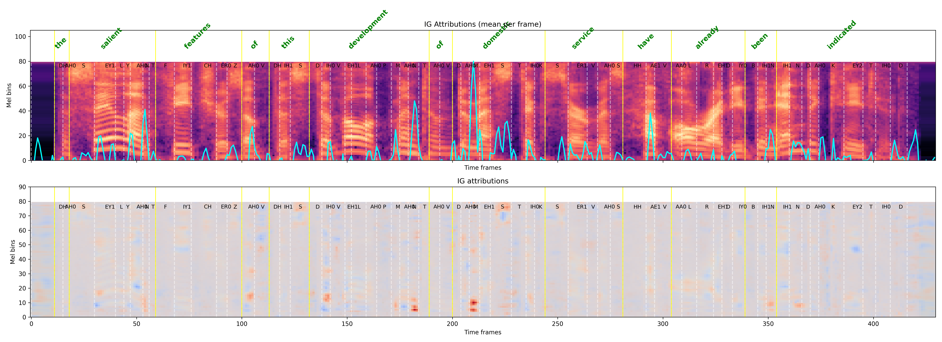
Example of IG Attributions
An example of IG attributions of the ECAPA-TDNN ASV system for a B3-anonymised utterance.

Slide 9
Research Hypotheses
H1 : Attacker models based on the self-supervised contextualised embeddings will achieve a considerably higher speaker verification success rate than models relying primarily on low-level acoustic features.
H2 : Voice privacy attackers with different architectures will exhibit significantly different attribution patterns over linguistic features, as measured by Integrated Gradients attributions.
H3 : Due to the preservation of the original prosody, the B5 anonymisation system will retain significantly more speaker-identifiable phonetic information than the B3 anonymisation system, as reflected in high and consistent Integrated Gradients attributions at the phone level.

Slide 10
Results

Slide 11
H1: Attacker models based on the self-supervised contextualised embeddings will achieve a considerably higher speaker verification success rate than models relying primarily on low-level acoustic features.

Slide 12
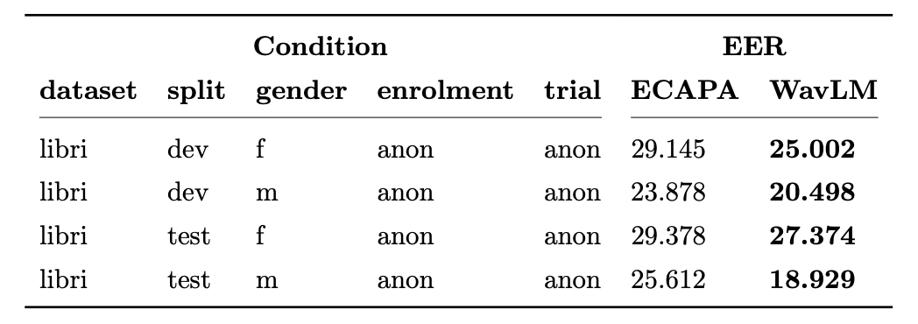
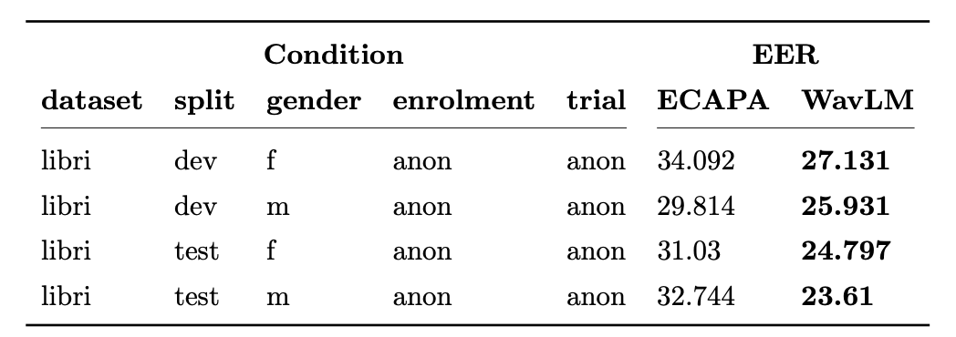
Evaluation Results
B3 system
B5 system

Slide 13
H2 : Voice privacy attackers with different architectures will exhibit significantly different attribution patterns over linguistic features, as measured by Integrated Gradients attributions.

Slide 14
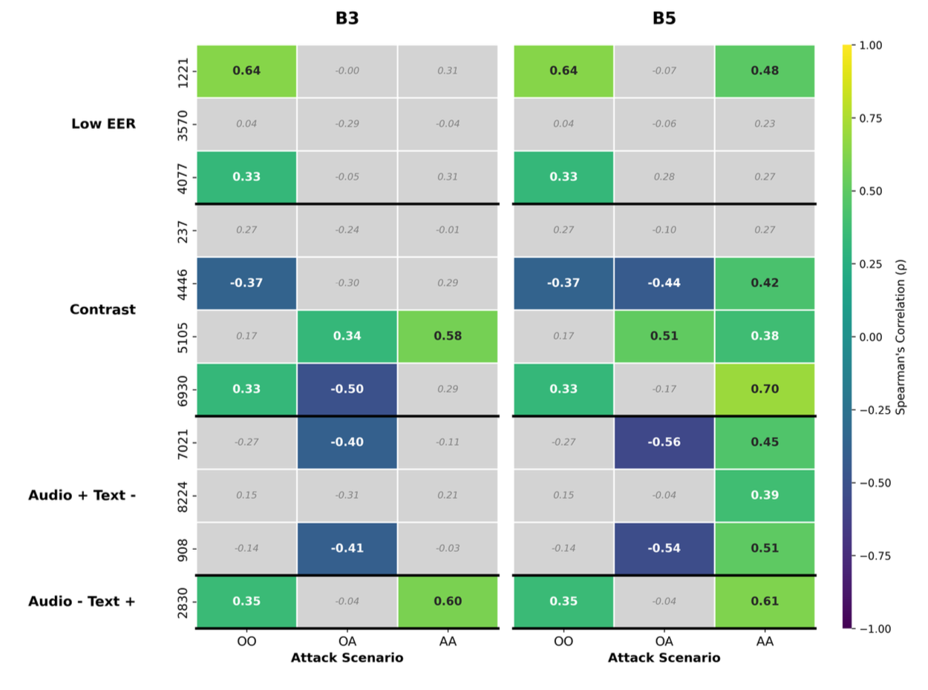
Inter-attacker Correlation: Phone Level
Spearman’s correlation of WavLM and ECAPA-TDNN speaker-level phone rankings for the B3 (left) and B5 (right) anonymisation systems.

Slide 15
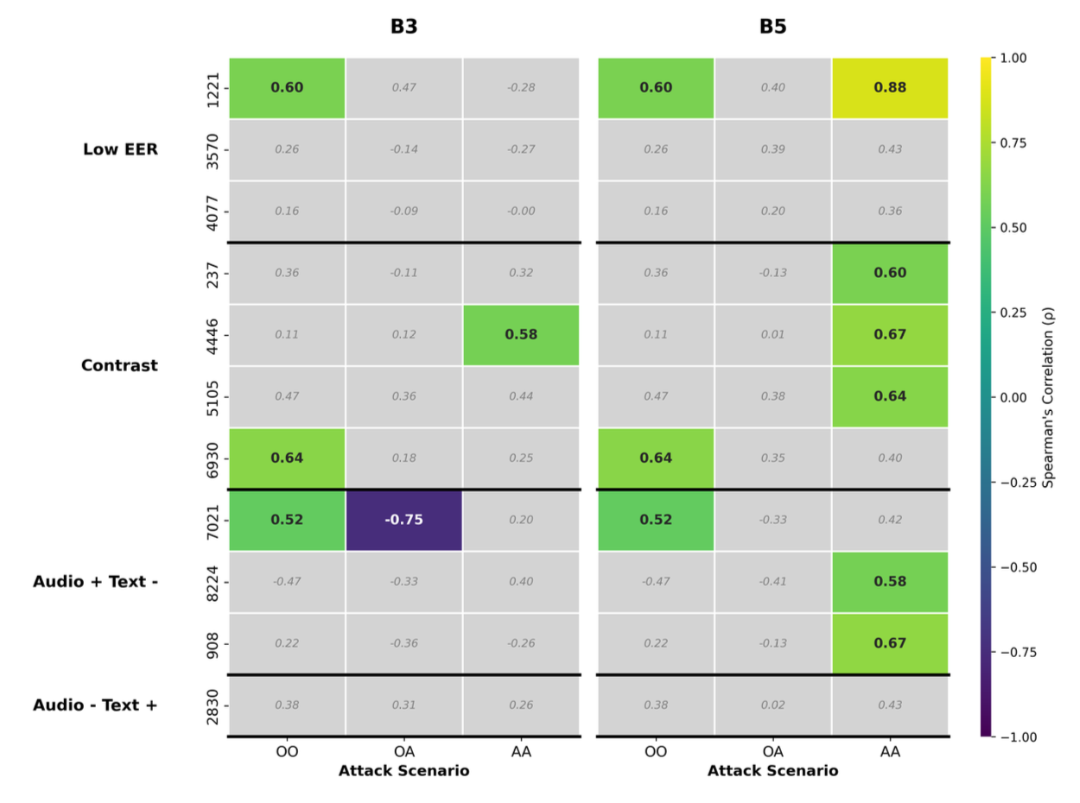
Inter-attacker Correlation: POS Level
Spearman’s correlation of WavLM and ECAPA-TDNN speaker-level POS rankings for the B3 (left) and B5 (right) anonymisation systems.

Slide 16
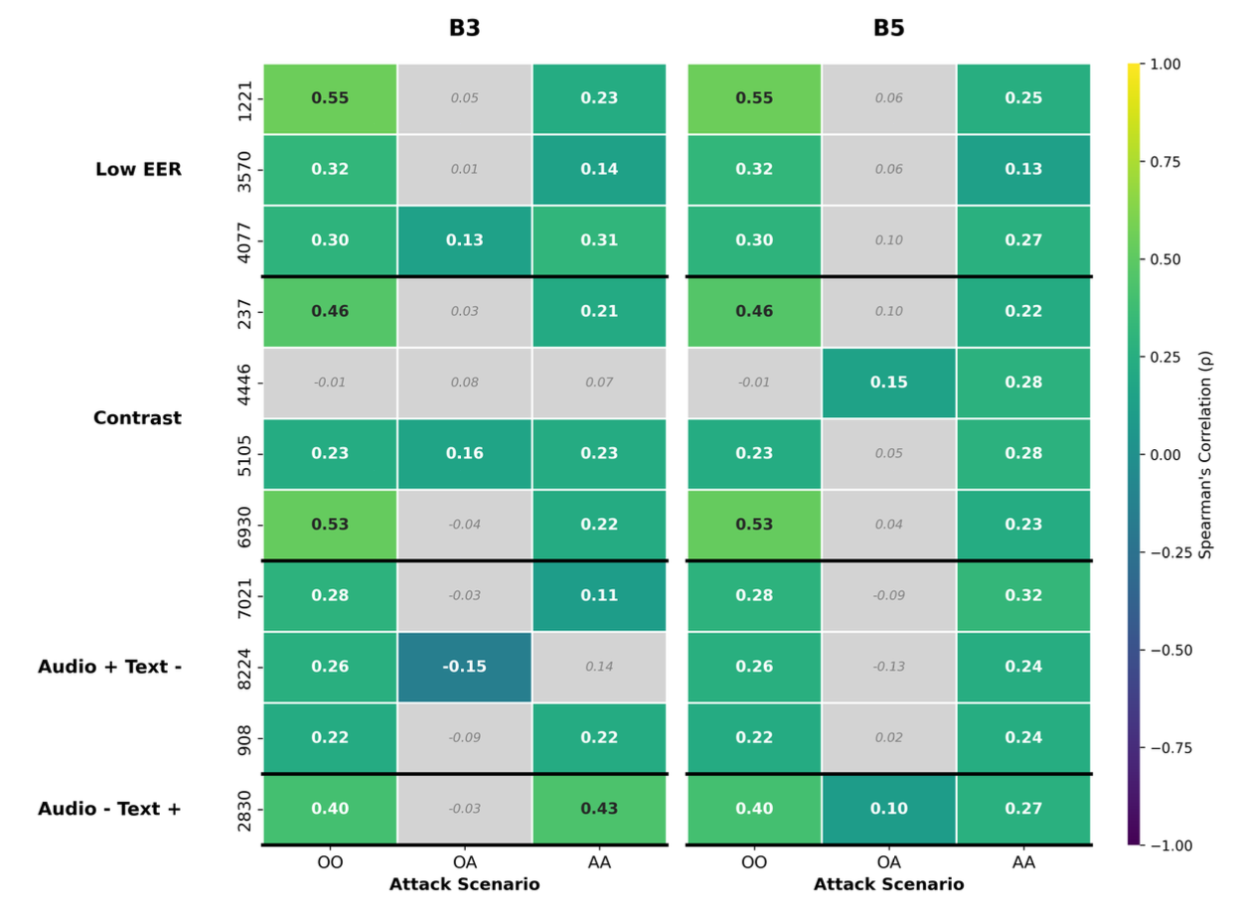
Inter-attacker Correlation: Word Level
Spearman’s correlation of WavLM and ECAPA-TDNN speaker-level word rankings for the B3 (left) and B5 (right) anonymisation systems.

Slide 17
H3 : Due to the preservation of the original prosody, the B5 anonymisation system will retain significantly more speaker-identifiable phonetic information than the B3 anonymisation system, as reflected in high and consistent Integrated Gradients attributions at the phone level.

Slide 18
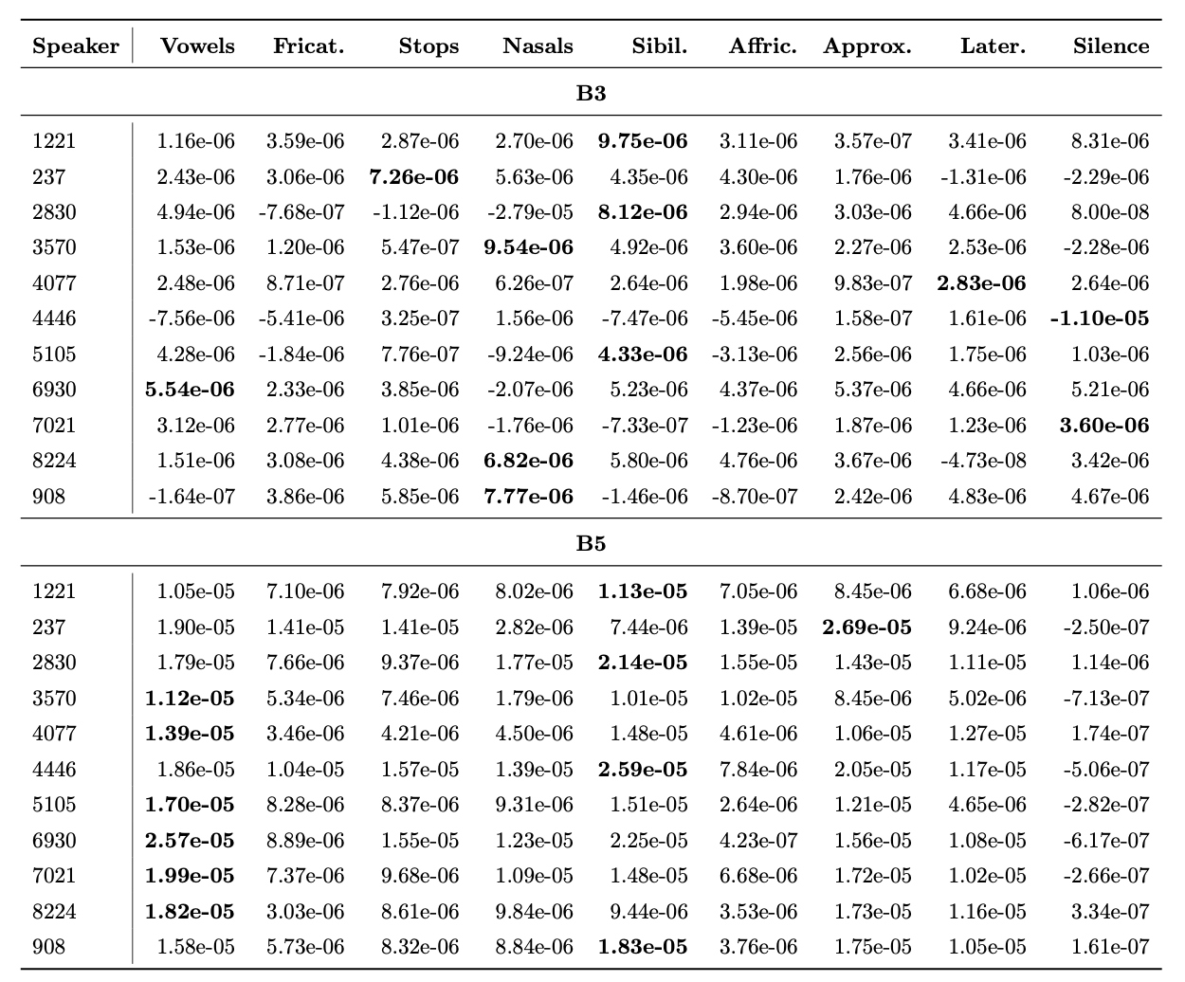
Average IG attributions by phone category in the semi-informed ECAPA-TDNN attack scenario.

Slide 19
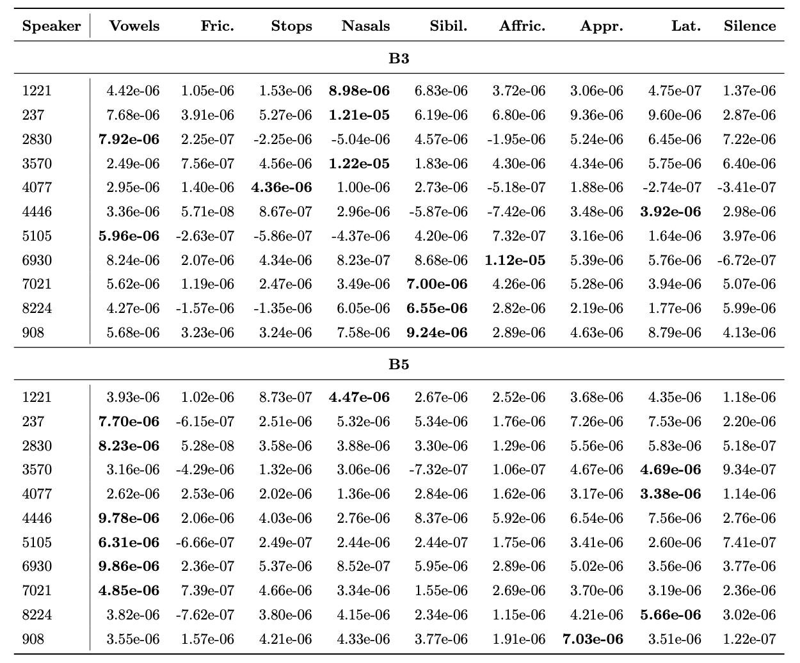
Average IG attributions by phone category in the context of the semi-informed WavLM attack scenario.

Slide 20
Conclusions
Exposure to anonymisation reduces architectural biases and drives attackers toward a shared, phonetics-driven strategy for identifying speakers.
B5 fails to sufficiently obscure vowel information, allowing both attackers to consistently exploit these segments as strong speaker cues.
B3 assigns high importance to silent regions, suggesting that artefacts in silent segments drive unintended speaker discrimination.
Speaker identity leakage is not necessarily tied to complex semantic representations but persists through relatively simple and robust phonetic patterns.

Slide 21
References
P. Champion, “Anonymizing speech: Evaluating and designing speaker anonymization techniques,” Ph.D. dissertation, Université de Lorraine, 2023.
S. Chen et al. (2022). ‘WavLM: Large-Scale Self-Supervised Pre-Training for Full Stack Speech Processing’. In: IEEE Journal of Selected Topics in Signal Processing.
B. Desplanques et al. (2020). ‘ECAPA-TDNN: Emphasized Channel Attention, Propagation and Aggregation in TDNN Based Speaker Verification’. In: Proc. Interspeech Conf.
U. E. Gaznepoglu et al. (2025). ‘You Are What You Say: Exploiting Linguistic Content for VoicePrivacy Attacks’. In: Proc. Interspeech Conf.
J. L. Kröger et al. (2020). ‘Privacy Implications of Voice and Speech Analysis – Information Disclosure by Inference’. In: Privacy and Identity Management. Data for Better Living: AI and Privacy: 14th IFIP WG 9.2, 9.6/11.7, 11.6/SIG 9.2.2 International Summer School, Windisch, Switzerland, August 19–23, 2019, Revised Selected Papers. Ed. by M. Friedewald et al. isbn: 978-3-030-42504-3.
S. Meyer et al. (2023). ‘Prosody Is Not Identity: A Speaker Anonymization Approach Using Prosody Cloning’. In: Proc. IEEE Intl. Conf. on Acoustics, Speech and Signal Processing (ICASSP).
M. Sundararajan et al. (2017). ‘Axiomatic Attribution for Deep Networks’. In: Proc. Intl. Conf. on Machine Learning (ICML).

