Slide 1
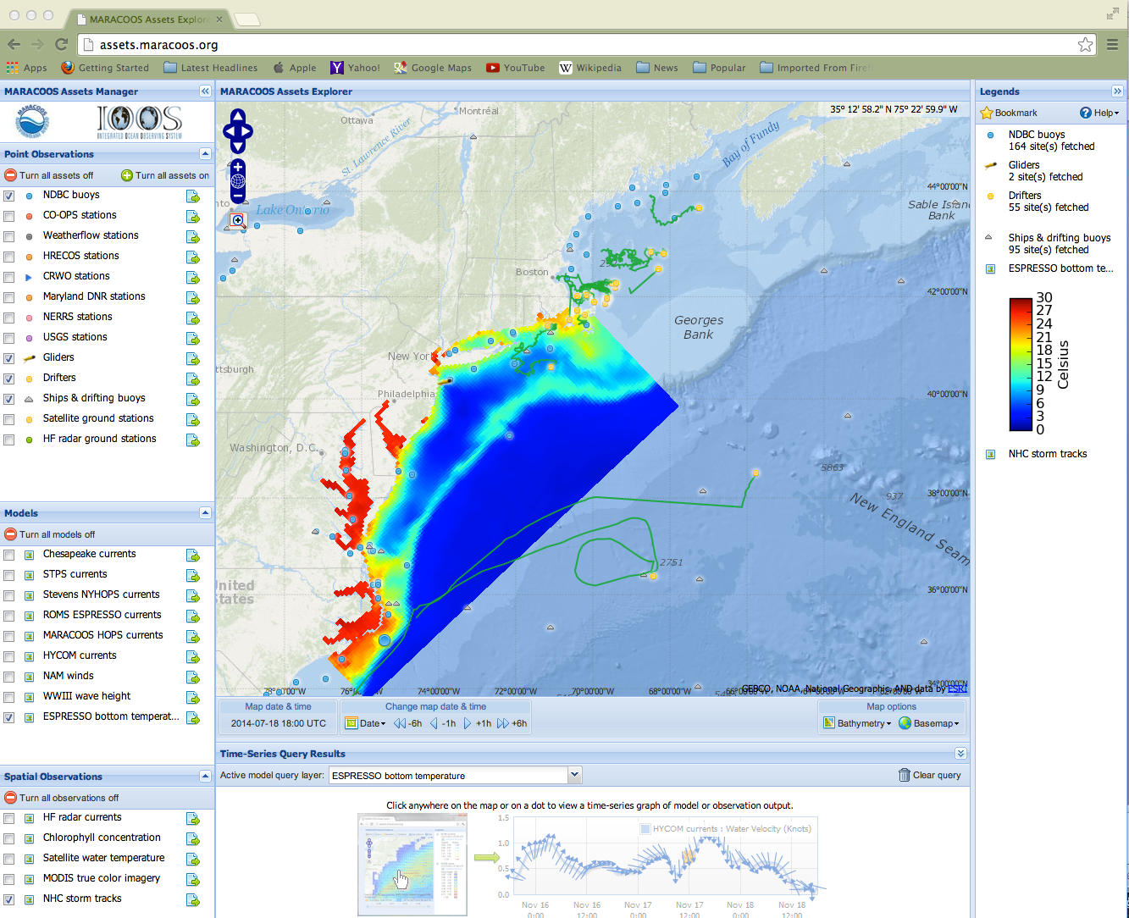
One popular gui, used by ocean types as part of the Mid-Atlantic IOOS community
Time series of a
Selected assett
http://assets.maracoos.org/
Can turn on and turn off layers.

Slide 2
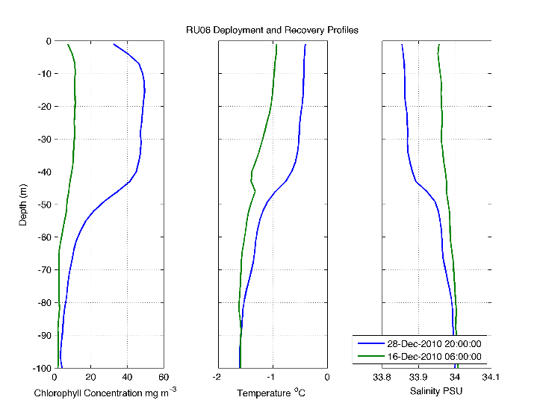
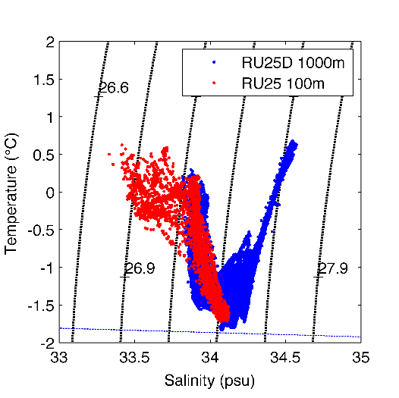
X-Y plots
Depth profiles are critical
Temperature & salinity plots
Highlighting a specific section (red vs blue)
Probably not useful

Slide 3
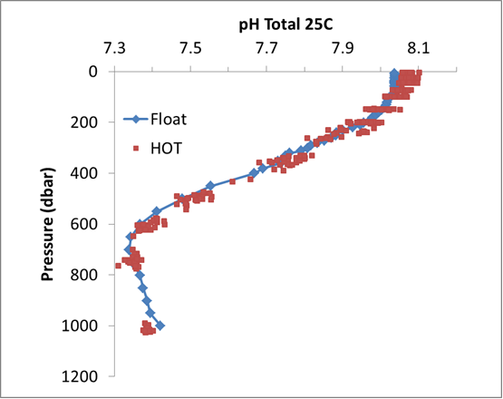
Multiple measurements from different systems in the
Same general area.

Slide 4
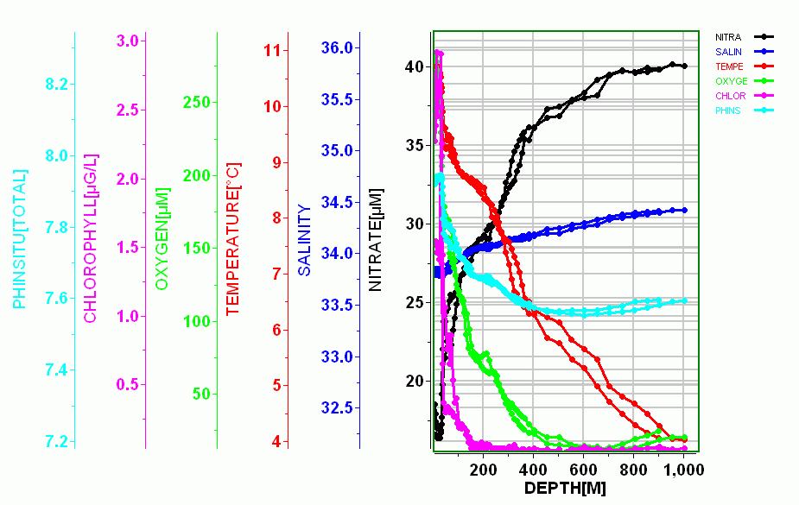
Plotting different parameters on a 2D plot

Slide 5
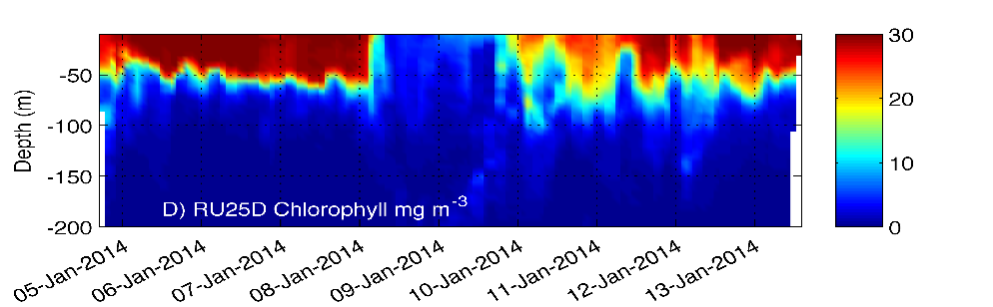
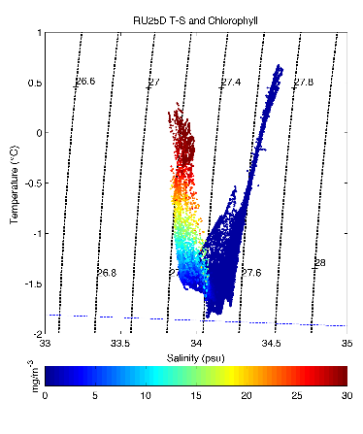
Examples of what “users” will want to visualize
X-Y-Z plots
X-axis could be time, location (lat or long) depending on the question
-examples can be found
http://marine.rutgers.edu/cool/auvs/index.php?did=419&view=imagery
Another type of an X-Y-Z, temperature-salinity and another variable measured with another sensor on the same package

Slide 6
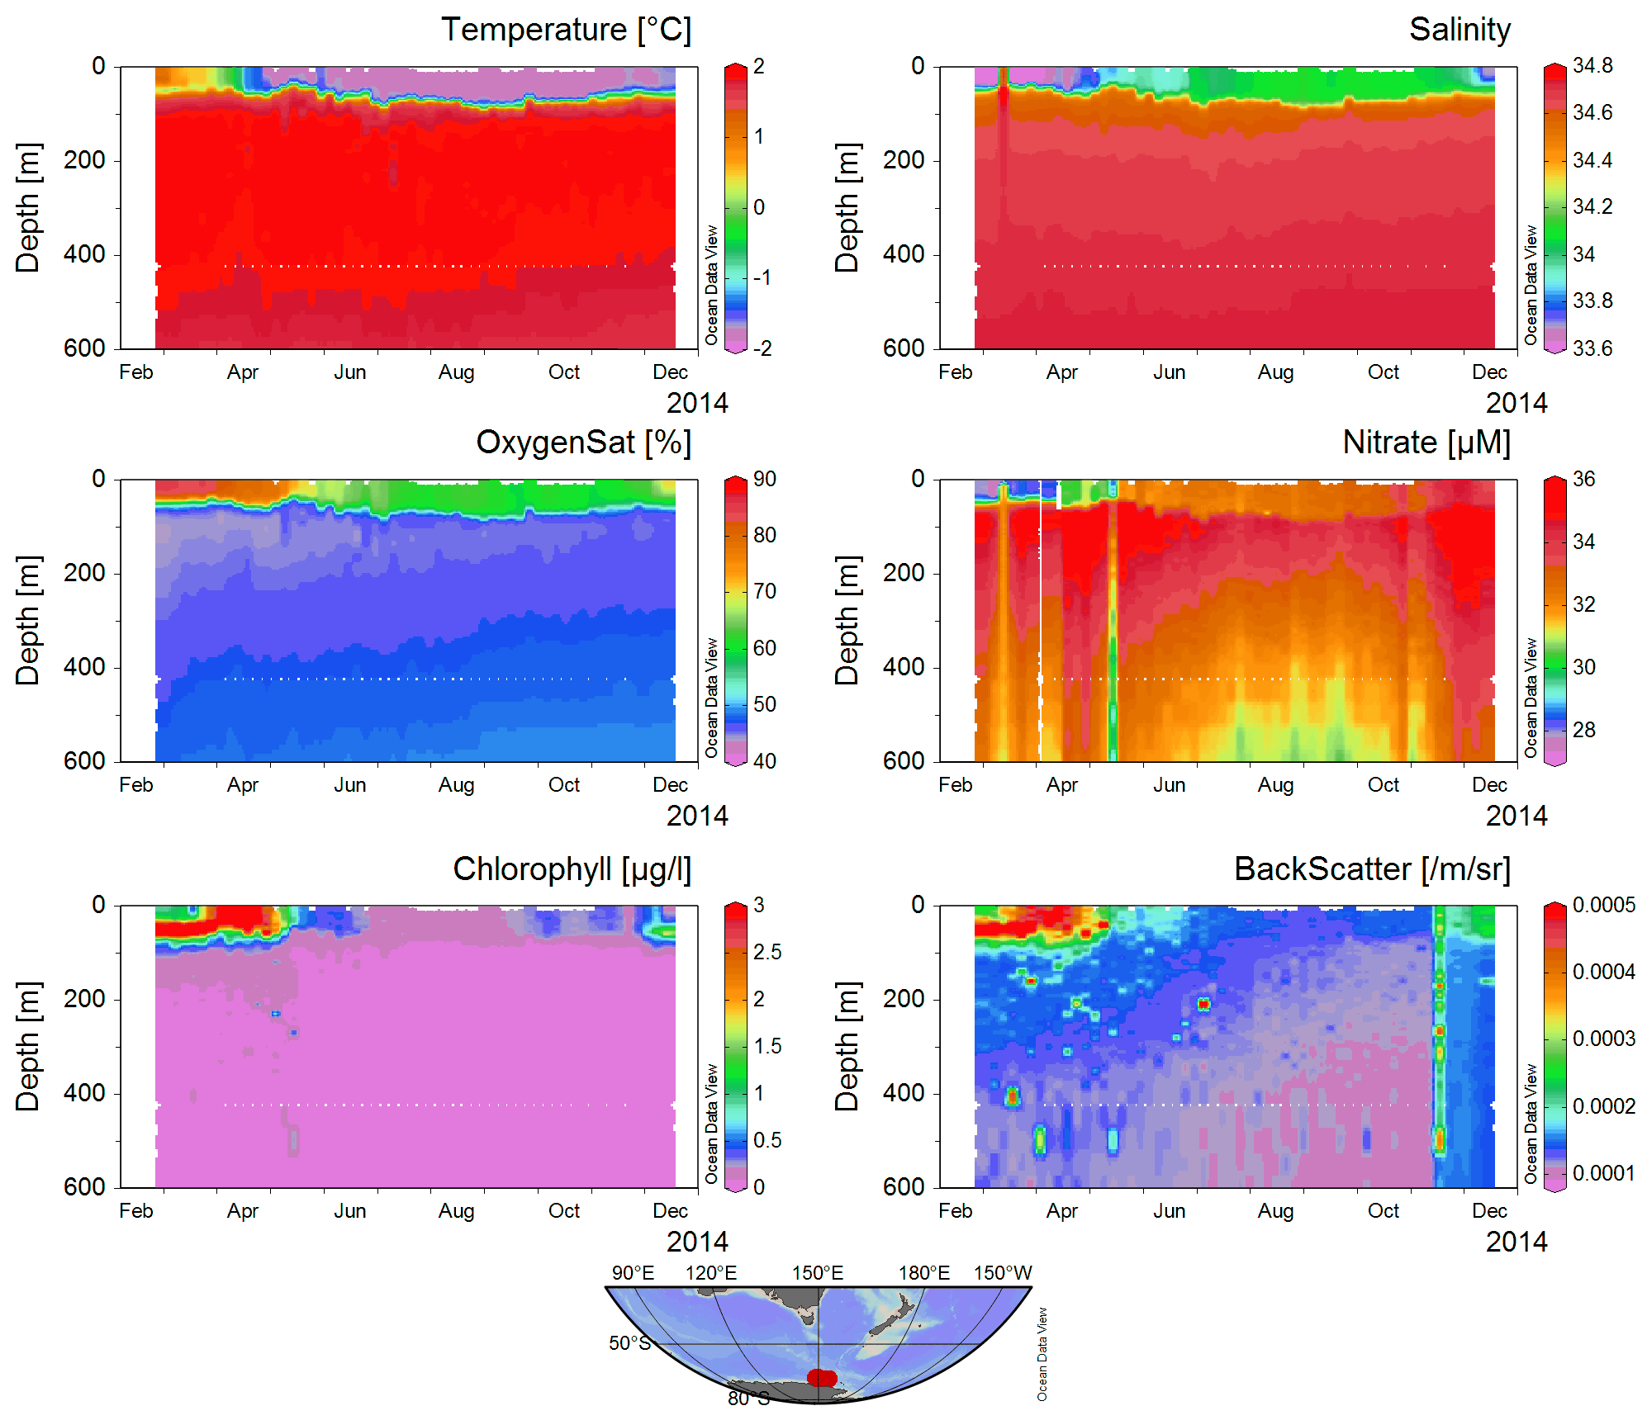
Multiple panels and location,
Data from a profiling float

Slide 7
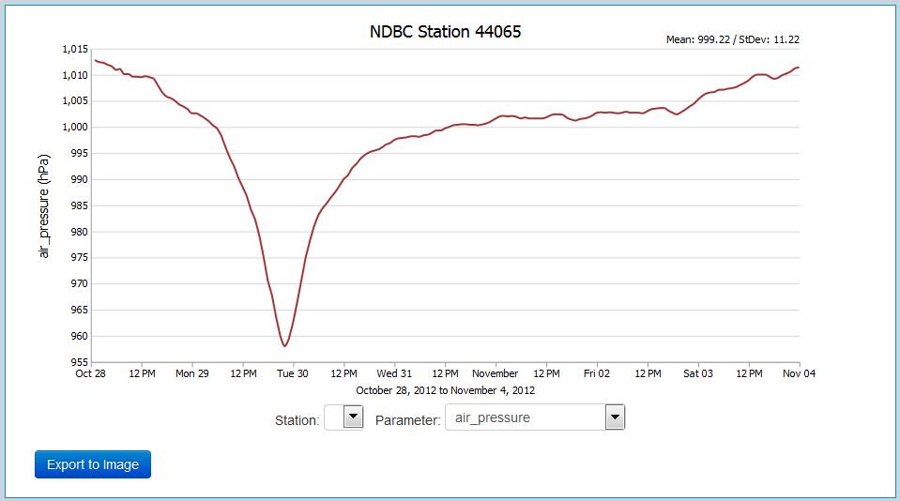
Example of the OOI Education Team’s simple time series visualization

Slide 8
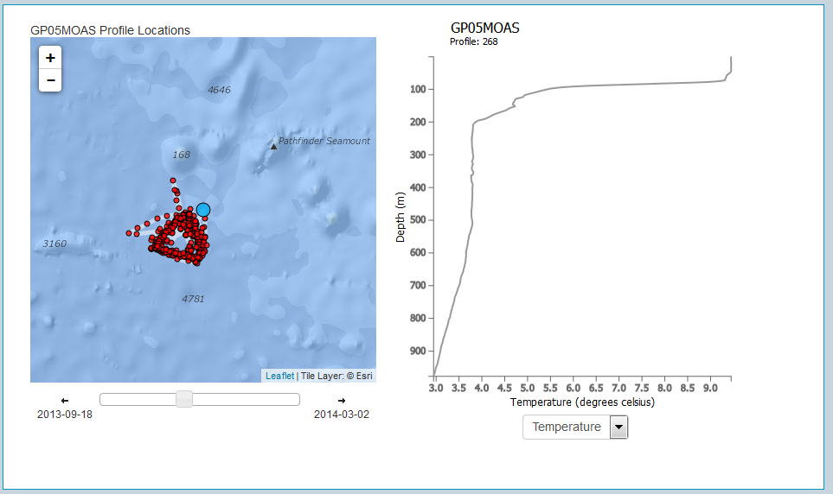
Example of the OOI Education Team’s Glider profiler explorer.

Slide 9
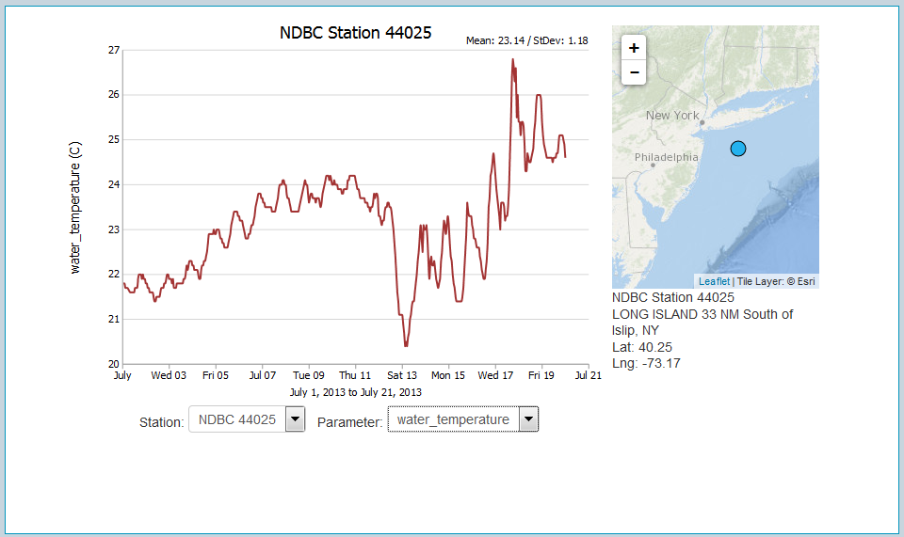
Example of the OOI Education Team’s simple time series visualization with interactive map

Slide 10
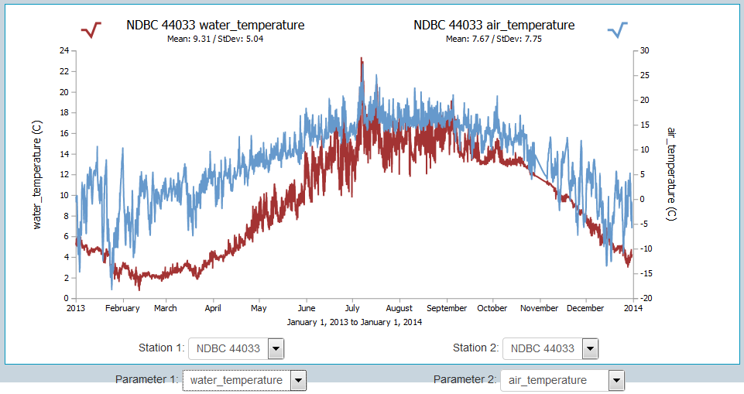
Example of the OOI Education Team’s dual time series visualization

