Slide 1
Denoising Self-Attentive Sequential Recommendation
Huiyuan Chen, Yusan Lin, Menghai Pan, Lan Wang, Chin-Chia Michael Yeh, Xiaoting Li, Yan Zheng, Fei Wang, Hao Yang
RecSys Best Paper 2022
Докладчик: Кристина Желтова
#recommender_systems: https://t.me/ods_recommender_systems

Slide 2
Introduction - Sequential Recommendation
Sequential recommendation aims to recommend the next item based on a user’s historical actions
Early Markov Chain models have been proposed to capture short-term item transitions
Many deep neural networks have been proposed to model the entire users’ sequences and achieve great success

Slide 3
Introduction - Sequential Recommendation
Inspired by the success of Transformers, several self-attentive sequential recommenders have been proposed and achieve the SOTA performance
Many real-world item sequences are naturally noisy, containing both true-positive and false-positive interactions
Vanilla self-attention network is not Lipschitz continuous¹, and is vulnerable to the quality of input sequences
In the tasks of LM, people found that a large amount of BERT’s attentions focus on less meaningful tokens, like "[SEP]"
¹ Roughly speaking, a function is Lipschitz continuous if changing its input by a certain amount will not significantly change its output

Slide 4
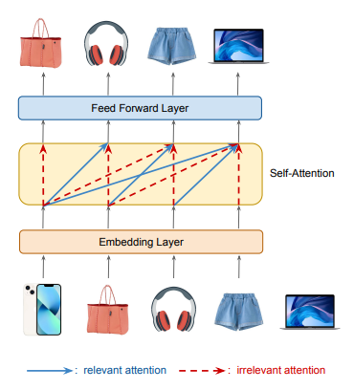
Introduction - Sequential Recommendation
In the setting of sequential recommendation, we intend to infer the next item
However, correlations among items are unclear
A trustworthy model should be able to only capture correlated items while ignoring these irrelevant
Existing self-attentive sequential models (e.g., SASRec¹ and BERT4Rec²) are insufficient to address noisy items within sequences
¹ Доклад Василия Челпанова по модели SASRec в рамках Reading Group
² Доклад Андрея Семенова по модели BERT4Rec в рамках RecSys Reading Group

Slide 5
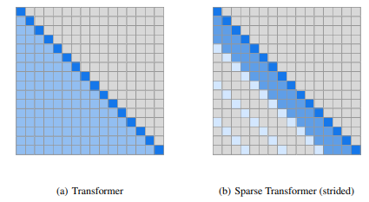
Introduction – Sparse Attention
The reason is that their full attention distributions are dense and would assign certain credits to all items, including irrelevant items
One straightforward strategy is to design sparse Transformer architectures that sparsify the connections in the attention layers
However, these models largely rely on pre-defined attention schemas, which lacks flexibility and adaptability in practice
Image taken from Generating Long Sequences with Sparse Transformers

Slide 6
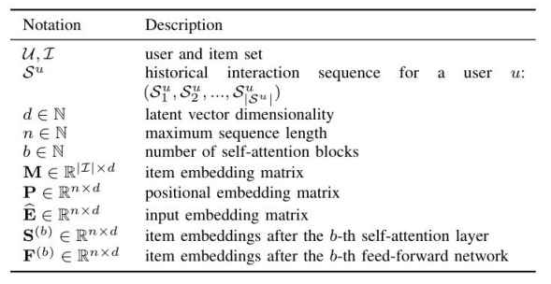
Problem & background - Problem Setup
Given the interaction history 𝑆^{𝑢}, sequential recommendation seeks to predict the next item 𝑆^{𝑢}_{|𝑆𝑢+1|} at time step |𝑆^{𝑢} + 1|
During the training process, it will be convenient to regard the model’s input as (𝑆^{𝑢}₁, 𝑆^{𝑢}₂, . . . , 𝑆^{𝑢}_{|𝑆 𝑢−1|} ) and its expected output is a shifted version of the input sequence

Slide 7
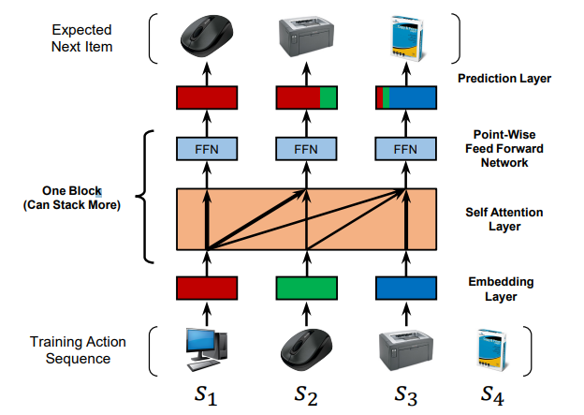
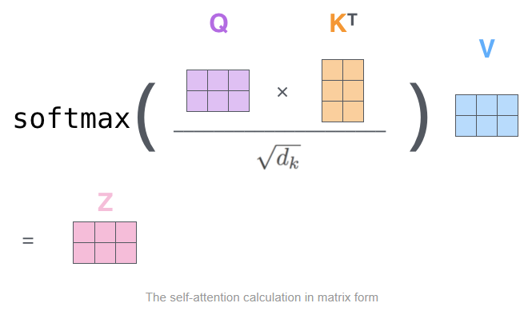
Problem & background – SASRec Design
Images taken from Self-Attentive Sequential Recommendation, The Illustrated Transformer

Slide 8

Problem & background – Learning Objective
Θ is the model parameters
𝛼 is the regularizer to prevent over-fitting
𝑜’_{𝑡} ∉ S_{𝑢} is a negative sample corresponding to 𝑜_{𝑡}
𝜎(·) is the sigmoid function

Slide 9
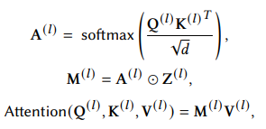
Rec-Denoiser
Rec-Denoiser consists of two parts: differentiable masks for self-attention layers and Jacobian regularization for Transformer blocks
Differentiable Masks: not every item in a sequence is aligned well with user preferences in the same sense that not all attentions are strictly needed in self-attention layers
Authors attach each self-attention layer with a trainable binary mask to prune noisy or task-irrelevant attentions
A^{(𝑙)} is the original full attentions
M^{(𝑙)} denotes the sparse attentions
⊙ is the element-wise product
Z^{(𝑙)} _{𝑢,𝑣} denotes whether the connection between query 𝑢 and key 𝑣 is present
Mask Z^{(𝑙)} (e.g., 1 is kept and 0 is dropped) requires minimal changes to the original self-attention layer == yielding exactly zero attention scores for irrelevant dependencies

Slide 10

Rec-Denoiser – Regularization term R_{M}
One way to encourage sparsity of M^{(𝑙)} is to explicitly penalize the number of non-zero entries of Z^{(𝑙)} , for 1 ≤ 𝑙 ≤ 𝐿, by minimizing:
There are two challenges for optimizing Z^{(𝑙)} : non-differentiability and large variance.
𝐿₀ is discontinuous and has zero derivatives almost everywhere.

Slide 11


Rec-Denoiser – Regularization term R_{M}
Combined L_{BCE} and R_{M} into one unified objective:
Authors further consider each Z^{(𝑙)}_{𝑢,𝑣} is drawn from a Bernoulli distribution parameterized by Π^{(𝑙)}_{𝑢,𝑣 .} The regularization term is now continuous. For L_{BCE} authors directly optimize discrete variables using the recently proposed augment-REINFORCEmerge (ARM)

Slide 12

Rec-Denoiser – Jacobian Regularization
The standard dot-product self-attention is not Lipschitz continuous and is vulnerable to the quality of input sequences
We can measure the robustness of the Transformer block using the residual error: 𝑓^{(𝑙)}(x + 𝝐) − 𝑓^{(𝑙)}(x), where 𝝐 is a small perturbation vector
Regularizing the 𝐿₂ norm on the Jacobians enforces a Lipschitz constraint at least locally, and the residual error is strictly bounded

Slide 13

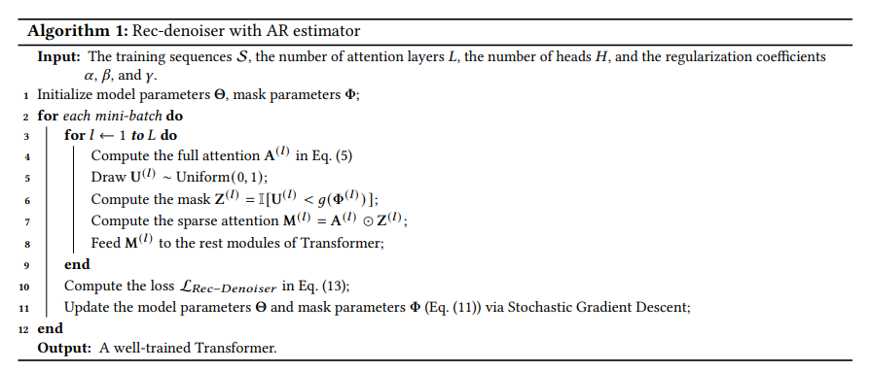
Rec-Denoiser – Joint Training
Differentiable masks and gradient regularizations will not change transformers architectures.
If we simply set all masks Z^{(𝑙)} to be all-ones matrix and 𝛽 = 𝛾 = 0, model boils down to their original designs.
If we randomly set subset of masks Z^{(𝑙)} to be zeros, it is equivalent to structured Dropout like LayerDrop, DropHead

Slide 14
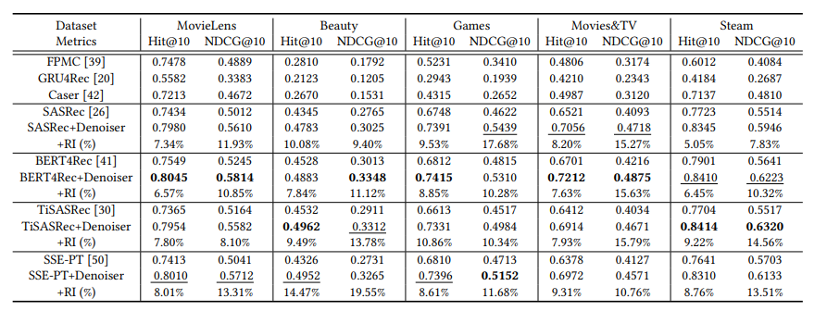
Experiments
Q1: How effective is the proposed Rec-Denoiser compared to the state-of-the-art sequential recommenders?
"RI" denotes the relative improvement of Rec-Denoisers over their backbones. The best performing results are boldfaced, and the second best ones are underlined

Slide 15
Experiments
The self-attentive sequential models (e.g., SASRec, BERT4Rec, TiSASRec, and SSE-PT) generally outperform FPMC, GRU4Rec, and Caser with a large margin
Comparing the original SASRec and its variants BERT4Rec, TiSASRec and SSE-PT, we find that the self-attentive models can gets benefit from incorporating additional information such as bi-directional attentions, time intervals, and user personalization.
The relative improvements of Rec-denoisers over their backbones are significant for all cases

Slide 16
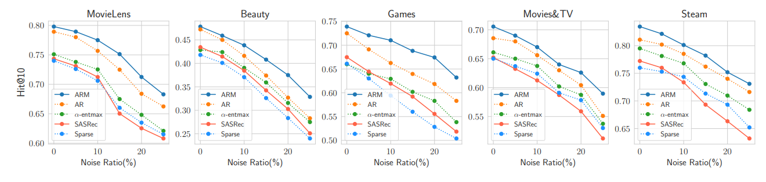
Experiments
Q2: How can Rec-Denoiser reduce the negative impacts of noisy items in a sequence?
Rec-denoiser (use either ARM or AR estimators) consistently outperforms 𝛼-entmax and Sparse Transformer under different ratios of noise
Differentaible masks have much more flexibility to adapt to noisy sequences
The Jacobian regularization further encourages the smoothness of our gradients, leading to better generalization

Slide 17
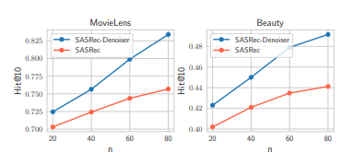
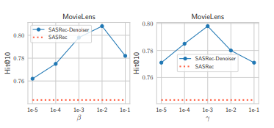
Experiments
Q3: How do different components (e.g., differentiable masks and Jacobian regularization) affect the overall performance of Rec-Denoiser?
The larger sequence we have, the larger probability that the sequence contains noisy items
SASRec-Denoiser improves the performance dramatically with longer sequences
Performance with different regularization parameters 𝛽 and γ is relatively stable with respect to different settings

Slide 18
Вопросы?

