Slide 1
Heron's Formula

Slide 2
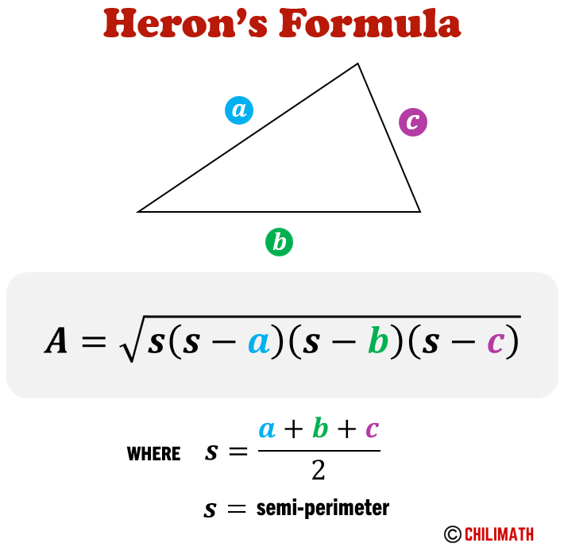
Heron's Formula
Formula: (s-a)(s-b)(s-c), where s = semi-perimeter
Used to find area of a triangle when height is not possible to find
Example: Area of a triangular park = 322+242-

Slide 3
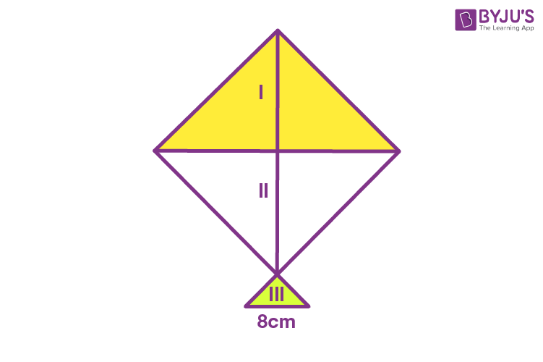
Applying Heron's Formula
Example 1: Find area of a triangular park with sides 40m, 24m, and 32m
Example 2: Find area of an equilateral triangle with side 10cm
Example 3: Find area of a triangle with sides in the ratio 3:5:7 and perimeter 300m

Slide 4
Quiz Time!
Question: What is the formula for finding the area of a triangle when the height is not possible to find?
(s-a)(s-b)(s-c)
(s+a)(s+b)(s+c)
(a+b+c)
(s-a)(s-b)(s+c)

Slide 5
Quiz Time! - Answer
Answer: (s-a)(s-b)(s-c)

Slide 6

Real-Life Applications
Example: Calculating the area of the triangular side walls of a flyover for advertisements
Example: Calculating the area of a slide in a park for painting a message
Example: Calculating the area of a triangle for fencing a plot

