Slide 1
Lectures 4-6
Marix algebra

Slide 2
Lecture 4
Matrix operations
The inverse of a matrix
Characterization of invertible matrices

Slide 3
System of linear equations: general representation
Introductory example – read from textbook, p.95

Slide 4
Matrix operations

Slide 7
Matrix multiplication
1. See, how matrix is multiplied by vector:

Slide 8
What is meaning for matrix multiplication?

Slide 9
How to define a matrix multiplied by matrix?
Remember how we multiply matrix by vector:

Slide 10
How to define a matrix multiplied by matrix?
Obviously, this rule is in concordance with matrix multiplied by vector

Slide 11
We want to define the rule of multiplication in such a way that A(Bx)=(AB)x

Slide 12
By linearity
Then this is a vector equation with following columns of its matrix

Slide 13
Then the elements of the matrix for the product of two transformations are as follows:
This is in concordance with matrix multiplied by vector.

Slide 14
DEFINITION OF MATRIX PRODUCT:

Slide 17
Example: Find AB₁₂ and AB₃₁
For AB₁₂ : in the mind's eye turn the 1st row vertically, multiply by column 2 of matrix B and summarize:
AB₁₂ =-12 -5=-17
AB₃₁ =
24-56-21=-53

Slide 18
For other examples see textbook, p.97,98
Identity matrix: I_{n} (nxn)

Slide 19
PROPERTIES OF MATRIX MULTIPLICATION:

Slide 20
Proof of a)

Slide 21
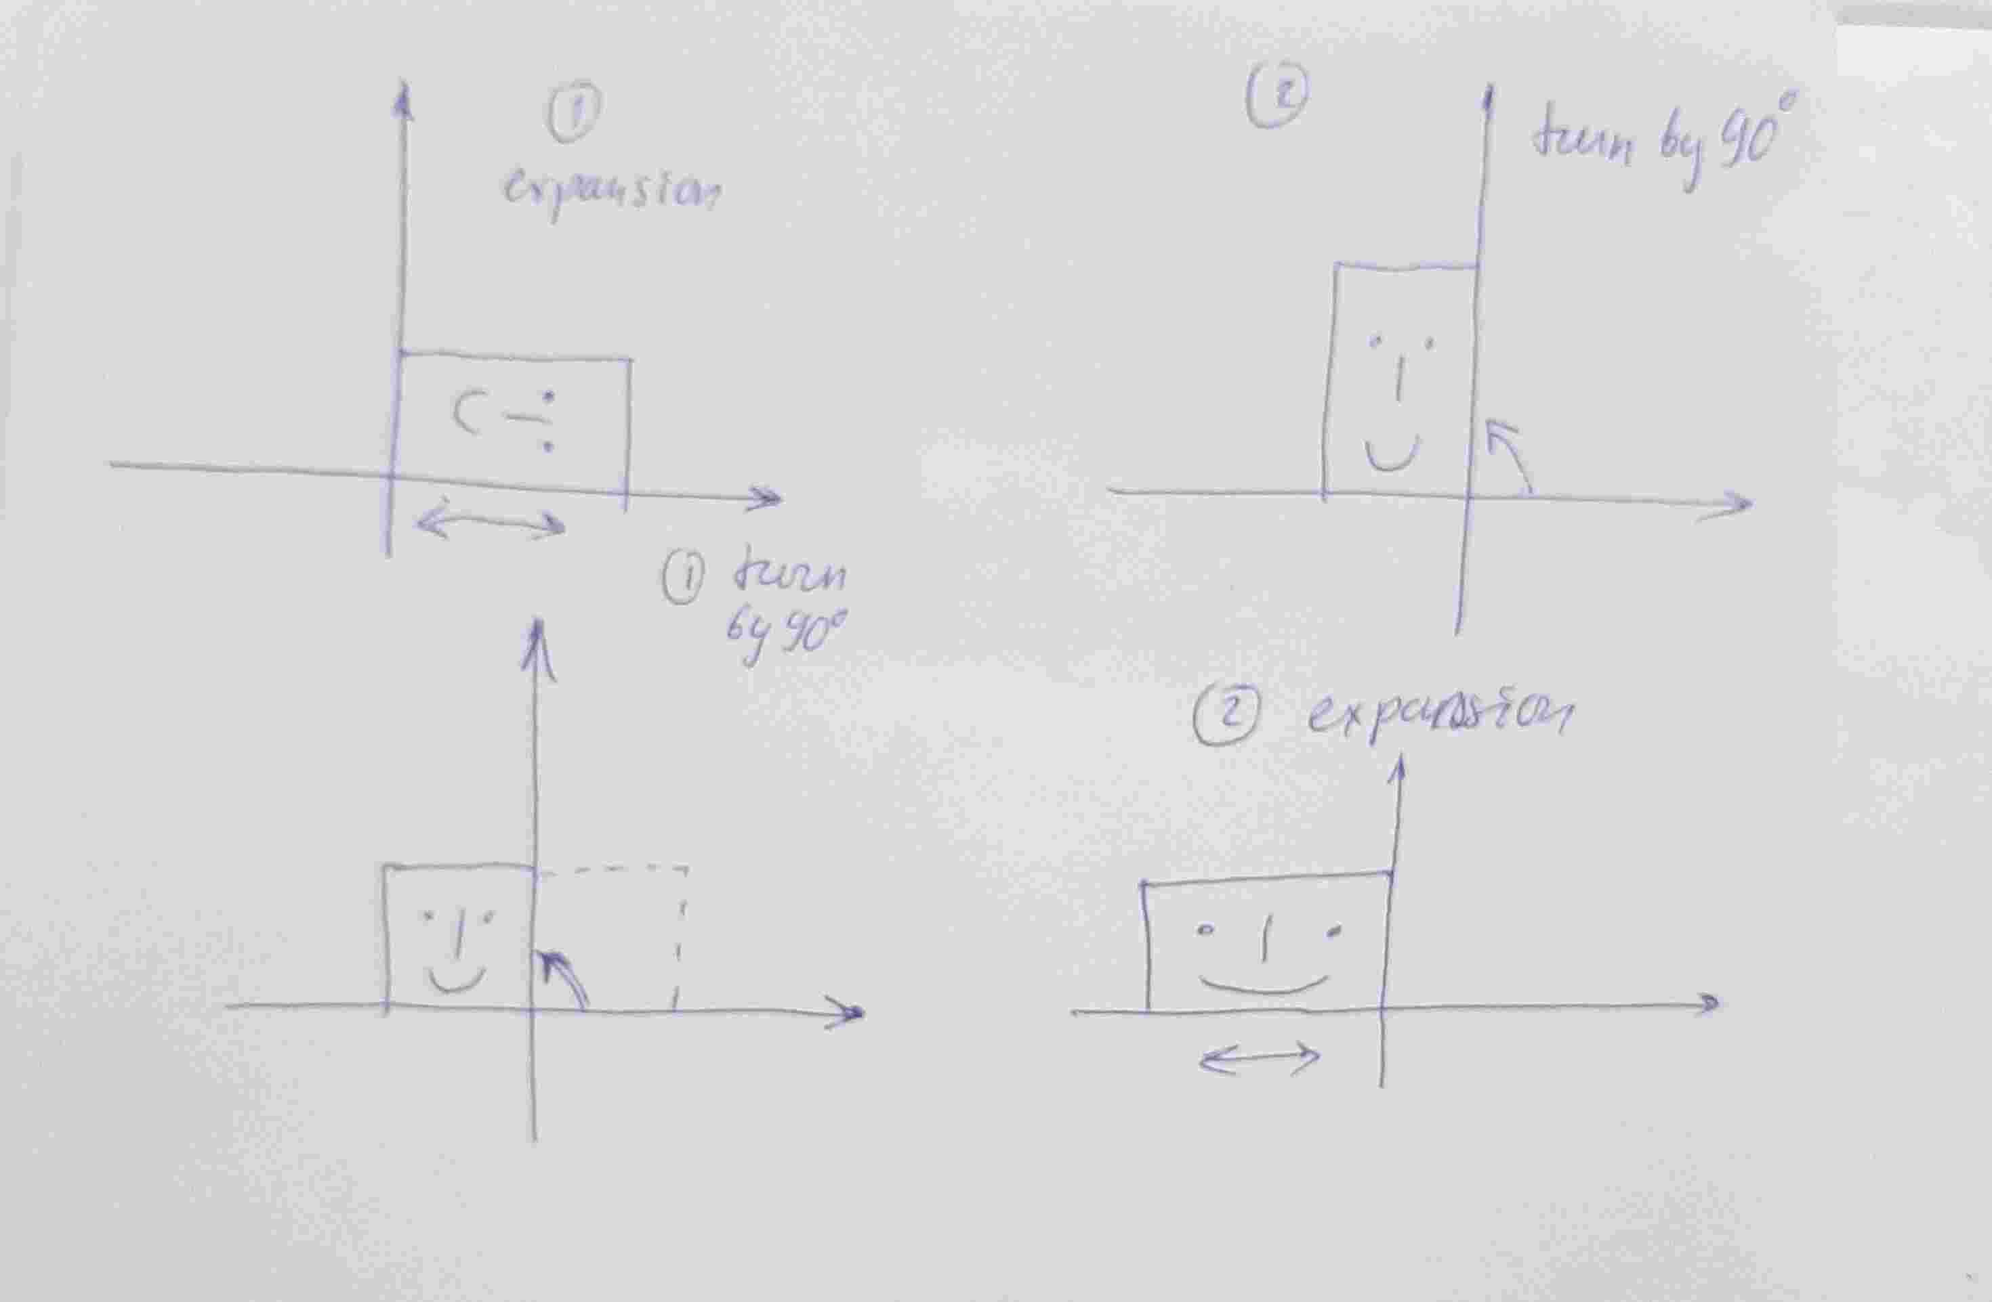

Slide 24
Proof.

Slide 25
Lecture 5
THE INVERSE OF A MATRIX

Slide 27
Properties of invertible matrices (Th.6)

Slide 28
Proof.

Slide 29
Elementary matrix
Let make an elementary operation of row reduction algorithm a) Replacement

Slide 31
Row exchange operation:
Multiply one row j by a scalar

Slide 32
Conclusion:

Slide 33
Theorem 7:

Slide 36
An algorithm for finding A⁻¹

Slide 39
The row reduction of [ A I] to [I A⁻¹] is equivalent to simultaneous solution of n systems:
Then columns of [A⁻¹] are solutions of the system above: x₁= A⁻¹ e₁,…, x_{n}= A⁻¹ e_{n}
Remark: product of matrix by base vector e_{k} is k-th column

Slide 40
Lecture 6
Characteristics of invertible matrices
Invertible Matrix Theorem and its consequences

Slide 41
Characteristics of invertible matrices

Slide 42
If the truth of statement (a) always implies that statement (j) is true, we say that
(a) implies (j) and write (a) (j)
If statement (a) is true, then A⁻¹ works for C in (j), so (a) (j).
(j) implies (d): Suppose CA = I_{n} (the (n x n) identity matrix). Show that the
equation Ax =0 has only the trivial solution:
Then CA x = 0, I x=0, x=0.
(d) implies (c): A has n pivot positions: if not, there non trivial solutions of Ax =0 would be possible:

Slide 43
If A is square and has n pivot positions, then the pivots must lie on the main diagonal, in which case the reduced echelon form of A is I_{n}: Thus (c) implies (b).

Slide 44
Also, (b) implies (a) by Theorem 7:

Slide 45
(a) implies (k) because A⁻¹ works for D.
(k) implies (g) : suppose AD = I_{m} (the m x m identity matrix). Then for any b in R^{m}, the equation Ax = b has a solution:
ADb = b, then x=Db is a solution for Ax=b for any b in R^{m}

Slide 46
⁽g) Implies (a): Suppose A is n x n and the equation Ax = b has a solution for each b in R^{n}. Then A is row equivalent to I_{n}:
So (k) and (g) are linked to the circle.

Slide 49
▪

Slide 50
Other properties of invertible matrices
It follows from the Theorem 8. AB=I, by theorem 8 (k) the matrix A is invertible, then there exists unique A⁻¹ such that A⁻¹A =I, multiply both sides of AB=I by A⁻¹
A⁻¹ AB=IB = A⁻¹, then B=A⁻¹ . Take inverse of the last equality. Then A = B ⁻¹.

Slide 52
The power of the Invertible Matrix Theorem lies in the connections it provides among so many important concepts, such as linear independence of columns of a matrix A and the existence of solutions to equations of the form Ax = b.
It should be emphasized, however, that the Invertible Matrix Theorem applies only to square matrices. For example, if the columns of a 4 x 3 matrix are linearly independent, we cannot use the Invertible Matrix Theorem to conclude anything about the existence or nonexistence of solutions to equations of the form Ax = b.

Slide 53
Invertible Linear Transformations and their Matrices
Recall that matrix multiplication corresponds to composition of linear transformations.
When a matrix A is invertible, the equation A⁻¹Ax = x can be viewed as a statement about linear transformations.

Slide 55
Transformation onto, one-to-one transformation, span of linear system of vectors

Slide 57
PROOF Suppose that T is invertible. Then (2) shows that T is onto R^{n} .
If b is in R^{n} and x = S(b), then T(x) =T(S(b)) = b, so each b is in the range of T .
By the Invertible Matrix Theorem, statement (i), A is invertible.
Conversely, suppose that A is invertible, and let S(x)= A⁻¹x.
Then, S is a linear transformation, and S obviously satisfies (1) and (2). For instance, S(T (x)) = S(Ax)=A⁻¹(Ax)= x. Thus, T is invertible.

Slide 58
Uniqueness of S. Let T: R^{n} → R^{n} be an invertible linear transformation, and let S and U be functions from R^{n} → R^{n} such that S(T (x)) = x and U(T (x)) = x for all x in R^{n} . Show that U(v)=S(v) for all v in R^{n}. Let take any v in R^{n}, then v =T (x) for some x because T is onto R^{n}. Now compute S(v)= S(T(x))= x, and U(v)= U(T(x))= x, i.e. U=S.

Slide 59
Discuss examples:

Slide 66
Importance of inverse matrix: it helps to solve the SLAE
Usefulness of linearity: To solve a given problem Ax=b for arbitrary b one can use solutions prepared in advance for basic vectors

