Slide 1

Adobe Animate
Interactive Infographics

Slide 2
Adobe Animate > New > WEB

Slide 3
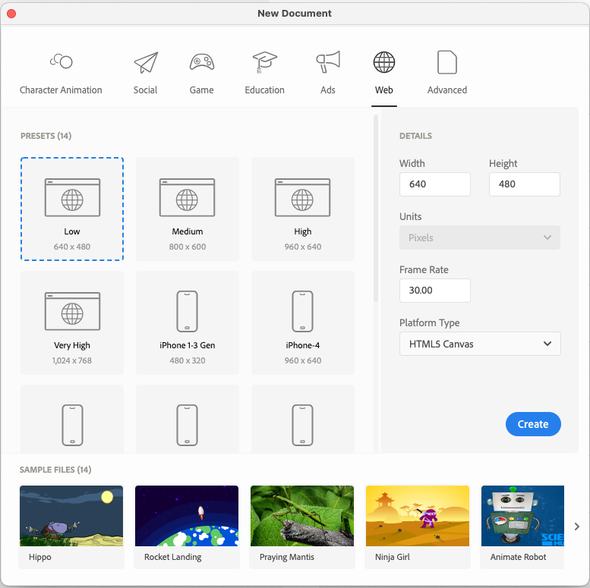

Slide 4
The UI of Adobe Animate
How to draw
How to add images
etc.

Slide 5
Size
Choose a stage size.

Slide 6
Frame by Frame: Indiana Jones flight style map
Select
Select an image as your background - a map.
Find
Also find a suitable plane or baloon that will travel over your map.
Create
Create a frame by frame animation of the trip.
Add
Add new frames: move the plane and draw a colored line behind the plane.

