Slide 1
Data Reduction / Dimension Reduction / PCA
Is more data better? Some times yes, sometimes no.
Practical concerns. Limited by your machine. Storage, memory, time….
Reduce noises and distractions, focusing on patterns and relevant part
Make data easier to interpret
Projection
Project a higher dimension data to a low dimension space but you can still tell what it is

Slide 2
Data Reduction with PCA
PCA
Principal Component Analysis
Find out dimensions of variables that explains most of the variation
Scenarios when PCA is useful
Problems with too many variables
We are analyzing return risks for a large number of stocks. But there are too many variables to look at, such as PE ratio, earnings, revenue, debts, market beta, cash flow…... or even the educational level of the employees This list can go on forever. But what are the principal components?

Slide 3
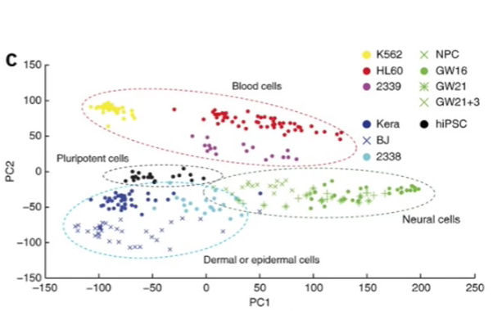
Data Reduction with PCA
Each dot in the graph is a cell, the idea is to cluster cells with similar transcription profiles. The question is how does transcription from 10,000 genes compressed to a single dot on the 2 dimensional graph.

Slide 4
PCA Explained
Characterize a cell by only 1 gene (gene A).
Cell | Gene A reading
1 | 10
2 | 0
3 | 14
4 | 5
5 | 7
6 | 8
7 | 12
……
Gene A reading

Slide 5
PCA Explained
Characterize a cell by 2 genes (gene A and gene B).
Cell | Gene A reading | Gene B reading
1 | 10 | 5
2 | 0 | 4
3 | 14 | 5
4 | 5 | 5
5 | 7 | 6
6 | 8 | 5
7 | 12 | 4
……
Gene B reading
Gene A reading
Flatten
Gene A reading
The vertical dimension (the gene B reading) does not help a lot in characterizing cells. So here, gene A is the principal component. We can then reduce our dataset to a 1-d dataset.

Slide 6
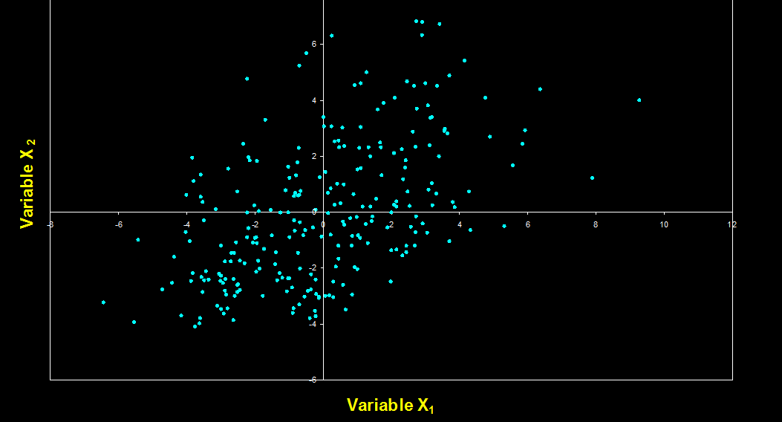
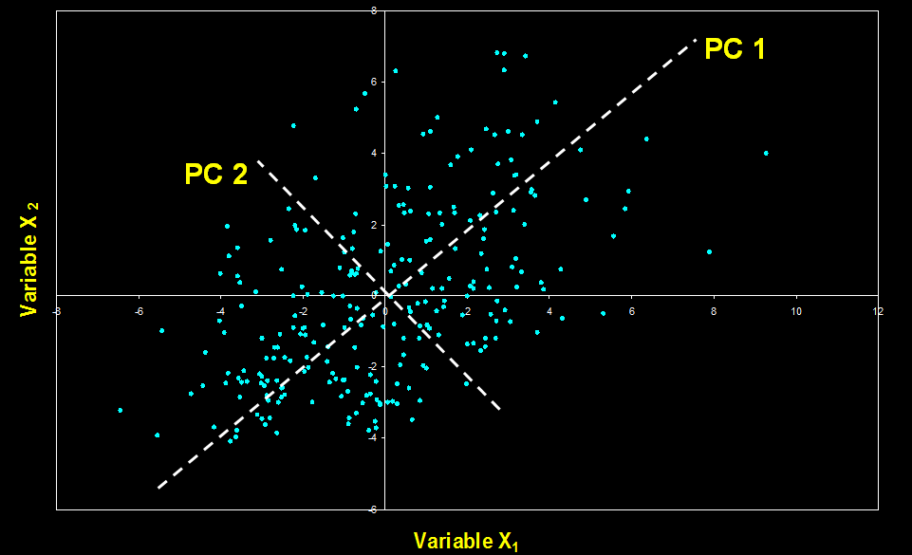
PCA Explained
X1 and X2 are not the direction with the max variation (principle components)
PCA
Now PC 1 is the direction with the max variation
PC 2 must be orthogonal with PC 1
Similarly, we can compress n-dimension graph onto a 2-dimension graph using PCA

Slide 7
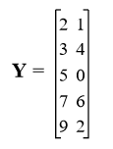
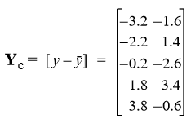

PCA Algebra
Consider a 2-d graph each observation is characterized with 2 attributes
Center it
Calculate the Covariance Matrix
Essence of PCA is to calculate the eigenvector of the S matrix

Slide 8

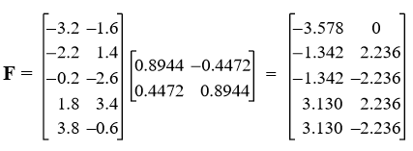
PCA Algebra
Calculate Eigenvalues: Please check: det(S-λI)=0
Then calculate the eigenvectors: Please check: S·U= λ·U
Eigenvector when λ=9
Eigenvector when λ=5
Finally, calculate coordinates of each observation in the new principal components space:
The meaning of eigenvector calculation is to rotate the original axis around the
centroid, until the coordinates of each observation on the new axis are independent with
each other.

Slide 9
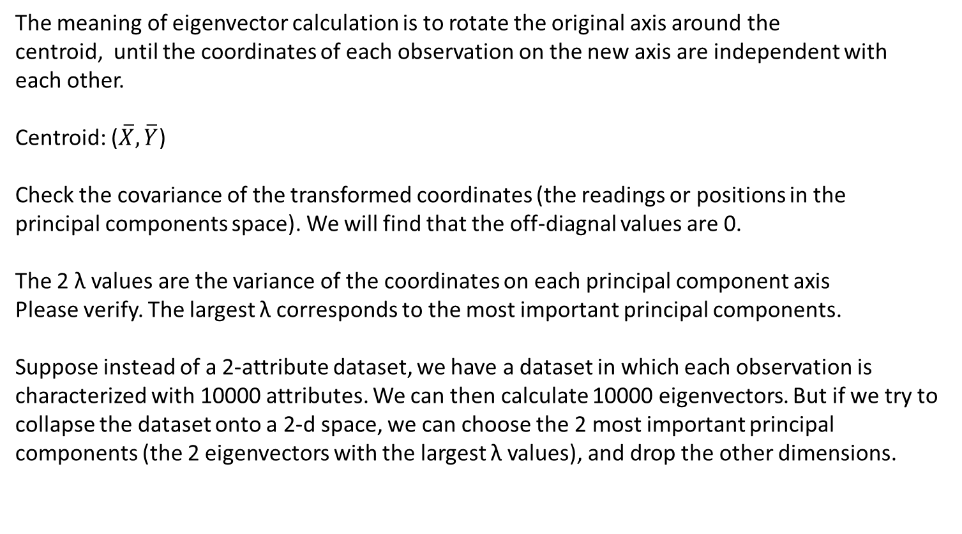
PCA Algebra
The meaning of eigenvector calculation is to rotate the original axis around the
centroid, until the coordinates of each observation on the new axis are independent with
each other.
Centroid: ($\overline{X},\overline{Y}$)
Check the covariance of the transformed coordinates (the readings or positions in the
principal components space). We will find that the off-diagnal values are 0.
The 2 λ values are the variance of the coordinates on each principal component axis
Please verify. The largest λ corresponds to the most important principal components.
Suppose instead of a 2-attribute dataset, we have a dataset in which each observation is
characterized with 10000 attributes. We can then calculate 10000 eigenvectors. But if we try to
collapse the dataset onto a 2-d space, we can choose the 2 most important principal
components (the 2 eigenvectors with the largest λ values), and drop the other dimensions.

Slide 10
PCA with R, Example 1
The data
https://raw.githubusercontent.com/steviep42/youtube/master/YOUTUBE.DIR/marks.dat
We have data about physics scores and statistics scores. (2-attributes dataset)
Find the 2 principal components
Usually we don’t do a 2-to-2 collapse. Most of the time, we do a n-to-2 collapse.

Slide 11
PCA with R, Example 2
The data
Manually generate a 3-d dataset
Identify 2 largest principal components
Calculate the coordinates of each observation on the principal component axis
Collapse the 3-d data into a 2-d data.

Slide 12
PCA with R, Example 3
The data
A real dataset about body fat and other related measures
Do principal component analysis using the built in prcomp command
Check all our algebra using this example

