Slide 1

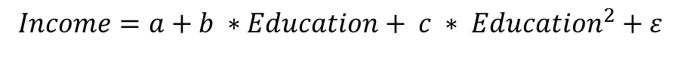
Regression Analysis
Linear regression is the most widely used data analytic model
Multipurpose
Easy to conduct, easy the understand
Standardized methods
Popular
What if the relationship between 2 variables are not linear?
$$Income=a+b ∗ Education+ ε$$
Many people out earn professors without a PHD degree?
Non linear relationship?
Just add a nonlinear factor in the model.
$$Income=a+b ∗Education+ {c ∗ Education}^{2}+ε$$

Slide 2
What to Do with Linear Regression
$$Income=a+b ∗Education+ {c ∗ Education}^{2}$$
Estimate the coefficient a, b, and c
To best capture the real data set (fit the model to the data)
Interpret the result (R squared value does not matter )
On average, one more year of education received, income increase by b
Make predictions (R squared matters)
Estimate the average salary for a master student

Slide 3
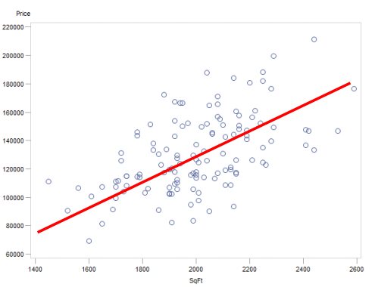
What it Looks like

Slide 4
What it Looks like
Study the relationship between advertising and sales.
Let’s try the excel trend line:
Store ID | Sales | Advt
1 | 145.1 | 9.5
2 | 128.3 | 10.1
3 | 121.3 | 9.4
4 | 134.4 | 11.6
5 | 106.5 | 10.3
6 | 111.5 | 9.5
7 | 132.7 | 11.2
8 | 126.9 | 9
9 | 151 | 11

Slide 5
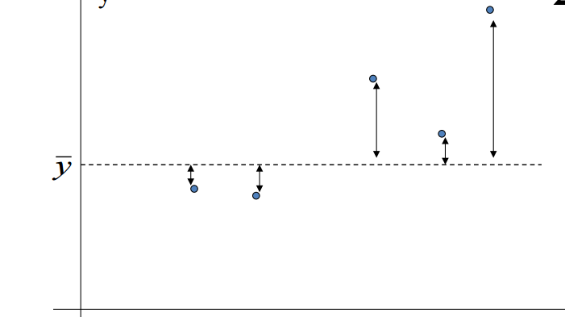
Least Square Method Explained
Without further information, the best predicted y value is y mean
But the errors are big
So use a linear model to improve the prediction

Slide 6
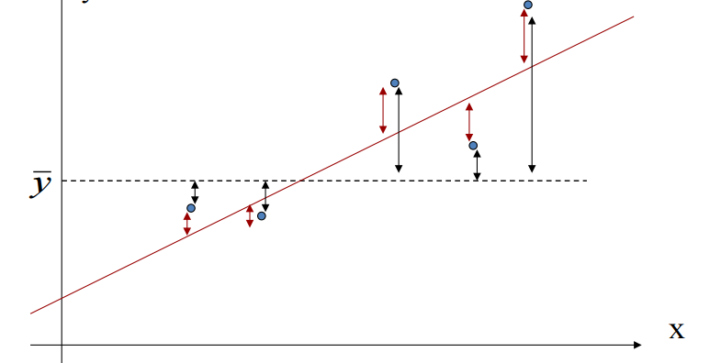

Least Square Method Explained
Let’s draw a line to “fit” the data trend
The red measures the prediction errors from the linear model
The least square method is to find the “fitted line” that minimize the total “red error”
$${SS}_{Total}=\sum{{(y_{i}−\overline{y})}^{2}}$$
$${SS}_{Res}=\sum{{(\hat{y}−y_{i})}^{2}}$$

Slide 7

R-squared: How the Model Fits
R-squared =
The proportion of total variation that is explained by the model =
1- the proportion of unexplained total variation
$$R^{2}=\frac{{SS}_{Total}−{SS}_{Res}}{{SS}_{Total}}$$

Slide 8
Prepare for LS –
Learn about the Data
Histogram – Check the variable distribution
Correlation matrix – Check how variables are related
Create Calculated Variables

Slide 9
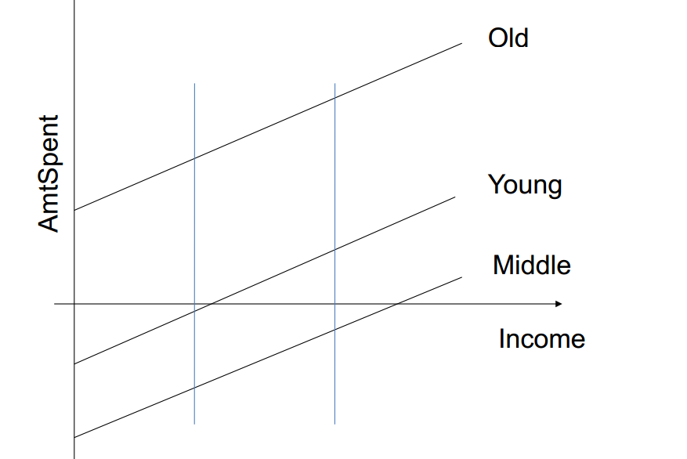
The Direct Marketing Example
Using dummy variable to study who spend more

Slide 10
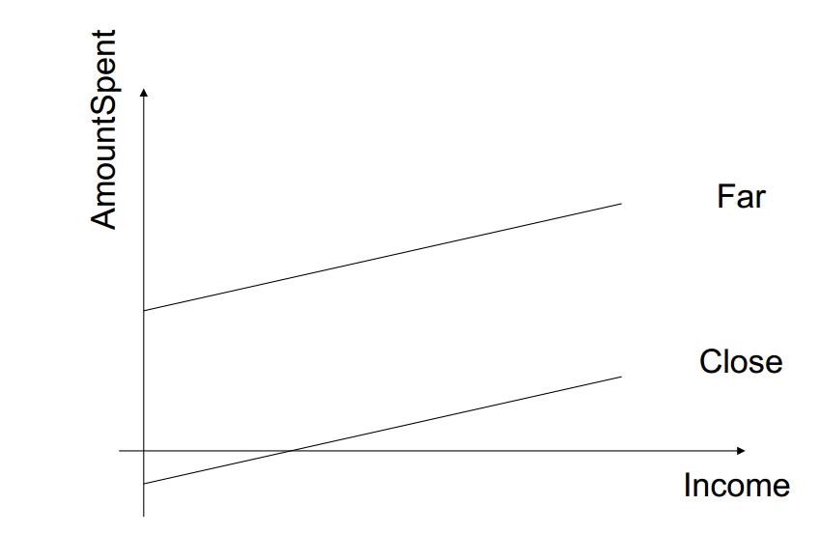
The Direct Marketing Example
Using dummy variable to study who spend more

Slide 11
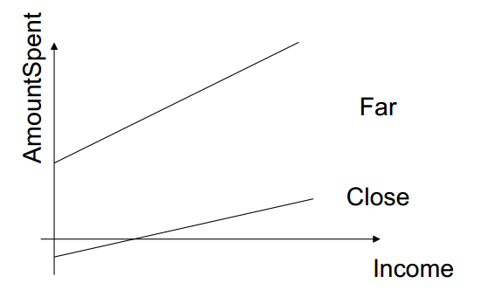
The Direct Marketing Example
What if the impact of Income on AmountSpent depends on the distance to home.

Slide 12
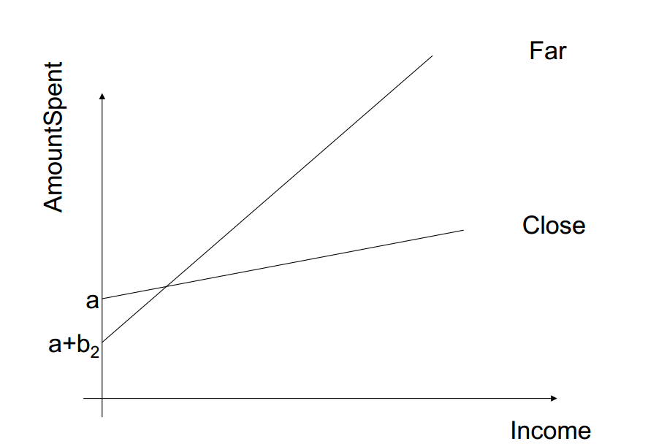
The Direct Marketing Example
What if the impact of Income on AmountSpent depends on the distance to home.

Slide 13
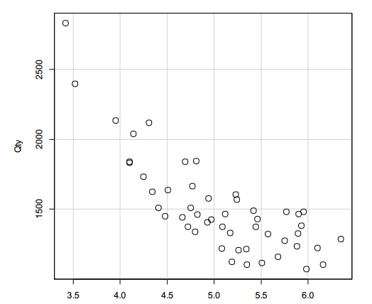
Nonlinear Model and Interpretation
A typical quantity and price analysis
A typical downward sloping demand curve
How shall we characterize the relationship?

Slide 14
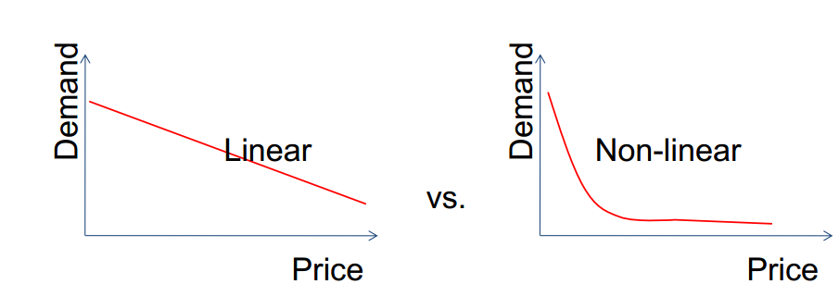
Nonlinear Model and Interpretation
Model A: Qty=a + b Price
Which one is more realistic?
Linear: Demand drop is constant for 1 unit of price change
Non-linear

Slide 15
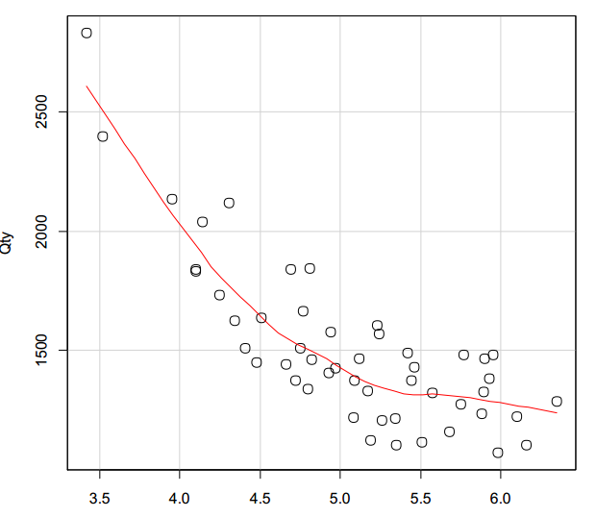
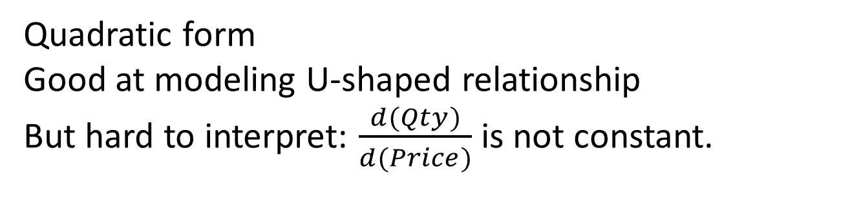

Nonlinear Model and Interpretation
Quadratic form
Good at modeling U-shaped relationship
But hard to interpret: $\frac{d(Qty)}{d(Price)}$ is not constant.
$$Qty=a+b1∗Price+b2∗ {Price}^{2}$$

Slide 16
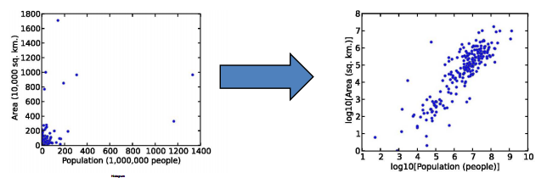
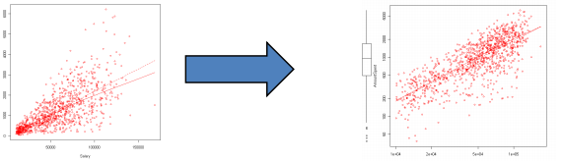
Nonlinear Model and Interpretation
Logarithm form (we should use natural log, easier to interpret)
Good at accommodate highly skewed data.
Many datasets are skewed

Slide 17
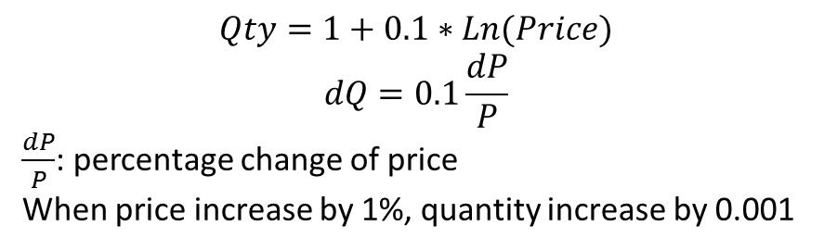
Nonlinear Model and Interpretation
Logarithm form Interpretation
Important: always use natural log transformation
$$Qty=1+0.1∗Ln(Price)$$
$$dQ=0.1\frac{dP}{P}$$
$\frac{dP}{P}$: percentage change of price
When price increase by 1%, quantity increase by 0.001

Slide 18
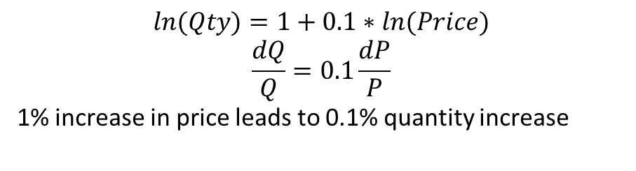
Nonlinear Model and Interpretation
If taking log on both sides:
$$ln⁡(Qty)=1+0.1∗ln(Price)$$
$$\frac{dQ}{Q}=0.1\frac{dP}{P}$$
1% increase in price leads to 0.1% quantity increase

Slide 19

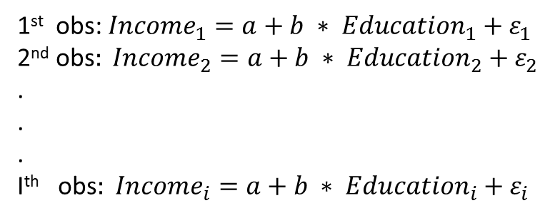
Assumption of LM
$E\left(ε\right)=0$, the mean of the residual is 0 (white noise). If violated: biased estimation
Residuals have equal variance
if violated: incorrect diagnosis
1st obs: ${Income}_{1}=a+b ∗ {Education}_{1}+ε_{1}$
2nd obs$: {Income}_{2}=a+b ∗ {Education}_{2}+ε_{2}$
.
.
.
Ith obs$: {Income}_{i}=a+b ∗ {Education}_{i}+ε_{i}$

Slide 20

Assumption of LM
No auto correlation
violation: incorrect diagnosis
4. Residual follow normal distribution
violation: incorrect diagnosis
No multicollinearity among explanatory variables
violation: incorrect diagnosis
Residuals are uncorrelated with explanatory variables
violation: incorrect diagnosis
$ε_{i}$ and $ε_{j}$ are independent

Slide 21
Assumption of LM
2,3,4,5 are easy to satisfy when your have a regular dataset. And even if you violate the assumption, on one would pick you because you will not find significant result
1 and 6 violations are caused by omitting important variables or endogeneity (remember the go to doctor example?)
This is the most important problem we constantly dealing with.

Slide 22
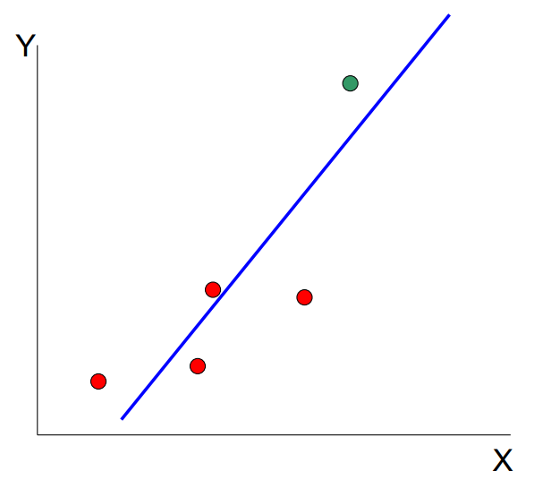
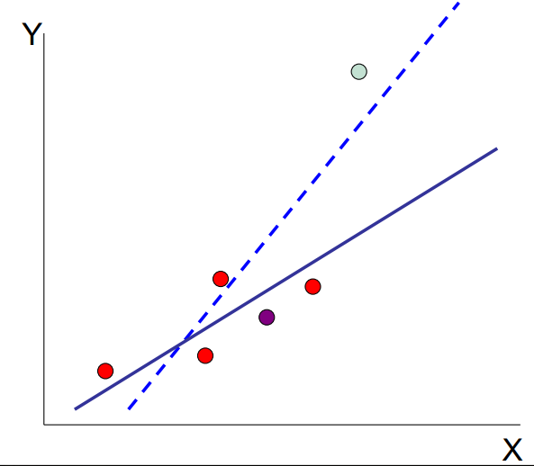
How to Estimate the Coefficients?
If you draw different samples from a same population, the result from each sample will be different
Sample chosen by Student B
Green is replaced by purple
Sample chosen by student A

Slide 23
How to Estimate the Coefficients?
This is called sampling error.
When sampling:
Get the sample as large as possible to reduce sampling error (law of large number)
Avoid biased sampling
Avoid selection bias (e.g. send out a education-related survey using email)

Slide 24
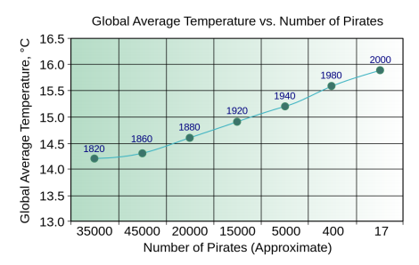
Treatment Effect and Dif-in-Dif
Correlation vs Causality
Correlation = Causality?
Number of Pirates affect global warming?
Hardly think so

Slide 25
Treatment Effect and Dif-in-Dif
Correlation vs Causality
How is correlation useful?
Easy, low cost, no hypothesis, prediction
How is causality useful?
Help decision making
Replicable (because we know the mechanism)
Understanding why something is happening

Slide 26
Treatment Effect and Dif-in-Dif
Go to Doctor Recap
Health = a + b1 * HospitalStay
More hospital trip, poorer health condition
Because we don’t know the health condition of the person, need to control, this is a missing variable

Slide 27
Treatment Effect and Dif-in-Dif
Randomized Controlled Experiment
Natural Experiment

Slide 28
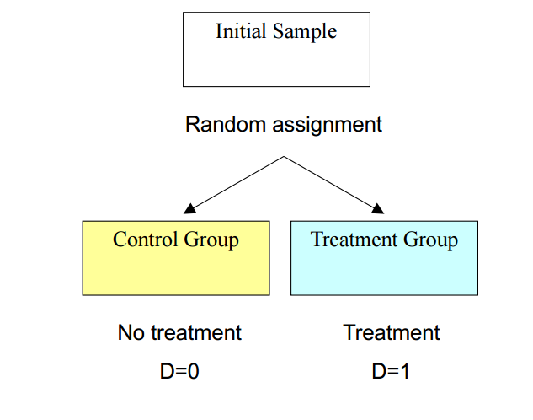
Treatment Effect and Dif-in-Dif
Randomized Controlled Experiment

Slide 29
Treatment Effect and Dif-in-Dif
Randomized Controlled Experiment
Study the effectiveness of class size
Is small class better?
TestScore = a + b * small + e
If this is a public dataset? Problem?
Selection bias: rich and better students afford small class
Missing variable: demographic information
No problem at all if doing a controlled experiment

Slide 30
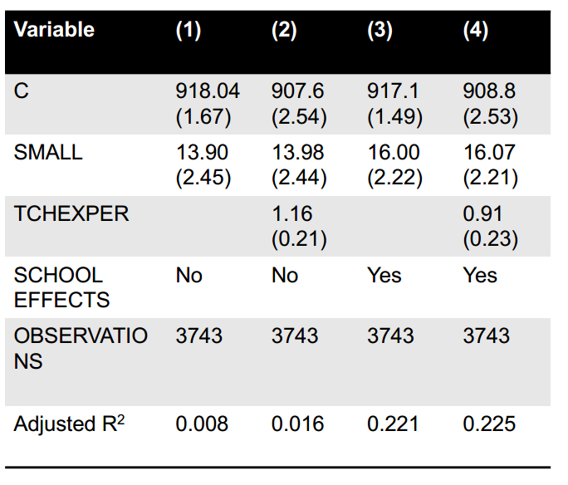
Treatment Effect and Dif-in-Dif
Randomized Controlled Experiment

Slide 31
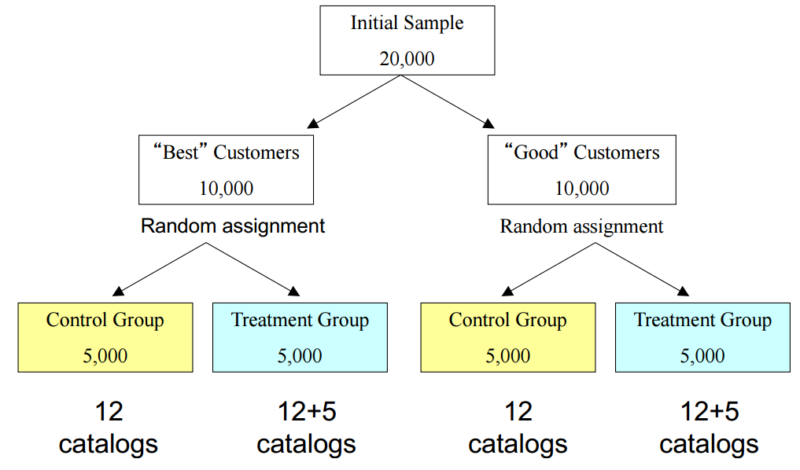
Treatment Effect and Dif-in-Dif
Randomized Controlled Experiment
Sending catalogs to loyal customers help?

Slide 32
Treatment Effect and Dif-in-Dif
Randomized Controlled Experiment
Natural Experiment
Approximate a randomized controlled experiment
Example
NYC lowers sales tax for local stores
Neighboring states do not change sales tax for local stores
The difference in purchase prior to this event between NYC and neighboring customers is tiny
The difference in purchase after this event between NYC and neighboring customers is the result of this event
Lower local sales tax
lower Internet sales
Problem with archival dataset
Not sure if the impact is a time trend
Not sure if the impact is from a state difference

Slide 33
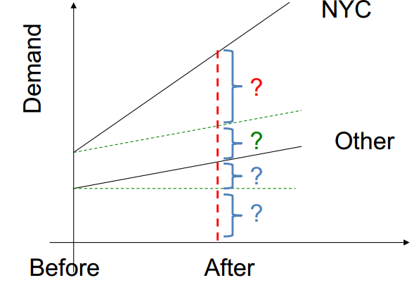
Treatment Effect and Dif-in-Dif
Randomized Controlled Experiment
Building the Dif-in-Dif model
Two dummy variables: NYC and After
And a interaction term NYC * After
Demand =a + b1* NYC+b2 * After+b3 * NYCAfter

Slide 34
Treatment Effect and Dif-in-Dif
Randomized Controlled Experiment
Steps in doing natural experiment
Understand the treatment that just happened
Check if there is a control group and a treatment group
If the two groups are roughly the same, b1 = 0 is the best (can’t really compare apple to orange)
CEO of Harrah’s
There are only two things that can get you fired. One is stealing from the company. The other is if they catch you running an experiment without a proper control group

