Slide 1
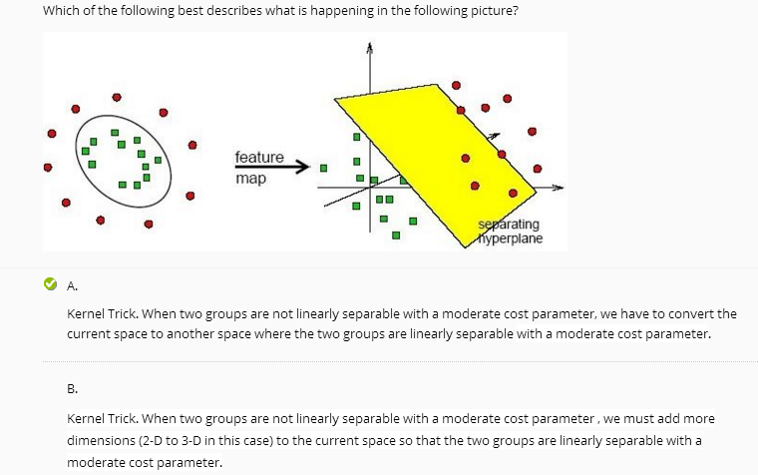
Linear Regression Analysis Part 2
Average Score: 16.8
This picture here is misleading. But the correct answer is still A.
But I give B choices 0.5 partial credits.

Slide 2
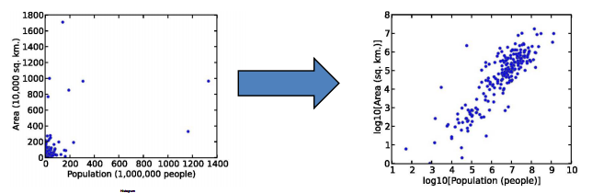
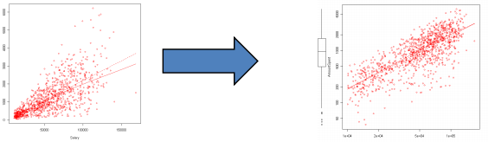
Nonlinear Model and Interpretation
Many datasets are skewed
The R-squared value will be very low.
We usually use a log transformation to make them less skewed – make patterns more visible
Always use natural log

Slide 3

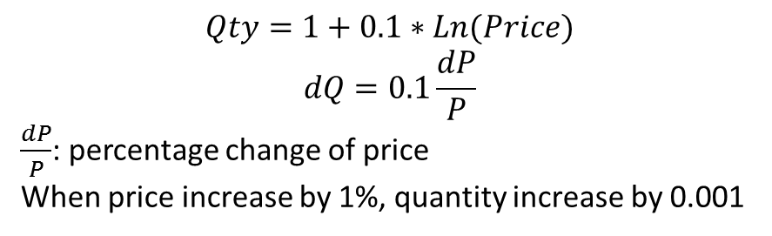
Nonlinear Model and Interpretation
Logarithm form Interpretation
$$Qty=1+0.1∗Ln(Price)$$
$$dQ=0.1\frac{dP}{P}$$
$\frac{dP}{P}$: percentage change of price
When price increase by 1%, quantity increase by 0.001
This is why we always use natural log

Slide 4
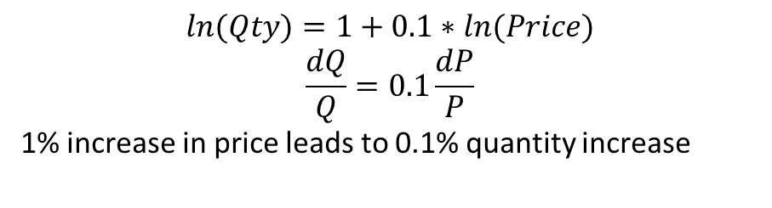
Nonlinear Model and Interpretation
If taking log on both sides:
$$ln⁡(Qty)=1+0.1∗ln(Price)$$
$$\frac{dQ}{Q}=0.1\frac{dP}{P}$$
1% increase in price leads to 0.1% quantity increase

Slide 5
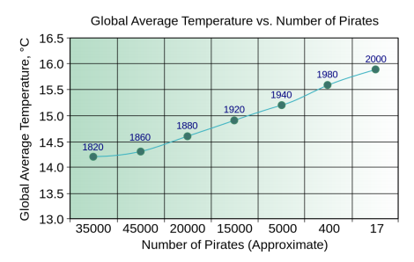
Treatment Effect and Dif-in-Dif
Correlation vs Causality
Correlation = Causality?
Number of Pirates affect global warming?
Hardly think so

Slide 6
Treatment Effect and Dif-in-Dif
Correlation vs Causality
How is correlation useful?
Easy, low cost, no hypothesis, prediction
How is causality useful?
Help decision making
Replicable (because we know the mechanism)
Understanding why something is happening

Slide 7
Treatment Effect and Dif-in-Dif
Go to Doctor Recap
Health = a + b1 * HospitalStay
More hospital trip, poorer health condition
Because we don’t know the health condition of the person, need to control, this is a missing variable

Slide 8
Treatment Effect and Dif-in-Dif
Randomized Controlled Experiment
Natural Experiment

Slide 9
Treatment Effect and Dif-in-Dif
Randomized Controlled Experiment
Study the effectiveness of class size
Is small class better?
TestScore = a + b * small + e
If this is a public dataset? Problem?
Selection bias: rich and better students afford small class
Missing variable: demographic information
No problem at all if doing a controlled experiment

Slide 10
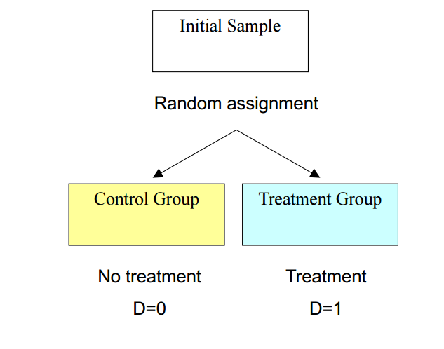
Treatment Effect and Dif-in-Dif
Randomized Controlled Experiment

Slide 11
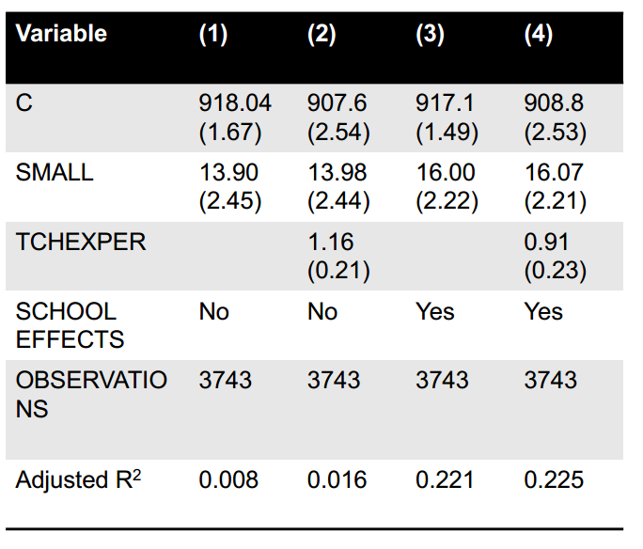
Treatment Effect and Dif-in-Dif
Randomized Controlled Experiment

Slide 12
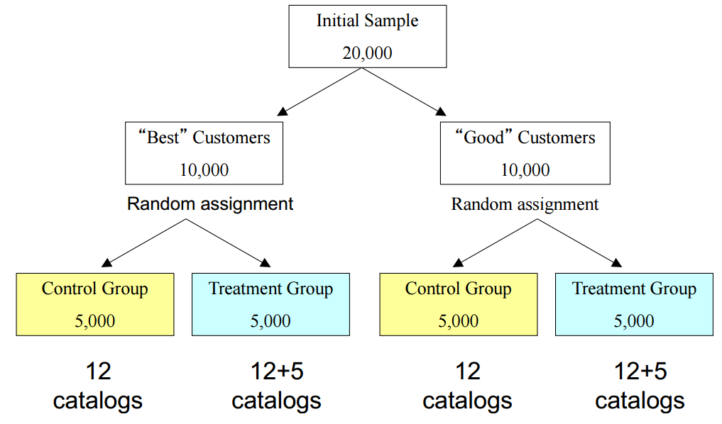
Treatment Effect and Dif-in-Dif
Randomized Controlled Experiment
Sending catalogs to loyal customers help?

Slide 13
Treatment Effect and Dif-in-Dif
Randomized Controlled Experiment
Natural Experiment
Approximate a randomized controlled experiment
Example
NYC lowers sales tax for local stores
The sales went up to 40
At the same time, sales of the neighbor cities went up to 30
Conclusion
Lower sales tax cause higher sales
But really?
Not sure if the increase is a time trend
Not sure if the difference is state specific, maybe NYC naturally has higher sales because of better economy

Slide 14
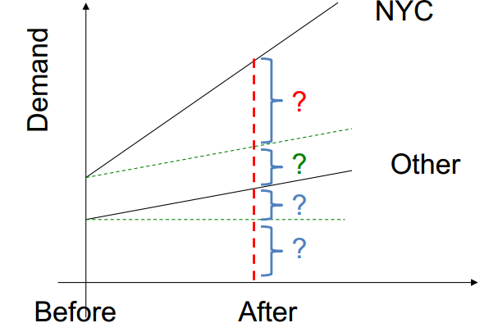
Treatment Effect and Dif-in-Dif
Randomized Controlled Experiment
Building the Dif-in-Dif model
Two dummy variables: NYC and After
And a interaction term NYC * After
Demand =a + b1* NYC+b2 * After+b3 * NYCAfter

Slide 15
Treatment Effect and Dif-in-Dif
Randomized Controlled Experiment
Steps in doing natural experiment
Understand the treatment that just happened
Check if there is a control group and a treatment group
If the two groups are roughly the same, b1 = 0 is the best (can’t really compare apple to orange)
CEO of Harrah’s
There are only two things that can get you fired. One is stealing from the company. The other is if they catch you running an experiment without a proper control group

Slide 16
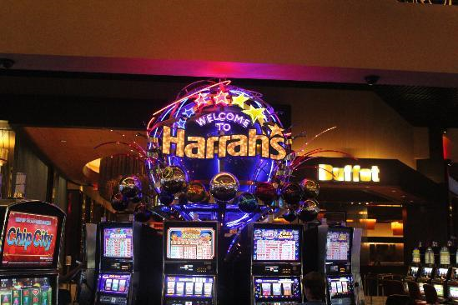
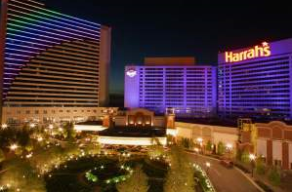
Harrah’s Data-Driven Success
From Casino Chain to the largest gaming company by revenue
53 Casinos
4 cruise ship casinos
More than 85,000 workers
On 5 continents

Slide 17
Harrah’s Data-Driven Success
- The Experiments
Harrah’s test every initiatives using experiments
No matter how smart the idea may sound
Raise hypothesis and design experiments
“In God we trust, others must bring data”
Some of the interesting findings at Harrah’s
Big money didn’t come from European princes or Hong Kong shipping heirs. But from locals
Big money comes from Grandmas!. Need find way to please them.
20-30 have no money, 30-45 too busy, 45 and older is where the money comes from
If suffering unusual losses in gambling, a free buffet coupon is offered
If a regular customer didn’t show up in a month, promotion offers or phone calls are made to invite them back
Don’t get too close to your customers (greeting by name, or talk about their past businesses at Harrah’s)
Drink ordering built into machine – a break in gambling is a halt in revenue

Slide 18
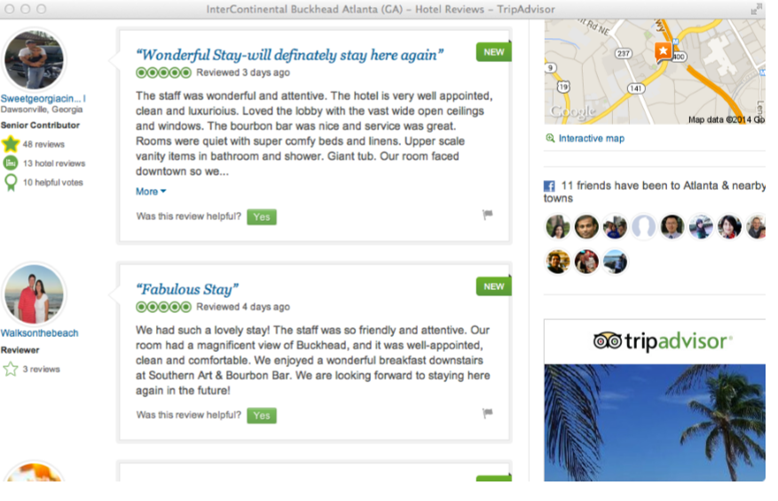
The Fixed Effect Model (Panel Data)
- Effect of Online Ratings on Hotel Booking

Slide 19
The Fixed Effect Model (Panel Data)
- Effect of Online Ratings on Hotel Booking
Data: about 100 IHG hotels, 3 years
Number of bookings
Number of nights
Average daily rate
Booking type (online/offline, member/non-member)
Online reviews

Slide 20
The Fixed Effect Model (Panel Data)
- Effect of Online Ratings on Hotel Booking
Panel Data set:
Hotel ID | Time | Other Variables
1 | Week1 | …
1 | Week2 | …
1 | Week3 | …
1 | Week4 | …
1 | Week5 | …
2 | Week1 | …
2 | Week2 | …
2 | Week3 | …
2 | Week4 | …
2 | Week5 | …
3 | Week1 | …
3 | Week2 | …
3 | Week3 | …
3 | Week4 | …
3 | Week5 | …
Hotel 1 Cross Section
Hotel 2 Cross Section
Hotel 3 Cross Section
Within each cross section, there is a time series data for hotel i.

Slide 21
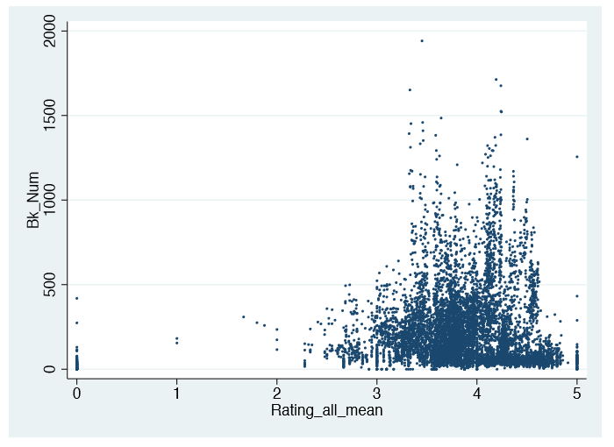
Effect of Online Ratings on Hotel Booking
Explore the Data
Booking vs Online Rating
The Number of booking is highly skewed
Most smaller than 500, some goes up to almost 2000
Need a logarithm transformation

Slide 22
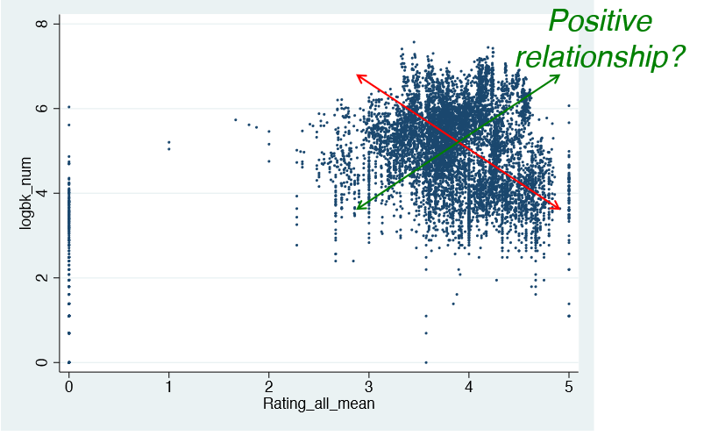
Effect of Online Ratings on Hotel Booking
Explore the Data
Ln(booking) vs Online rating
Or negative?
I see a negative relationship….
But is it?

Slide 23
Effect of Online Ratings on Hotel Booking
Explore the Data
The result of a basic model
Ln(Booking) = a + b * OnlineRating + c * ln(Average Daily Rate) + e
 | Estimate | Standard Deviation | T Value | P Value
Intercept | 1.873 | 0.139 | 13.51 | <0.0001
Online Rating | -0.567 | 0.023 | -24.64 | <0.0001
Ln(Daily Rate) | 1.103 | 0.026 | 42.15 | <0.0001
Do numbers lie?
Effect of online rating is negative?
Effect of average daily rate is positive?

Slide 24
Effect of Online Ratings on Hotel Booking
Explore the Data
The reason
Hotel and hotel are different
Some are five star, some are no star. Are they comparable?
This is the effect we want to test!
Higher rating → better service at same price range → more booking
Confounding effect:
Higher rating → luxury hotel → higer price → fewer booking
Higher rating → …………………………………….. → more booking
Higher rating → …………………………………….. → fewer booking
There are so many factors
And most of them are unobservable
We only know two variables: Online rating and Average Rate…
How the tease out the first effect??
The answer: fixed effect model
Control for hotel level observable variables.

Slide 25
Effect of Online Ratings on Hotel Booking
Explore the Data
The true model:
Ln(Booking) = a + b * OnlineRating + c * ln(Average Daily Rate) +
d1 * unobservable1 + d2 * unobservable2 + …… dn * unobservablen+ e
If we leave out the unobservables, we got biased estimates
For each hotel, use one dummy variable to represent all unobervables.
$${ln⁡(booking)}_{it}=a+b×{OnlineRating}_{it}+c×{ln⁡\left(AverageRates\right)}_{it}$$
$$+ d1×I_{hotel1}+d2×I_{hotel2}+…{dn×I}_{hoteln}+e$$
$$I_{hoteli}=\left\{\begin{matrix}1, if this data point is about hotel i \\ 0, otherwise\end{matrix}\right.$$

Slide 26
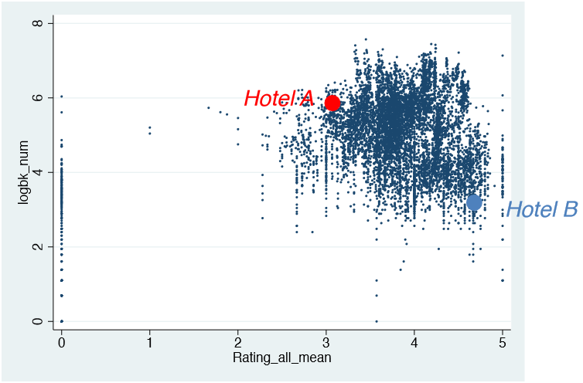
Visual Representation of Fixed Effect Model
We may see a downward sloping trend, but remember, each hotel is incomparable, unless we controlled for all factors affecting the booking.
Not possible? Just use a hotel level dummy variables to control (Fixed effect)

Slide 27
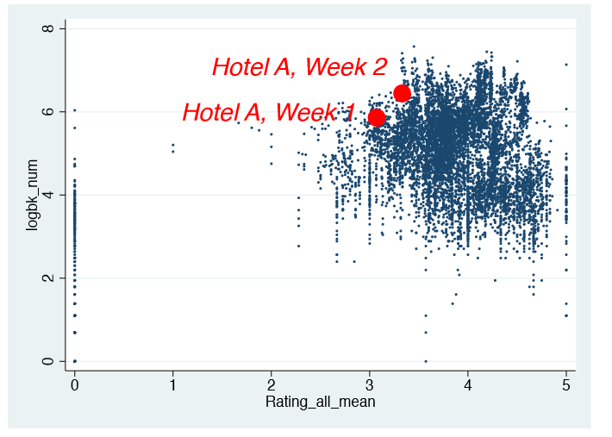
Visual Representation of Fixed Effect Model
We don’t compare between different hotels, we actually compare within the same hotel across different time periods.
this is what we are modeling right now. Hotel A is comparable to Hotel A.

Slide 28
Visual Representation of Fixed Effect Model
After we controlled for the unimportant unobservables, this is what we are modeling right now. Hotel A is comparable to Hotel A.
The whole data may look downward sloping, but for each hotel, it is a upward sloping line – Higher rating means Higher booking

Slide 29
The Reality
We always have unobservables, we cannot measure everything.
That is why Fixed Effect modeling is so important.
That is why panel dataset is so important.
If you don’t have a panel data set, usually there is nothing you can do because you will suffer from the biases caused by unobservables.
Usually, we also add time fixed effect on top of hotel fixed effect to control for the time effect (two-way fixed effect model, this is the most common model)

Slide 30
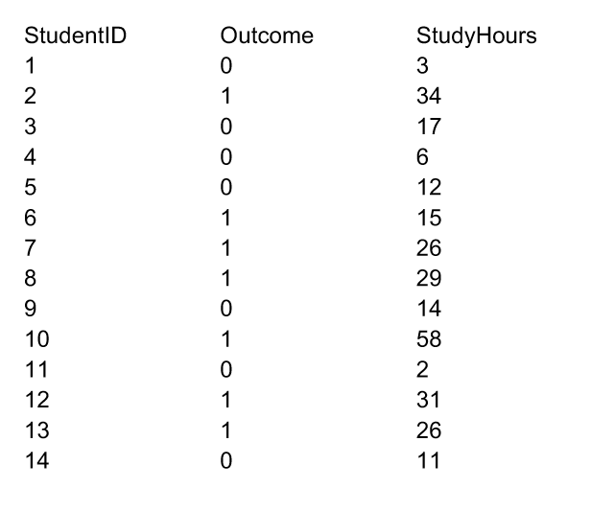
Logit Model – When Dependent Variable is Binary
What if the dependent variables are not continuous?
If a student gets an A?
If the customer files a complain?

Slide 31
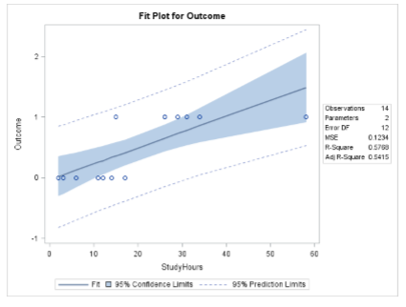
Logit Model – When Dependent Variable is Binary
Problem if using ordinary regressions
Cannot do prediction
Difficult to interpret the result.

Slide 32
Logit Model – When Dependent Variable is Binary
Y (outcome or response) is categorical
Yes/No
Approval/Reject
Responded/Did not respond
Solution
We model the probability of being in either group

Slide 33
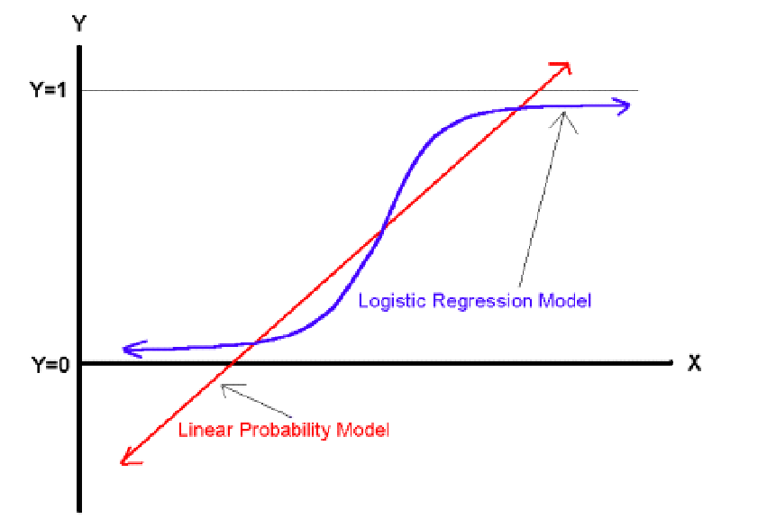
Logit Model – When Dependent Variable is Binary
Transform the Y so that we confine it to the range of 0 and 1 (the probability)

Slide 34
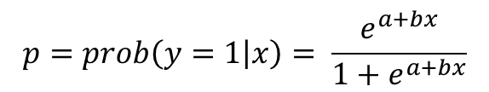
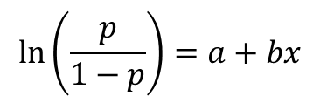
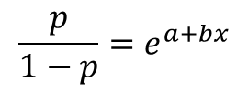
Logit Model – When Dependent Variable is Binary
$$p=prob\left(y=1 | x\right)= \frac{e^{a+bx}}{{1+e}^{a+bx}}$$
By this transformation, we confined it within (0,1)
$$\frac{p}{1−p}=e^{a+bx}$$
$$\ln\left(\frac{p}{1−p}\right)=a+bx$$
This is what we are going to model
This is the “ODDS”
Probability of A is 0.25, odds = 0.25/(1-0.25) = 1/3

Slide 35
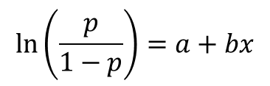
Logit Model – When Dependent Variable is Binary
Model Interpretation
For example, b = 0.01
One unit increase in x, odds that y happens increases by 1%
We estimate this types of regression using Maximum Likelihood
$$\ln\left(\frac{p}{1−p}\right)=a+bx$$

