Slide 1
Introduction to Probability

Slide 2
Random Experiments
Random Experiment
A process that generates well-defined experimental outcomes. On any single repetition or trial, the outcome that occurs is determined completely by chance.
Sample Space
The sample space for a random experiment is the set of all experimental outcomes.
All experimental outcomes are mutually exclusive and collectively exhaustive.
Example:
Random experiment: flip a coin
Sample space: S = {Head, Tail}

Slide 3
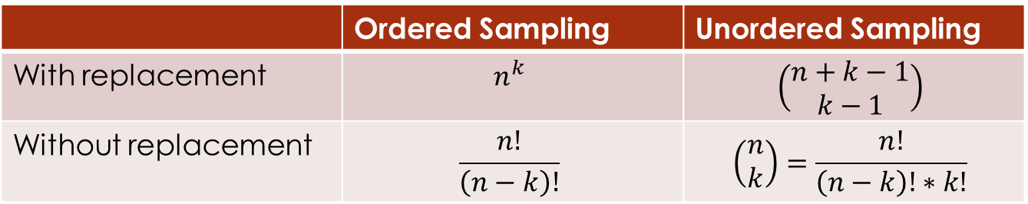

Counting Rules
Multiplication rule for multi-step experiment
If an experiment consists of a sequence of k steps with n₁ possible outcomes in step 1, n₂ possible outcomes in step 2, and so on, then the total number of experimental outcomes (size of sample space) is given by $n_{1}×n_{2}×⋯×n_{k}$.
Sampling Methods
How many distinguishable samples of size k can be chosen from a population of size n?
 | Ordered Sampling | Unordered Sampling
With replacement | $$n^{k}$$ | $$\left(\begin{matrix}n+k−1 \\ k−1\end{matrix}\right)$$
Without replacement | $$\frac{n!}{\left(n−k\right)!}$$ | $$\left(\begin{matrix}n \\ k\end{matrix}\right)=\frac{n!}{\left(n−k\right)!∗k!}$$

Slide 4
Counting Rules Examples
Ordered Sampling with Replacement
You are taking a multiple-choice quiz that has 5 questions. Each question has four answer choices, with one correct answer per question. If you select one of these four choices for each question and leave nothing blank, in how many ways can you answer these five questions in the quiz?
Ordered Sampling without Replacement (Permutation)
In how many ways can the letters of the word ‘PYTHON’ be arranged?
In how many ways can the letters of the word ‘DATA’ be arranged? (Distinguishable Permutation)
A ship’s captain sends signals by arranging 4 red, 3 green, and 2 blue flags on a vertical pole. How many different signals could the captain possibly send?

Slide 5
Counting Rules Examples
Unordered Sampling without Replacement (Combination)
A quality inspector randomly selects two out of five parts to test for defects. How many combinations of two parts can be selected?
Unordered Sampling with Replacement
12 passengers get on a shuttle at the airport, which stops at 4 hotels. Each passenger gets off the shuttle at his or her hotel. The driver records how many passengers leave the shuttle at each hotel. How many possibilities exist?

Slide 6

More on Combination
Binomial coefficient in binomial formula
${(1+x)}^{n}=\sum_{k=0}^{n}{\left(\begin{matrix}n \\ k\end{matrix}\right)x^{k}}$
Pascal’s rule: the recursion relation
$\left(\begin{matrix}n \\ k\end{matrix}\right)=\left(\begin{matrix}n−1 \\ k\end{matrix}\right)+\left(\begin{matrix}n−1 \\ k−1\end{matrix}\right)$
${(1+x)}^{n}={(1+x)}^{n−1}+x{(1+x)}^{n−1}$

Slide 7
Assigning Probabilities
Assigning Probabilities
Basic requirements for assignment probabilities
Probability of any experimental outcome must be between 0 and 1.
The sum of the probabilities of all experimental outcomes must equal 1.
Classic method: Naïve definition of probability for experiments with equally likely outcomes
Relative frequency method
Subjective method: Assign probabilities on the basis of judgment.

Slide 8
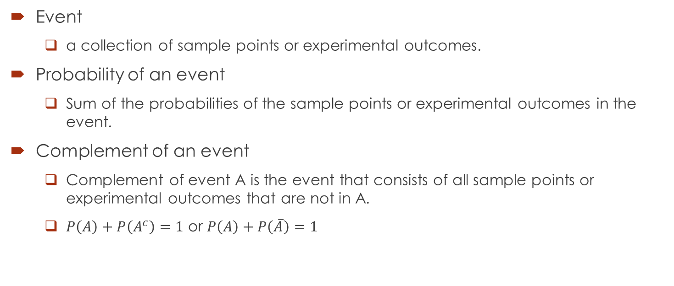
Events and Their Probabilities
Event
a collection of sample points or experimental outcomes.
Probability of an event
Sum of the probabilities of the sample points or experimental outcomes in the event.
Complement of an event
Complement of event A is the event that consists of all sample points or experimental outcomes that are not in A.
$P\left(A\right)+P\left(A^{c}\right)=1$ or $P\left(A\right)+P\left(\overline{A}\right)=1$

Slide 9
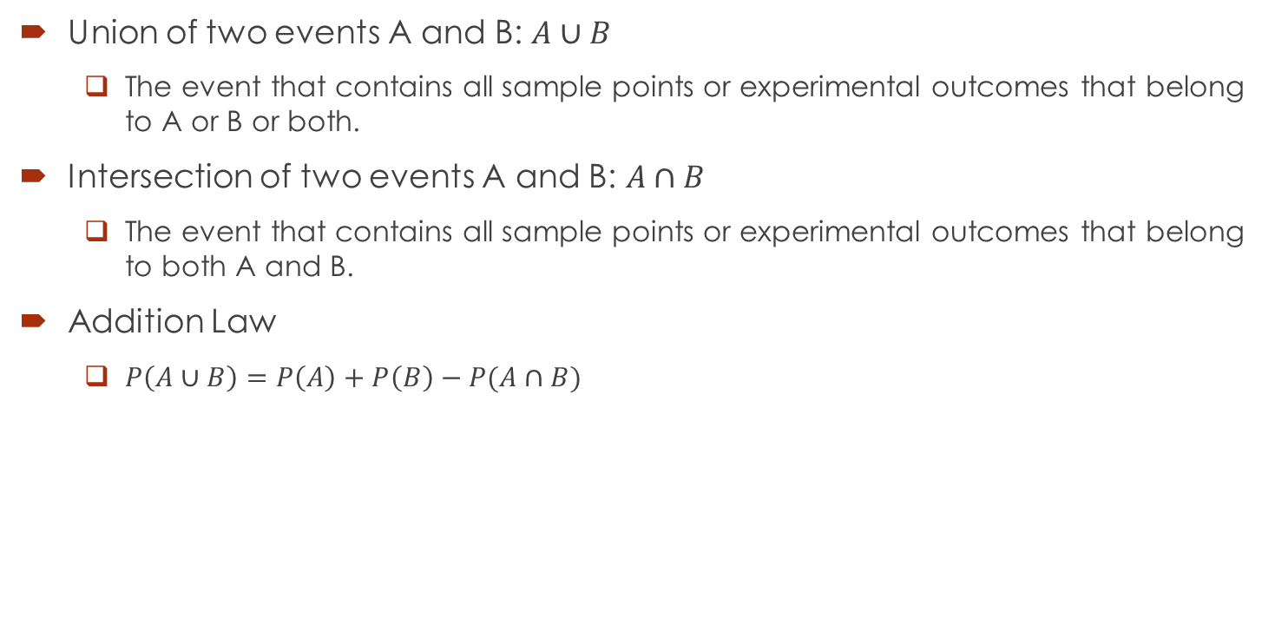
Events and Their Probabilities
Union of two events A and B: $A∪B$
The event that contains all sample points or experimental outcomes that belong to A or B or both.
Intersection of two events A and B: $A∩B$
The event that contains all sample points or experimental outcomes that belong to both A and B.
Addition Law
$P\left(A∪B\right)=P\left(A\right)+P\left(B\right)−P(A∩B)$

Slide 10
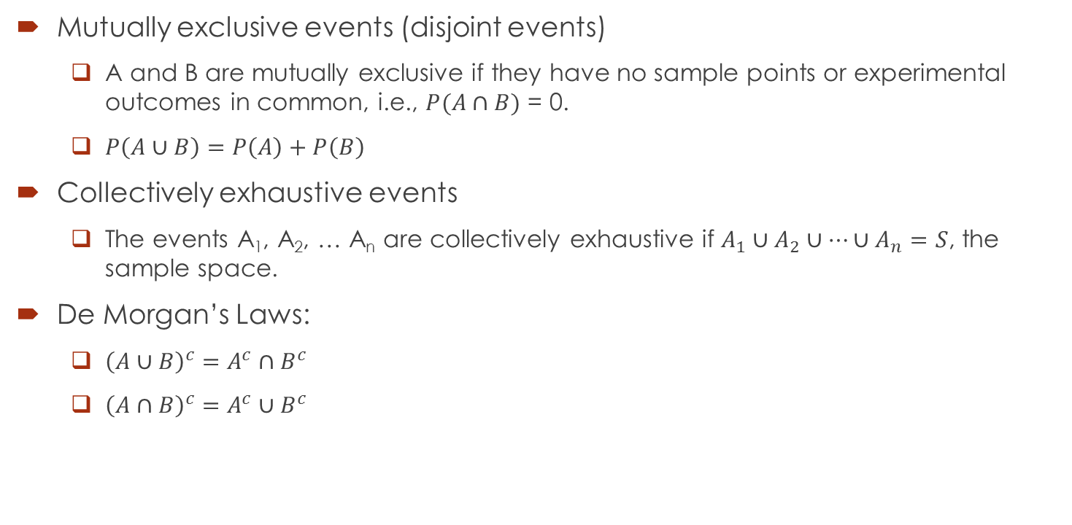
Events and Their Probabilities
Mutually exclusive events (disjoint events)
A and B are mutually exclusive if they have no sample points or experimental outcomes in common, i.e., $P(A∩B)$ = 0.
$P\left(A∪B\right)=P\left(A\right)+P\left(B\right)$
Collectively exhaustive events
The events A₁, A₂, … A_{n} are collectively exhaustive if $A_{1}∪A_{2}∪⋯∪A_{n}=S$, the sample space.
De Morgan’s Laws:
${\left(A∪B\right)}^{c}=A^{c}∩B^{c}$
${\left(A∩B\right)}^{c}=A^{c}∪B^{c}$

Slide 11
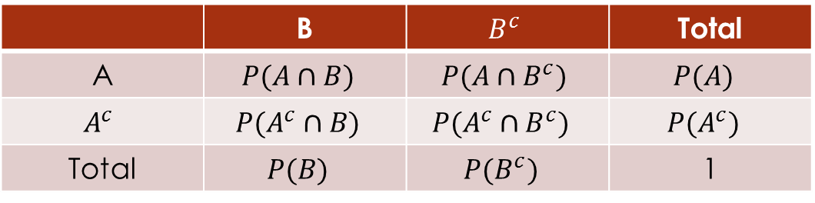
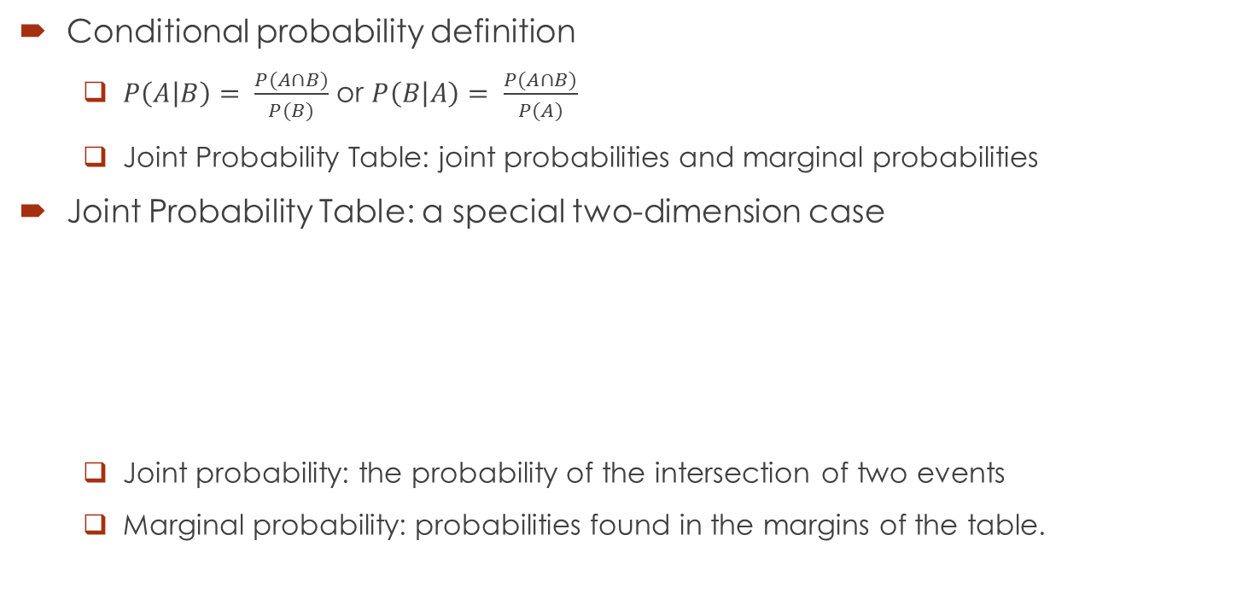
Conditional Probability and Joint Probability Table
Conditional probability definition
$P\left(A | B\right)= \frac{P(A∩B)}{P(B)}$ or $P\left(B | A\right)= \frac{P(A∩B)}{P(A)}$
Joint Probability Table: joint probabilities and marginal probabilities
Joint Probability Table: a special two-dimension case
Joint probability: the probability of the intersection of two events
Marginal probability: probabilities found in the margins of the table.
 | B | $$B^{c}$$ | Total
A | $$P(A∩B)$$ | $$P(A∩B^{c})$$ | $$P(A)$$
$$A^{c}$$ | $$P(A^{c}∩B)$$ | $$P(A^{c}∩B^{c})$$ | $$P(A^{c})$$
Total | $$P(B)$$ | $$P(B^{c})$$ | 1

Slide 12
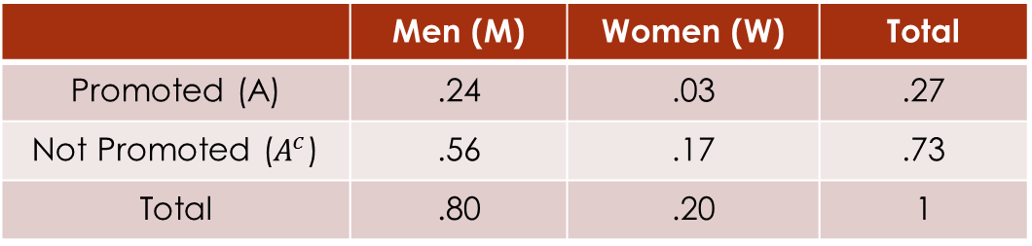
Conditional Probability and Joint Probability Table Example
Promotion Status of Police Officers
Joint Probability Table for promotion
What is the probability that a female officer has been promoted?
 | Men | Women | Total
Promoted | 288 | 36 | 324
Not Promoted | 672 | 204 | 876
Total | 960 | 240 | 1200
 | Men (M) | Women (W) | Total
Promoted (A) | .24 | .03 | .27
Not Promoted ($A^{c}$) | .56 | .17 | .73
Total | .80 | .20 | 1

Slide 13
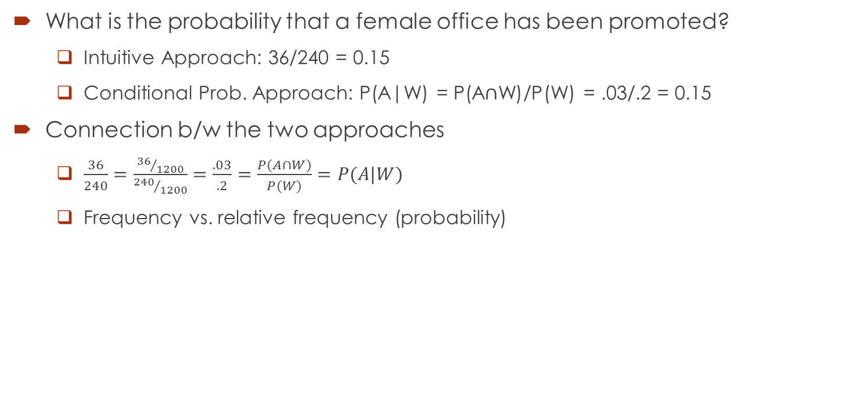
Conditional Probability and Joint Probability Table Example
What is the probability that a female office has been promoted?
Intuitive Approach: 36/240 = 0.15
Conditional Prob. Approach: P(A|W) = P(A$∩$W)/P(W) = .03/.2 = 0.15
Connection b/w the two approaches
$\frac{36}{240}=\frac{{36}/{1200}}{{240}/{1200}}=\frac{.03}{.2}=\frac{P(A∩W)}{P(W)}=P(A|W)$
Frequency vs. relative frequency (probability)

Slide 14
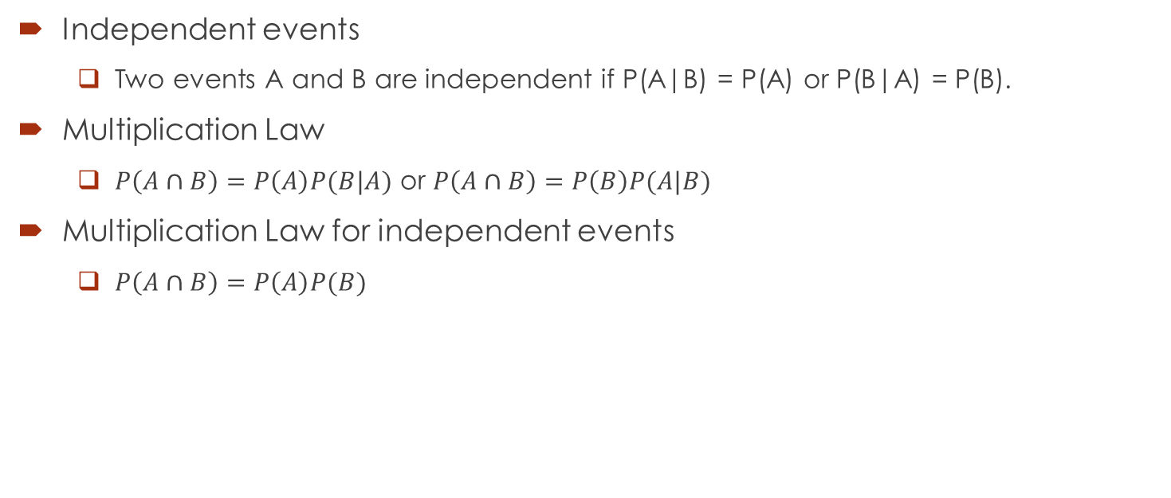
Independent Events and Multiplication Law
Independent events
Two events A and B are independent if P(A|B) = P(A) or P(B|A) = P(B).
Multiplication Law
$P\left(A∩B\right)=P\left(A\right)P(B|A)$ or $P\left(A∩B\right)=P\left(B\right)P(A|B)$
Multiplication Law for independent events
$P\left(A∩B\right)=P\left(A\right)P(B)$

Slide 15
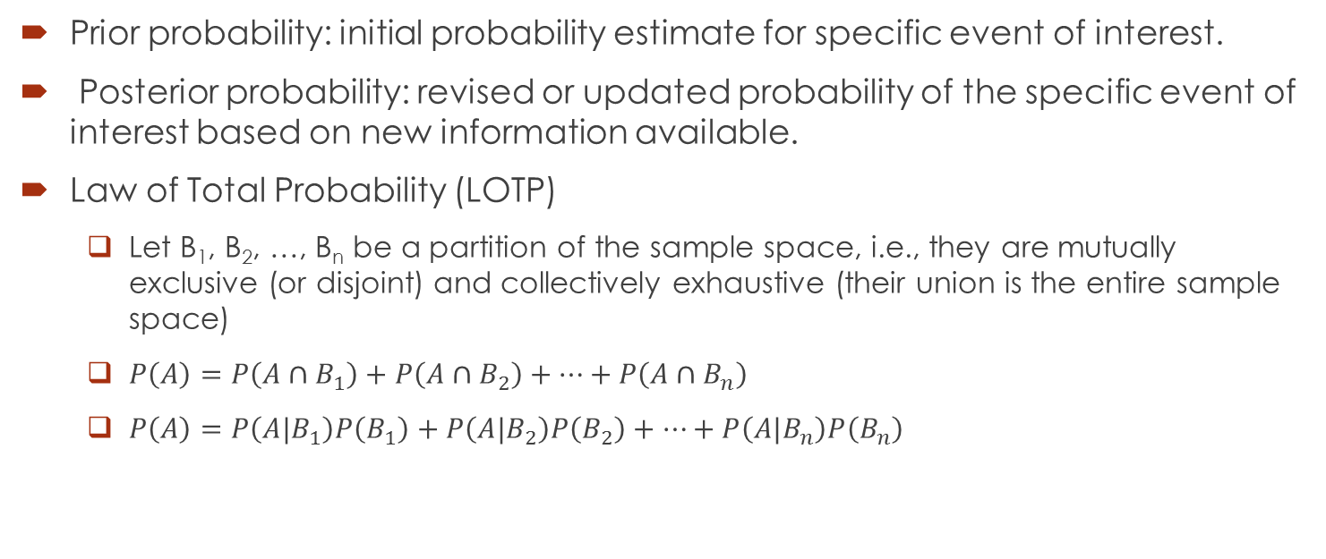
Bayes’ Theorem
Prior probability: initial probability estimate for specific event of interest.
Posterior probability: revised or updated probability of the specific event of interest based on new information available.
Law of Total Probability (LOTP)
Let B₁, B₂, …, B_{n} be a partition of the sample space, i.e., they are mutually exclusive (or disjoint) and collectively exhaustive (their union is the entire sample space)
$P\left(A\right)=P\left(A∩B_{1}\right)+P\left(A∩B_{2}\right)+⋯+P\left(A∩B_{n}\right)$
$P\left(A\right)=P\left(A|B_{1}\right)P\left(B_{1}\right)+P\left(A|B_{2}\right)P\left(B_{2}\right)+⋯+P\left(A|B_{n}\right)P\left(B_{n}\right)$

Slide 16
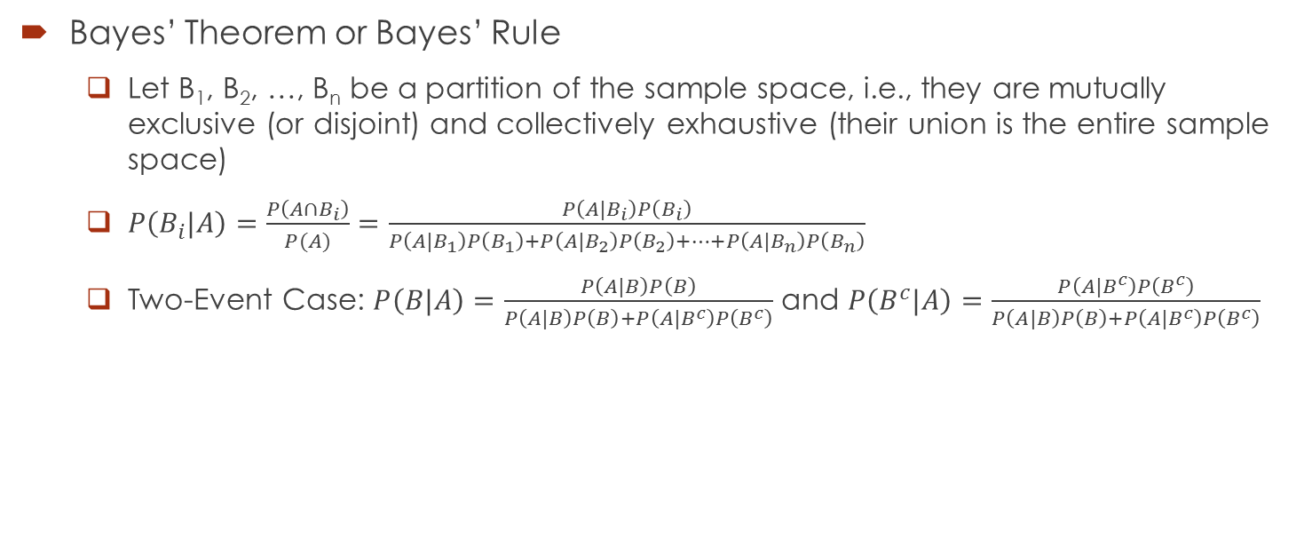
Bayes’ Theorem
Bayes’ Theorem or Bayes’ Rule
Let B₁, B₂, …, B_{n} be a partition of the sample space, i.e., they are mutually exclusive (or disjoint) and collectively exhaustive (their union is the entire sample space)
$P\left(B_{i}|A\right)=\frac{P\left(A∩B_{i}\right)}{P(A)}=\frac{P\left(A|B_{i}\right)P\left(B_{i}\right)}{P\left(A|B_{1}\right)P\left(B_{1}\right)+P\left(A|B_{2}\right)P\left(B_{2}\right)+⋯+P\left(A|B_{n}\right)P\left(B_{n}\right)}$
Two-Event Case: $P\left(B|A\right)=\frac{P\left(A|B\right)P\left(B\right)}{P\left(A|B\right)P\left(B\right)+P\left(A|B^{c}\right)P\left(B^{c}\right)}$ and $P\left(B^{c}|A\right)=\frac{P\left(A|B^{c}\right)P\left(B^{c}\right)}{P\left(A|B\right)P\left(B\right)+P\left(A|B^{c}\right)P\left(B^{c}\right)}$

