Slide 1
California State University, East Bay College of Business and Economics MGMT 6165 Prescriptive Analytics
Introduction to Optimization Modeling
Lecture Materials
Dr. Z. Radovilsky
Notes:
1
1

Slide 2
Learning Objectives
Define linear programming (LP) optimization model
Explain characteristics of LP models including objective criterion, limited resources, linear relationships, additivity, divisibility, and non-negativity
Formulate an LP model by understanding initial data and applying model’s decision variables, objective function, and constraints
Apply Excel Solver to identify optimal solutions
Analyze LP model’s optimal solutions with Excel Solver and Solver Add-in Table
Notes:
2
2

Slide 3
Optimization Model in Prescriptive Analytics
Optimization model is a business model that uses quantitative methods to identify the optimal (best) business and management solution(s) for a specific objective (goal, problem) in an organization
Objective: maximize returns (profits, sales, quality, etc.) with limited resources and other company constraints
Example: maximize return (revenue) of business investments; constraints represent limited financial resources (money) and needs for diversification of investments
Objective: minimize costs (number of employees, quality defects, etc.) while fulfilling production and service results
Example: develop a production plan that satisfies customer needs with the minimum used inventory and capacity resources
Multi-criteria optimal business and management decisions
Example: identify a mix of suppliers with the highest quality of supplies delivered on time and with minimum total cost

Slide 4
Linear Optimization: Linear Programming
Linear Programming (LP) is an important subset of a larger class of optimization models called mathematical programming models
LP enables managers to find optimal solutions to certain problems in which the solutions satisfy set of requirements, or constraints.
Usually constraints represent limited resources of production or service:
Materials (inventory), labor
Capacity, space
Technology and equipment
Diversification of investment
Demand and supply
Logical constraints

Slide 5
Product Mix Optimization
Bell Computers, Inc. is one of the world leaders in desktop and laptop personal computers. The company has recently introduced two new 7th Generation Intel Core i7 laptop computers: B-100 and B-200. The company produces these computers on the same assembly line. Then, the computers are tested and stored for a short time period before shipment. The assembly line, inspection, and storage space requirements for each product and respective daily capacities are presented in the following table:
Available B-100, per unit B-200, per unit Daily Capacity
____________________________________________________________________________
Assembly Time, hrs. 4 10 100
Inspection Time, hrs. 2 1 22
Storage Space, cub. ft. 3 3 39
____________________________________________________________________________
Bell Computers can earn $60 of profit per one unit of B-100 and $50 per one unit of B-200. The management of Bell Computers is attempting to determine the best possible daily schedule for B-100 and B-200 in order to maximize total profit.

Slide 6
Standard Linear Programming (LP) Requirements/Properties
Objective criterion – objective function
An LP problem must have one explicitly (quantitatively) defined objective criterion or objective function – a target (goal) to be optimized
Limited resources (constraints)
LP is a useful technique to analyze problems, which involve the consumption of limited resources
Linear relationship -- proportionality
If the level of any activity is multiplied by a constant factor, the contribution of this activity to the objective, or to any of the constraints in which the activity is involved, is multiplied by the same factor
Additivity
Implies that the contribution of any decision variable to the objective or to any constraint is independent of the levels of the other decision variables
Divisibility
Both non-integer and integer solution values are allowed
Non-negativity
Decision variables should have nonnegative values

Slide 7
Steps in Solving Optimization Problem
1. Model development/formulation – decide what the decision variables are, what the objective function is, which constraints are required, and how everything fits together
Mathematical (algebraic) model – derive the decision variables, objective, and constraints with correct algebraic expression
Spreadsheet model – relate the formulated model with appropriate cells and cell formulas
2. Optimization – identify optimal solution(s) to the problem
Choose the values of the decision variables that make the objective as large (for maximization) or small (for minimization) as possible and cause all of the constraints to be satisfied
In Excel, apply Solver add-in to derive the optimal solution
3. Sensitivity analysis – general analysis of the optimal solutions in case of input parameters are varying
It is wishful thinking to believe that all of the input values you use are exactly correct
Provide specific “what-if” analysis of the model’s input parameters

Slide 8
LP Model Development/Formulation
Understand the problem data
What is an objective of a problem?
What needs to be identified to reach the objective?
What are the constraints of the problem?
Explain input parameters of the model
Identify decision variables
Decision variables are variables (items) that affect an objective of a problem and the items for which a decision maker has a control over (number of products to produce, to distribute, finance resources, etc.)
Formulate objective function
Objective function is a mathematical form of a problem's objective (maximizing profits, minimizing costs, etc.), which includes the decision variables and known problem data
Determine constraints
Constraints represent any physical limitations or other restrictions imposed on the values of the decision variables of the problem:
Resource constraints (labor, materials, money)
Diversification of investments
Demand and supply constraints, etc.

Slide 9
Product Mix: LP Model Formulation
Decision variables:
B1 = number of B-100 units produced daily, units
B2 = number of B-200 units produced daily, units
Objective:
Maximize profit: 60B1 + 50B2
Constraints:
Assembly time <= 100 hrs.: 4B1 + 10B2 <= 100
Inspection time <= 22 hrs.: 2B1 + B2 <= 22
Storage space <= 39 cub. ft.: 3B1 + 3B2 <= 39
Nonnegativity: B1, B2 >= 0

Slide 10
Optimization Step
To optimize means that you must systematically choose the values of the decision variables that make the objective as large (for maximization) or small (for minimization) as possible and cause all of the constraints to be satisfied
Any set of values of the decision variables that satisfies all of the constraints is called a feasible solution
The set of all feasible solutions is called the feasible region
In contrast, an infeasible solution is a solution that violates at least one constraint
Infeasible solutions are disallowed

Slide 11
Graphical Solution for LP
Graphical linear programming is a relatively simple method for determining the optimal solution to LP models
This method can be used only for the LP models that involve two decision variables
The graphical approach to LP provides a visual portrayal of many important concepts that are used for the analytical solution of the LP models using the simplex method
Corner point
of the feasible region is a point of intersection of two or more constraints
The Corner Point Theorem
States that for an LP model that has an optimal solution, this solution will occur at a corner point

Slide 12
Graphical Solution to LP Models – Corner Point Approach
Corner point approach
Determine all corner points in the feasible solution region -basic feasible solutions
Calculate the value of the objective function in each corner point
Identify the optimal solution which is a corner point that optimizes the value of objective function

Slide 13
Simplex Method of LP
One algorithm for searching through the feasible region is called the simplex method, programmed into Excel’s Solver add-in
The simplex method approach
Based on the corner point theorem
Begins with an initial feasible solution that satisfies all constraints. It may not be optimal, but serves as a starting point
The simplex method iterative process consistently examines corner points with each subsequent solution at a corner point is better than the previous one
The LP solution is improved until no further improvement is possible, i.e., until the optimal solution has been identified

Slide 14
Excel Spreadsheet for Product Mix Model

Slide 15
Spreadsheet Model
There are many ways to develop an LP spreadsheet model
We do not provide exact prescriptions, but we do present enough examples to help you develop good habits
The common elements in all LP spreadsheet models are the inputs, decision variables (changing cells), objective function (objective cell), and constraints
Inputs
All numerical inputs – that is, all numeric data given in the statement of the problem – should appear somewhere in the spreadsheet
Color all of the input cells blue
Decision variable cells
Designated cells for the decision variables
The values in these cells must be allowed to vary freely, so there should not be any formulas in the changing cells
Color variable cells red

Slide 16
Spreadsheet Model (continued)
Objective function – objective cell
Contains the value of objective function
This cell must be linked, either directly or indirectly, to the changing cells by formulas
Color the objective cell gray
Constraints
Excel does not show the constraints directly on the spreadsheet, but you can provide the left-hand side (LHS) and right-hand side (RHS) for each constraint
Color the constraints cells green
Non-negativity constraints
Do not need to be written explicitly; you simply check an option in the Solver dialog box
Note, however, that if you want to constrain any other cells to be nonnegative, you must specify these constraints explicitly

Slide 17
Using Solver
Installing Solver Add-in
Go to File menu
Select Options
In Options menu, select Add-ins
In Add-ins menu, in Manage use Excel Add-ins (default option), and then click Go button
Check the box next to Solver Add-in, and click Ok
To invoke Excel’s Solver, select Solver from the Data ribbon
The Solver dialog boxes on the next slide should be completed as shown in the next slides
Three important sections
Set Objective - objective function cell
By Changing Variable Cells – decision variable cells
Subject to the Constraints – model constraints
Make Unconstrainted Variables Non-Negative – check the box
Select a Solving Method – Simplex LP

Slide 18
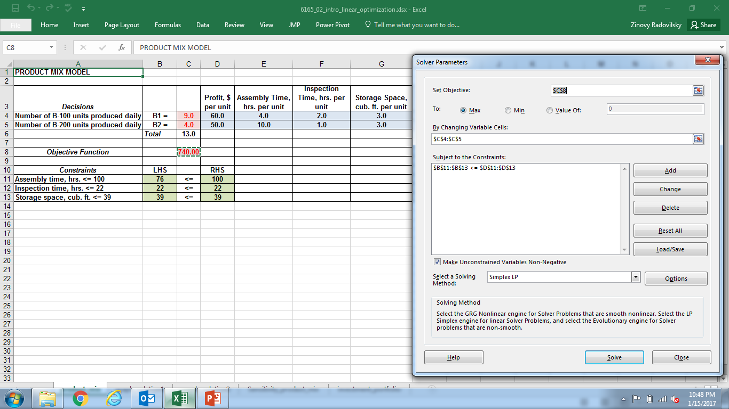
Excel Solver: Initial Input

Slide 19
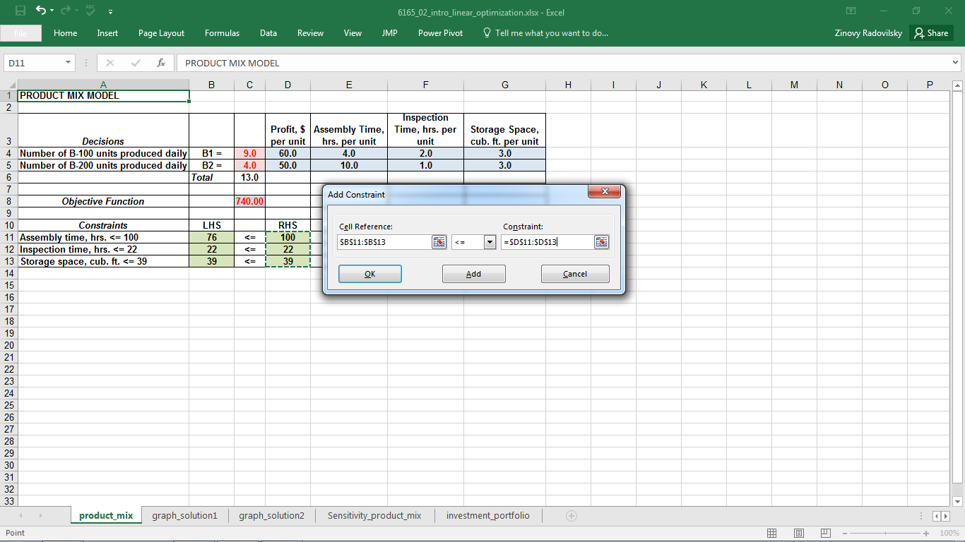
Excel Solver: Adding Constraint

Slide 20
Excel Solver Solution
Feasible solution is any solution that satisfies all constraints
Optimal solution is the best solution that optimizes objective function and satisfies all constraints
A problem that has no feasible solutions is called infeasible

Slide 21
Typical LP Solutions
Of all the inequality constraints, some are satisfied exactly and others are not.
An inequality constraint is binding if the solution makes it an equality. Otherwise, it is nonbinding
The positive difference between the two sides of the constraint is called the slack
In a typical solution, you should pay attention to two aspects
First, which of the changing cells are positive (as opposed to 0)
Generically, these are the “activities” that are done at a positive level
In a product mix model, they are the products included in the optimal mix
Second, you should check which of the constraints are binding. Again, these represent the bottlenecks that keep the objective from improving

Slide 22
Solver’s Sensitivity Report
Solver offers you the option to obtain a sensitivity report
The report is based on a well-established theory of sensitivity analysis in optimization models
Solver’s sensitivity report performs two types of sensitivity analysis:
On the coefficients of the objectives, the cs
On the right-hand sides of the constraints, the bs
On the Solver run, a sensitivity report is requested in Solver’s final dialog box
The sensitivity report appears on a new worksheet, and contains two sections
The top section is for sensitivity to changes in the coefficients. Each row in this section indicates how the optimal solution changes if one of these coefficients changes
The bottom section is for sensitivity to changes in the right sides. Each row in this section indicates how the optimal solution changes if one of these availabilities changes

Slide 23
Sensitivity Report

Slide 24
Solver’s Sensitivity Report (continued)
The reduced costs in the second column indicate, in general, how much the objective coefficient of a decision variable that is currently 0 must change before the variable changes
Each row in the bottom section corresponds to a constraint, although upper bound constraints on changing cells are omitted in this section
A shadow price indicates the change in the optimal value of the objective when the right-hand side of some constraint changes by one unit

Slide 25
SolverTable Add-in
SolverTable allows you to ask sensitivity questions about any of the input variables, not just coefficients of the objective and the right sides of constraints, and it provides straightforward answers.
The SolverTable add-in was developed to mimic Excel’s built-in data table tool. It can be used in two ways
One-way table: there is a single input cell and any number of output cells.
Two-way table: there are two input cells and one or more output cells.

Slide 26
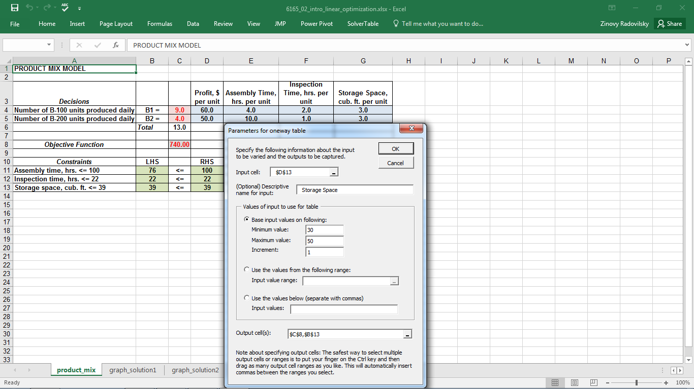
SolverTable Add-in (continued)

Slide 27
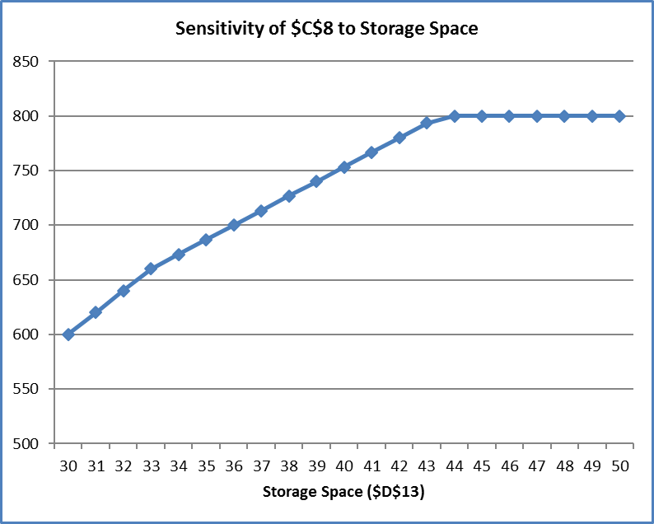
SolverTable Add-in (continued)

Slide 28
Solver’s Sensitivity Report vs. SolverTable
Solver’s sensitivity report focuses only on the coefficients of the objective and the right sides of the constraints. SolverTable allows you to vary any of the inputs
Solver’s sensitivity report provides very useful information through its reduced costs, shadow prices, and allowable increases and decreases. This same information can be obtained with SolverTable, but it requires a bit more work and some experimentation with the appropriate input ranges
Solver’s sensitivity report is based on changing only one objective coefficient or one right side at a time. This one-at-a-time restriction prevents you from answering certain questions directly. SolverTable is much more flexible in this respect
Solver’s sensitivity report is not even available for integer-constrained models, and its interpretation for nonlinear models is more difficult than for linear models. SolverTable’s outputs have the same interpretation for any type of optimization model
Solver’s sensitivity report comes with Excel. SolverTable is a separate add-in that is not included with Excel

Slide 29
Investment Portfolio Selection
First Investment Co. is located in San Francisco. First Investment has obtained $120 million by converting industrial bonds to cash and is now looking for other investment opportunities for this money. Considering the company's current investments, the firm's senior financial analyst recommends that all new investments should be made in the wireless technology companies (Wireless System and Mobile First), service organizations (Dell Comp Service and Huber Tech Service), or in government bonds. Specifically, the analyst has identified five investment opportunities and projected their annual rates of return:
_____________________________________
Projected Rate
Investment of Return (%)
_____________________________________
Wireless System 6.3
Mobile First 10.3
Dell Comp Service 6.9
Huber Tech Service 7.5
Government Bonds 4.5
_____________________________________
Management of First Investment Co. has imposed the following investment guidelines:
Neither industry (wireless technology or service) should receive more than $60 million of the total investment.
Government bonds should be at least 25% of the wireless industry and service investments.
The investment in Mobile First, a high-return but high-risk investment, cannot be more than 60% of the total wireless industry investment.
What portfolio recommendations (investments and amounts) should be made for the available $120 million?

Slide 30
Investment Portfolio: LP Model Formulation
Decision variables:
X_{W} = investment in Wireless System, $ mln
X_{M} = investment in Mobile First, $ mln
X_{D} = investment in Dell Comp Service, $ mln
X_{H} = investment in Huber Tech Service, $ mln
X_{G} = investment in government bonds, $ mln
Objective Function: Maximize total return
Max 0.063X_{W} + 0.103X_{M} + 0.069X_{D} + 0.075X_{H} + 0.045X_{G}
Constraints:
Wireless industry <= $60 mln: X_{W} + X_{M} <= 60
Service industry <= $60 mln: X_{D} + X_{H} <= 60
Gov. bonds = > 25%: X_{G} >= 0.25 (X_{W} + X_{M} + X_{D} + X_{H})
Mobile First <= 60%: X_{M} <= 0.6(X_{W} + X_{M})
Total investment =$120 mln: X_{W} + X_{M} + X_{D} + X_{H} + X_{G} = 120
Nonnegativity: X_{W}, X_{M}, X_{D}, X_{H}, X_{G} >= 0

Slide 31
Initial Input

Slide 32
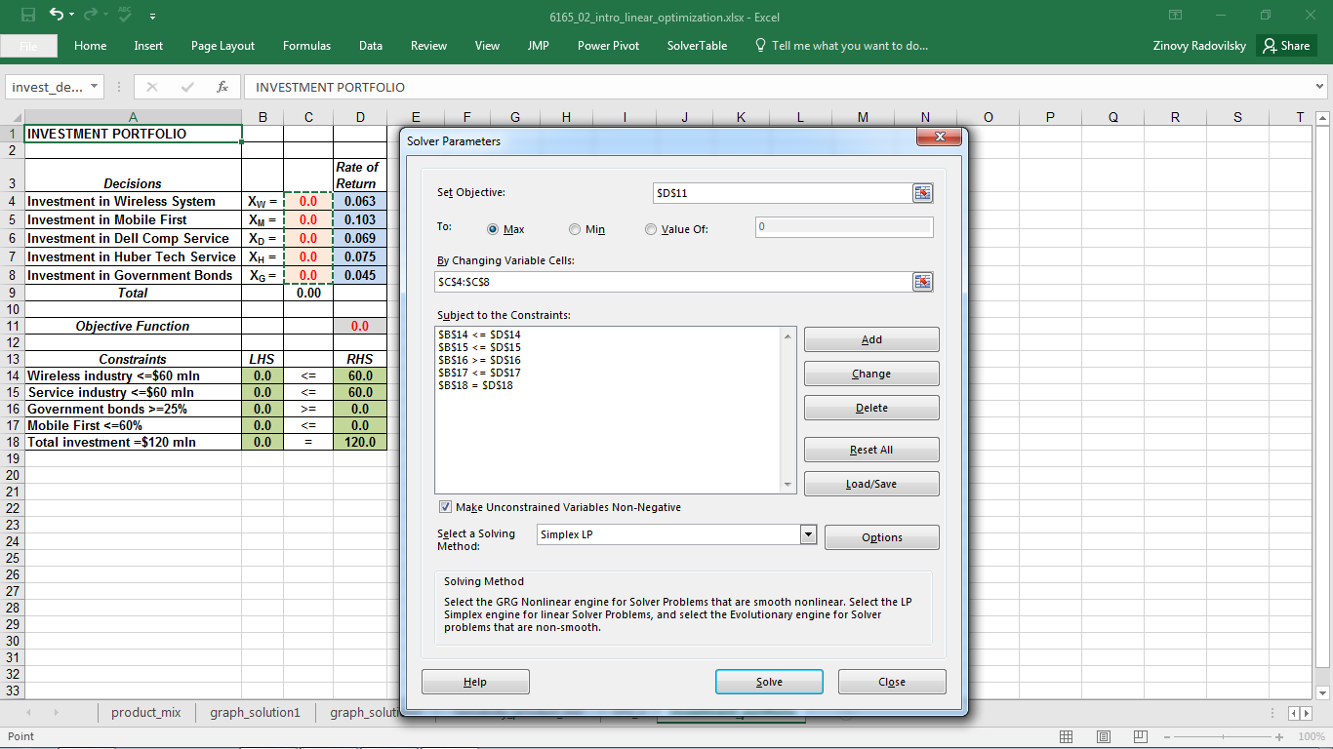
Solver Input

