Slide 1
Hypothesis Testing

Slide 2
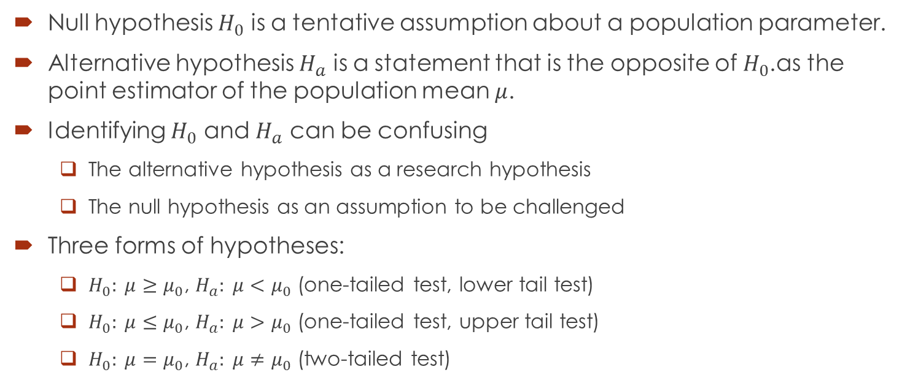
Null and Alternative Hypotheses
Null hypothesis $H_{0}$ is a tentative assumption about a population parameter.
Alternative hypothesis $H_{a}$ is a statement that is the opposite of $H_{0}$.as the point estimator of the population mean $μ$.
Identifying $H_{0}$ and $H_{a}$ can be confusing
The alternative hypothesis as a research hypothesis
The null hypothesis as an assumption to be challenged
Three forms of hypotheses:
$H_{0}: μ≥μ_{0}$, $H_{a}: μ<μ_{0}$ (one-tailed test, lower tail test)
$H_{0}: μ≤μ_{0}$, $H_{a}: μ>μ_{0}$ (one-tailed test, upper tail test)
$H_{0}: μ=μ_{0}$, $H_{a}: μ≠μ_{0}$ (two-tailed test)

Slide 3
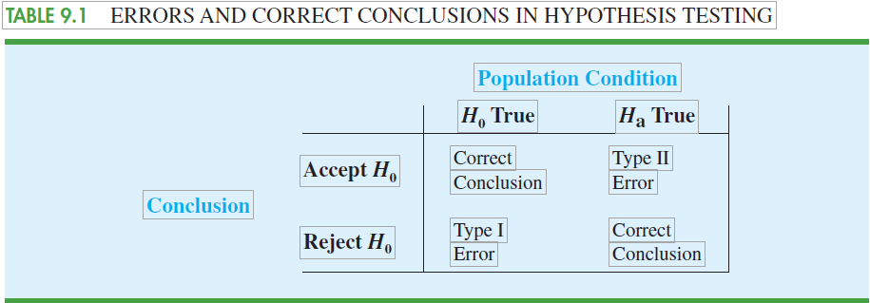
Type I and Type II Errors

Slide 4
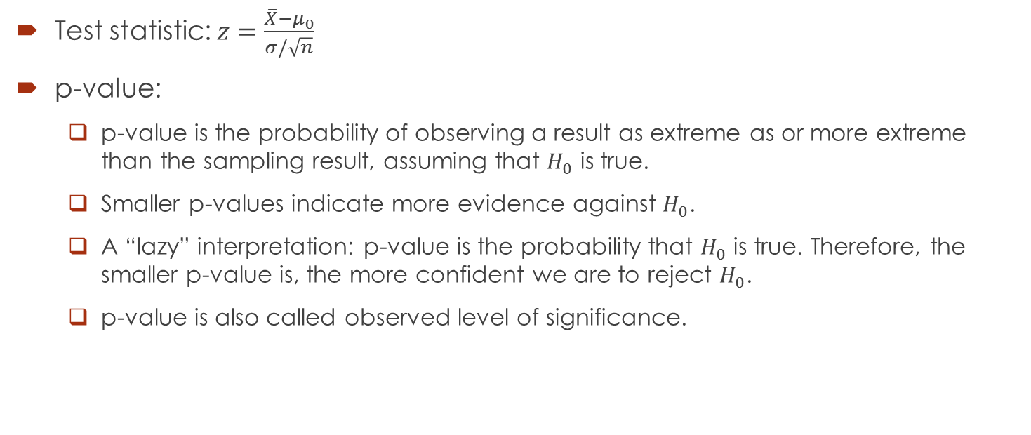

One-Tailed Hypothesis Test of Population Mean: $σ$ Known
Test statistic: $z=\frac{\overline{X}−μ_{0}}{σ/\sqrt{n}}$
p-value:
p-value is the probability of observing a result as extreme as or more extreme than the sampling result, assuming that $H_{0}$ is true.
Smaller p-values indicate more evidence against $H_{0}$.
A “lazy” interpretation: p-value is the probability that $H_{0}$ is true. Therefore, the smaller p-value is, the more confident we are to reject $H_{0}$.
p-value is also called observed level of significance.

Slide 5

One-Tailed Hypothesis Test of Population Mean: $σ$ Known
Computing p-value:
Suppose the cdf of test statistic is F(.), which is normal distribution.
Upper tail test: p-value = 1 – F(z)
Lower tail test: p-value = F(z)
Rejection rule using p-value:
Reject $H_{0}$ if p-value $≤α$.

Slide 6

One-Tailed Hypothesis Test of Population Mean: $σ$ Known
Critical value approach: Let $F^{−1}(.)$ be the inverse cdf.
In lower tail test, critical value $z_{α}=F^{−1}(α)$. Reject $H_{0}$ if ${z≤z}_{α}$.
In upper tail test, critical value $z_{α}=F^{−1}(1−α)$. Reject $H_{0}$ if ${z≥z}_{α}$.
Alternatively in any one-tailed test, reject $H_{0}$ if ${|z|≥|z}_{α}|$.

Slide 7
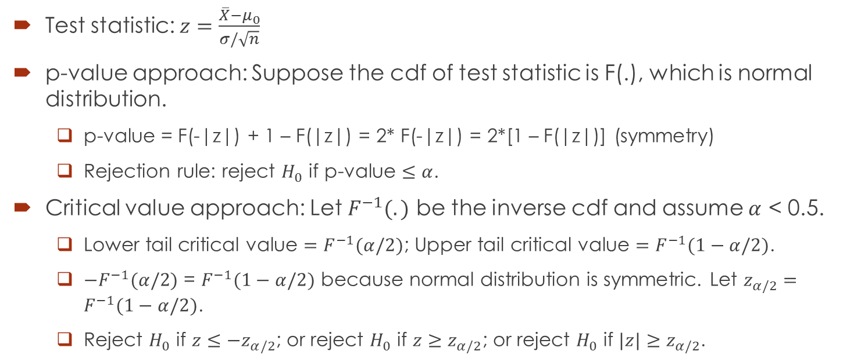

Two-Tailed Hypothesis Test of Population Mean: $σ$ Known
Test statistic: $z=\frac{\overline{X}−μ_{0}}{σ/\sqrt{n}}$
p-value approach: Suppose the cdf of test statistic is F(.), which is normal distribution.
p-value = F(-|z|) + 1 – F(|z|) = 2* F(-|z|) = 2*[1 – F(|z|)] (symmetry)
Rejection rule: reject $H_{0}$ if p-value $≤α$.
Critical value approach: Let $F^{−1}(.)$ be the inverse cdf and assume $α$ < 0.5.
Lower tail critical value $=F^{−1}(α/2)$; Upper tail critical value $=F^{−1}(1−α/2)$.
$−F^{−1}(α/2)$ = $F^{−1}(1−α/2)$ because normal distribution is symmetric. Let $z_{α/2}=F^{−1}(1−α/2)$.
Reject $H_{0}$ if ${z≤−z}_{α/2}$; or reject $H_{0}$ if ${z≥z}_{α/2}$; or reject $H_{0}$ if ${|z|≥z}_{α/2}$.

Slide 8
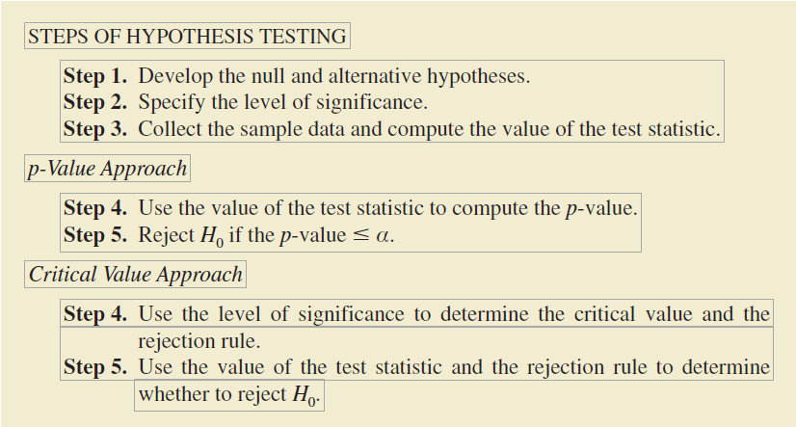
Steps of Hypothesis Testing

Slide 9
Example
Individuals filing federal income tax returns prior to March 31 received an average refund of $1056. Consider the population of “last-minute” filers who mail their tax return during the last five days of the income tax period (typically April 10 to April 15).
A researcher suggests that individuals who wait until the last five days on average these receive lower refunds than do early filers. Develop appropriate hypotheses such that rejection of H0 will support the researcher’s contention.
For a sample of 400 individuals who filed a tax return between April 10 and 15, the sample mean refund was $910. Based on prior experience a population standard deviation of σ = $1600 may be assumed. What is the p-value?
At α = .05, what is your conclusion?
Repeat the preceding hypothesis test using the critical value approach.

Slide 10
Example
Wall Street securities firms paid out record year-end bonuses of $125,500 per employee for 2005. Suppose we would like to take a sample of employees at the Jones & Ryan securities firm to see whether the mean year-end bonus is different from the reported mean of $125,500 for the population.
State the null and alternative hypotheses you would use to test whether the year-end bonuses paid by Jones & Ryan were different from the population mean.
Suppose a sample of 40 Jones & Ryan employees showed a sample mean year-end bonus of $118,000. Assume a population standard deviation of σ = $30,000 and compute the p-value.
With α = .05 as the level of significance, what is your conclusion?
Repeat the preceding hypothesis test using the critical value approach.

Slide 11
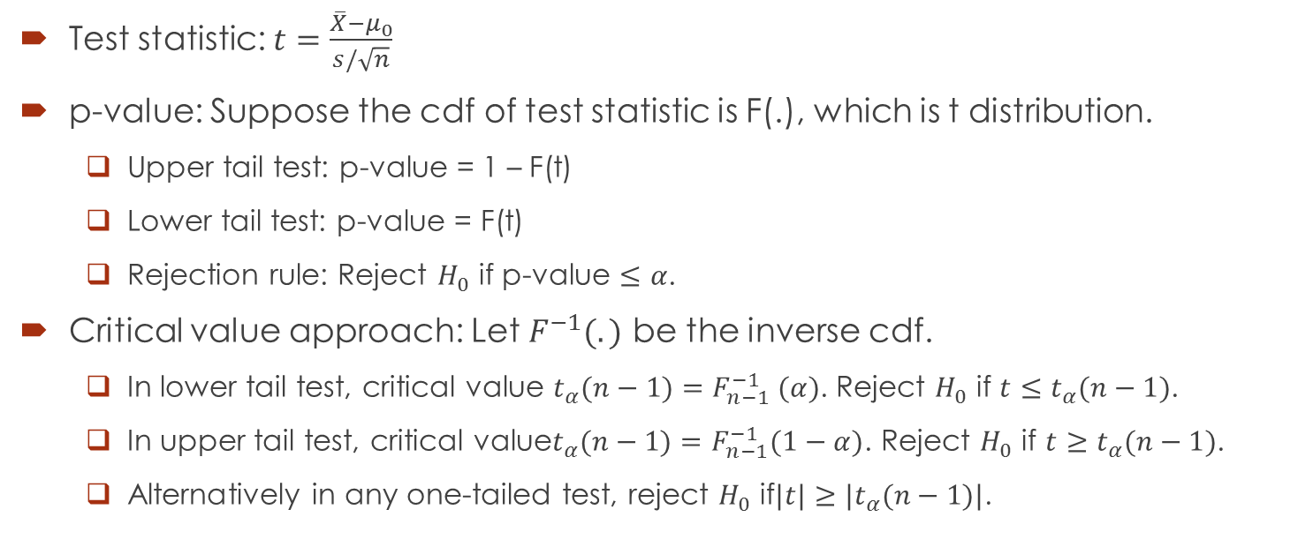

One-Tailed Hypothesis Test of Population Mean: $σ$ Unknown
Test statistic: $t=\frac{\overline{X}−μ_{0}}{s/\sqrt{n}}$
p-value: Suppose the cdf of test statistic is F(.), which is t distribution.
Upper tail test: p-value = 1 – F(t)
Lower tail test: p-value = F(t)
Rejection rule: Reject $H_{0}$ if p-value $≤α$.
Critical value approach: Let $F^{−1}(.)$ be the inverse cdf.
In lower tail test, critical value $t_{α}(n−1)=F_{n−1}^{−1} (α)$. Reject $H_{0}$ if ${t≤t}_{α}(n−1)$.
In upper tail test, critical value$t_{α}(n−1)=F_{n−1}^{−1}(1−α)$. Reject $H_{0}$ if $t≥t_{α}(n−1)$.
Alternatively in any one-tailed test, reject $H_{0}$ if$|t|≥|t_{α}(n−1)|$.

Slide 12
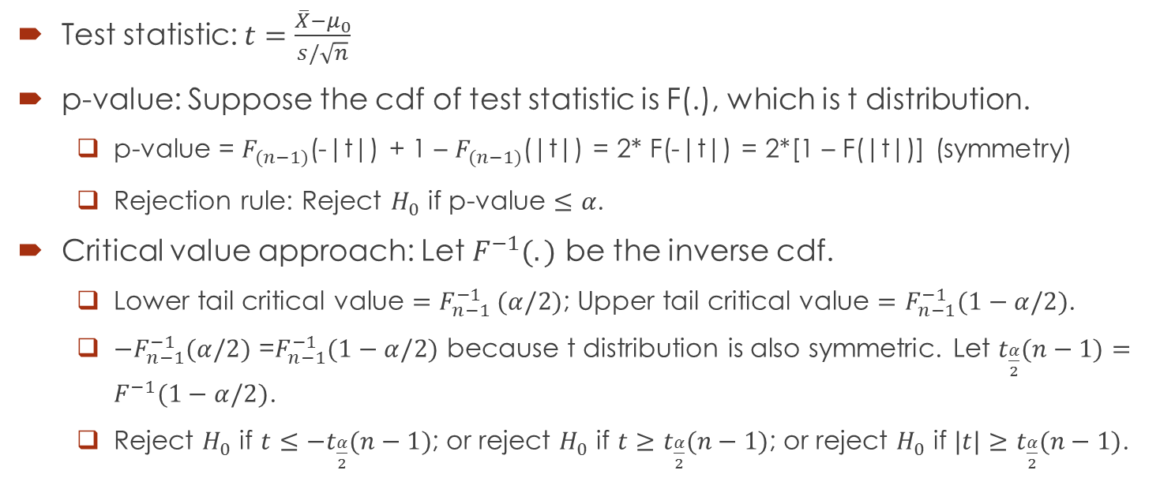

Two-Tailed Hypothesis Test of Population Mean: $σ$ Unknown
Test statistic: $t=\frac{\overline{X}−μ_{0}}{s/\sqrt{n}}$
p-value: Suppose the cdf of test statistic is F(.), which is t distribution.
p-value = $F_{(n−1)}$(-|t|) + 1 – $F_{(n−1)}$(|t|) = 2* F(-|t|) = 2*[1 – F(|t|)] (symmetry)
Rejection rule: Reject $H_{0}$ if p-value $≤α$.
Critical value approach: Let $F^{−1}(.)$ be the inverse cdf.
Lower tail critical value $=F_{n−1}^{−1} (α/2)$; Upper tail critical value $=F_{n−1}^{−1}(1−α/2)$.
$−F_{n−1}^{−1}(α/2)$ =$F_{n−1}^{−1}(1−α/2)$ because t distribution is also symmetric. Let $t_{\frac{α}{2}}(n−1)=F^{−1}(1−α/2)$.
Reject $H_{0}$ if $t≤−t_{\frac{α}{2}}(n−1)$; or reject $H_{0}$ if $t≥t_{\frac{α}{2}}(n−1)$; or reject $H_{0}$ if $|t|≥t_{\frac{α}{2}}(n−1)$.

Slide 13
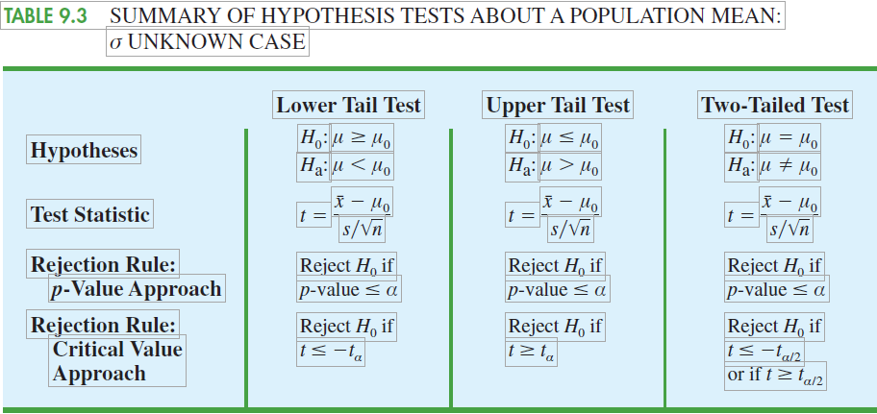

Summary of Hypothesis Tests About Population Mean: $σ$ Unknown

Slide 14
Example
The Employment and Training Administration reported that the U.S. mean unemployment insurance benefit was $238 per week. A researcher in the state of Virginia anticipated that sample data would show evidence that the mean weekly unemployment insurance benefit in Virginia was below the national average.
Develop appropriate hypotheses such that rejection of H0 will support the researcher’s contention.
For a sample of 100 individuals, the sample mean weekly unemployment insurance benefit was $231 with a sample standard deviation of $80. What is the p-value?
At α = .05, what is your conclusion?
Repeat the preceding hypothesis test using the critical value approach.

Slide 15
Example
AOL Time Warner Inc.’s CNN has been the longtime ratings leader of cable television news. Nielsen Media Research indicated that the mean CNN viewing audience was 600,000 viewers per day. Assume that for a sample of 40 days, the daily audience was 612,000 viewers with a sample standard deviation of 65,000 viewers.
What are the hypotheses if CNN management would like information on any change in the CNN viewing audience?
What is the p-value?
Select your own level of significance. What is your conclusion?
What recommendation would you make to CNN management in this application?

Slide 16
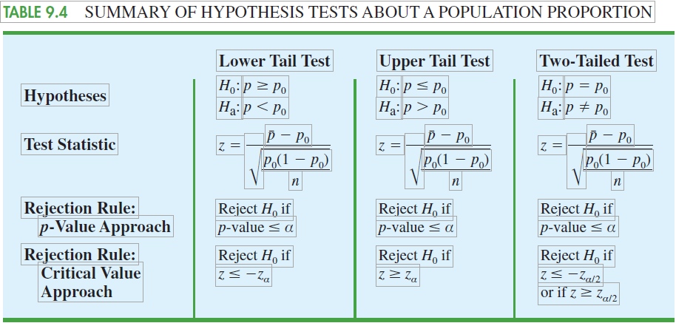
Hypothesis Test About Population Proportion

Slide 17
Example
A study found that, in 2005, 12.5% of U.S. workers belonged to unions (The Wall Street Journal, January 21, 2006). Suppose a sample of 400 U.S. workers is collected in 2006 to determine whether union efforts to organize have increased union membership.
Formulate the hypotheses that can be used to determine whether union membership increased in 2006.
If the sample results show that 52 of the workers belonged to unions, what is the p-value for your hypothesis test?
At α = .05, what is your conclusion?

Slide 18
Example
A study by Consumer Reports showed that 64% of supermarket shoppers believe super-market brands to be as good as national name brands. To investigate whether this result applies to its own product, the manufacturer of a national name-brand ketchup asked a sample of shoppers whether they believed that supermarket ketchup was as good as the national brand ketchup.
Formulate the hypotheses that could be used to determine whether the percentage of supermarket shoppers who believe that the supermarket ketchup was as good as the national brand ketchup differed from 64%.
If a sample of 100 shoppers showed 52 stating that the supermarket brand was as good as the national brand, what is the p-value?
At α = .05, what is your conclusion?
Should the national brand ketchup manufacturer be pleased with this conclusion? Explain.

Slide 19

Calculating the Probability of Type II Errors
$β$: probability of Type II error
1- $β$: power
Power curve: for a given $μ$, the probability of correctly rejecting H₀ and accepting H_{a}.

Slide 20
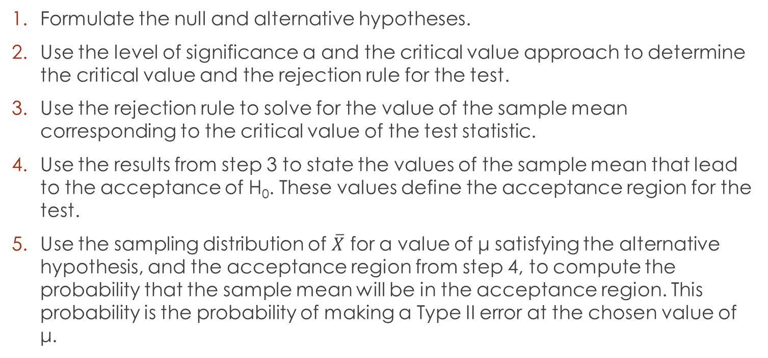

Step-by-step Procedure for Computing $β$
Formulate the null and alternative hypotheses.
Use the level of significance α and the critical value approach to determine the critical value and the rejection rule for the test.
Use the rejection rule to solve for the value of the sample mean corresponding to the critical value of the test statistic.
Use the results from step 3 to state the values of the sample mean that lead to the acceptance of H₀. These values define the acceptance region for the test.
Use the sampling distribution of $\overline{X}$ for a value of μ satisfying the alternative hypothesis, and the acceptance region from step 4, to compute the probability that the sample mean will be in the acceptance region. This probability is the probability of making a Type II error at the chosen value of μ.

Slide 21
Example
Fowle Marketing Research, Inc., bases charges to a client on the assumption that telephone surveys can be completed within 15 minutes or less. If more time is required, a premium rate is charged. With a sample of 35 surveys, a population standard deviation of 4 minutes, and a level of significance of .01, the sample mean will be used to test the null hypothesis H₀: μ <= 15.
What is your interpretation of the Type II error for this problem? What is its impact on the firm?
What is the probability of making a Type II error when the actual mean time is μ = 17 minutes?
What is the probability of making a Type II error when the actual mean time is μ = 18 minutes?

