Slide 1
Sampling Distribution and Central Limit Theorem

Slide 2
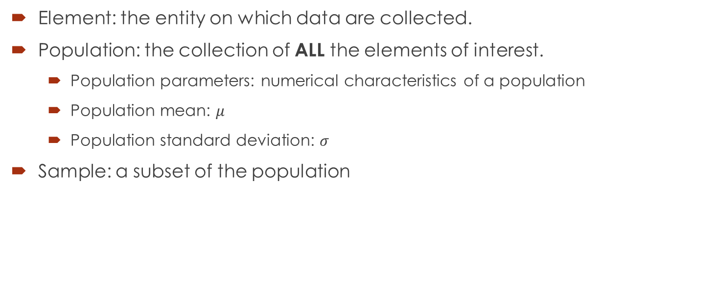
Population and Sample
Element: the entity on which data are collected.
Population: the collection of ALL the elements of interest.
Population parameters: numerical characteristics of a population
Population mean: $μ$
Population standard deviation: $σ$
Sample: a subset of the population

Slide 3
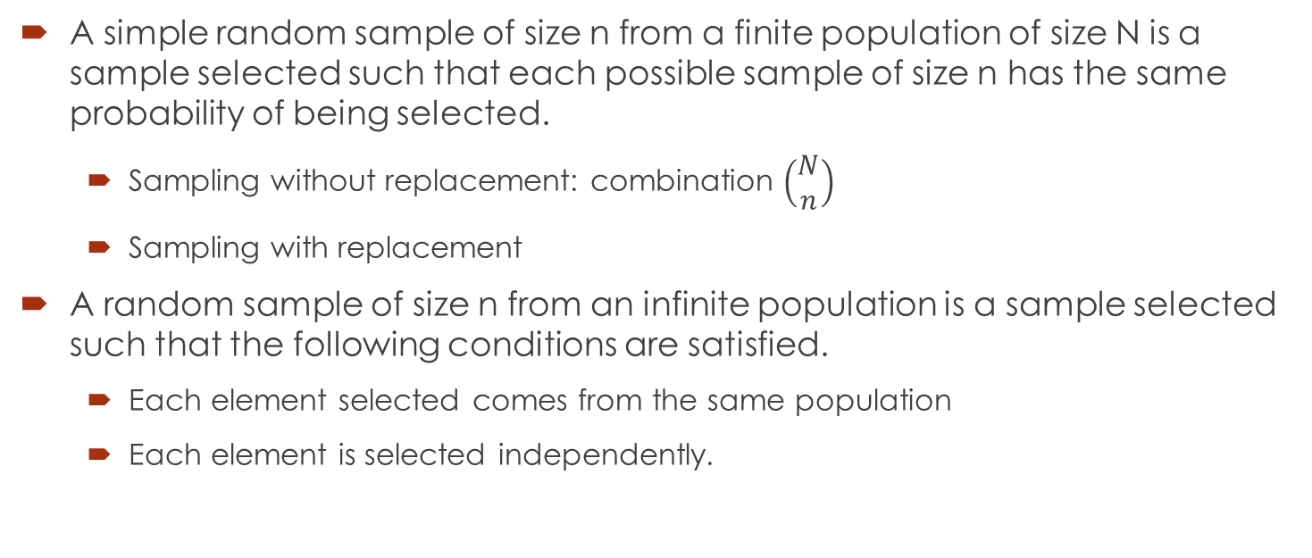
Sampling
A simple random sample of size n from a finite population of size N is a sample selected such that each possible sample of size n has the same probability of being selected.
Sampling without replacement: combination $\left(\begin{matrix}N \\ n\end{matrix}\right)$
Sampling with replacement
A random sample of size n from an infinite population is a sample selected such that the following conditions are satisfied.
Each element selected comes from the same population
Each element is selected independently.

Slide 4
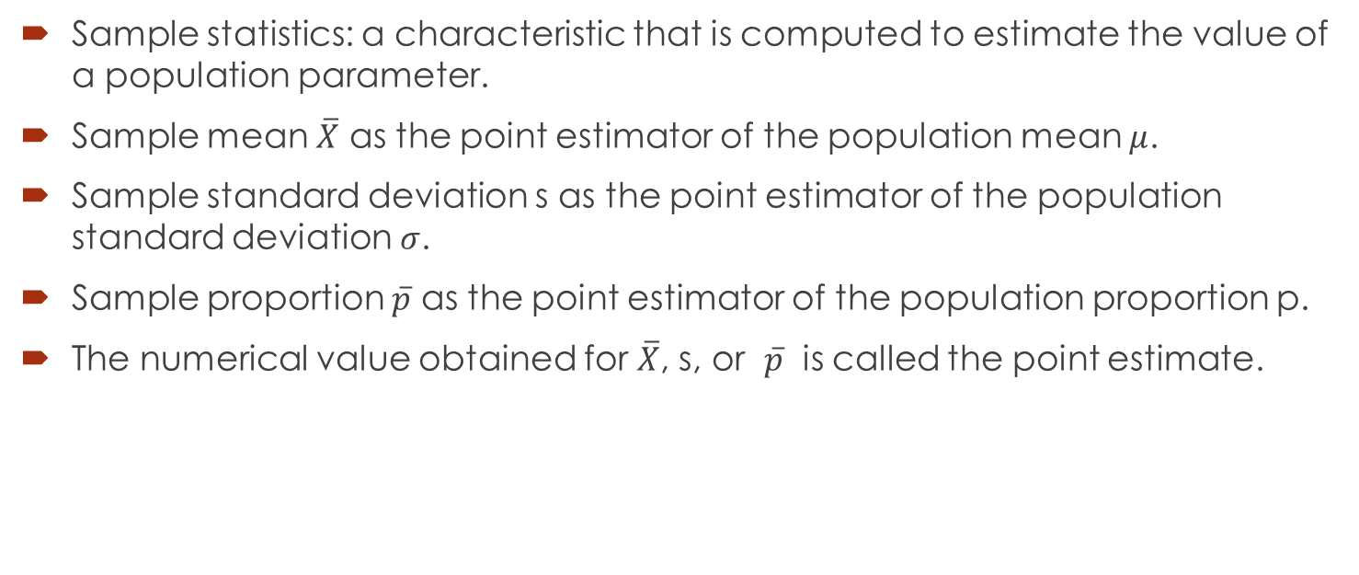
Point Estimation
Sample statistics: a characteristic that is computed to estimate the value of a population parameter.
Sample mean $\overline{X}$ as the point estimator of the population mean $μ$.
Sample standard deviation s as the point estimator of the population standard deviation $σ$.
Sample proportion $\overline{p}$ as the point estimator of the population proportion p.
The numerical value obtained for $\overline{X}$, s, or $\overline{p}$ is called the point estimate.

Slide 5
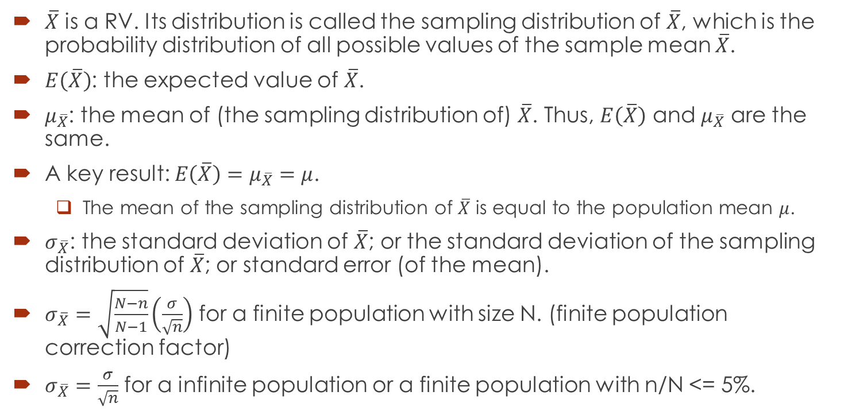

Sampling Distribution of $\overline{X}$
$\overline{X}$ is a RV. Its distribution is called the sampling distribution of $\overline{X}$, which is the probability distribution of all possible values of the sample mean $\overline{X}$.
$E\left(\overline{X}\right)$: the expected value of $\overline{X}$.
$μ_{\overline{X}}$: the mean of (the sampling distribution of) $\overline{X}$. Thus, $E\left(\overline{X}\right)$ and $μ_{\overline{X}}$ are the same.
A key result: $E\left(\overline{X}\right)=μ_{\overline{X}}=μ$.
The mean of the sampling distribution of $\overline{X}$ is equal to the population mean $μ$.
$σ_{\overline{X}}$: the standard deviation of $\overline{X}$; or the standard deviation of the sampling distribution of $\overline{X}$; or standard error (of the mean).
$σ_{\overline{X}}=\sqrt{\frac{N−n}{N−1}}\left(\frac{σ}{\sqrt{n}}\right)$ for a finite population with size N. (finite population correction factor)
$σ_{\overline{X}}=\frac{σ}{\sqrt{n}}$ for a infinite population or a finite population with n/N <= 5%.

Slide 6
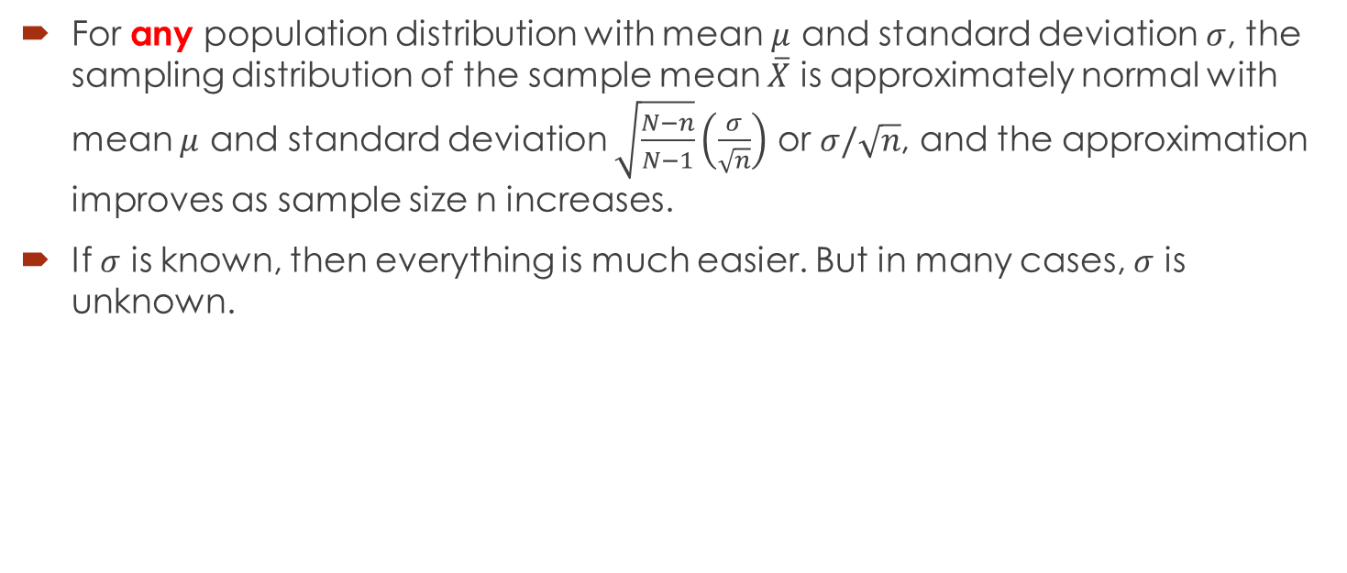
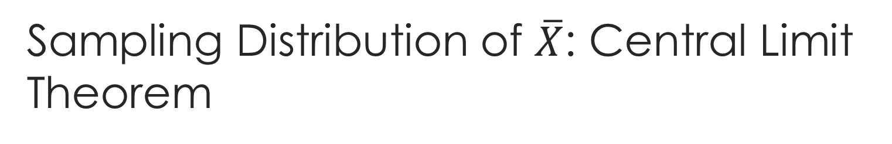
Sampling Distribution of $\overline{X}$: Central Limit Theorem
For any population distribution with mean $μ$ and standard deviation $σ$, the sampling distribution of the sample mean $\overline{X}$ is approximately normal with mean $μ$ and standard deviation $\sqrt{\frac{N−n}{N−1}}\left(\frac{σ}{\sqrt{n}}\right)$ or $σ/\sqrt{n}$, and the approximation improves as sample size n increases.
If $σ$ is known, then everything is much easier. But in many cases, $σ$ is unknown.

Slide 7
Example
The mean annual cost of automobile insurance is $939. Assume that the standard deviation is σ = $245.
What is the probability that a simple random sample of automobile insurance policies will have a sample mean within $25 of the population mean for each of the following sample sizes: 30, 50, 100, and 400?
What is the advantage of a larger sample size when attempting to estimate the population mean?

Slide 8
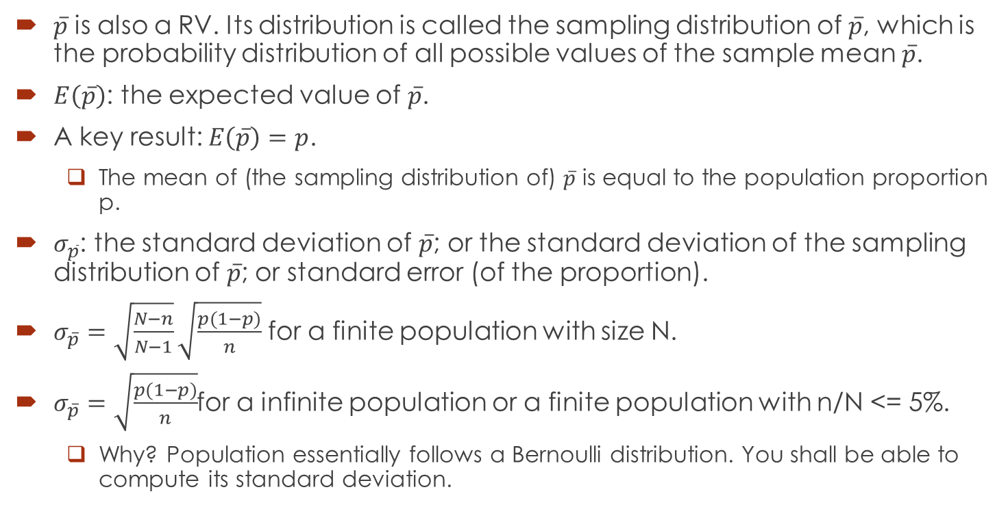

Sampling Distribution of $\overline{p}$
$\overline{p}$ is also a RV. Its distribution is called the sampling distribution of $\overline{p}$, which is the probability distribution of all possible values of the sample mean $\overline{p}$.
$E\left(\overline{p}\right)$: the expected value of $\overline{p}$.
A key result: $E\left(\overline{p}\right)=p$.
The mean of (the sampling distribution of) $\overline{p}$ is equal to the population proportion p.
$σ_{\overline{p}}$: the standard deviation of $\overline{p}$; or the standard deviation of the sampling distribution of $\overline{p}$; or standard error (of the proportion).
$σ_{\overline{p}}=\sqrt{\frac{N−n}{N−1}}\sqrt{\frac{p(1−p)}{n}}$ for a finite population with size N.
$σ_{\overline{p}}=\sqrt{\frac{p(1−p)}{n}}$for a infinite population or a finite population with n/N <= 5%.
Why? Population essentially follows a Bernoulli distribution. You shall be able to compute its standard deviation.

Slide 9

Sampling Distribution of $\overline{p}$
The sampling distribution of $\overline{p}$ can be approximated by a normal distribution whenever np>=5 and n(1-p)>= 5.
Sample size n should be sufficiently large.

Slide 10
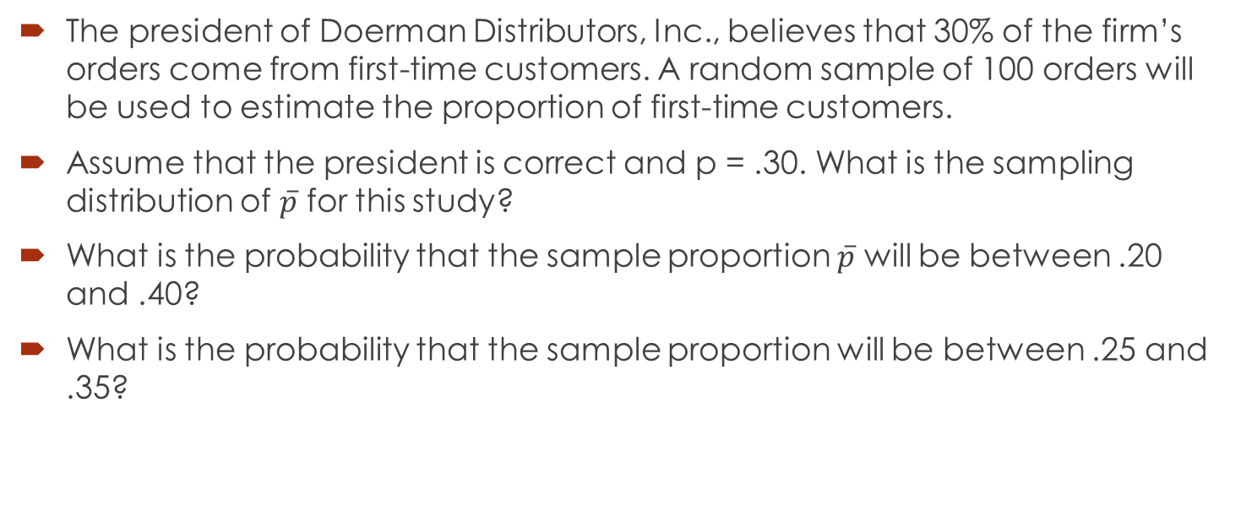
Example
The president of Doerman Distributors, Inc., believes that 30% of the firm’s orders come from first-time customers. A random sample of 100 orders will be used to estimate the proportion of first-time customers.
Assume that the president is correct and p = .30. What is the sampling distribution of $\overline{p}$ for this study?
What is the probability that the sample proportion $\overline{p}$ will be between .20 and .40?
What is the probability that the sample proportion will be between .25 and .35?

Slide 11
Properties of (Good) Point Estimators
Unbiased: the expected value of the sample statistic is equal to the population parameter.
Efficiency: the point estimator with smaller standard error is said to have greater relative efficiency.
Consistency: a point estimator is consistent if the values of the point estimator tend to become closer to the population parameter as the sample size increases.

Slide 12
Other Sampling Methods
Stratified Random Sampling:
The elements in the population are first divided into groups called strata, such that each element in the population belongs to one and only one stratum.
A simple random sample is taken from each stratum.
Cluster Sampling
The elements in the population are first divided into groups called clusters, such that each element in the population belongs to one and only one cluster
A simple random sample of the clusters is taken. All elements in randomly selected clusters form the sample.

Slide 13
Other Sampling Methods
Systematic Sampling
Convenience Sampling (a non-probability sampling)
Judgment Sampling: person most knowledgeable on the subject selects elements that s/he feels are most representative of the population.

