Slide 1
ITM 6280: Data Warehousing
Chapter 17
DW/BI Lifecycle

Slide 2
Agenda
Recap: ETL Subsystems
DW/BI Lifecycle
Homework 2 discussion
SSAS – Creating Time Series Data Mining Structure with Movie Database

Slide 3
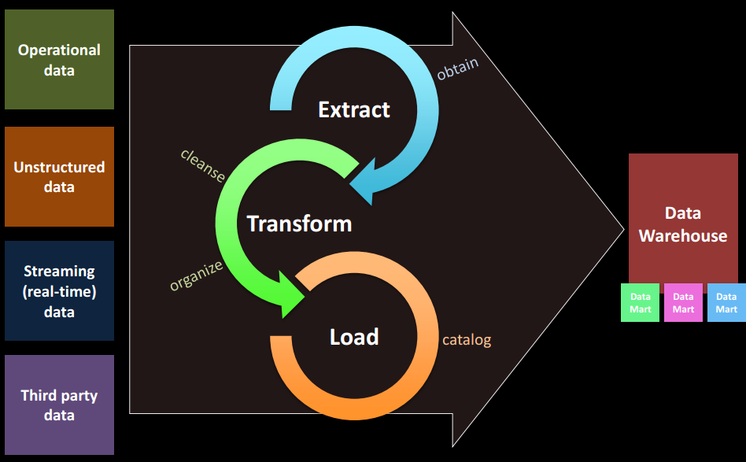
ETL Process

Slide 4
Ten Requirements for ETL
Business Needs
Compliance
Data Quality
Security
Data Integration
Data Latency
Archiving
BI Delivery Interface
Available Skills
Legacy Licenses

Slide 5
Subsystems of ETL
Subsystem 1: Data Profiling
Subsystem 2: Change Data Capture System
Subsystem 3: Extract System
Subsystem 4: Data Cleansing System
Subsystem 5: Error Event Schema
Subsystem 6: Audit Dimension Assembler
Subsystem 7: Conforming System
Subsystem 8: Delivering – SCD, OLAP, Hierarchy etc…

Slide 6
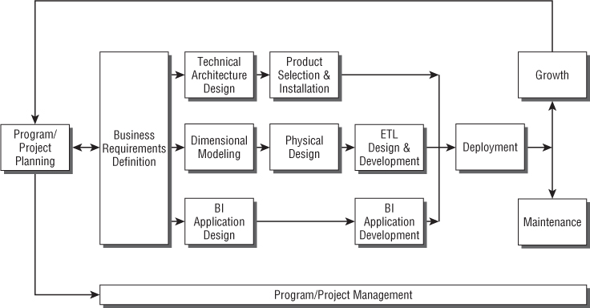
Kimball Lifecycle Diagram

Slide 7
Program/Project Planning and Management
Scoping: Scope of DW/BI project should be meaningful and manageable
Justification: Estimation of benefit and cost
Staffing: Cross-functional team with resources from both business and IT

Slide 8
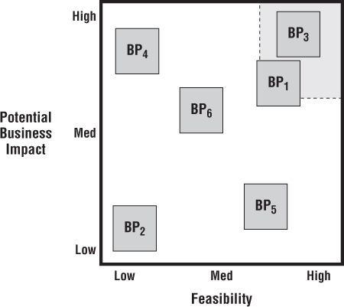
Business Requirements Definition
Requirement Planning
Find how business decisions are made
Prepare requirements team
Collecting, Documenting and Prioritizing Requirements

Slide 9
Technical Architecture Design
Establish an Architecture Task Force
Collect Architecture Requirements
Document Architecture Requirements
Create Architecture Model
Determine implementation phases
Design and specify the Subsystems
Review and finalize the Architecture

Slide 10
Product Selection and Installation
Understand the Corporate Purchasing Process
Develop a Product Evaluation Matrix
Conduct Market Research
Evaluate a Short List of Options
If necessary, conduct a Prototype
Select Product, Install on Trial

Slide 11
Dimension Modeling
Map the Dimension Model
Use Conformed Dimensions
Create DW Enterprise Bus Matrix
OLAP

Slide 12
Physical Design
Develop Naming and Database Standards
Develop Physical Database Model
Design Aggregations, OLAP Database
Finalize Physical Storage Detail

Slide 13
ETL Design and Develpment
Identify ETL subsystems

Slide 14
BI Application Specification
Create parameter-driven BI applications (templates) which will satisfy a large percentage of the business users needs.

Slide 15
BI Application Development
Focus on standards, naming conventions, calculations, libraries, codes to minimize future rework.

Slide 16
Deployment
Perform end-to-end system testing.
Provide a user’s manual guide.

Slide 17
Maintenance and Growth
Technical and program support.
Education.
Growth for new project, data, applications, enhancement.

Slide 18
Thank You. Have a great life ahead
Do not forget to submit your course evaluation

