Slide 1
ITM 6280: Data Warehousing
Chapter 19
ETL Subsystems

Slide 2
Agenda
Recap: Subtype/supertype
ETL subsystems
Homework 2 discussion
SSAS – Creating Enterprise Bus Architecture

Slide 3
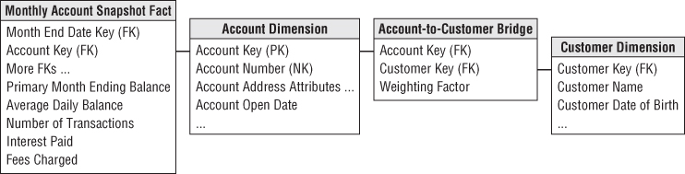
Recap: Multivalued Dimensions
How to represent accounts with multiple account holders?
Use Account-to-Customer bridge table with weighting factor

Slide 4
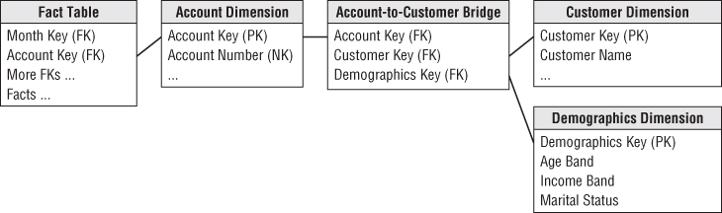
Recap: Adding a Mini Dimension to a Bridge Table
How to represent a very large account-to-bridge table with a rapidly changing dimension?
Add a mini dimension

Slide 5
Recap: Supertype and Subtype
When do we use a single supertype fact table?
Global view
Insight into the complete account portfolio across all lines of business.
When do we use special subtype fact tables for each line of business?
Focus on the in-depth details of one business, such as checking.

Slide 6
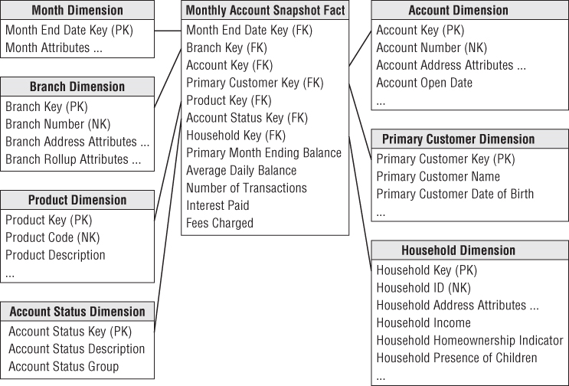
Supertype Fact table for all Accounts

Slide 7
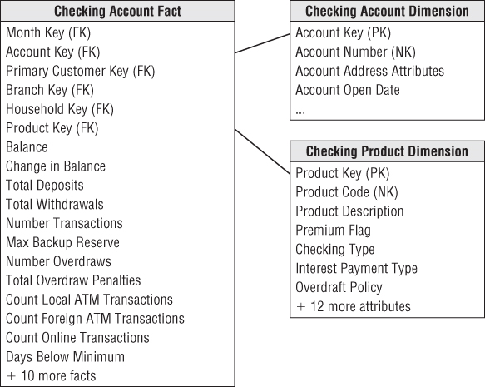
LOB Subtype Schema for Checking

Slide 8
ETL Process
What does ETL stands for?
Extract, Transformation, and Load
Extracting: Gathering raw data from source system and writing it to disk
Cleaning and Conforming:
Improve the quality of the data received from source
Merging data to create and enforce conformed dimensions
Delivering and Managing: Physically structuring and loading the data into the target dimensional model.

Slide 9
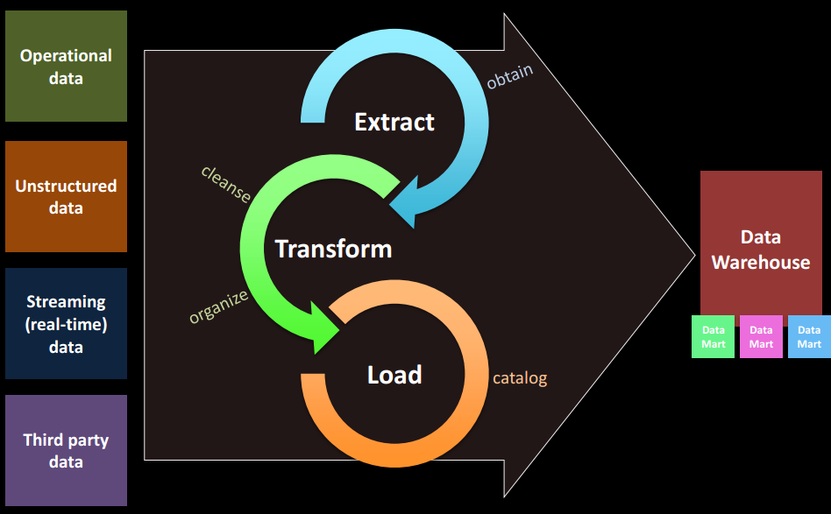
ETL Process

Slide 10
Ten Requirements for ETL
Business Needs
Maintain a list of KPIs
Compliance
All data and reports are subject to compliance requirements
Data Quality
List data elements with questionable quality
Security
Compliance list should also contain privacy and security requirements
Data Integration
Use bus matrix to generate priority list for conforming dimensions

Slide 11
Ten Requirements for ETL (contd…)
Data Latency
How quickly source data can be delivered to the business users.
Archiving
All staged data should be archived
BI Delivery Interface
ETL team should work closely with modeling team
List all facts and dimension tables, list all OLAP cubes and indexes
Available Skills
Inventory of OS, ETL tools, scripting language, SQL, DMBS, OLAP etc…
Legacy Licenses

Slide 12
Subsystems of ETL
Extracting
Subsystem 1: Data Profiling
Describe the contents, consistency, and structure
Provides information about data cleaning requirements
Subsystem 2: Change Data Capture System
Isolate the latest source data
Just transfer the data that has changed since the last load
Audit columns – stores date and time of each modification of a record
Timed Extract – Time based selection is not recommended
Full Diff Compare – identify the change by comparing record by record

Slide 13
Subsystems of ETL
Extracting
Subsystem 3: Extract System
Each source might be in a different system, environment or DBMS
Create MapReduce/Hadoop extract step to extract unstructured, semistructured “Big Data”.

Slide 14
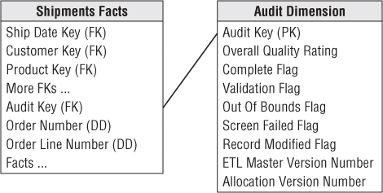
Subsystems of ETL
Cleaning and Conforming Data
Subsystem 4: Data Cleansing System
Cleansing data and controlling data quality using quality screens
Subsystem 5: Error Event Schema
Record every error event identified by quality screen
Subsystem 6: Audit Dimension Assembler

Slide 15
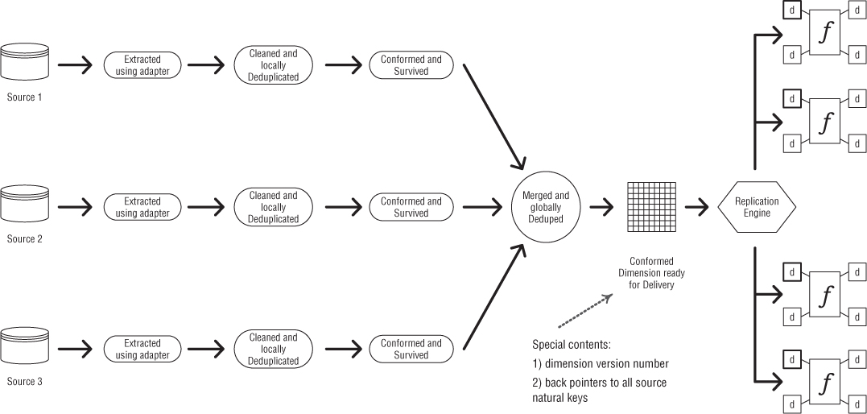
Subsystems of ETL: Conforming System

Slide 16
Subsystems of ETL
Delivering
Focus on dimension table processing
Slowly Changing Dimension Manager
Surrogate Key Generator
Hierarchy Manager
Special Dimension Manager
Date/time, Junk, Mini dimension, Shrunken subset…
Multivalued Dimension Bridge Table Builder
OLAP Cube Builder

Slide 17
Homework 2
Creating Bus Architecture
Add two Access databases in SQL Server
Create conformed dimension by using merge join
Use conformed dimension to create bus matrix
Drill-across fact tables

