Slide 1
ITM 6280: Data Warehousing
Chapter 4: Inventory

Slide 2
Agenda
Dimensional Modeling Recap
Inventory Models
Value Chain Integration
Enterprise Bus Architecture

Slide 3
Dimensional Modeling Recap
Step1: Select Business Process
Start with most important
Step2: Declare the Grain
Use most detailed atomic information captured by a business process
Step3: Identify Dimensions
Who, what, why, when and how? Context of measurements
Step4: Identify Facts
KPI, Typically additive

Slide 4
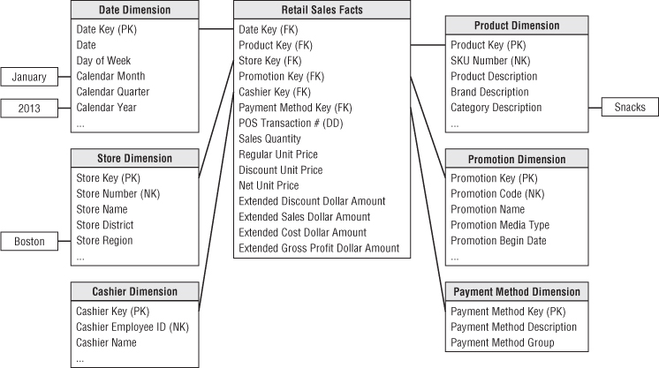
Retail Sales Schema

Slide 5
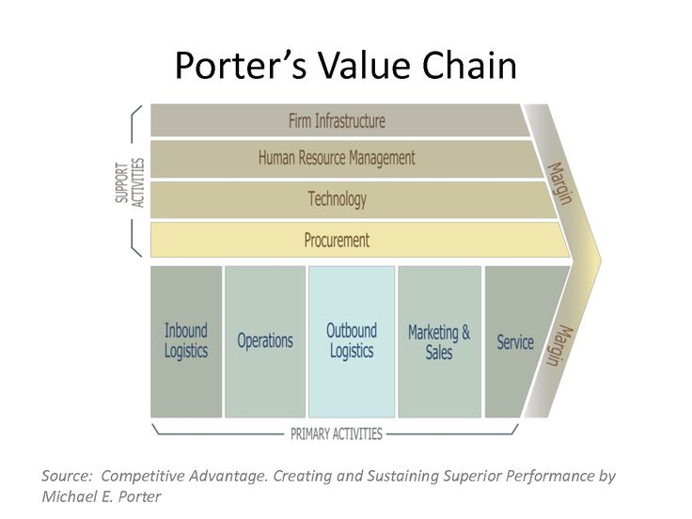
Value Chain
Notes:
Done with sales, what about others? Where next?
Services value chain etc. Insurance value chain?

Slide 6
Retail Value Chain
Inbound Logistics
Operations
Outbound Logistics
Sales
Service
Support Activities:
Procurement
Human Resources
Accounting
Order Management
Customer Relationship Management
Inventory Management, Distribution
Store Operations
Notes:
Inventory: CH4
Store Operations: CH3
Order Management: CH 6
CRM: CH8
Procurement: CH5
HR : CH9
Accounting: CH7

Slide 7
Inventory Management
Issue Purchase Order
Receive Warehouse Delivery
Warehouse Product Inventory
Receive Store Delivery
Store Product Inventory
Retail Sales

Slide 8
Inventory Models
Goals
Sufficient inventory for smooth operations and prevent stockouts
Minimize inventory to reduce carrying costs and increase profit
Inventory Models
Periodic Snapshot
Inventory Transactions
Accumulating Snapshots

Slide 9
Model 1: Inventory Periodic Snapshots
Four Step Dimensional Model
Process: Periodic inventory snapshots
Grain: Snapshot – Hourly, Daily, Monthly etc.
Dimensions: Product, Date, Store or Warehouse
Fact: Quantity on hand

Slide 10
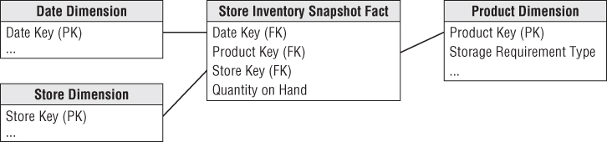
Inventory Snapshot Schema
Notes:
Date dim – same as in retail
Product and store can have additional details
Product – min reorder quantity
Discuss reorder point – if inventory falls to this level reorder or will stockout
How much to reorder- Economic reorder point – minimize order cost vs holding cost
Store DIM – storage capacity

Slide 11
Semi Additive FACTS
Inventory Quantity on Hand is Semi-Additive
Additive across stores and products
Not additive across dates
Semi Additive measures are less problematic if the data is deployed via OLAP cubes.
SQL AVG Function cannot work
OLAP AVG function can average with specific aggregation rules

Slide 12
Find the average inventory in all stores across three dates
ProductID | StoreID | DateID | Quantity on Hand
1 | 1 | 1 | 25
1 | 1 | 2 | 50
1 | 1 | 3 | 75
1 | 2 | 1 | 20
1 | 2 | 2 | 40
1 | 2 | 3 | 60
1 | 3 | 1 | 20
1 | 3 | 2 | 40
1 | 3 | 3 | 80
Notes:
Sql will avg by dividing across all rows (9) than just date(3)
Group by will give 3 averages – need one.

Slide 13
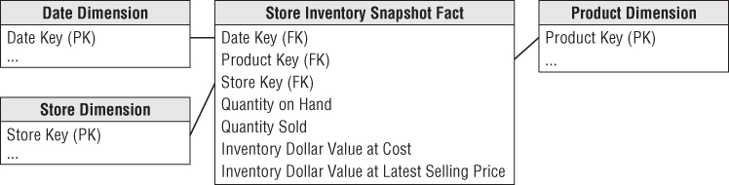
Enhanced Inventory Facts
Inventory analysts are also interested in the extended value of the quantity sold, inventory at cost, and inventory at latest selling price.
Notes:
Additive or Semi-Additive?
Inventory Dollar Value at cost or selling price are not additive. (see errata)

Slide 14
Model 2: Inventory Transactions
Record every transaction that affects inventory
Inventory transactions at warehouse
Receive product
Inspect
Return to vendor
Place in product bin
Package/Ship
Receive from customer/returns
Remove from inventory

Slide 15
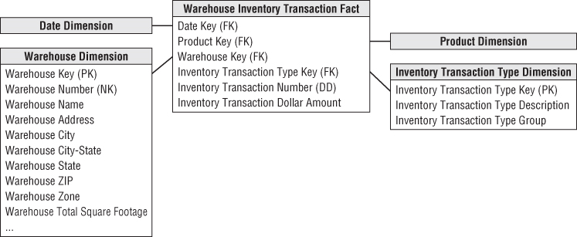
Inventory Transactions Model
Useful in measuring the frequency and timing of
specific transaction types.
A snapshot model can be achieved by rolling up from known inventory position however, it is too cumbersome and impractical
Notes:
Detailed data that mirrors transaction tables, Useful for measuring transaction type frequencies, but cumbersome and impractical for inventory position.
Fact table fact : dollar amount

Slide 16
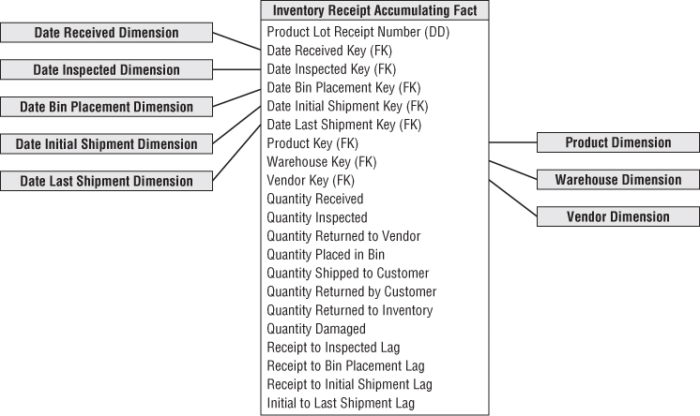
Model 3: Inventory Accumulating Snapshot
Each fact row tracks receipt through disposition of product
Possible when products received in one shipment can be distinguished from products received later
Track products by Serial number or lot number
Notes:
Definite beg, end and milestones

Slide 17
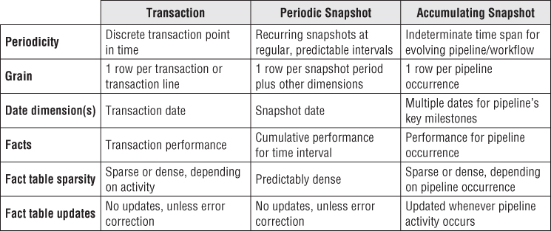
Inventory Fact table Types

Slide 18
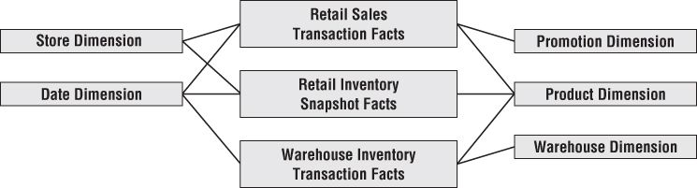
Value Chain Integration

Slide 19
Enterprise Data Warehouse Bus Architecture
“Family of dimensional models that share a comprehensive set of common, conformed dimensions”
“Master suite of standardized dimensions and facts with uniform interpretation across enterprise”
New dimensional models closely adhere to the Bus architecture and fit together like pieces of a puzzle
Notes:
Bus architecture – overall enterprise wide design but can be built incrementally

Slide 20
Enterprise Data Warehouse Bus Architecture
Bus architecture is independent of database technology and platforms.
Both relational and OLAP models can be integrated in this architecture if they are designed around confirmed dimensions and facts.
Bus architecture – overall enterprise wide design but can be built incrementally

Slide 21
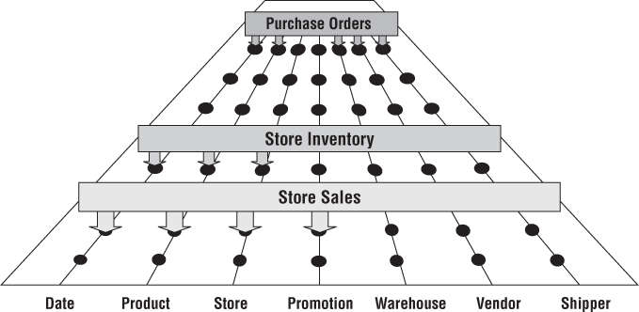
Enterprise Data Warehouse Bus with Shared Dimensions
Confirmed Dimensions
Notes:
Development process
Important deliverable of DW/BI
Multiple purposes – architecture planning, db design, data governance coord, org communication

Slide 22
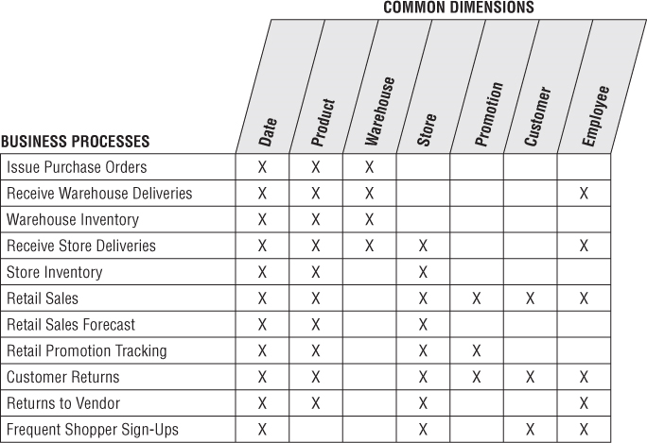
Enterprise Data Warehouse Bus Matrix for a Retailer
Dimensional Models representing the primary activities
Notes:
Development process
Important deliverable of DW/BI
Multiple purposes – architecture planning, db design, data governance coord, org communication

Slide 23

Conformed Dimensions
Standardized dimensions which are consistent across dimensional models and reusable
Helps in combining performance measurements from different business processes in a single report (Drilling Across Fact Tables)
Notes:
Different bp’s have revenue – can be added only if same
Revenue = sold, or revenue = sold - returns

Slide 24
Identical Conformed Dimensions
These are same with every possible fact table to which they are joined.
Inventory Fact
Sales Fact
Identical with consistent
Dimension keys
Attribute column names
Attribute definitions
Attribute values
Date Dimension
Date Dimension
Notes:
Different bp’s have revenue – can be added only if same
Revenue = sold, or revenue = sold - returns

Slide 25
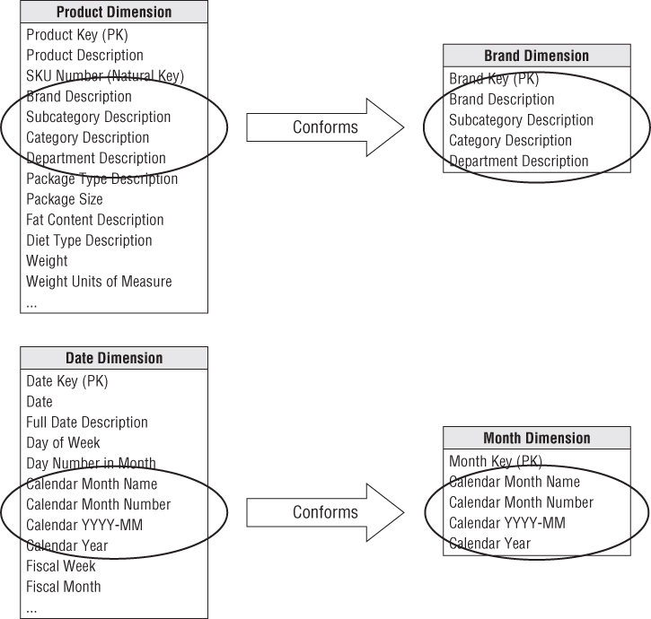
Shrunken Rollup Conformed Dimensions with Attribute Subset
Contain a subset of attribute from a more granular dimension
Notes:
Different bp’s have revenue – can be added only if same
Revenue = sold, or revenue = sold - returns

Slide 26
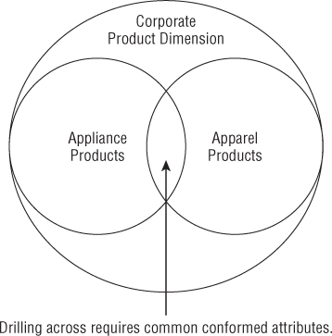
Shrunken Conformed Dimensions with Row Subset
Two dimensions are at the same level of granularity, but one represents only a subset of rows

Slide 27
Conformed Facts
Key Performance Indicators (KPI) - revenue, profit, standard prices, customer satisfaction are facts that must be conformed
Limited Conformity
If each line of business has unique customers and products and there is no interest in cross selling across lines then there is no need for an enterprise architecture.

Slide 28
Data Governance
Conformed Dimensions – need enterprise consensus on attribute names and contents
IT can facilitate but cannot be sole driver – SME lead
Data Governance Objective: Common data definitions, labels and domain values
Master Data Management : Master file that is a common point of reference

Slide 29
Assignment 1 discussion
Develop Star Schema for a given Business Case
Case Description
OLTP Schema
Deliverables
Describe 4 step process for given case
Star Schema
Description of facts and dimensions
Other details of schema

