Slide 1
ITM 6280: Data Warehousing
Chapter 10
Financial Services

Slide 2
Agenda
Recap: Hierarchies
Dimensional Models for Financial Services
Supertype and Subtype facts
SSAS – Creating Enterprise Bus Architecture

Slide 3
Recap
What is a hierarchy?
Levels/subsidiary with parent-child relationship
Example: Day -> month -> year
Department -> division -> enterprise
Types of hierarchies
Fixed Depth Positional Hierarchies
Ragged Hierarchies

Slide 4
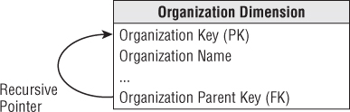
Recap: Recursive Pointer
What is a recursive pointer?
Notes:
Ragged hierarchy pg 216
Recursive keys (pg 217) hard to maintain with type 2 changes – cascade.

Slide 5
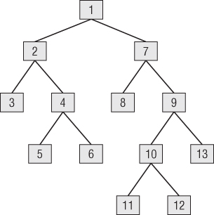
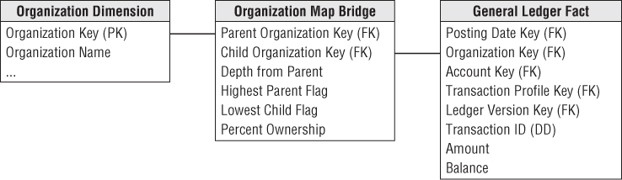
Recap: Ragged Variable Depth Hierarchy
How to represent arbitrary rollup structures?
What is a bridge table?
Notes:
Ragged hierarchy pg 216
Recursive keys (pg 217) hard to maintain with type 2 changes – cascade.

Slide 6
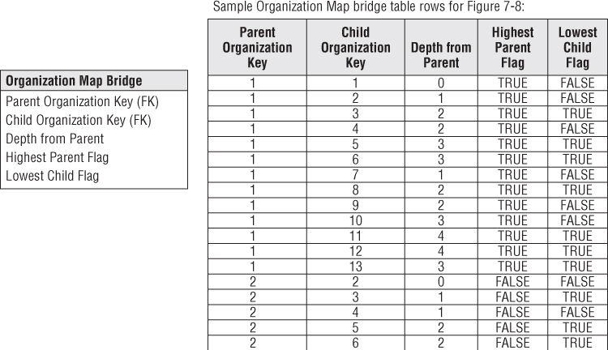
Bridge Table representing parent-child relationship

Slide 7
Financial Services
Financial Processes
Retail banking, credit card accounts, insurance, loan, mortgage, investment, financial portfolio
BI user requirements
Historical monthly snapshot data on every account
Household identification
Many more…

Slide 8
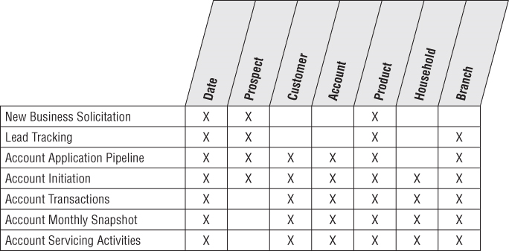
Subset of Bus Matrix Rows of a Bank

Slide 9
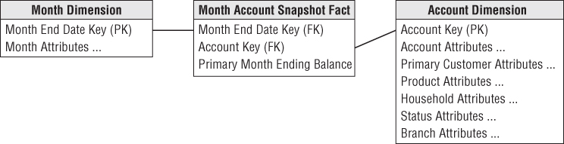
Grain and Simple Schema
What is the grain of the fact table?
One row for primary balance of each account each month.
Is it fully additive?

Slide 10
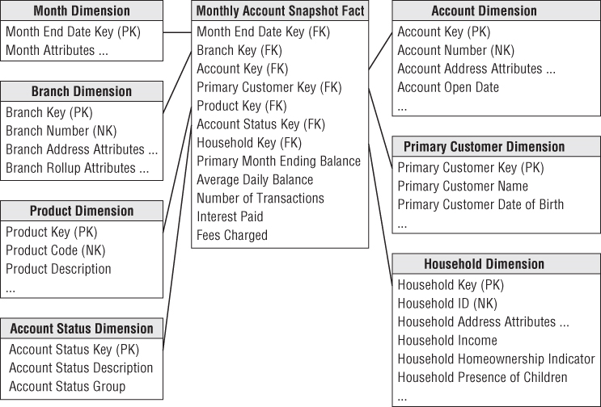
Snapshot Fact table for all Accounts

Slide 11
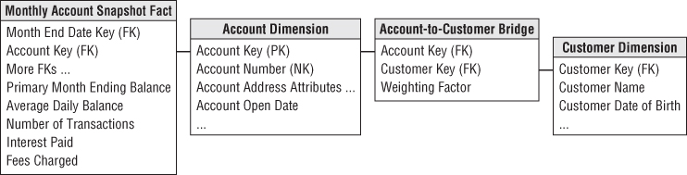
Multivalued Dimensions
How to represent accounts with multiple account holders?
Cannot include customer in the account dimension -> violates PK
Cannot include customer in fact table -> violates granularity

Slide 12
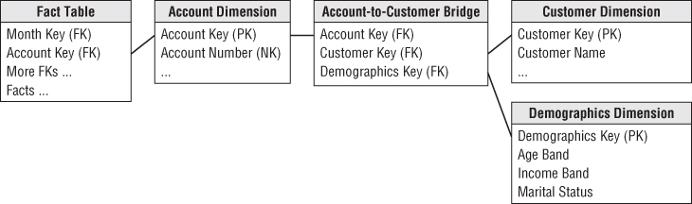
Adding a Mini Dimension to a Bridge Table
How to represent a very large account-to-bridge table with a rapidly changing dimension?
Customer demography and status attribute can change frequently

Slide 13
Supertype and Subtype for Heterogeneous Products
Business owners typically require two different perspectives:
Global view
Line-of-business view
Global view: Insight into the complete account portfolio across all lines of business.
Line-of-business: Focus on the in-depth details of one business, such as checking.
(Single supertype fact table)
(Special subtype fact table for each LOB)

Slide 14
Supertype Fact table for all Accounts

Slide 15
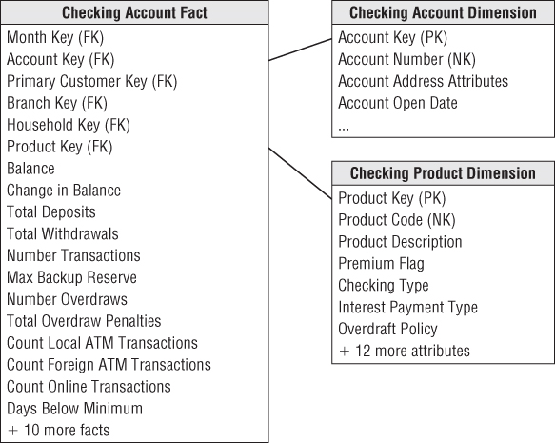
LOB Subtype Schema for Checking

Slide 16
Supertype and Subtype
Supertype fact table can represent only a limited number of facts across all line of business.
Subtype schema must also contain the supertype fact attributes to avoid joining tables.
A family of supertype and subtype are needed when a business has heterogeneous products but a single customer base.

Slide 17
SSAS
Creating Bus Architecture
Add two Access databases in SQL Server
Create conformed dimension by using merge join
Use conformed dimension to create bus matrix
Drill-across fact tables

