Slide 1
Dimensional Modeling Process Chapter 5
The Data Warehouse Toolkit, Ralph Kimball And Margy Ross, John Wiley & Sons Inc. 2013

Slide 2
Agenda
Recap: Enterprise DW Bus Architecture
Procurement Process Dimensional Model
Slowly Changing Dimensions
SSIS Tutorial

Slide 3
Recap: Enterprise Data Warehouse Bus Architecture
What is a Bus Architecture?
“Master suite of standardized dimensions and facts with uniform interpretation across enterprise”
What are Conformed Dimensions?
“Family of dimensional models that share a comprehensive set of common dimensions”
Notes:
Bus architecture – overall enterprise wide design but can be built incrementally

Slide 4
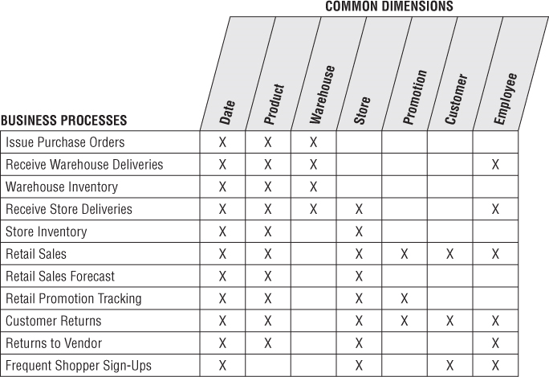
Enterprise Data Warehouse Bus Matrix for a Retailer
Dimensional Models representing the primary activities
Notes:
Development process
Important deliverable of DW/BI
Multiple purposes – architecture planning, db design, data governance coord, org communication

Slide 5
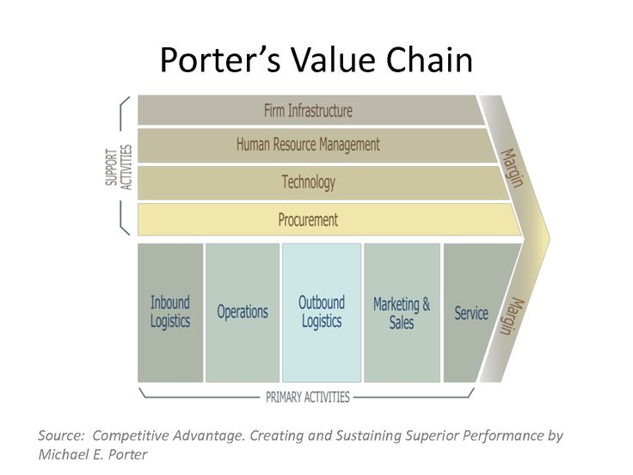
Value Chain: Procurement Process
Notes:
Done with sales, what about others? Where next?
Services value chain etc. Insurance value chain?

Slide 6
Procurement
Procurement Activities
Negotiate contracts
Issue Purchase requisitions
Track receipts and authorize payments
Procurement analytics requirements
What is purchased? From whom? At what cost?
Monitoring organizational purchasing behavior
Monitoring vendor performance
Overall procurement goal: Source appropriate materials in most economical manner

Slide 7
Procurement Processes
Purchase Requisitions
Purchase Orders
Shipping Notification
Warehouse Receipts
Vendor Invoice
Vendor Payments
Which Departments/Functions are involved?
Purchase
Warehouse
Accounts Payable
Notes:
Purchase Req – want new server – approval, budget etc. # Requisitions , qty, amt
Purchase Order – to approved vendors #orders
Shipping – sent by vendor - # shipped in a quarter how many were shipped – cross check with inventory
Warehouse Receipt – warehouse receives materials # how many received ?
Vendor invoice – sends the bill
Vendor payments - payments

Slide 8
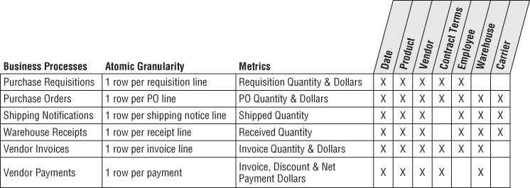
Procurement Process Bus Matrix
Notes:
PO and receipt date generalized as transaction dates
Receiving clerk, purchasing agent generalized as employee

Slide 9
Single vs Multiple Fact Tables
Varying Perspectives on Procurement Process
Different source systems – Purchase, warehouse, accounts
Should we build a blended transaction fact table or build fact tables for each transaction type?
Single or Multiple Fact table design considerations
Analytic requirements
Unique business processes
Source systems
Dimensionality
Notes:
Contracts – PO, Accts payable, not receiving
Analytics -. Vendor performance (deliver on time and agreed cost) diff from purchasing behavior (how much are we buying and who is?)
Unique business process – separate control nos or natural keys PO number, payment check no,
PO date, Receipt date. Purch agent, Rec aclerk ->emplyee

Slide 10
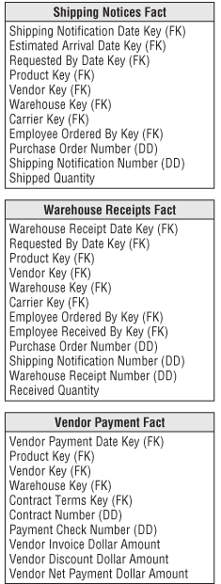
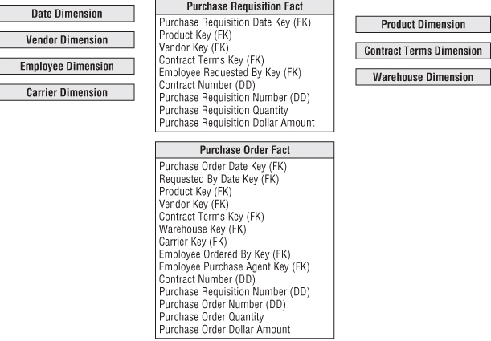
Multiple Fact Tables
Allows richer and more descriptive dimensionality

Slide 11
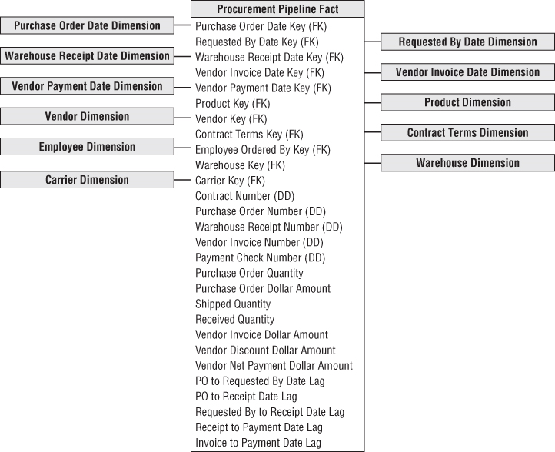
Accumulating Fact tables
Procurement Snapshot Table
Useful in monitoring product movement

Slide 12
Slowly Changing Dimensions (SCD)
As Dimensions change over time, how should they be handled in DW?
Example:
Change in customer profile
Transfer of Employees from one region to another
Notes:
Persistent supernatural durable keys – employee changes, employee id, emp_id surrogate, supernatural
Type 1: Fig 5-5
Product and Department Example

Slide 13
Type 0: Retain Original
Attribute value never changes
Appropriate for attributes labeled “Original”
Persistent durable keys, date dimension attributes
No change in fact table
Notes:
Persistent supernatural durable keys – employee changes, employee id, emp_id surrogate, supernatural
Type 1: Fig 5-5
Product and Department Example

Slide 14
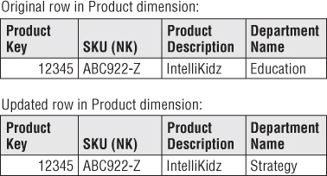
Type 1: Overwrite
Overwrite old attribute value with current value in the dimension row
Loss of history
Appropriate when changes are insignificant
Fact table is untouched
BI application can produce different results before and after type 1 change
Notes:
Persistent supernatural durable keys – employee changes, employee id, emp_id surrogate, supernatural
Type 1: Fig 5-5
Product and Department Example

Slide 15
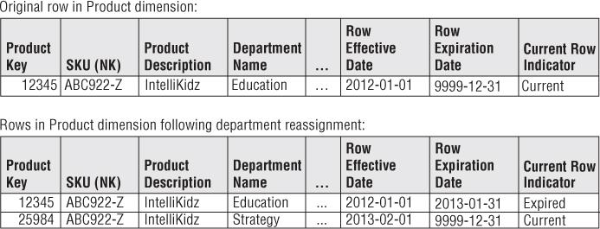
Type 2: Add New Row
Partition of
history
Predominant technique to preserve history
Pre-existing aggregations do not change
Although it partitions history, it does not enable us to associate the new attribute value with old fact history
Notes:
Fig 5-6
Safest response can revert to type 1 but other way not possible
Difference – change not visible in Type 1, in Type 2 changes due to re-categorization visible
Product and Department example with Fact table to show aggregations

Slide 16
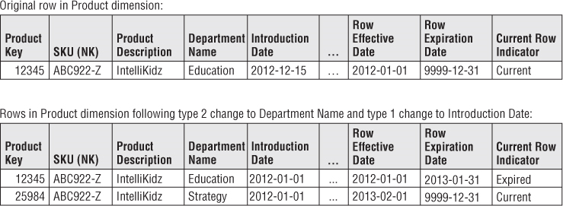
Type 1 and Type 2 are both Used
Type 1 updates in a dimension with Type 2 attributes sample rows
What is the difference between Type 1 and Type 2?
Notes:
Fig 5-6
Safest response can revert to type 1 but other way not possible
Difference – change not visible in Type 1, in Type 2 changes due to re-categorization visible
Product and Department example with Fact table to show aggregations

Slide 17
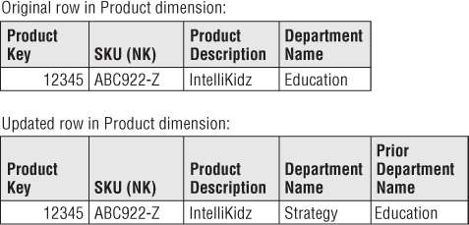
Type 3: Add New Column for Prior Value
Appropriate when
Business need is to track both new and prior values
Significant change affecting many rows
Example: Product line or sales district reorganization
Notes:
Fig 5-8
Affect many users
Unpredictable changes – customer state change , some 10 days, some 10 years , go for type 2

Slide 18
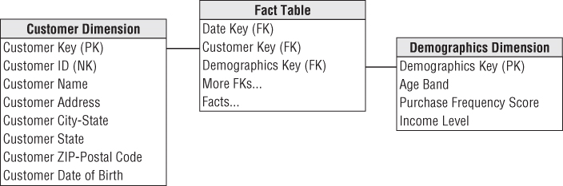
Type 4: Add Mini-Dimension
Break off frequently analyzed/changing attributes into separate dimension (mini dimension)
Example: Customer Demographics
Notes:
Fig 5-10, 5-11
Customer Dimension example. Change to credit score, income

Slide 19
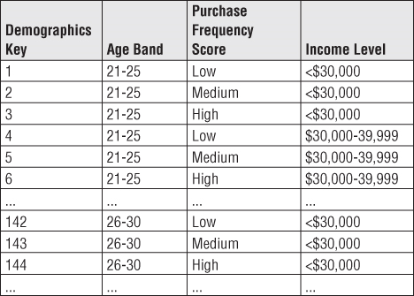
Type 4: Add Mini-Dimension (contd.)
Appropriate when
Dimensions are large and many frequent changes
Notes:
Fig 5-10, 5-11
Customer Dimension example. Change to credit score, income

Slide 20
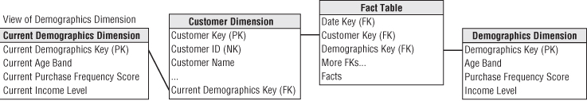
Hybrid Types Type 5: Add Mini-Dimension and Type1 Outrigger
Mini-Dimension key is added to Primary Dimension as Type 1 (Overwritable) attribute
Useful for current profile in absence of fact table entry
Notes:
Fig 5-12
Fig 5-13 Type 6. Current is Type1, Historic and add rows is Type2
Fig 5-14 Type 7: Type 2 add rows, current attrib is type 1.

Slide 21
Next Class
Develop Enterprise DW Bus Architecture for Hotel Industry
What is the value chain of a hotel business?
What are the processes?
SCD Exercises

Slide 22
SSAS Tutorial
Visualizing using MS Excel
Reports
Drill Up/Down
Semi Additive Measures
Using Calculated Fields (MDX Expressions)
Add Dimensional Intelligence
Add Business Intelligence for Semi-Additive Fields

