Slide 1
ITM 6280: Data Warehousing
Chapter 7

Slide 2
Agenda
Recap: Role Playing and Junk Dimensions
Dimensional Models for Accounting Processes
Hierarchies
SSAS
Creating Hierarchies
OLAP Mining Structure
Multi-dimensional Expressions (MDX)
OLAP operations

Slide 3
Recap
What is a role playing dimension?
Single dimension simultaneously appears multiple times in the same fact table
Example: Date dimension plays the role of Order date and Ship date
Why do we need different views of the same dimension?
Notes:
6-3
6-4
Pg 170

Slide 4
Recap
What is a Junk dimension?
A dimension consisting of low-cardinality flags and indicators.
Example: Payment type (Cash/Credit), Loan decision (Y/N)
One junk dimension or multiple junk dimensions?
Adding rows incrementally to the junk dimension table or creating all combinations of indicators
Notes:
6-3
6-4
Pg 170

Slide 5
Accounting Processes
Accounting as support process in value chain
Accounting Processes
Journals/ledger entry
Invoicing
Account receivable/payable
Fixed asset
Budgeting
DW/BI system provides a single source of usable, understandable financial information.
Notes:
Accounting Processes
Journal- All transactions are recorded in a journal as debit credit
Accounts – different accounts are debited or credited
Ledger – Sales, Purchase, General (Asset, Liabilities, Income, Expense, Capital)
Purpose-

Slide 6
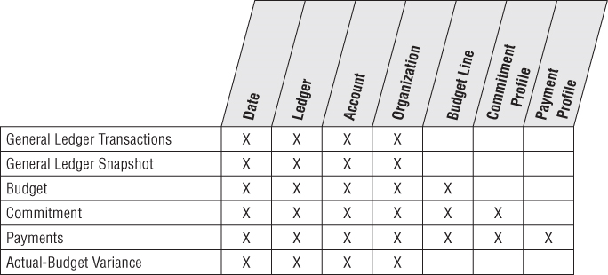
Bus Matrix Rows for Accounting Processes

Slide 7
Accounting Dimensional Model
1. General Ledger Periodic Snapshot
Snapshot of general ledger account at the end of each fiscal period
2. General Ledge Journal Transaction Fact Table
Grain is one row for every general ledger entry
Each row in the journal entry fact table is identified as either a credit or a debit

Slide 8
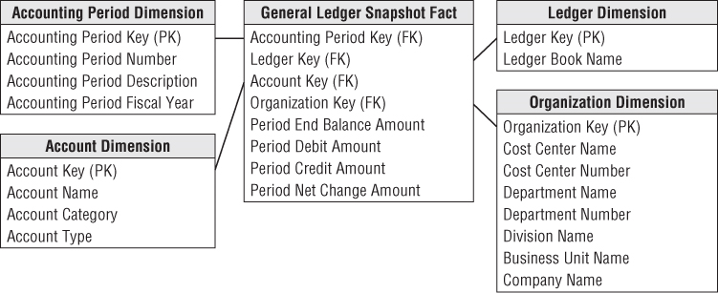
General Ledger Periodic Snapshot

Slide 9
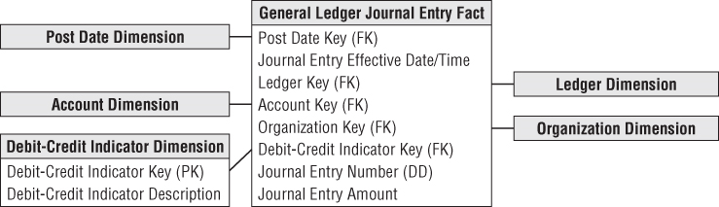
General Ledger Journal Entry Transaction

Slide 10
Budgeting Process
Budgeting chain is a series of fact tables
Budget Fact -> Establish budget for each division and account
Commitment Fact -> Make commitments against each budget
Payment Fact -> Make payments against each commitments

Slide 11
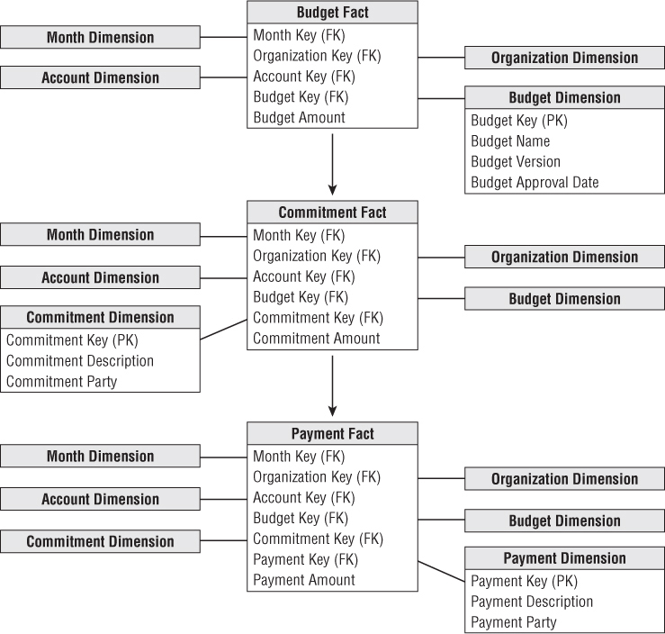
Chain of Budget Processes

Slide 12
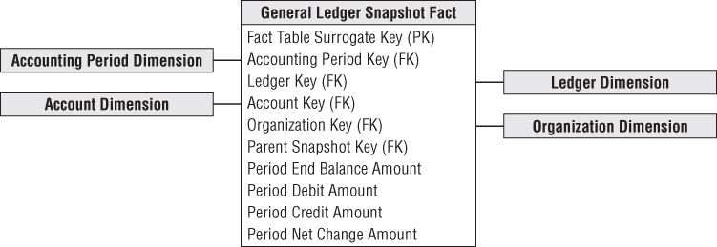
Drilling Down a Multilevel Hierarchy
Multiple ledgers arranged in ascending hierarchy
Department -> division -> enterprise

Slide 13
Hierarchies
Fixed Depth Positional Hierarchies
Ragged Hierarchies

Slide 14
Fixed Depth Positional Hierarchy
Has fixed set of levels
Day -> month -> year
Day -> fiscal period -> year
Manager level -> director level -> executive level

Slide 15
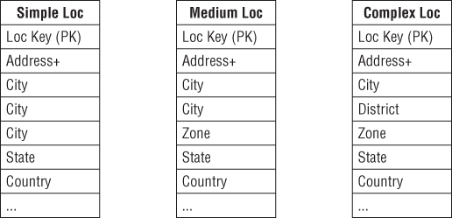
Slightly Ragged Variable Depth Hierarchy
Geographic hierarchy
Simple Location: Address -> city -> state -> country
Medium Location: Address -> city -> zone -> state -> country
Complex Location: Address -> city -> District -> zone -> state -> country
Notes:
Ragged hierarchy pg 216
Recursive keys (pg 217) hard to maintain with type 2 changes – cascade.

Slide 16
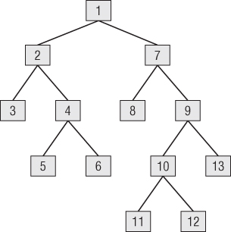
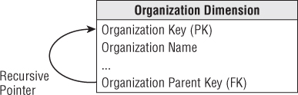
Ragged Variable Depth Hierarchy (Tree)
Organization structure hierarchy: Arbitrary rollup
Use recursive pointers from each row to its parent
Notes:
Ragged hierarchy pg 216
Recursive keys (pg 217) hard to maintain with type 2 changes – cascade.

Slide 17
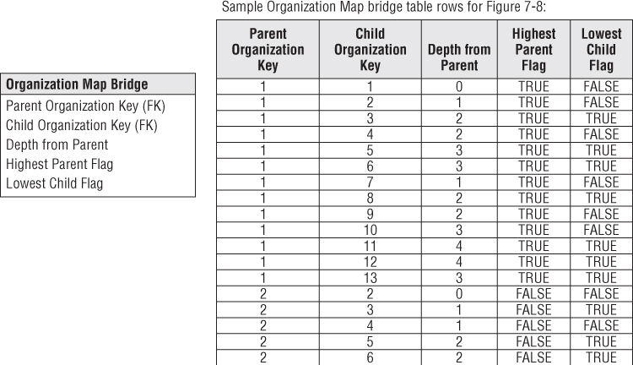
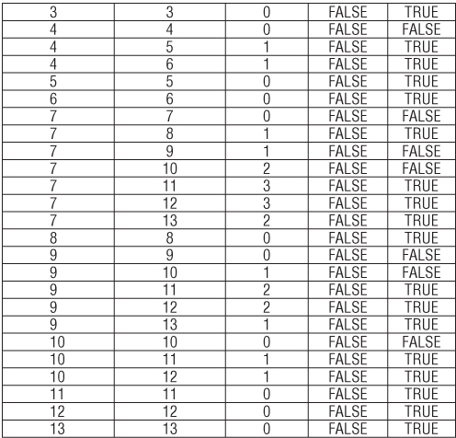

Slide 18
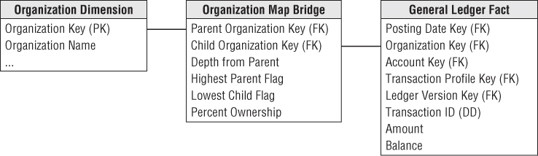
Ragged Variable Depth Hierarchy (Tree)
How to represent arbitrary rollup structures?
Build a bridge table that is independent of from the primary dimension table and contains all information about the rollup.
Notes:
Ragged hierarchy pg 216
Recursive keys (pg 217) hard to maintain with type 2 changes – cascade.

Slide 19
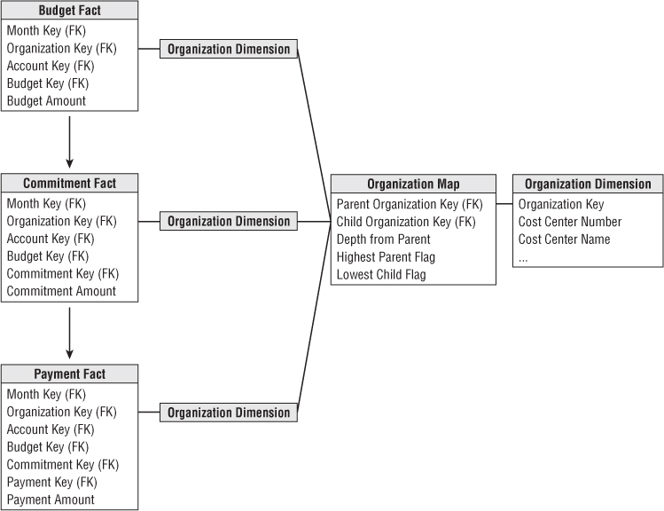
Drill Across and Rolling Up the Budget Chain
Drill Across
Rolling Up
Notes:
Ragged hierarchy pg 216
Recursive keys (pg 217) hard to maintain with type 2 changes – cascade.

Slide 20
SSAS
Creating Hierarchies in Relational Model
https://docs.microsoft.com/en-us/sql/analysis-services/lesson-9-create-hierarchies
Create Hierarchies in Multidimensional Model
https://docs.microsoft.com/en-us/sql/analysis-services/lesson-3-2-modifying-the-customer-dimension
OLAP Mining Structure
https://www.mssqltips.com/sqlservertutorial/4007/data-mining-build-model-with-olap-data-source/
Multi Dimensional Expressions (MDX)

