Slide 1
Chapter 5: Discrete Probability Distribution

Slide 2
Random Variables
Random variables
A numerical description of the outcome of an experiment
Discrete RV
Continuous RV

Slide 3
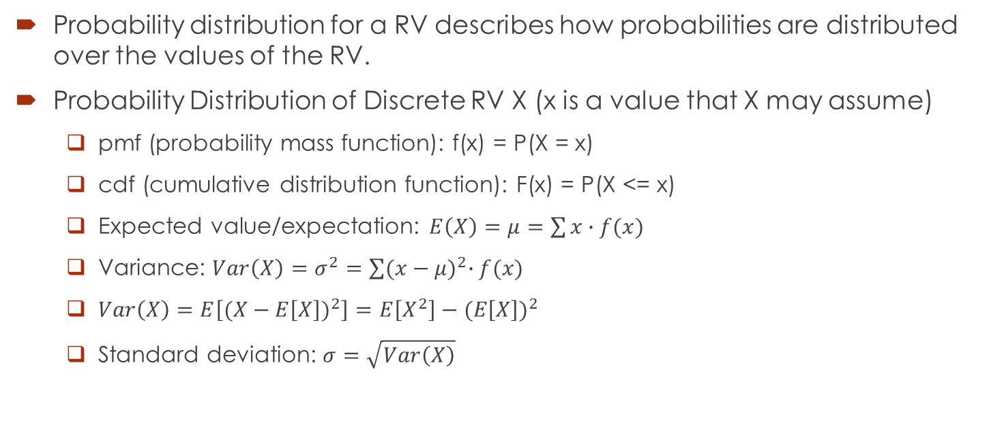
Random Variables
Probability distribution for a RV describes how probabilities are distributed over the values of the RV.
Probability Distribution of Discrete RV X (x is a value that X may assume)
pmf (probability mass function): f(x) = P(X = x)
cdf (cumulative distribution function): F(x) = P(X <= x)
Expected value/expectation: $E\left(X\right)=μ=\sum{x∙f(x)}$
Variance: $Var\left(X\right)=σ^{2}=\sum{{(x−μ)}^{2}∙f(x)}$
$Var\left(X\right)=E\left[{(X−E\left[X\right])}^{2}\right]=E\left[X^{2}\right]−{(E\left[X\right])}^{2}$
Standard deviation: $σ=\sqrt{Var\left(X\right)}$

Slide 4
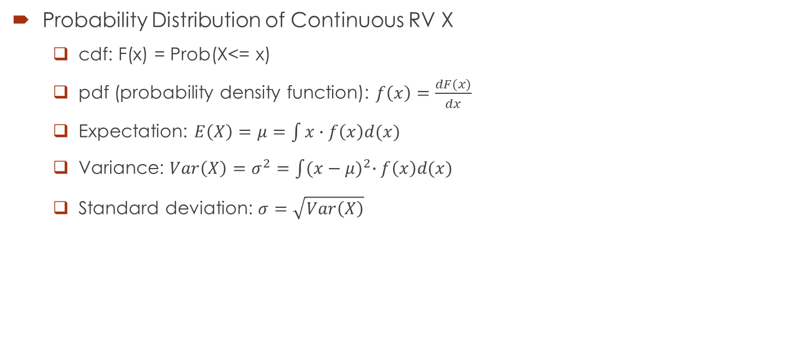
Random Variables
Probability Distribution of Continuous RV X
cdf: F(x) = Prob(X<= x)
pdf (probability density function): $f\left(x\right)=\frac{dF(x)}{dx}$
Expectation: $E\left(X\right)=μ=\int{x∙f\left(x\right)d(x)}$
Variance: $Var\left(X\right)=σ^{2}=\int{{(x−μ)}^{2}∙f\left(x\right)d(x)}$
Standard deviation: $σ=\sqrt{Var\left(X\right)}$

Slide 5
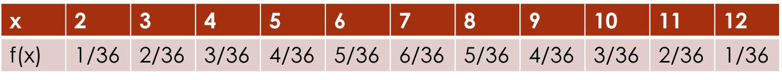
Example: Discrete Probability Distribution
Experiment: roll two fair, six-sided dice.
What is the sample space?
Let X be the sum of the two resulting numbers.
What is pmf (probability mass function, only for discrete random variable) of X?

Slide 6
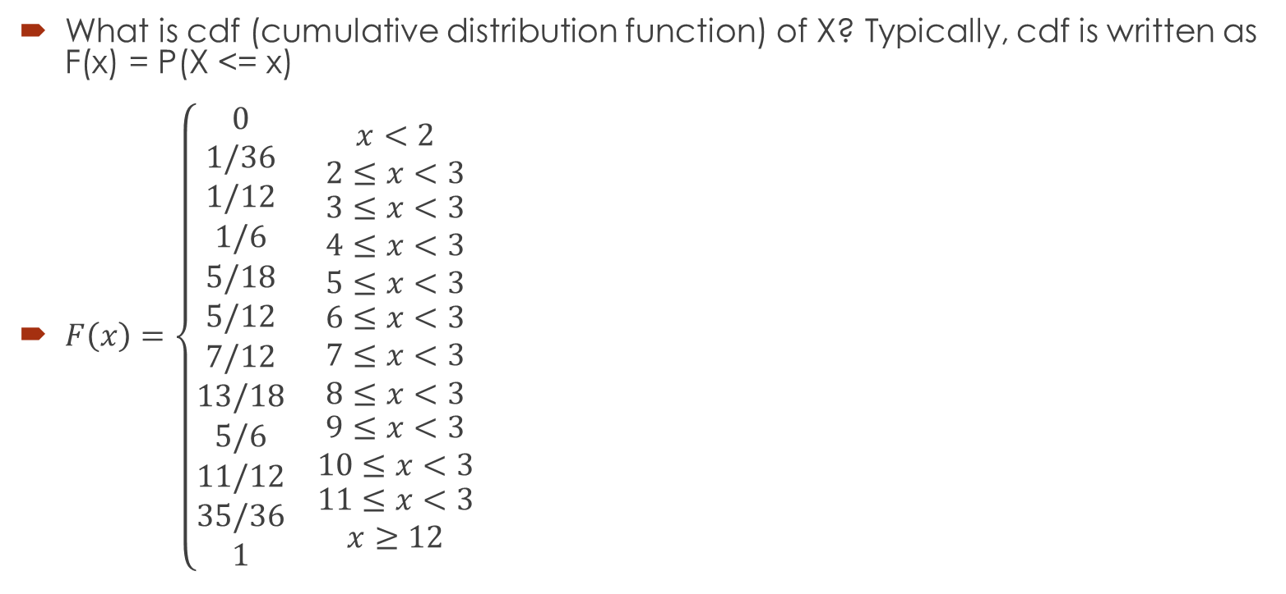
Example: Discrete Probability Distribution
What is cdf (cumulative distribution function) of X? Typically, cdf is written as F(x) = P(X <= x)
$F\left(x\right)=\left\{\begin{matrix}\begin{matrix}\begin{matrix}0 \\ 1/36 \\ \begin{matrix}1/12 \\ 1/6 \\ 5/18\end{matrix}\end{matrix} \\ \begin{matrix}5/12 \\ 7/12 \\ 13/18\end{matrix} \\ \begin{matrix}5/6 \\ 11/12 \\ \begin{matrix}35/36 \\ 1\end{matrix}\end{matrix}\end{matrix} & \begin{matrix}\begin{matrix}x<2 \\ 2≤x<3 \\ \begin{matrix}3≤x<3 \\ 4≤x<3 \\ 5≤x<3\end{matrix}\end{matrix} \\ \begin{matrix}6≤x<3 \\ 7≤x<3 \\ 8≤x<3\end{matrix} \\ \begin{matrix}9≤x<3 \\ 10≤x<3 \\ \begin{matrix}11≤x<3 \\ x≥12\end{matrix}\end{matrix}\end{matrix}\end{matrix}\right.$

Slide 7
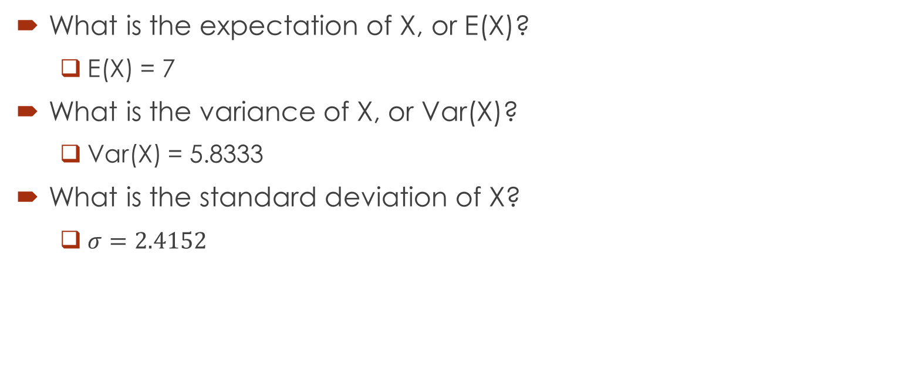
Example: Discrete Probability Distribution
What is the expectation of X, or E(X)?
E(X) = 7
What is the variance of X, or Var(X)?
Var(X) = 5.8333
What is the standard deviation of X?
$σ=2.4152$

Slide 8
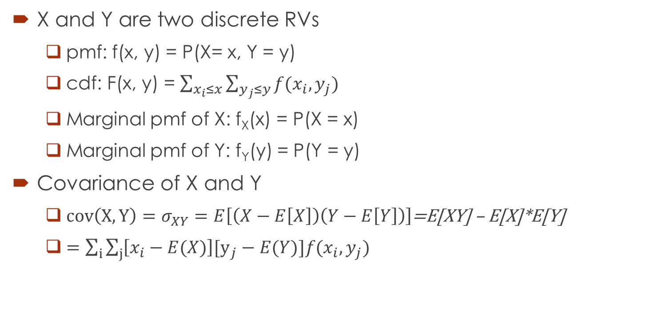
Bivariate Distributions (Discrete Case)
X and Y are two discrete RVs
pmf: f(x, y) = P(X= x, Y = y)
cdf: F(x, y) = $\sum_{x_{i}≤x}{\sum_{y_{j}≤y}{f(x_{i},y_{j})}}$
Marginal pmf of X: f_{X}(x) = P(X = x)
Marginal pmf of Y: f_{Y}(y) = P(Y = y)
Covariance of X and Y
$cov\left(X, Y\right)=σ_{XY}=E\left[\left(X−E\left[X\right]\right)\left(Y−E\left[Y\right]\right)\right]$=E[XY] – E[X]*E[Y]
$=\sum_{i}{\sum_{j}{\left[x_{i}−E(X)\right][y_{j}−E(Y)]f(x_{i},y_{j})}}$

Slide 9
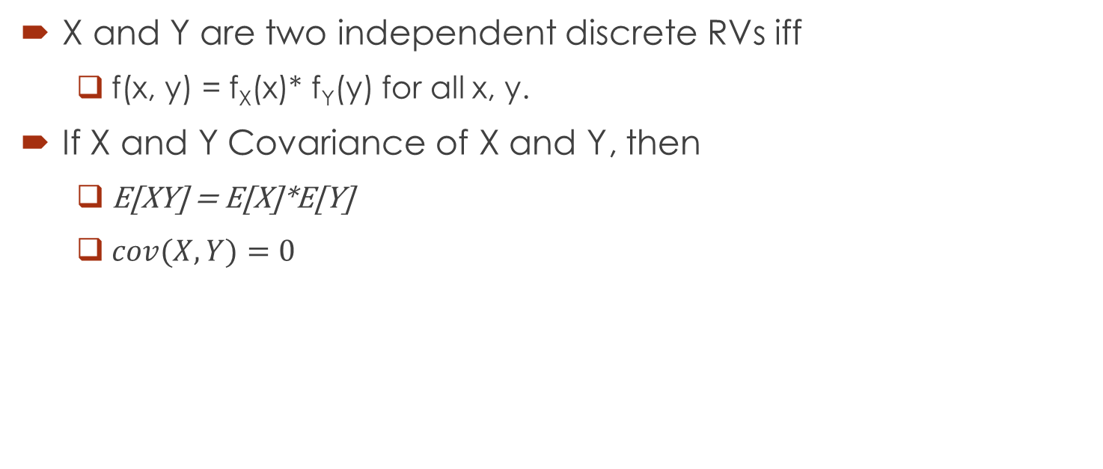
Bivariate Distributions (Discrete Case)
X and Y are two independent discrete RVs iff
f(x, y) = f_{X}(x)* f_{Y}(y) for all x, y.
If X and Y Covariance of X and Y, then
E[XY] = E[X]*E[Y]
$cov(X, Y)=0$

Slide 10
Properties of Expectation and Variance
X and Y are RVs; a, b and c are constants
E(aX + bY + c) = aE(X) + bE(Y) + c
Var(aX+bY) = a²*Var(X) + b²*Var(Y) – 2ab*cov(X, Y)
If X and Y are independent, then Var(aX + bY) = a²*Var(X) + b²*Var(Y)

Slide 11
Binomial Distribution
Properties of Binomial Experiment
The experiment consists of a sequence of n identical trials.
Two outcomes are possible on each trial. We refer to one outcome as a success and the other outcome as a failure.
The probability of a success, denoted by p, does not change from trial to trial. Consequently, the probability of a failure, denoted by 1- p, does not change from trial to trial.
The trials are independent.
Note
If n = 1, then it is also called Bernoulli or binary distribution.
Therefore, binomial experiment can be considered as the sum of n identical and independent Bernoulli experiments.

Slide 12
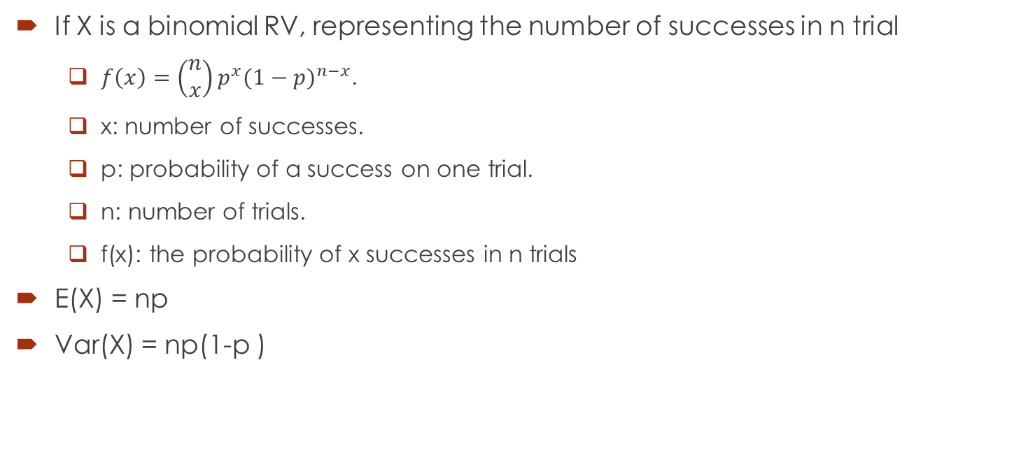
Binomial Distribution
If X is a binomial RV, representing the number of successes in n trial
$f\left(x\right)=\left(\begin{matrix}n \\ x\end{matrix}\right)p^{x}{(1−p)}^{n−x}$.
x: number of successes.
p: probability of a success on one trial.
n: number of trials.
f(x): the probability of x successes in n trials
E(X) = np
Var(X) = np(1-p )

Slide 13
Example
In San Francisco, 30% of workers take public transportation daily. Take a random sample of 4 workers. Let X be the number of workers taking public transportation out of these 4 workers.
Develop pmf for X, i.e., f(x) = ?
Develop cdf for X, i.e., F(x) = ?
What is the probability at exactly 3 workers take public transportation?
What is the probability that at least 3 workers take public transportation?
What is the probability that at most 3 workers take public transportation?
What is the expected number of workers taking public transportation?
What is the variance and what is the standard deviation?

Slide 14
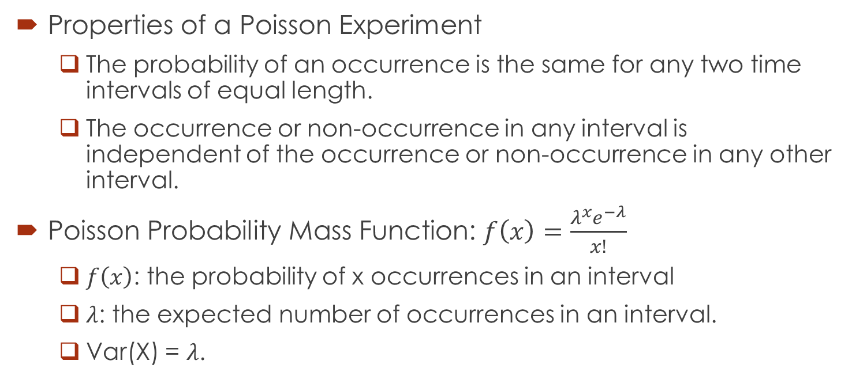
Poisson Probability Distribution
Properties of a Poisson Experiment
The probability of an occurrence is the same for any two time intervals of equal length.
The occurrence or non-occurrence in any interval is independent of the occurrence or non-occurrence in any other interval.
Poisson Probability Mass Function: $f\left(x\right)=\frac{λ^{x}e^{−λ}}{x!}$
$f\left(x\right)$: the probability of x occurrences in an interval
$λ$: the expected number of occurrences in an interval.
Var(X) = $λ$.

Slide 15
Poisson Probability Distribution Example (Problem 46, Page 255)
Phone calls arrive at the rate of 48 per hour at the reservation desk for Regional Airways.
Compute the probability of receiving 3 calls in 5-minute time interval.
Compute the probability of receiving exactly 10 calls in 15 minutes.
Suppose no calls are currently on hold. If the agent takes 5 minutes to complete the current call, how many callers do you expect to be waiting by that time? What is the probability that non will be waiting?
If no calls are currently being processed, what is the probability that the agent can take 3 minutes for personal time without being interrupted by a call?

