Slide 1
California State University, East Bay College of Business and Economics MGMT 6165 Prescriptive Analytics
Linear Programming Models
Lecture Materials
Dr. Z. Radovilsky
Notes:
1
1

Slide 2
Learning Objectives
Present various types of real applications where linear programming (LP) models may be used
Formulate and solve, using (LP) models, a wide range of real applications
Apply Excel Solver to identify optimal solution for these applications using LP spreadsheet modeling
Apply Excel Solver Sensitivity Report and SolverTable to analyze optimal solutions
Notes:
2
2

Slide 3
LP Optimization Models
Main goals of this class
Illustrate the wide range of real applications that can take advantage of LP
Increase your capability and efficiency in modeling and analyzing LP problems in Excel
The best way to learn is to see many examples and work through numerous problems
All of the models discussed are linear models as described in the previous class
Objective function is a sum of products of constants and decision variables
Constant does not depend on decision variables

Slide 4
Typical LP Applications
Objective Decisions to Make Constraints
1. Product Mix (New Product Introduction)
Select a mix of How much to produce and Demand
products or services market of each product Capacity of resources
that results in maximum or service for the planning
profits for a planning period
period
2.Marketing (Purchasing Adds or Promotion Decision)
To select a mix of How many ads need to be Minimum exposure required
advertisements in various purchased in each marketing Advertising budget
marketing sources with source
minimum advertising cost
and maximum exposure
3.Supply Chain Management (Outsourcing)
Select a set of suppliers How many units to outsource Accepted quality of suppliers
to minimize total from each supplier On time delivery
purchasing cost Cost of supplies
and provide high quality Total units outsourced
of supplies and on-time delivery

Slide 5
Typical LP Applications (Continued)
Objective Decisions to Make Constraints
4.Finance Management
Select an investment How much money to allocate Investment limits
plan(s) that maximizes in each fund (stock) Investment risk
total return Portfolio diversification
5.Ingredient Mix (Diet Problem, Blending Problem)
To select a mix of How much of each major raw Demand
major ingredients going material or ingredient to Technology of product
into final products use in the planning period Capacity of resources
that results in minimum
operating costs
6.Production (Aggregate) Planning
Select an amount How much to use labor and Demand
of products or services materials during each month Capacity of labor
to be produced to of the year Inventory capacity
minimize costs of
labor and inventories

Slide 6
Managing Supply
You started to work as a supply chain analyst in MicroSystems, Inc. Your first assignment is to work with four suppliers from which the company purchases its key component part. Historical records from the purchasing database provide information concerning the quality of each supplier's product and their on-time delivery record. This information, along with the price quote from each supplier, is summarized in the following table:
MicroSystems needs at least 4,500 units of the key component part per month. However, the supply chain manager plans to order 5200 units of this part from suppliers to insure some safety stock of the key component part. The manager has the following goals of purchasing from suppliers:
Average quality acceptance rate of at least 94%
On-time delivery average of at least 90%
Average unit cost of $14 or lower
No single supplier should receive more than 50% of the total purchase.
You need to make a decision on how to purchase the key component part. Formulate and solve a linear programming model to identify the optimal purchasing plan with minimum total cost.
Suppliers | Quality Acceptance Rate | On-time Delivery Rate | Cost per Unit, $
Supplier 1 | 0.99 | 0.95 | 15.00
Supplier 2 | 0.90 | 0.85 | 12.30
Supplier 3 | 0.95 | 0.90 | 14.50
Supplier 4 | 0.90 | 0.94 | 13.90

Slide 7
Managing Supply: LP Model Formulation
Decision variables:
S1 = number of units purchased from supplier 1, units
S2 = number of units purchased from supplier 2, units
S3 = number of units purchased from supplier 3, units
S4 = number of units purchased from supplier 4, units
Objective:
Minimize total purchase cost: 15.0S1 +12.3S2 +14.5S3 +13.9S4
Constraints:*
Total purchase=5200: S1 + S2 + S3 + S4 = 5200
Accept>=94%: .99S1 +.90S2 +.95S3 +.9S4 => 4888 (0.94*5200 = 4888)
Delivery>=90%: .95S1 +.85S2 +.9S3 +.94S4 => 4680 (0.90*5200 = 4680)
Average Price<=$14: 15.0S1 +12.3S2 +14.5S3 +13.9S4 <= 72800 (14*5200 = 72800)
Supplier1<=50%: S1 <= 2600
Supplier2<=50%: S2 <= 2600
Supplier3<=50%: S3 <= 2600
Supplier4<=50%: S4 <= 2600
Non-negativity: S1, S2, S3, S4 >= 0
*Constraint S1 + S2 +S3 +S4 >= 4500 is not necessary; it is redundant to the first constraint (=5200)

Slide 8
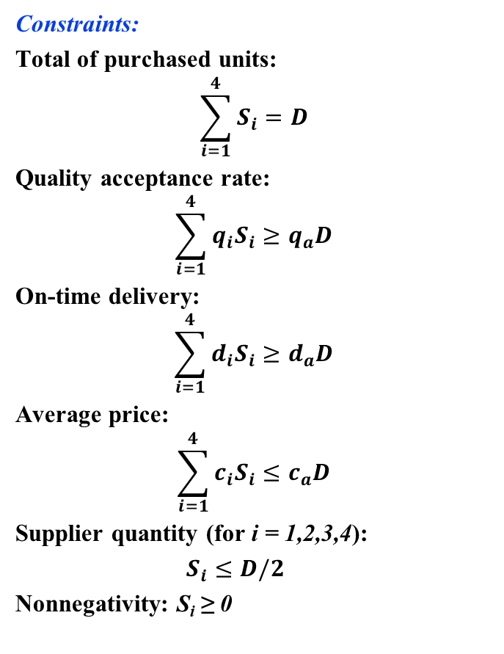
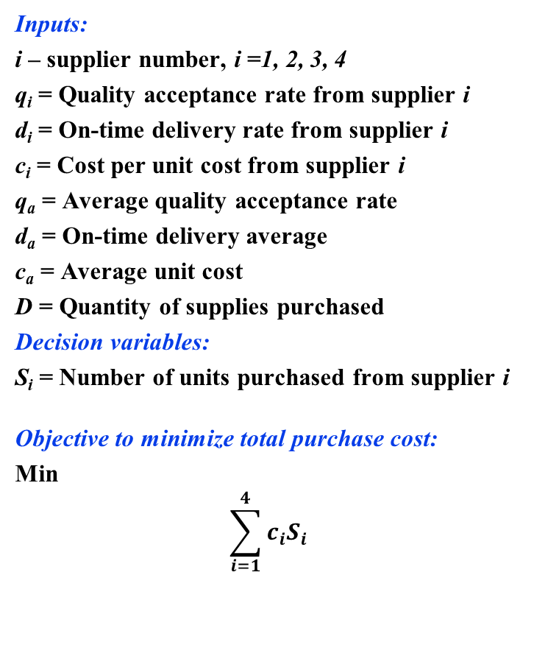
Managing Supply: LP Model Formulation with Index Notations
Inputs:
i – supplier number, i =1, 2, 3, 4
q_{i} = Quality acceptance rate from supplier i
d_{i} = On-time delivery rate from supplier i
c_{i} = Cost per unit cost from supplier i
q_{a} = Average quality acceptance rate
d_{a} = On-time delivery average
c_{a} = Average unit cost
D = Quantity of supplies purchased
Decision variables:
S_{i} = Number of units purchased from supplier i
Objective to minimize total purchase cost:
Min
$$\sum_{i=1}^{4}{c_{i}S_{i}}$$
Constraints:
Total of purchased units:
$$\sum_{i=1}^{4}{S_{i}}=D$$
Quality acceptance rate:
$$\sum_{i=1}^{4}{q_{i}S_{i}}≥q_{a}D$$
On-time delivery:
$$\sum_{i=1}^{4}{d_{i}S_{i}}≥d_{a}D$$
Average price:
$$\sum_{i=1}^{4}{c_{i}S_{i}}≤c_{a}D$$
Supplier quantity (for i = 1,2,3,4):
$S_{i}$ $≤D/2$
Nonnegativity: S_{i} ≥ 0

Slide 9
Managing Supply: Spreadsheet Model

Slide 10
Managing Supply: Solution Results

Slide 11
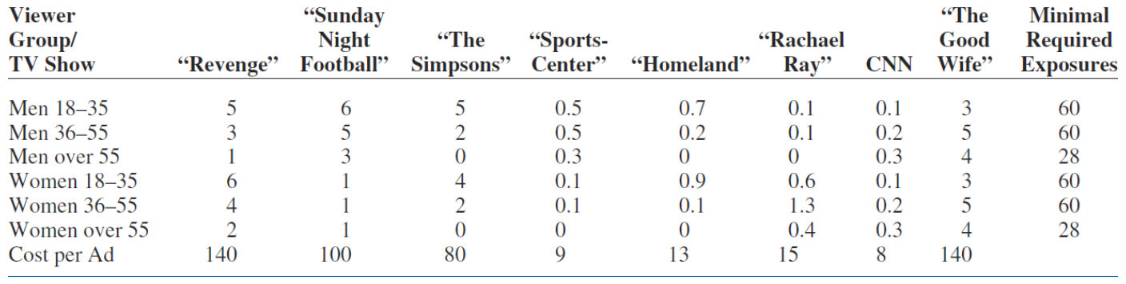
Advertising: Purchasing Ads
The General Flakes Company sells a brand of low-fat breakfast cereal that appears to people of all age groups and both genders. The company advertises this cereal in a variety of 30-second television adds, and these ads can be placed in a variety of television shows listed in the top of the table below. The ads in different shows vary by cost—some 30-second slots are much more expensive than others—and by the types of viewers they are likely to reach. The company has segmented the potential viewers into six mutually exclusive categories also listed in the first column of the table below.
A rating service can supply data on the numbers of viewers in each of these categories who will watch a 30-second ad on any particular television show. Each such viewer is call exposure. The company has determined the required number of exposures it wants to obtain for each group. The data on costs per add, numbers of exposures per ad, and minimum required exposures are listed in the table below, where numbers of exposures are expressed in millions, and costs in thousands of dollars.
The company wants to know how many ads to place on each of several television shows to obtain these exposures at minimum cost.

Slide 12
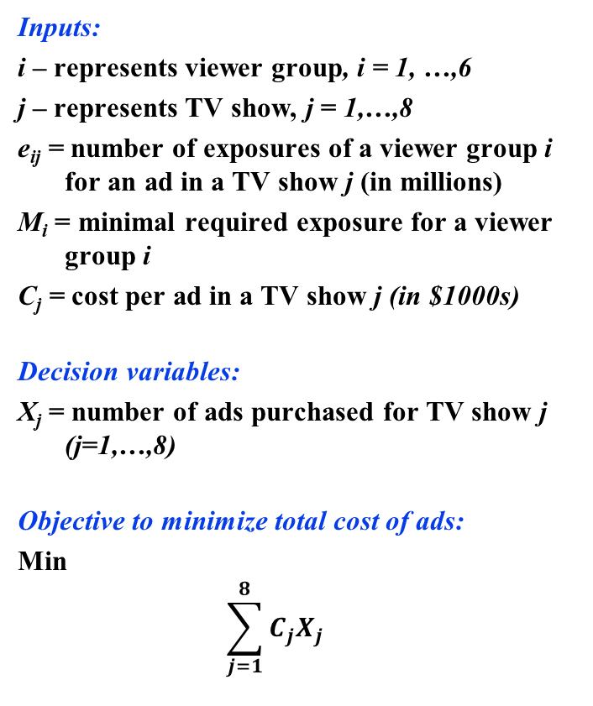

Advertising: LP Model Formulation
Inputs:
i – represents viewer group, i = 1, …,6
j – represents TV show, j = 1,…,8
e_{ij} = number of exposures of a viewer group i for an ad in a TV show j (in millions)
M_{i} = minimal required exposure for a viewer group i
C_{j} = cost per ad in a TV show j (in $1000s)
Decision variables:
X_{j} = number of ads purchased for TV show j (j=1,…,8)
Objective to minimize total cost of ads:
Min
$$\sum_{j=1}^{8}{C_{j}X_{j}}$$
Constraints:
For each viewer group i (i = 1,…,6):
$$\sum_{j=1}^{8}{e_{ij}X_{j}}≥M_{i}$$
Nonnegativity: X_{j} ≥ 0

Slide 13
Advertising: Spreadsheet Model

Slide 14
Advertising: Model Solution Results

Slide 15
Advertising Model Extension: Dual Objectives
The advertising model is extended with the following objectives:
Obtain as many exposures as possible
Keep the total advertising cost as low as possible
Objective 1 is considered as an objective function of maximizing total number of excess exposures
Objective 2 is converted to a constraint, where the total advertising cost cannot exceed a predetermined budget value of $2M

Slide 16
Advertising Model Extension: Spreadsheet Model

Slide 17
Advertising Model Extension: Spreadsheet Model Solution

Slide 18
401K Portfolio
You found a new job at ProNet Inc. Among benefits that you received was the 401K Pension Plan. You could invest up to 15% of your salary in the plan, which is tax free, and the company will match 6% of the invested money. According to the plan, you need to place this money into one or several of eight mutual equity funds designated by the company’s policy. These funds could bring you an additional return by increased NAVs (net asset values) of the funds over a period of time. The main questions you face are what mutual funds to select, and what percentage of the total amount should be invested in each of the selected funds in order to maximize your return and minimize risk.
To answer these questions, you analyzed information about past performance of the designated mutual funds. This information collected from the funds’ prospectus is present in the table below (all funds are “no load” funds with approximately the same annual fees):
Average Annual Total Return, %
Mutual Funds Objective 1 Year 3 Years 5 Years 10 Years Risk
__________________________________________________________________________________________
Fund #1 Growth 10.69 4.74 7.76 6.56 Above Average
Fund #2 Aggressive Growth -7.16 1.80 19.15 12.23 High
Fund #3 Growth 4.51 5.51 19.31 8.40 Above Average
Fund #4 Foreign 2.94 7.32 12.35 10.23 Above Average
Fund #5 Growth/Income 7.39 6.34 9.62 8.15 Average
Fund #6 Income/Value 4.29 1.98 4.45 5.23 Low
Fund #7 Income/Value 1.30 3.61 9.56 5.02 Below Average
Fund #8 Small Company 1.85 9.29 12.35 10.56 Above Average
Suppose, that you would like to receive at least 4% of the annual average return in one year from the funds you invested in. Also, you plan to receive at least 6% of the average annual return in three years, and at least 8% in five and ten years. You would like to have a combined average risk of no higher than “Average.”
Select the optimal portfolio of mutual funds.

Slide 19
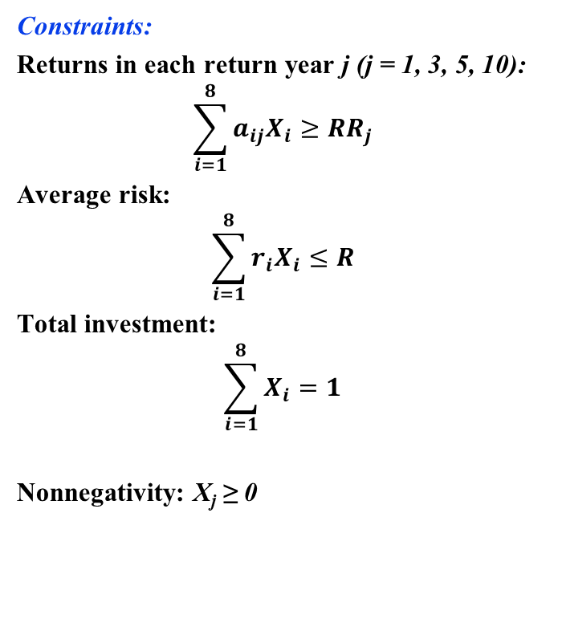
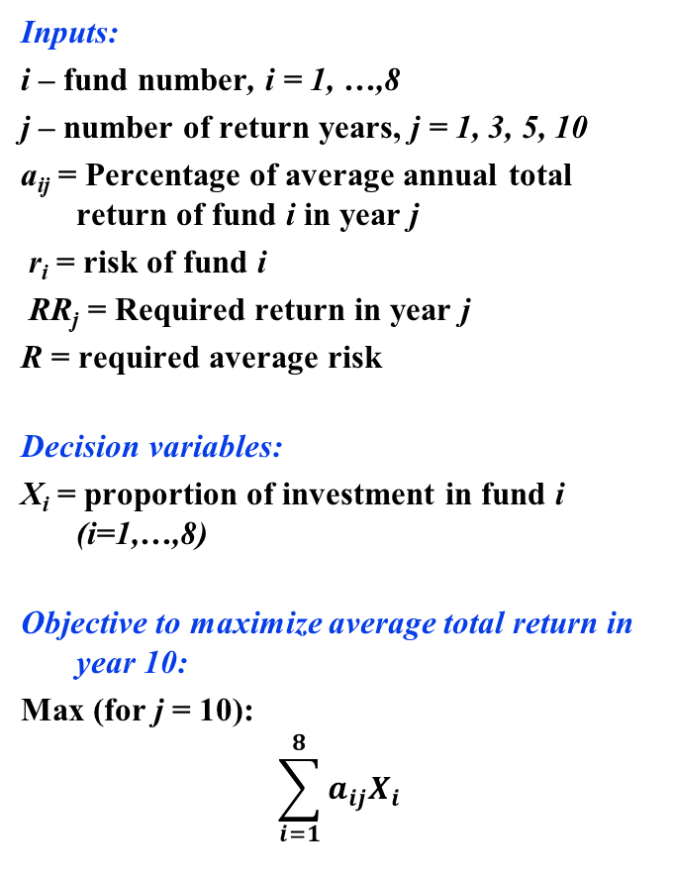
401K Portfolio: LP Model Formulation
Inputs:
i – fund number, i = 1, …,8
j – number of return years, j = 1, 3, 5, 10
a_{ij} = Percentage of average annual total return of fund i in year j
r_{i} = risk of fund i
RR_{j} = Required return in year j
R = required average risk
Decision variables:
X_{i} = proportion of investment in fund i (i=1,…,8)
Objective to maximize average total return in year 10:
Max (for j = 10):
$$\sum_{i=1}^{8}{a_{ij}X_{i}}$$
Constraints:
Returns in each return year j (j = 1, 3, 5, 10):
$$\sum_{i=1}^{8}{a_{ij}X_{i}}≥{RR}_{j}$$
Average risk:
$$\sum_{i=1}^{8}{r_{i}X_{i}}≤R$$
Total investment:
$$\sum_{i=1}^{8}{X_{i}}=1$$
Nonnegativity: X_{j} ≥ 0

Slide 20
401K Portfolio: Spreadsheet Model

Slide 21
401K: Model Solution Results

