Slide 1
Interval Estimation

Slide 2

Interval Estimation
Point estimate $±$ margin of error
$\overline{X}±$ margin of error
$\overline{p}±$ margin of error

Slide 3
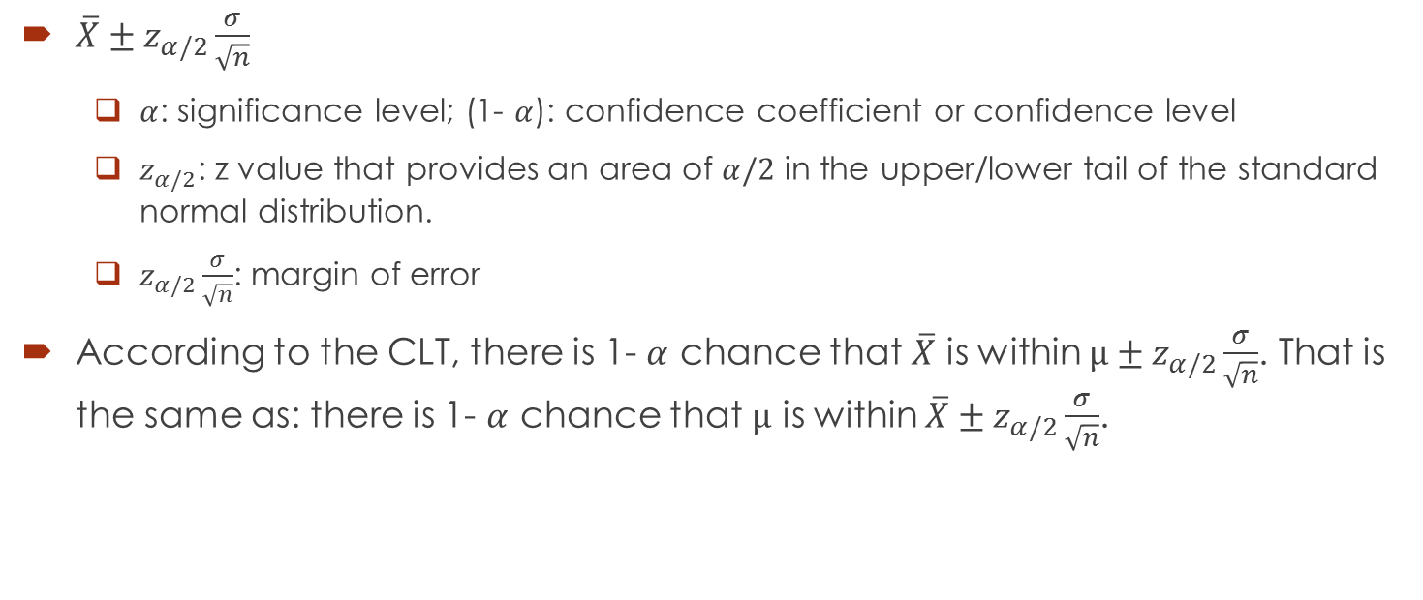

Interval Estimate of Population Mean: $σ$ Known
$\overline{X}±z_{α/2}\frac{σ}{\sqrt{n}}$
$α$: significance level; (1- $α$): confidence coefficient or confidence level
$z_{α/2}$: z value that provides an area of $α/2$ in the upper/lower tail of the standard normal distribution.
$z_{α/2}\frac{σ}{\sqrt{n}}$: margin of error
According to the CLT, there is 1- $α$ chance that $\overline{X}$ is within $μ±z_{α/2}\frac{σ}{\sqrt{n}}$. That is the same as: there is 1- $α$ chance that $μ$ is within $\overline{X}±z_{α/2}\frac{σ}{\sqrt{n}}$.

Slide 4
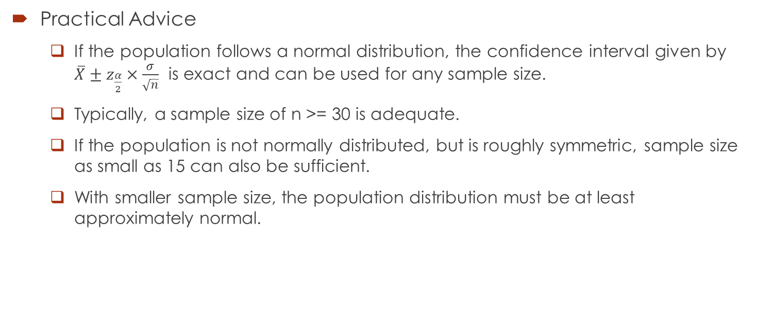
Interval Estimate of Population Mean: $σ$ Known
Practical Advice
If the population follows a normal distribution, the confidence interval given by $\overline{X}±z_{\frac{α}{2}}×\frac{σ}{\sqrt{n}}$ is exact and can be used for any sample size.
Typically, a sample size of n >= 30 is adequate.
If the population is not normally distributed, but is roughly symmetric, sample size as small as 15 can also be sufficient.
With smaller sample size, the population distribution must be at least approximately normal.

Slide 5
Example
In an effort to estimate the mean amount spent per customer for dinner at a major Atlanta restaurant, data were collected for a sample of 49 customers. Assume a population standard deviation of $5.
At 95% confidence, what is the margin of error?
If the sample mean is $24.80, what is the 95% confidence interval for the population mean?

Slide 6
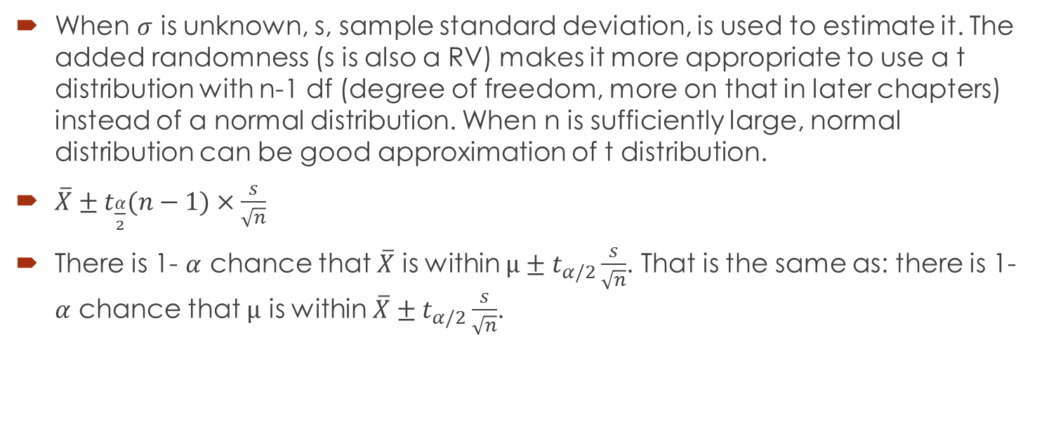

Interval Estimate of Population Mean: $σ$ Unknown
When $σ$ is unknown, s, sample standard deviation, is used to estimate it. The added randomness (s is also a RV) makes it more appropriate to use a t distribution with n-1 df (degree of freedom, more on that in later chapters) instead of a normal distribution. When n is sufficiently large, normal distribution can be good approximation of t distribution.
$\overline{X}±t_{\frac{α}{2}}(n−1)×\frac{s}{\sqrt{n}}$
There is 1- $α$ chance that $\overline{X}$ is within $μ±t_{α/2}\frac{s}{\sqrt{n}}$. That is the same as: there is 1- $α$ chance that $μ$ is within $\overline{X}±t_{α/2}\frac{s}{\sqrt{n}}$.

Slide 7
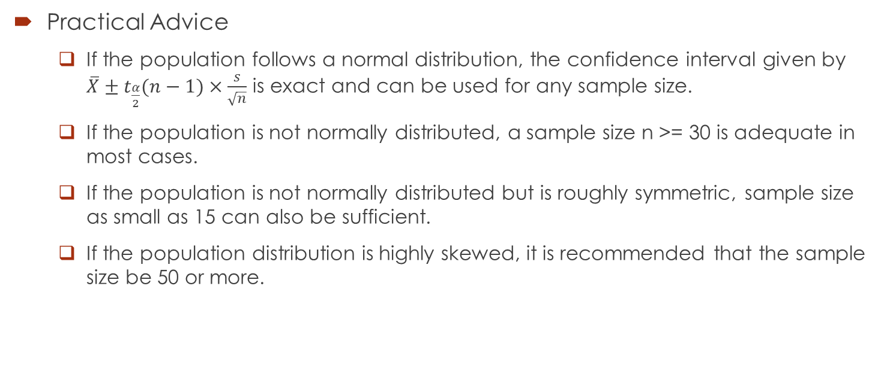
Interval Estimate of Population Mean: $σ$ Unknown
Practical Advice
If the population follows a normal distribution, the confidence interval given by $\overline{X}±t_{\frac{α}{2}}(n−1)×\frac{s}{\sqrt{n}}$ is exact and can be used for any sample size.
If the population is not normally distributed, a sample size n >= 30 is adequate in most cases.
If the population is not normally distributed but is roughly symmetric, sample size as small as 15 can also be sufficient.
If the population distribution is highly skewed, it is recommended that the sample size be 50 or more.

Slide 8
Example
Sales personnel for Skillings Distributors submit weekly reports listing the customer contacts made during the week. A sample of 65 weekly reports showed a sample mean of 19.5 customer contacts per week. The sample standard deviation was 5.2. Provide 90% and 95%confidence intervals for the population mean number of weekly customer contacts for the sales personnel.

Slide 9

Sample Size for Interval Estimate of Population Mean
E = desired margin of error = $z_{α/2}\frac{σ}{\sqrt{n}}$.
In many cases, we have desirable E and we want to know what sample size will deliver the desirable margin of error.
$n=\frac{{\left(z_{α/2}\right)}^{2}σ^{2}}{E^{2}}$

Slide 10
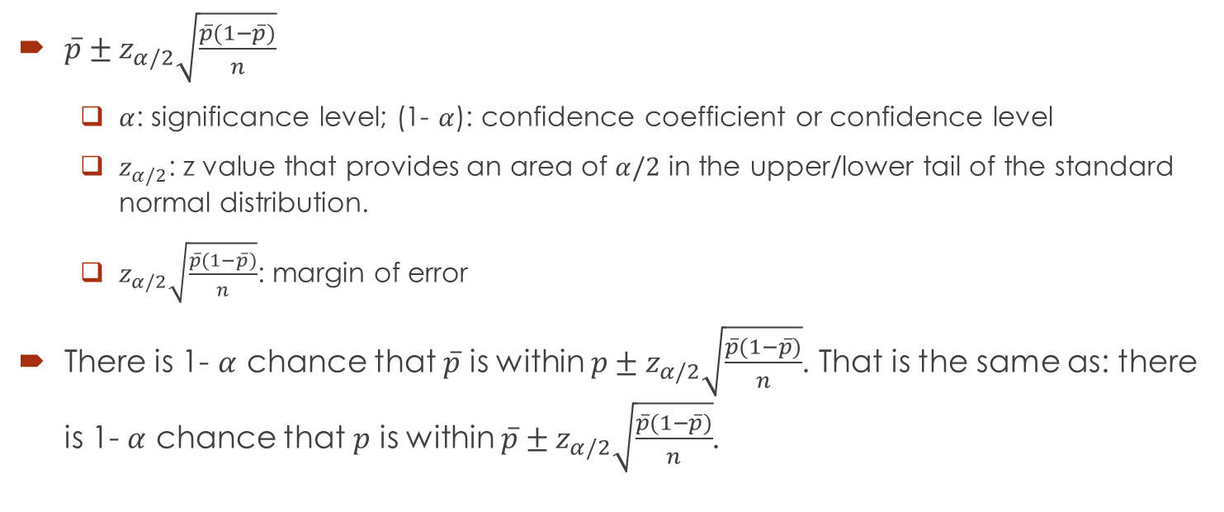
Interval Estimate of Population Proportion
$\overline{p}±z_{α/2}\sqrt{\frac{\overline{p}(1−\overline{p})}{n}}$
$α$: significance level; (1- $α$): confidence coefficient or confidence level
$z_{α/2}$: z value that provides an area of $α/2$ in the upper/lower tail of the standard normal distribution.
$z_{α/2}\sqrt{\frac{\overline{p}(1−\overline{p})}{n}}$: margin of error
There is 1- $α$ chance that $\overline{p}$ is within $p±z_{α/2}\sqrt{\frac{\overline{p}(1−\overline{p})}{n}}$. That is the same as: there is 1- $α$ chance that $p$ is within $\overline{p}±z_{α/2}\sqrt{\frac{\overline{p}(1−\overline{p})}{n}}$.

Slide 11
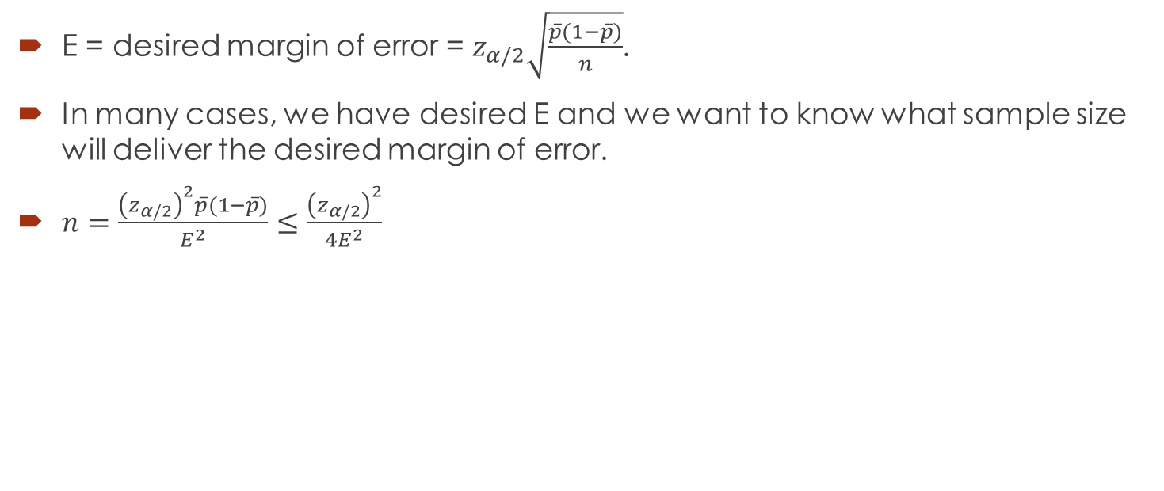
Determining the Sample Size
E = desired margin of error = $z_{α/2}\sqrt{\frac{\overline{p}(1−\overline{p})}{n}}$.
In many cases, we have desired E and we want to know what sample size will deliver the desired margin of error.
$n=\frac{{\left(z_{α/2}\right)}^{2}\overline{p}(1−\overline{p})}{E^{2}}≤\frac{{\left(z_{α/2}\right)}^{2}}{{4E}^{2}}$

Slide 12
Example
The Consumer Reports National Research Center conducted a telephone survey of 2000 adults to learn about the major economic concerns for the future. The survey results showed that 1760 of the respondents think the future health of Social Security is a major economic concern.
What is the point estimate of the population proportion of adults who think the future health of Social Security is a major economic concern?
At 90% confidence, what is the margin of error?
Develop a 90% confidence interval for the population proportion of adults who think the future health of Social Security is a major economic concern.
Develop a 95% confidence interval for this population proportion.
Suppose the desirable margin of error is 2%. Given a confidence level of 95%, what would be an appropriate sample size?

