Slide 1
Inference About Means and Proportions with Two Populations

Slide 2
Inferences About the Difference Between Two Population Means Based on Independent Samples: σ₁ and σ₂ Known
μ₁ = mean of population 1
μ₂ = mean of population 2
σ₁ and σ₂: two population standard deviations
n₁ and n₂: sample size of a simple random sample selected from population 1 and 2, respectively (independent simple random samples).

Slide 3
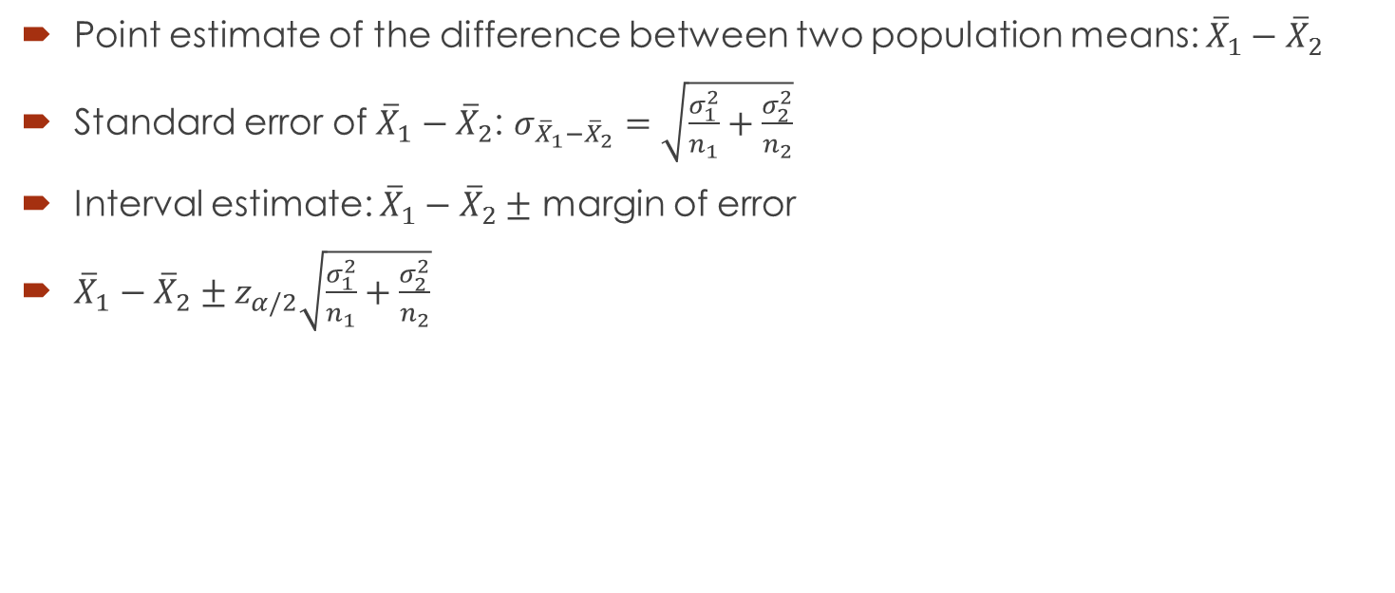
Interval Estimation of μ₁ - μ₂
Point estimate of the difference between two population means: ${\overline{X}}_{1}−{\overline{X}}_{2}$
Standard error of ${\overline{X}}_{1}−{\overline{X}}_{2}$: $σ_{{\overline{X}}_{1}−{\overline{X}}_{2}}=\sqrt{\frac{σ_{1}^{2}}{n_{1}}+\frac{σ_{2}^{2}}{n_{2}}}$
Interval estimate: ${\overline{X}}_{1}−{\overline{X}}_{2}±$ margin of error
${\overline{X}}_{1}−{\overline{X}}_{2}±z_{α/2}\sqrt{\frac{σ_{1}^{2}}{n_{1}}+\frac{σ_{2}^{2}}{n_{2}}}$

Slide 4

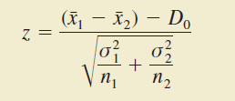
Hypothesis Tests About μ₁ - μ₂
D₀: hypothesized difference between μ₁ and μ₂ ; in many cases, D₀ = 0.
Test statistic for hypothesis tests about μ₁ - μ₂ with σ₁ and σ₂ known :

Slide 5

Practical Advice
In most cases, $n_{1}≥30$ and $n_{2}≥30$ are adequate.
When either or both sample sizes are less than 30, it is recommended that the two population distributions are approximately normal.

Slide 6
Example
Condé Nast Traveler conducts an annual survey in which readers rate their favorite cruise ship. All ships are rated on a 100-point scale, with higher values indicating better service. A sample of 37 ships that carry fewer than 500 passengers resulted in an average rating of 85.36, and a sample of 44 ships that carry 500 or more passengers provided an average rating of 81.40. Assume that the population standard deviation is 4.55 for ships that carry fewer than 500 passengers and 3.97 for ships that carry 500 or more passengers.
What is the point estimate of the difference between the population mean rating for ships that carry fewer than 500 passengers and the population mean rating for ships that carry 500 or more passengers?
At 95% confidence, what is the margin of error?
What is a 95% confidence interval estimate of the difference between the population mean ratings for the two sizes of ships?

Slide 7
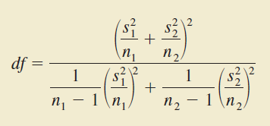

Inferences About the Difference Between Two Population Means: σ₁ and σ₂ Unknown
Interval Estimation of μ₁ - μ₂
${\overline{X}}_{1}−{\overline{X}}_{2}±t_{α/2}\sqrt{\frac{s_{1}^{2}}{n_{1}}+\frac{s_{2}^{2}}{n_{2}}}$
Round non-integer df DOWN to provide a larger t-value and a more conservative interval estimate.
1-$α$: confidence coefficient or confidence level

Slide 8
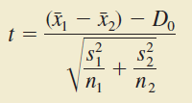
Hypothesis Tests About μ₁ - μ₂
D₀: hypothesized difference between μ₁ and μ₂ ; in many cases, D₀ = 0.
Test statistic for hypothesis tests about μ₁ - μ₂ with σ₁ and σ₂ unknown :
The df is given by the same equation on the previous slide.

Slide 9
Practical Advice
In most cases, equal or nearly equal sample sizes such that n₁+n₂ is at least 20 are adequate.
If the population distributions are highly skewed, larger sample sizes are recommended.
Smaller sample sizes can be used only if the population distributions are approximately normal.

Slide 10
Example
The U.S. Department of Transportation provides the number of miles that residents of the 75 largest metropolitan areas travel per day in a car. Suppose that for a simple random sample of 50 Buffalo residents the mean is 22.5 miles a day and the standard deviation is 8.4 miles a day, and for an independent simple random sample of 40 Boston residents the mean is 18.6 miles a day and the standard deviation is 7.4 miles a day.
What is the point estimate of the difference between the mean number of miles that Buffalo residents travel per day and the mean number of miles that Boston residents travel per day?
What is the 95% confidence interval for the difference between the two population means?

Slide 11
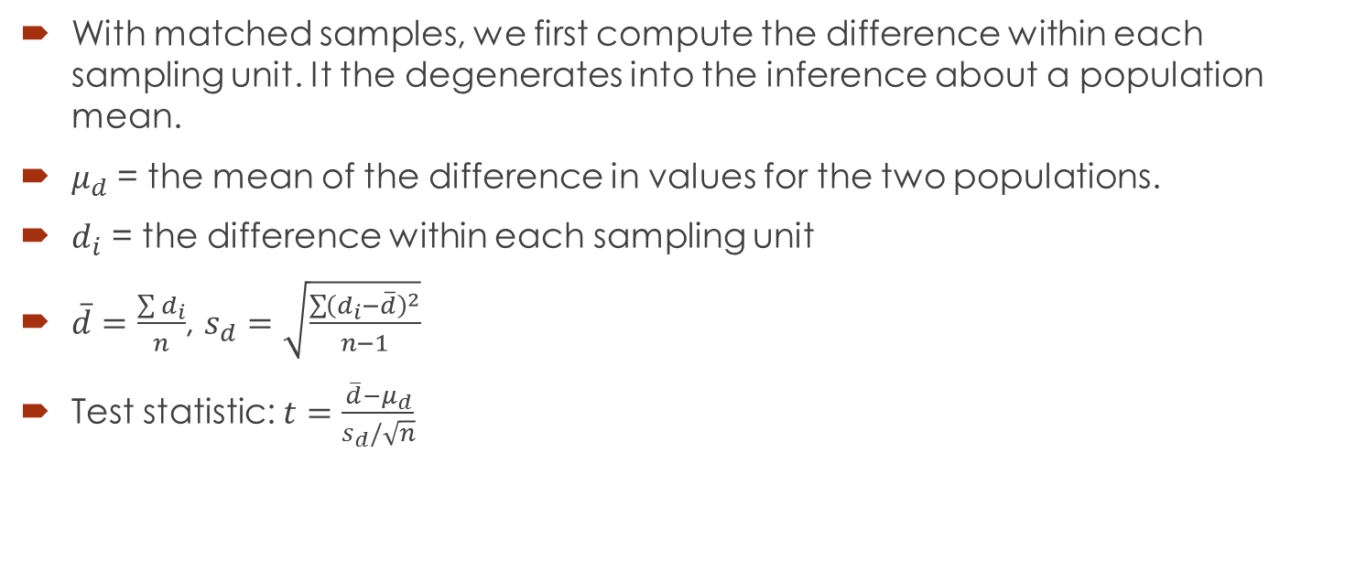
Inferences About the Difference Between Two Population Means: Matched Samples
With matched samples, we first compute the difference within each sampling unit. It the degenerates into the inference about a population mean.
$μ_{d}$ = the mean of the difference in values for the two populations.
$d_{i}$ = the difference within each sampling unit
$\overline{d}=\frac{\sum{d_{i}}}{n}$, $s_{d}=\sqrt{\frac{\sum{{\left(d_{i}−\overline{d}\right)}^{2}}}{n−1}}$
Test statistic: $t=\frac{\overline{d}−μ_{d}}{s_{d}/\sqrt{n}}$

Slide 12

Inferences About the Difference Between Two Population Proportions
$p_{1}$: proportion for population 1
$p_{2}$: proportion for population 2
${\overline{p}}_{1}$: sample proportion for a simple random sample from population 1
${\overline{p}}_{2}$: sample proportion for a simple random sample from population 2

Slide 13
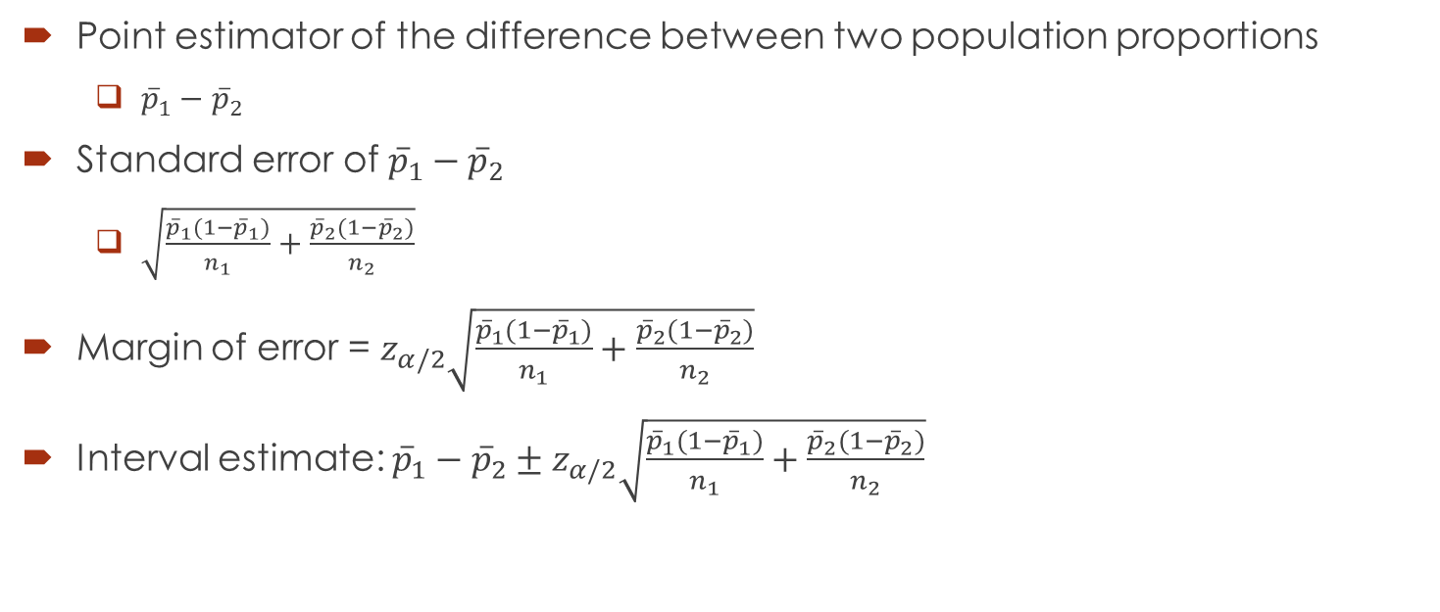

Interval Estimation of $p_{1}$- $p_{2}$
Point estimator of the difference between two population proportions
${\overline{p}}_{1}−{\overline{p}}_{2}$
Standard error of ${\overline{p}}_{1}−{\overline{p}}_{2}$
$\sqrt{\frac{{\overline{p}}_{1}(1−{\overline{p}}_{1})}{n_{1}}+\frac{{\overline{p}}_{2}(1−{\overline{p}}_{2})}{n_{2}}}$
Margin of error = $z_{α/2}\sqrt{\frac{{\overline{p}}_{1}(1−{\overline{p}}_{1})}{n_{1}}+\frac{{\overline{p}}_{2}(1−{\overline{p}}_{2})}{n_{2}}}$
Interval estimate: ${\overline{p}}_{1}−{\overline{p}}_{2}±z_{α/2}\sqrt{\frac{{\overline{p}}_{1}(1−{\overline{p}}_{1})}{n_{1}}+\frac{{\overline{p}}_{2}(1−{\overline{p}}_{2})}{n_{2}}}$

Slide 14



Hypothesis Tests About $p_{1}$- $p_{2}$
test statistic:
$z=\frac{{\overline{p}}_{1}−{\overline{p}}_{2}}{\sqrt{\frac{{\overline{p}}_{1}(1−{\overline{p}}_{1})}{n_{1}}+\frac{{\overline{p}}_{2}(1−{\overline{p}}_{2})}{n_{2}}}}$

Slide 15
Practical Advice
n₁p₁, n₁(1-p₁), n₂p₂, and n₂(1-p₂) are all greater than or equal to 5.

Slide 16
Example
The Professional Golf Association (PGA) measured the putting accuracy of professional golfers playing on the PGA Tour and the best amateur golfers playing in the World Amateur Championship (Golf Magazine, January 2007). A sample of 1075 6-foot putts by professional golfers found 688 made puts. A sample of 1200 6-foot putts by amateur golfers found 696 made putts.
Estimate the proportion of made 6-foot putts by professional golfers. Estimate the proportion of made 6-foot putts by amateur golfers. Which group had a better putting accuracy?
What is the point estimate of the difference between the proportions of the two populations? What does this estimate tell you about the percentage of putts made by the two groups of golfers?
What is the 95% confidence interval for the difference between the two population proportions? Interpret his confidence interval in terms of the percentage of putts made by the two groups of golfers.

