Slide 1
A Multiple Comparison Procedure

Slide 2
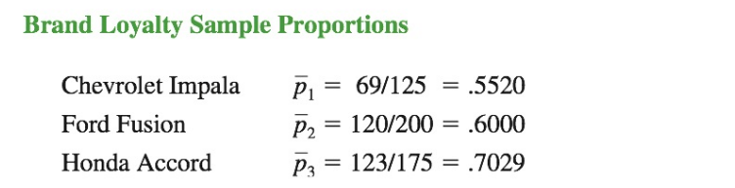
Brand Loyalty Example

Slide 3
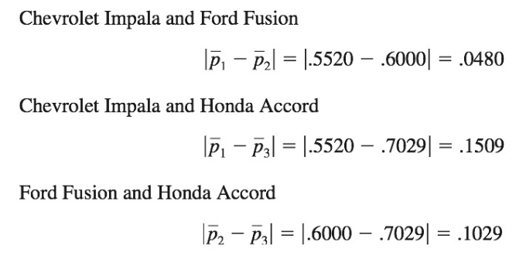
Marascuilo Procedure

Slide 4
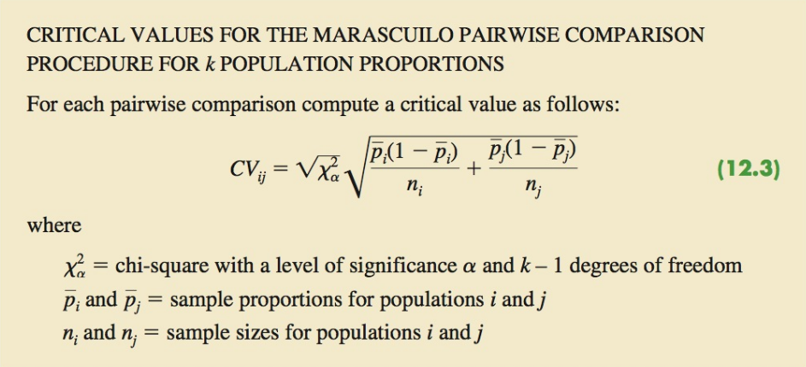
Marascuilo Procedure

Slide 5
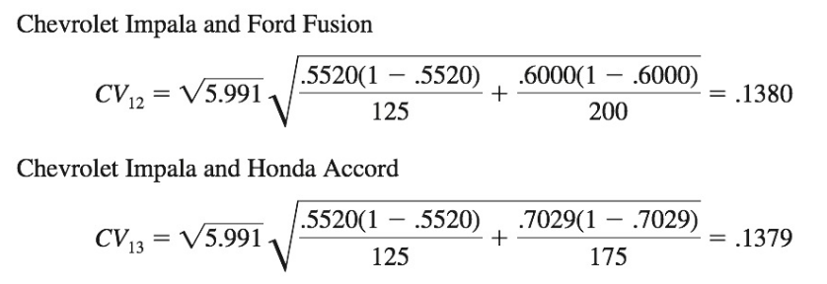
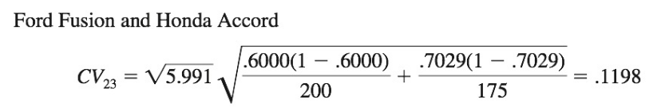
Marascuilo Procedure

Slide 6
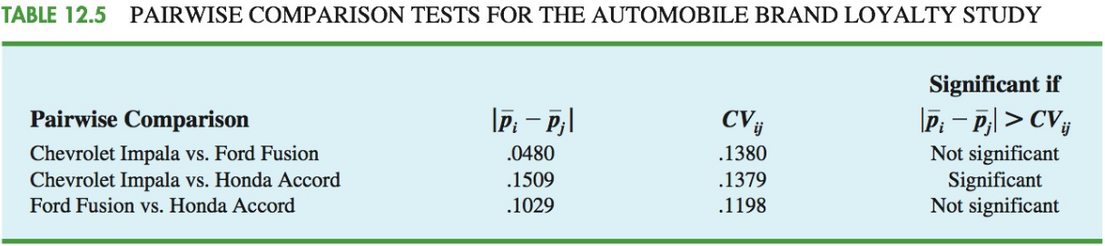
Marascuilo Procedure

