Slide 1
Tests of Goodness of Fit and Independence

Slide 2
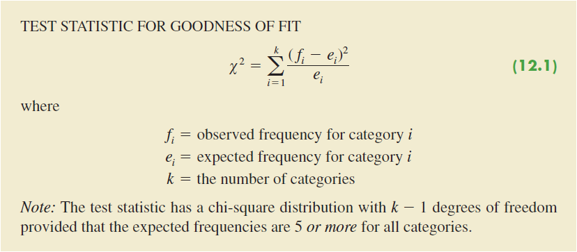
Test Statistic for Goodness of Fit

Slide 3
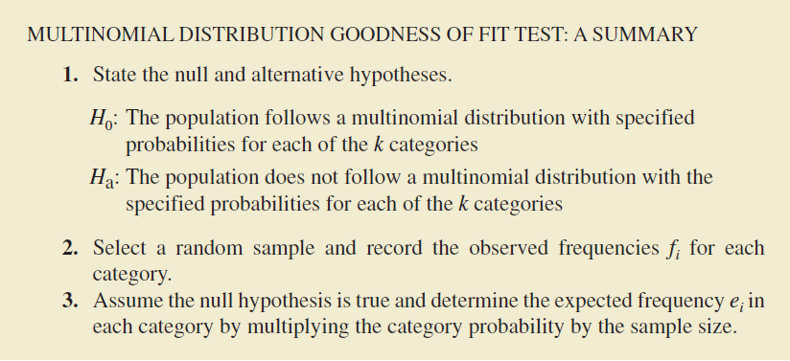
Multinomial Distribution Goodness of Fit Test

Slide 4
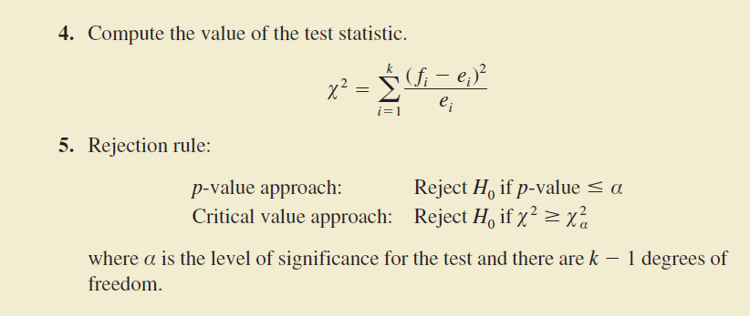
Multinomial Distribution Goodness of Fit Test

Slide 5
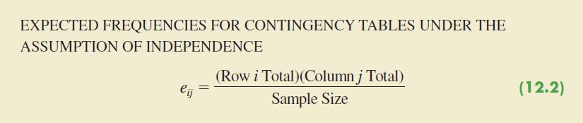
Test of Independence
A.k.a.: contingency table test
We are essentially testing P(IJ) = P(I)*(PJ)

Slide 6
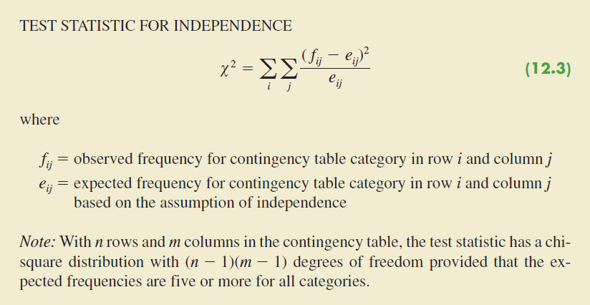
Test of Independence

Slide 7
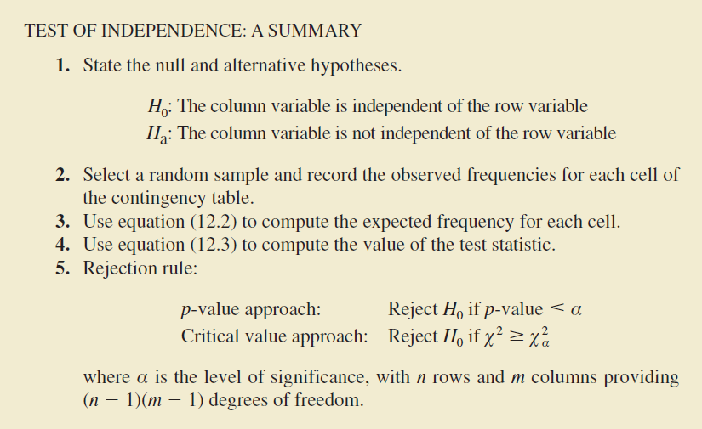
Test of Independence

Slide 8
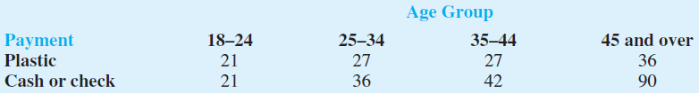
Example
Visa Card USA studied how frequently consumers of various age groups use plastic cards (debit and credit cards) when making purchases. Sample data for 300 customers shows the use of plastic cards by four age groups.
Test for the independence between method of payment and age group. What is the p-value? Using α = .05, what is your conclusion?
If method of payment and age group are not independent, what observation can you make about how different age groups use plastic to make purchases?
What implications does this study have for companies such as Visa, MasterCard, and Discover?

Slide 9
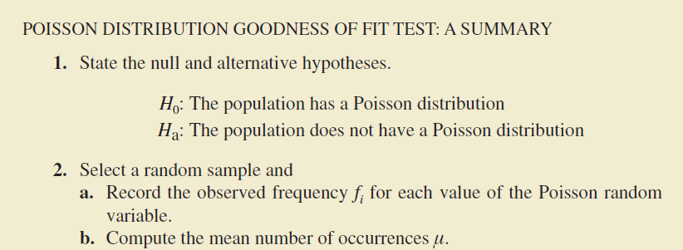
Goodness of Fit Test: Poisson Distributions

Slide 10
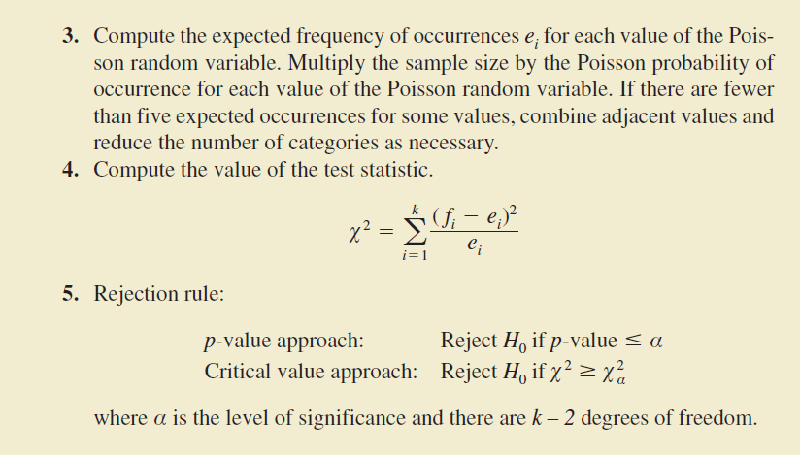
Goodness of Fit Test: Poisson Distributions

Slide 11
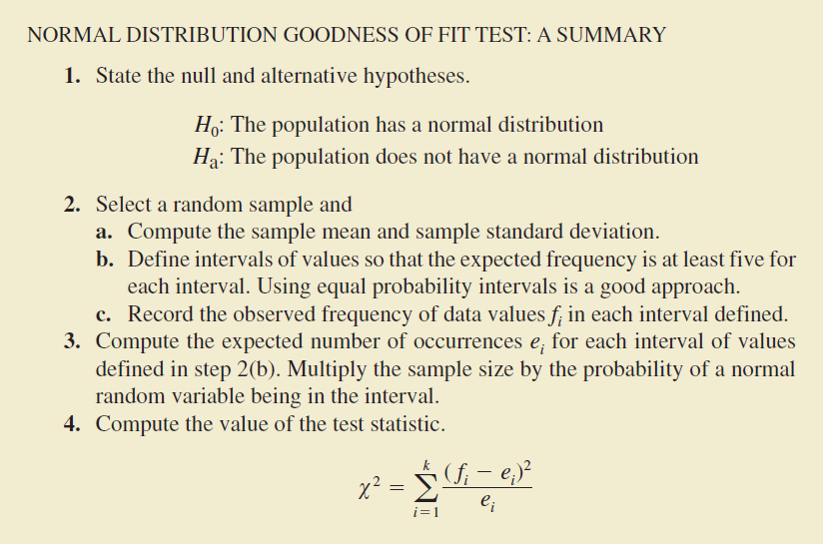
Goodness of Fit Test: Normal Distributions

Slide 12
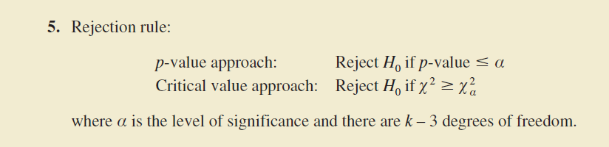
Goodness of Fit Test: Normal Distributions

Slide 13
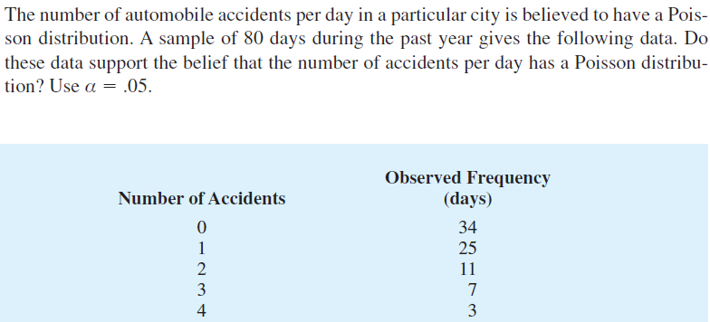
Example

Slide 14
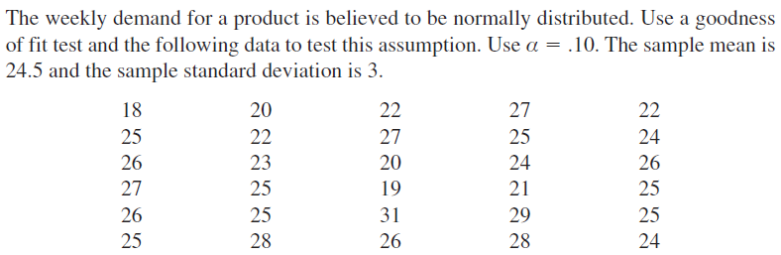
Example

