Slide 1
Graph Mining - Social Network Analysis

Slide 2
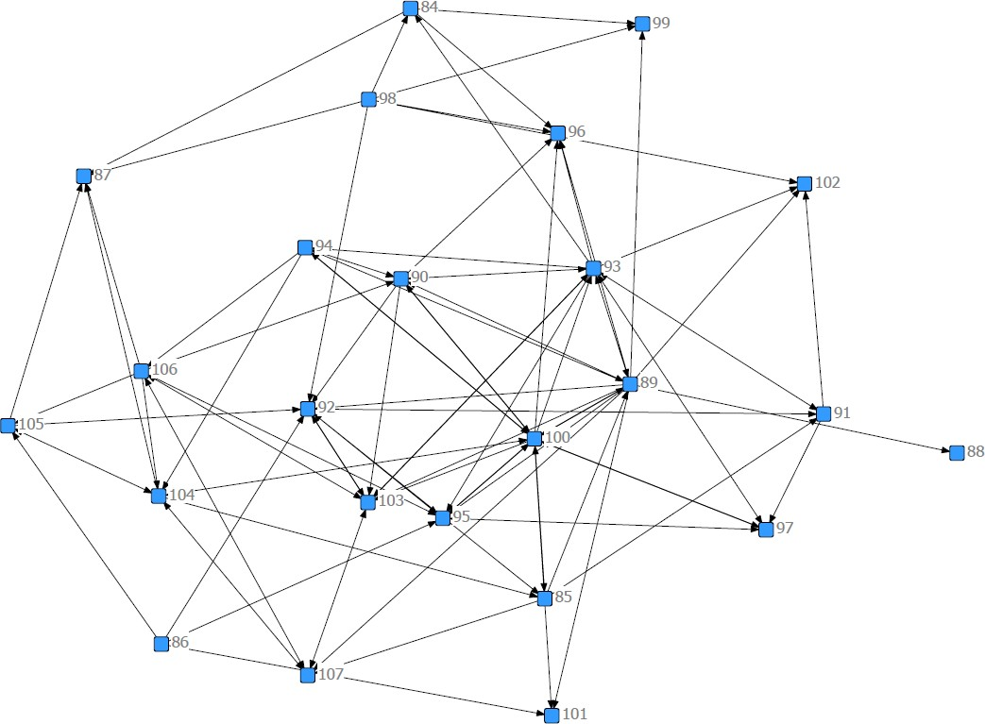
What is a social network?
A network is a graph G(V, E) consisting of
A set of nodes (V)
A set of ties (E) that connect pairs of nodes
A social network is a social structure made up of a set of social actors and a set of dyadic ties.
 | A | B | C | D
A | - | 1 | 0 | 1
B | 1 | - | 1 | 0
C | 0 | 1 | - | 1
D | 1 | 0 | 1 | -

Slide 3
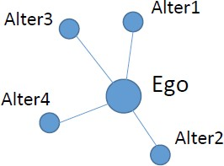
Actors (Nodes)
Individual vs. Collective
E.g., employees, teams, firms…
Ego vs. Alters
Node that we focus on is ego.
Nodes that ego is connected to are alters.
The sets of nodes an ego is connected to, along with ties among them, is an ego network.
Attributes: the characteristics of nodes that distinguish among them.
E.g., gender, age, personality…

Slide 4
Ties
Types of ties
Directed vs. undirected
E(x, y) always equals E(y, x)? E.g. friend
E.g., leadership vs. co-location
 | A | B | C | D
A | - | 1 | 0 | 1
B | 1 | - | 1 | 0
C | 0 | 1 | - | 1
D | 1 | 0 | 1 | -
 | A | B | C | D
A | - | 1 | 0 | 1
B | 1 | - | 1 | 0
C | 1 | 0 | - | 1
D | 0 | 1 | 1 | -

Slide 5
Ties
Types of ties
Valued vs. unvalued
Existence (0 or 1)
Strength of ties
Information capacity of ties
Distance between nodes
Probabilities of transferring information
Frequency of interaction
 | A | B | C | D
A | - | 1 | 0 | 1
B | 2 | - | 3 | 0
C | 1 | 0 | - | 1
D | 0 | 1 | 4 | -

Slide 6
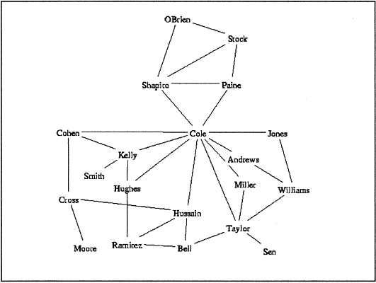
Centrality
Centrality is a measure of how network structure and position contributes to a “node’s importance” and power (Brass, 1993).
Different measures
Degree
Betweenness
(Freeman, 1979; Bonacich, 1987)
16
Source: Cross et al., 2001

Slide 7
Degree centrality
Undirected network
Degree centrality
Degree: The number of ties a node has
Directed network
Indegree centrality
Indegree: The number of ties directed to the node
Outdegree centrality
Outdegree: The number of ties that the node directs to others
7

Slide 8
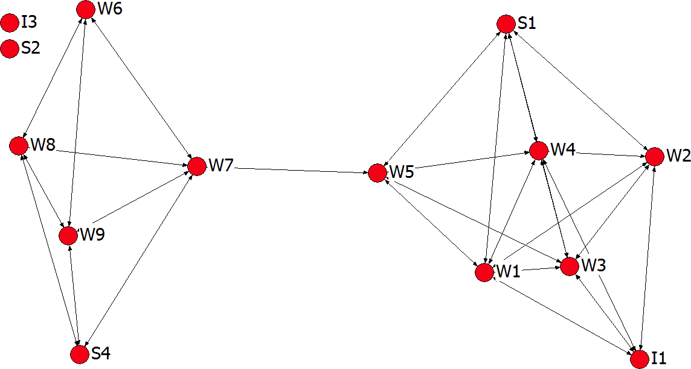
Degree centrality (undirected)
8

Slide 9
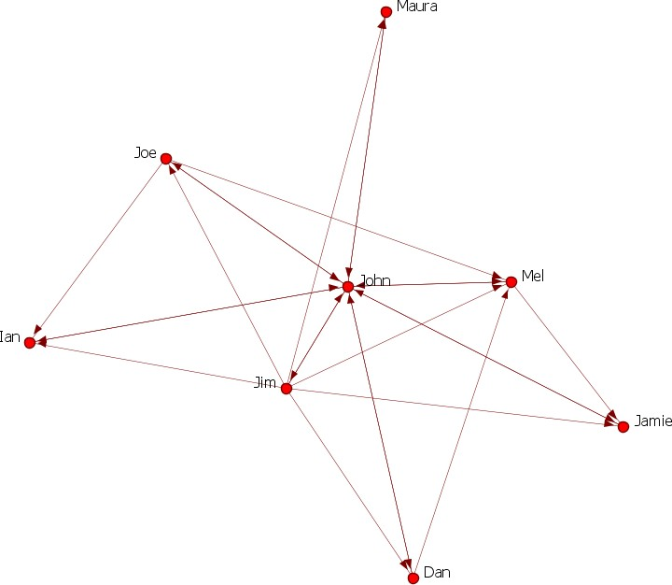
Degree centrality (directed)
9

Slide 10
Betweenness centrality
Betweenness centrality is a measure of how often a node lies along the shortest path between two
other nodes
Interpreted as the potential of gatekeeping, brokering, and controlling the flow.
Assuming traffic flows along shortest path
10

Slide 11


Betweenness centrality
11

Slide 12
Cohesion
Network cohesion
Density
The ratio of the number of ties in the network over the total number of possible ties in the network.
 | Reflexive | Non-Reflexive
Undirected network | T n² / 2 | T n(n −1) / 2
Directed network | T _{n}2 | T n(n −1)
(n is the number of nodes; T is the number of ties in the network).
12

Slide 13
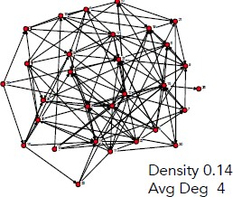
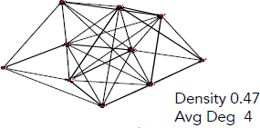
Cohesion
Network cohesion
Average degree
Average number of links per person
Equals density*(n-1); density is normalized average degree.
Less influenced by overall network size
13

Slide 14
Cohesion
Network cohesion
Diameter
The maximum distance between any two nodes
Reciprocity (only in directed networks)
Arc reciprocity: Proportion of outgoing ties that are answered with an incoming tie
R/(R+U)
(R = no. of reciprocated arcs; U = no. of unreciprocated arcs).
14

Slide 15
So what?
Nodes with higher dyadic cohesion may be more likely to influence each other (Balkundi & Kilduff, 2006).
Cohesive network helps the formation of a sense of belonging and social identity (Coleman, 1990).
Cohesive network promotes the development of norms and reduces conflicts (Podolny & Baron, 1997).
My Research: Network cohesion is negatively related to network informativeness due to free riding and information correlation.
15

