Slide 1
Inference About Population Variances

Slide 2
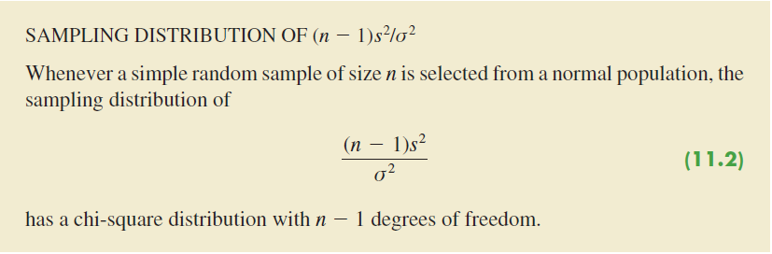

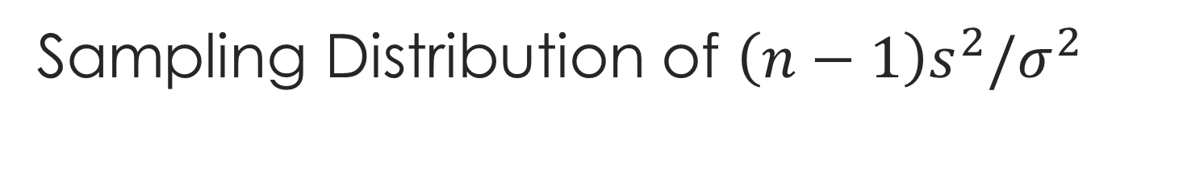
Sampling Distribution of $\left(n−1\right)s^{2}/σ^{2}$
The sample variance
$s^{2}=\frac{\sum{{\left(X_{i}−\overline{X}\right)}^{2}}}{n−1}$

Slide 3
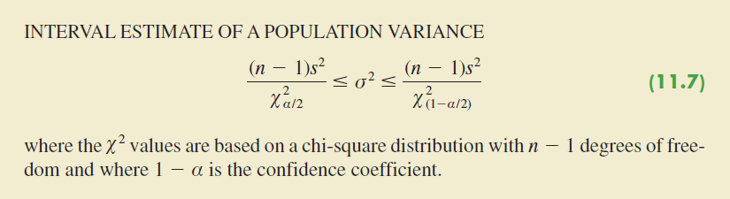
Interval Estimation

Slide 4

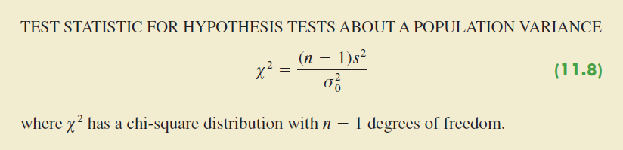
Hypothesis Test

Slide 5
Example
The variance in drug weights is critical in the pharmaceutical industry. For a specific drug, with weights measured in grams, a sample of 18 units provided a sample variance of s² = .36.
Construct a 90% confidence interval estimate of the population variance for the weight of this drug.
Construct a 90% confidence interval estimate of the population standard deviation.

Slide 6
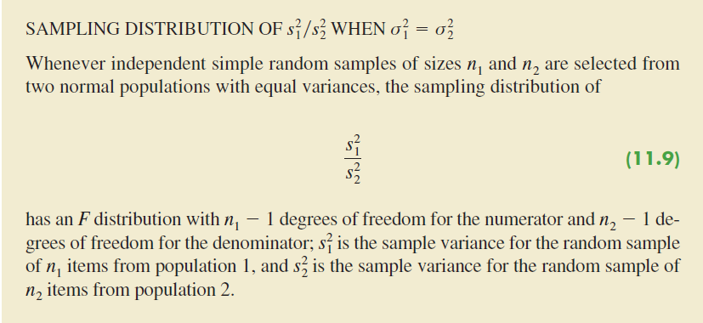
Inferences About Two Population Variances

Slide 7
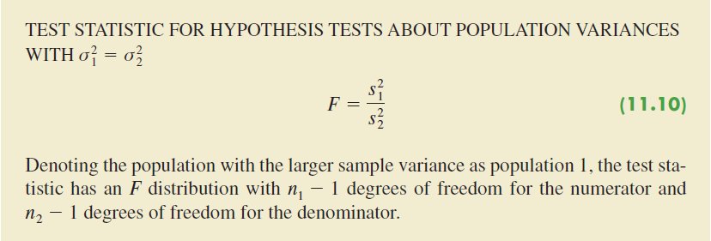
Inferences About Two Population Variances

Slide 8
Example
Investors commonly use the standard deviation of the monthly percentage return for a mutual fund as a measure of the risk for the fund; in such cases, a fund that has a larger standard deviation is considered more risky than a fund with a lower standard deviation. The standard deviation for the American Century Equity Growth fund and the standard deviation for the Fidelity Growth Discovery fund were recently reported to be 15.0% and 18.9%, respectively. Assume that each of these standard deviations is based on a sample of 60 months of returns. Do the sample results support the conclusion that the Fidelity fund has a larger population variance than the American Century fund? Which fund is more risky?

