Slide 1
California State University, East Bay College of Business and Economics MGMT 6165 Prescriptive Analytics
Queuing Models
Lecture Materials
Dr. Z. Radovilsky
Notes:
1
1

Slide 2
Learning Objectives
Describe the waiting lines and how queues form
Address attributes of waiting
Describe essential features of a queuing system
Analyze arrival process and service process in waiting lines
Describe a queuing model using Kendall notation
Apply queuing models to calculate system performance measures
Describe the relationships between queuing system characteristics
Apply queuing models to optimize queuing capacity
Notes:
2
2

Slide 3
Where the Times Goes
In a life time, the average American will spend:
SIX MONTHS Waiting at stoplights
ONE YEAR Looking for misplaced objects
EIGHT MONTHS Opening junk mail
TWO YEARS Reading e-mails
FOUR YEARS Doing housework
FIVE YEARS Waiting in line
SIX YEARS Eating

Slide 4
Understanding Waiting
Understanding waiting lines or queues and learning how to manage them is one of the most important areas in business, specifically in service management
The act of waiting--either in person or on the phone--"has a disproportionately high impact" on customers
A customer waiting in line is potentially a lost customer
The wait can destroy an otherwise perfect service experience

Slide 5
Understanding Waiting (Continued)
Waiting lines are everyday occurrence
Inevitability of waiting
Waiting results from variations in arrival rates and service rates
Both arrivals of customers and service times exhibit a high degree of variability
As a result, there are times when the system becomes temporarily overloaded or underloaded
Business questions/decisions related to waiting lines
What are parameters of waiting lines, e.g., arrival patterns, service patterns, average time of waiting, average number of customers in the queue, etc.?
What are ways to reduce waiting and improve customer satisfaction in the queuing process?
How to make waiting productive and profitable?
What is the best service capacity to minimize total service and waiting costs

Slide 6
General Features and Configuration of Queuing System
2. Arrival
process
4. Queue
discipline
1.Calling
Population
(Customers)
5. Service
process
Departure
3. Queue
configuration
No future
need for
service

Slide 7
Calling Population
Calling
Population
Subpopulation
Homogeneous
Finite
Unlimited
(Infinite)
Finite
Unlimited
(Infinite)

Slide 8
Arrival Process
Arrival
Process
Static
Dynamic
Random
arrivals with
constant rate
Random arrival
rate varying
with time
Facility-
controlled
Customer-
exercised
control
Accept/Reject
Price
Appointments
Reneging
Balking

Slide 9
Variation in Arrival Rates

Slide 10
Arrival Pattern: Poisson Distribution
Frequently in queuing problems, the number of arrivals per unit of time can be estimated by a probability distribution known as the Poisson distribution:
where
P(x) = probability of X arrivals
x = number of arrivals per unit of time
λ = average arrival rate per unit time
e = 2.7182...(the basis of natural logarithm)
Properties of the Poisson Distribution
The Poisson process of arrivals is a purely random arrival process
This means that all arrivals are random and independent of one another
The Poisson distribution gives discrete numbers (integer number of arrivals)
The mean of the Poisson distributed data λ is equal to the variance, only λ is needed to identify probability of possible arrivals
Time between arrivals is distributed as a negative exponential distribution with the mean 1/λ

Slide 11
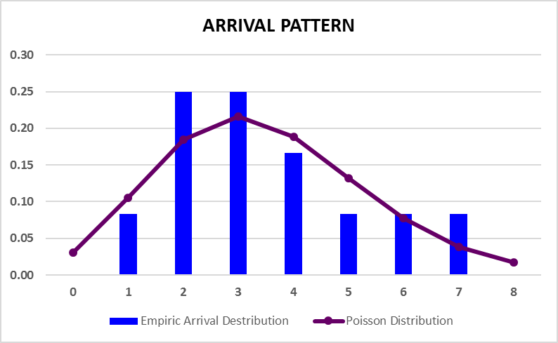
Example of Poisson Distribution

Slide 12
Arrival Pattern (continued)
Mean (average) arrival rate of the Poisson distributed data is defined as λ (lambda)
Time between arrivals has a mean of 1/λ
Examples
The average arrival rate to a grocery store between 10 am and 12 pm is: λ = 20 customers/hour. Then, average time between two consecutive arrivals: t = 1/ λ = 1/20=0.05 hour = 0.05*60 min. = 3 min.
The average time between customer arrivals at a gas station during morning hours is t = 4.8 min. Then, the average arrival rate per hour: λ = 1/t = 1/4.8 min = 60 min/4.8 min = 12.5 customers/hour

Slide 13
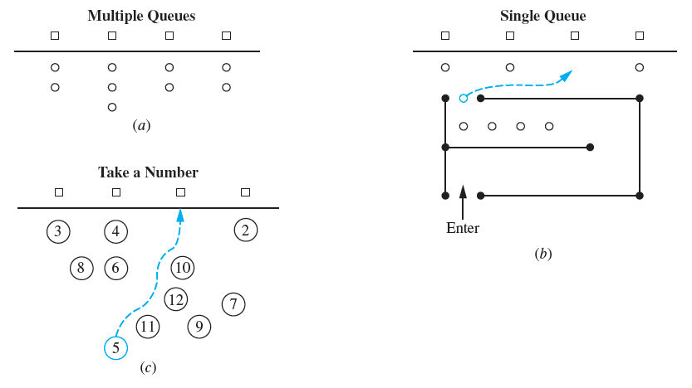
Queue Configurations

Slide 14
Queue Configurations (Continued)
Queue
Service
Arrival
Departure
from System
Single-Server, Single-Phase System
Queue
Service 1
Service 2
Arrival
Departure
Departure
from System
Single-Server, Multiple-Phase System
Queue
Arrival
Departure
from System
Multiple-Server, Single-Phase Systems

Slide 15
Queue Discipline
Queue
Discipline
Static
FCFS (first come, first served)
Dynamic
Selection
based on status
of queue
Selection based
on individual
customer
attributes
Number of
customers
waiting
Round robin
Priority
Preemptive
Processing time
of customers

Slide 16
Service Pattern
Service time could be either constant or random. The latter is the most common thing in reality. In many cases, it can be assumed that random service times are described by the negative exponential distribution:
where
f(t)=probability density function
t = service time
μ = average service rate
e = 2.7182...(the basis of natural logarithm)
The cumulative probability function (probability that time of service will be t or less) is:
Properties of Negative Exponential Distribution
Distribution is a continuous distribution with a mean of μ
Service time is a pure random variable
Duration of services is an independent value. This means that if a server is busy when a customer arrives, the amount of time that elapses until the completion of service is still exponential with the rate of 1/μ
Probability of serving is independent of the number of customers in the system
Example
The average service time per customer at a bank counter is: t = 5 min. The average service rate per hour is: μ = 1/t = 1 hour/5 min = 60 min/5 min = 12 customers/hour

Slide 17
Distribution of Service Times at ATM

Slide 18
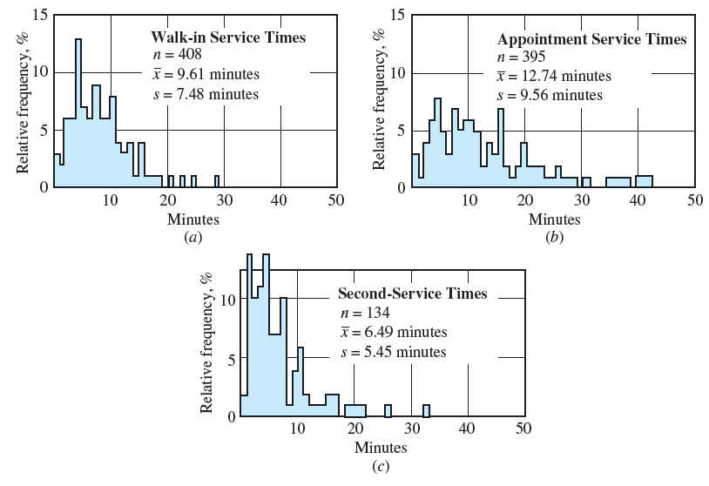
Outpatient Service Process Distributions

Slide 19
Service Process Classification
Service
Process
Static
Dynamic
Self –
service
Machine-
paced
Varying
service rate
Closing and
opening
service lines

Slide 20
Kendall Notation
Arrival Distribution
M=Poisson
D =Constant (Deterministic)
G=General Distribution
Service Distribution
M=Negative Exponential Distribution
D =Constant (Deterministic)
G=General Distribution
Number of Servers
1=Single‑Channel System
s =Multi‑Channel System
Queue Discipline
FCFS=First Come, First Served
LCFS=Last Come, First Served
SIRO=Service in Random Order
GD=General Service
Size of Queue
∞=Unlimited
K=Finite (Maximum Size of K)
Size of Calling Population
∞ =Unlimited
M=Finite (Maximum Size of M)
Arrival Dist./Service Dist./Number of Servers/Queue Disc./Size of Queue/Size of Calling Population
Example: M/M/1/FCFS/ ∞/ ∞

Slide 21
Cost of Waiting
There are two basic categories of costs in a queuing system:
waiting for service -waiting (customer) costs
capacity of service--service costs
Service costs may include:
Cost of construction (capital investment) as expressed by interest and amortization
Cost of operations: labor, energy, and materials required for operations
Cost of maintenance
Other costs: insurance, taxes, rental space, other fixed costs
Waiting (customer) costs may include:
Loss of revenue because of waiting and leaving the line
Loss of not coming back after waiting for a long time
Ill‑will cost incurred by the poor maintained facility
Extra cost of the extreme situations associated with waiting in the line

Slide 22
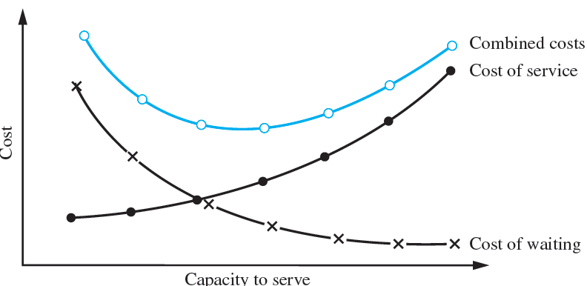
Queuing System Cost Tradeoff

Slide 23
Queuing System Cost Tradeoff
C_{s} = Hourly cost per server
s = Number of servers
C_{w} = Cost of one customer waiting in queue for an hour
L_{q} = average number of customers waiting in queue
Total Cost/hour = Hourly Service Cost + Hourly Waiting Cost
Total Cost/hour = C_{s} s + C_{w} L_{q}

Slide 24
Main Objectives of Managing Waiting Lines
The managerial problem in a queuing system is essentially to minimize total costs—waiting and service--associated with the system
Usually, the queuing model represents an identification of a capacity (number of servers) that minimizes total costs of service and customers' waiting
The main objectives of analyzing waiting lines:
Identify waiting line parameters (average time of waiting in the system, average number of customers in the system, etc.)
Identify service capacity that will minimize the total costs or maximize profits associated with a queuing system.

Slide 25
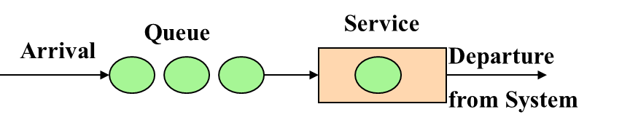
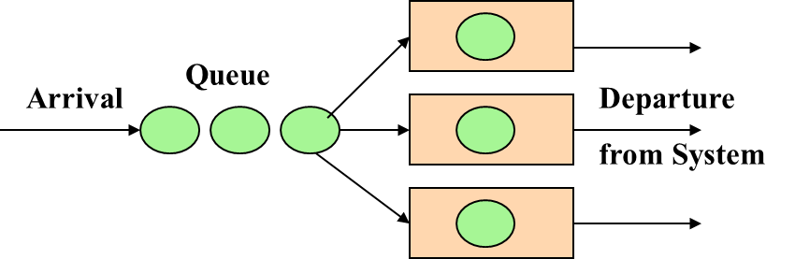
Typical Queues
M/M/1
The first “M” represents a Poisson (random) arrival of customers to service with an average rate of λ
The second “M” stands for an exponential (random) distribution of service time with an average rate of μ
“1” means a single server
This queue assumes a FCFS discipline, unlimited calling population and unlimited size of the queue
M/M/s
The first “M” represents a Poisson (random) arrival of customers to service with an average rate of λ
The second “M” stands for an exponential (random) distribution of service time with an average rate of μ
“s” represents multi-server (2 or more servers)
This queue assumes a FCFS discipline, unlimited calling population and queue size

Slide 26
ATM at Hayward Bank
You work as a service manager for Hayward Bank. At the present time, the bank has one ATM machine, which is installed right in front of the bank’s entrance. Although the ATM machine works on a 24-hour basis, it experiences waiting lines only from 12-2 p.m., when most of the customers arrive to the bank. Past study showed that on the average 52 customers arrive to ATM during this two-hour period, and the arrivals constitute a Poisson process.
The mean time to complete customer transactions at the ATM machine is 2 minutes, and individual service times are approximated by a negative exponential distribution. Past experience showed that a significant drop-off in clientele soon follows when customers are forced to experience lengthy waits. This drop-off leads to an expected net present value in lost future profits of $15 per hour per customer in the system. The hourly cost of maintaining and operating ATM is $8.
The management is concerned with a recent flow of complaints about long waiting times at the Hayward Bank’s ATM. You are asked to research a possibility of reducing the waiting time to no more than 5 minutes. If it not possible with the current ATM machine, one or two new ATMs may be installed.
Initial parameters of the queue:
Arrival rate: λ =52/2 = 26 customers/hour
Service time: t = 2 minutes/customer; Service rate: μ = 1/t = 60 min/2min = 30 customers/hour
Hourly cost per server: C_{s} = $8/hour; Hourly waiting cost/customer: C_{w} = $15/hour
Waiting time no more than 5 min: W_{q} ≤ 5 min (0.083 hour)
Number of servers (ATM machine): s = 1, or, possibly 2, 3 or more
Goal: Identify the number of servers (ATM capacity) that minimizes the total cost of waiting and service, and also allows for waiting time of no more than 5 min.

Slide 27
M/M/1 Queue Parameters
Single server, s=1 (single ATM machine )
Utilization factor:
Only consider the queuing system where ρ < 1
Probability of no customers in the system (system is idle):
Average time of waiting in queue:
Average time of waiting and service in the system:
Average number of customers waiting in queue:
Average number of customers in the system (waiting and service):
Total cost/hour
Total Cost/hour =
C_{s} s + C_{w} L_{q} = 8*1 + 15*5.64 = $92.50
The solution with one ATM machine (one server, s=1) is not appropriate because W_{q} = 0.217 hour = 13.02 min, and thus greater than required 5 min or less.

Slide 28
M/M/1 Queue: Results

Slide 29
M/M/s Queues
Number of servers = s. Consider, for example, s = 2
Utilization factor:
Average number of customers waiting in the line
Average number of customers in the system (waiting and on service):
Average time of waiting in the line:
Average time of waiting and service in the system:
Total cost/hour: C_{s} s + C_{w} L_{q} = 8*2 + 15*0.200 = $19

Slide 30
M/M/s Queue: Results

Slide 31
M/M/1 and M/M/s Queues
The best capacity that minimizes the total cost of service and waiting is two ATM machines (two servers, s=2).
With two ATM machines (s=2), the average waiting time is:
W_{q} = 0.008 hour = 0.008*60 min = 0.48 min ≤ 5 min required

Slide 32
Bumper Car Attraction
One of the main attractions at the Santa Cruz Boardwalk is the bumper car amusement attraction. The attraction has a problem of cars becoming disabled and in need of repair. Repair personnel can be hired at the rate of $16 per hour, but they only work as one team. Thus if one person is hired, he or she works alone; two or three people only work together on the same repair.
One repair mechanic can repair in an average time of 30 minutes. Two repair mechanics take 20 minutes to repair a bumper car, and three mechanics take 15 minutes to do a car. While these cars are down, lost income is $22 per car/hour. Cars tend to break down at the average rate of two per hour. The distribution of car breakdowns is Poisson, and service time is distributed according to the negative exponential distribution.
Questions.
How many repair mechanics should be hired if they work together in a team? Use the queuing model analysis to answer this question.
How many repair mechanics should be hired if they work individually? Use the queuing model analysis to answer this question.
Based on the answers to questions 1 and 2, is it optimal to hire the mechanics to work together in a team, or to hire them to work individually? Explain.

