Slide 1
California State University, East Bay College of Business and Economics MGMT 6165 Prescriptive Analytics
Optimization Models with Integer Variables
Lecture Materials
Dr. Z. Radovilsky
Notes:
1
1

Slide 2
Learning Objectives
Present various types of real applications where integer programming (IP) models may be used
Explain the main approach of solving IP models using branch-and-bound method
Use different integer variables including binary variables
Formulate and solve, using IP models, a wide range of real-world applications
Apply Excel Solver to identify optimal solution for these applications using IP spreadsheet modeling
Apply SolverTable to analyze optimal solutions
Notes:
2
2

Slide 3
Integer Programming
Integer linear programming (ILP) or simply integer programming (IP) is developed for solving linear programming models, which require integer solutions
The IP models require the following:
Linear objective function
Set of linear constraints
Non-negativity constraints for model variables
Integer values for some or all solution variables
Types of IP models:
Pure‑integer model requires all integer values for the optimal solution
Mixed‑integer model requires only certain variables to be integers
Zero‑one integer model requires only values of zero or one for the decision variables

Slide 4
IP Applications
OBJECTIVE DECISION VARIABLES CONSTRAINTS
1. PRODUCT (MACHINE) MIX
To select a mix of How much to produce and Market demand, capacity
products or machines market of each product of different resources
that results in maximum or service for the planning
profits for planning period. Decision var. are
period all or partially integer
2. PERSONNEL SCHEDULING
To create a schedule for Number of workers(full or Limited number of workers
personnel that results in part-time) in each shift. in the shifts
minimum costs for an Decision variables are all Union regulations
organization integer
3. FINANCE (BUDGETING) MODELS
To select investments' mix What type of investment to Limitations imposed
that maximizes total return be used. Decision variables on budgeting
(net present value). are 0‑1 variables or mixed-integer

Slide 5
IP Applications (Continued)
OBJECTIVE DECISION VARIABLES CONSTRAINTS
4. NETWORK MODELS
Minimizing total travel All decision variables are The beginning and ending
costs while visiting 0‑1 variables destinations should be visited
expected destinations. ones. Balance of input and output flows
5. ASSIGNMENT
To assign jobs to the All decision variables are All jobs should be allocated
employees that results 0‑1 variables (a job can be All employees should be
in minimum total cost assigned or not to an assigned
of assignments employee)

Slide 6
Daily Scheduling in Bank
The main branch of California Bank requires at least 8 to 17 tellers on duty depending on the time of day, as indicated in the table below. Full-time tellers work from 8 am to 4 pm. A full-time teller costs the bank $32 per hour. Part-time tellers work 4 consecutive hours at $20 per hour starting at 8 am, 10 am, or 12 noon. Union regulations require that at least 50% of tellers be full-time (on a daily basis) The teller requirements for the main branch of California Bank are presented below.
Number Of Tellers
Time Period (At Least Required)
_______________________________________
8-10 a.m. 3
10-12 noon. 2
12-2 p.m. 7
2-4 p.m. 4
As the branch operations manager, make a recommendation as to the number of full-time and part-time employees needed throughout the day to minimize the total daily cost.

Slide 7
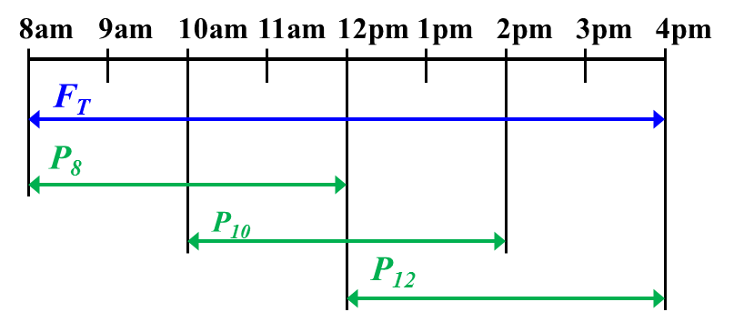
Integer Programming Model for Daily Scheduling
Decision Variables:
F_{T} = Number of full-time tellers starting at 8 am
P₈ = Number of part-time tellers starting at 8 am
P₁₀ = Number of part-time tellers starting at 10 am
P₁₂ = Number of part-time tellers starting at 12 pm
Objective Function is to minimize total cost:
Min 256 F_{T} +80 P₈ + 80 P₁₀ + 80 P₁₂
Constraints:
Tellers at 8-10 am: F_{T} + P₈ >= 3
Tellers at 10 am - 12 pm: F_{T} + P₈ + P₁₀ >= 2
Tellers at 12 - 2 pm: F_{T} + P₁₀ + P₁₂ >= 7
Tellers at 2 - 4 pm: F_{T} + P₁₂ >= 4
Full-time >= 50% Total: F_{T} >= 0.5(F_{T} + P₈ + P₁₀ + P₁₂)
F_{T}, P₈, P₁₀, P₁₂ >= 0 and Integer

Slide 8
Spreadsheet Model

Slide 9
Solver: Non-integer Solutions

Slide 10
Overview of Optimization with Integer Variables
When Excel’s Solver or other LP software solves a linear model without integer constraints, it uses a very efficient algorithm, the simplex method, to perform the optimization
The simplex method is efficient because it typically examines only a very small fraction of the hundreds, thousands, or even millions of possible corner points before determining the best corner point
The main difference between LP and IP models is that LP models allow fractional values, such as 0.5 or 3.5, in the variables cells, whereas IP models allow only integer values in integer-constrained variable cells

Slide 11
Branch and Bound Method of IP
Although several solution methods have been suggested by researchers on how to optimize IP models, the most popular solution method is called branch and bound
The branch and bound method is an algorithm that can be used to solve all-integer and mixed-integer programs
It searches for an optimal solution by examining only a small part of the total number of possible solutions
The branch and bound method starts with solving the model using the simplex method. If non-integer solutions exists, it breaks the area of feasible solutions into smaller parts (subproblems) until the optimal solution is found
It introduces the concept of feasible and infeasible bounds
Each subproblem is solved using the simplex method
If the solution of a subproblem has a total profit or cost worse than the current feasible bound, it will be discarded, and only the remaining subproblems will be examined.
At the point where no more subproblems can be created, the optimal solution is reached

Slide 12
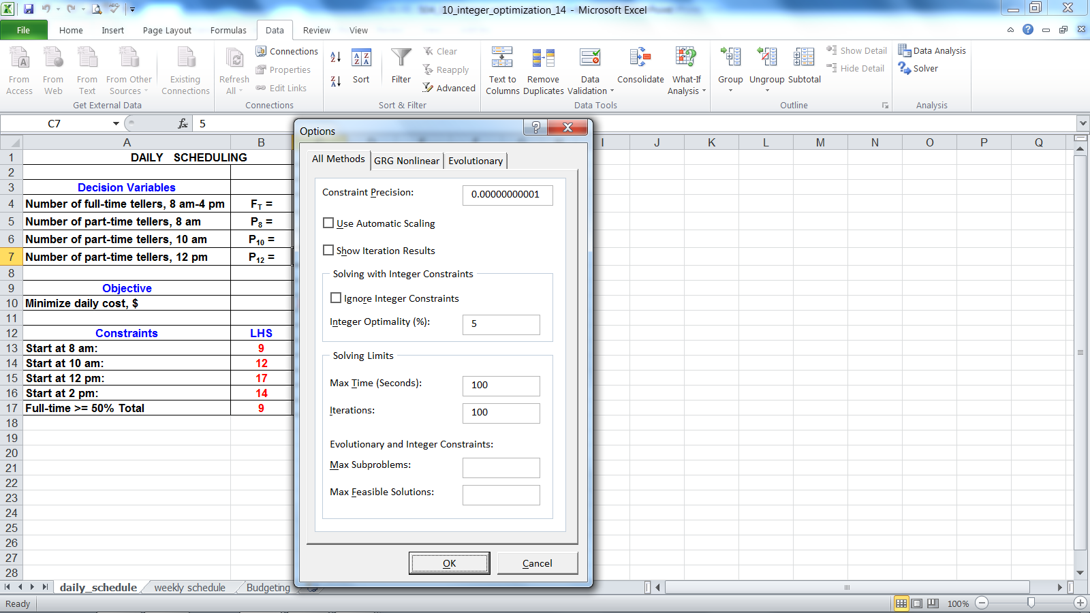
Integer Constraints
The Solver Options dialog box contains a Tolerance setting, which is relevant for integer-constrained models
Excel’s default tolerance is 5%. In Excel 2010, 2013, and 2016, this setting, listed as Integer Optimality (%), is found under Solver Options in the dialog box shown here
Uncheck the box to incorporate full integer constraints if the model has relatively small dimensions (number of variables, all integers, and constraints)
For a model with a relatively large or large number of integer variables (both integer and binary) and constraints, check the box; the optimal solution will be within 5% of the best possible integer solution

Slide 13
Solution Results

Slide 14
Weekly Scheduling
A business analyst at Body Health Club is given an assignment to develop a weekly schedule for its full-time attendants that are called body health trainers. The company’s policy states that each full-time attendant should work five consecutive days and then receive two days off.
The analyst knows that the number of members at the club throughout the day tends to be low in the mornings and early afternoons and higher in the late afternoons and evenings. In spite of this pattern, the analyst believes that the workload on the attendants is usually uniform throughout the day because members who attend in the mornings and early afternoons (till 2 pm) tend to be on formal exercise and personal training programs and to require more assistance. Members who attend in the late afternoons (after 2 pm) and evenings tend to participate more in recreation activities and to require less assistance. Therefore the hourly workload for attendants is approximately uniform.
Based on daily customer appointments and daily number of customers exercising at Body Health Club, the analyst identified the number of attendants required daily:
___________________________________________________________________
Mon. Tue. Wed. Thu. Fri. Sat. Sun.
___________________________________________________________________
5 6 6 8 10 10 10
Develop a work shift schedule for the Body Health Club that would minimize the number of full-time employees on its payroll.

Slide 15
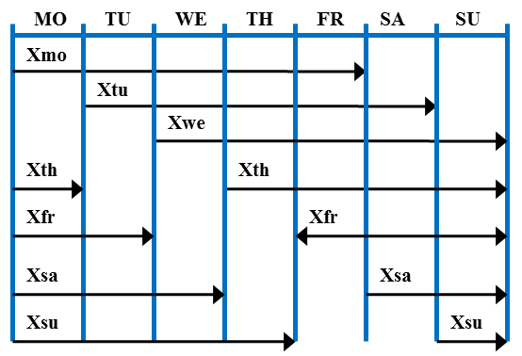
Formulation of IP Model for Weekly Scheduling
Decision Variables
Xmo = number of attendants that start on Monday
Xtu = number of attendants that start on Tuesday
Xwe = number of attendants that start on Wednesday
Xth = number of attendants that start on Thursday
Xfr = number of attendants that start on Friday
Xsa = number of attendants that start on Saturday
Xsu = number of attendants that start on Sunday
Objective – minimize number of attendants:
Min Xmo + Xtu + Xwe + Xth + Xfr + Xsa + Xsu
Constraints
Work on Monday: Xmo + Xth + Xfr + Xsa + Xsu ≥ 5
Work on Tuesday: Xmo + Xtu + Xfr + Xsa + Xsu ≥ 6
Work on Wednesday: Xmo + Xtu + Xwe + Xsa + Xsu ≥ 6
Work on Thursday: Xmo + Xtu + Xwe + Xth + Xsu ≥ 8
Work on Friday: Xmo + Xtu + Xwe + Xth + Xfr ≥ 10
Work on Saturday: Xtu + Xwe + Xth + Xfr + Xsa ≥ 10
Work on Sunday: Xwe + Xth + Xfr + Xsa + Xsu ≥ 10
All Xs ≥ 0 and integer

Slide 16
Spreadsheet Model

Slide 17
Solution Results

Slide 18
Budgeting Decision
Bensen Consulting is a research and development (R&D) company that develops computer systems and software primarily for the medical industry. The company has proposals from its own researchers for eight new projects. Each of the proposed research projects requires limited resources, and it is not possible to undertake all of them. The following table shows the developmental budget, the number of researchers, and the expected annual sales from each project if successfully developed and implemented.
_______________________________________________________________________________
Development Number of Expected Annual
Project Budget ($mln) Research Personnel Sales ($ Mln)
_______________________________________________________________________________
1 0.675 6 1.15
2 1.050 9 1.75
3 0.725 10 1.60
4 0.430 8 1.29
5 1.240 5 1.55
6 0.890 8 1.70
7 1.620 4 1.94
8 1.200 6 1.80
The company has developed the followings set of objectives for selecting which projects to initiate.
The company would like to remain within a total development budget of $5,000,000.
The number of available research personnel is 27, and Bensen Consulting would like to avoid obtaining extra researchers.
The company would like the expected future annual sales from the implemented projects to be at least $6,500,000 (30% of gross profit to the allocated budget).
Projects 2,3,4,5,6, and 7 are considered the most risky of the projects, and the company would prefer not to select any more than three of these projects.
Formulate a model that would identify the best budgeting policy while accumulating the specified objectives.

Slide 19
Budgeting Decision: Formulation of IP Model with Binary Variable
Decision Variables
P₁ = selection of project 1, P₁=1 if project 1 is selected , and P₁= 0 if not
P₂ = selection of project 2, P₂=1 if project 2 is selected , and P₂= 0 if not
P₃ = selection of project 3, P₃=1 if project 3 is selected , and P₃= 0 if not
P₄ = selection of project 4, P₄=1 if project 4 is selected , and P₄= 0 if not
P₅ = selection of project 5, P₅=1 if project 5 is selected , and P₅= 0 if not
P₆ = selection of project 6, P₆=1 if project 6 is selected , and P₆= 0 if not
P₇ = selection of project 7, P₇=1 if project 7 is selected , and P₇= 0 if not
P₈ = selection of project 8, P₈=1 if project 8 is selected , and P₈= 0 if not
Objective – maximize gross profit from selected projects
Max (1.15-0.675)P₁ + (1.75-1.05)P₂ + (1.6-0.725)P₃ +
(1.29-0.43)P₄ + (1.55-1.24)P₅ + (1.7-0.89)P₆ +
(1.94-1.62)P₇ + (1.8-1.2)P₈
or
Max 0.475P₁+ 0.7P₂ + 0.875P₃+ 0.86P₄ + 0.31P₅ + 0.81P₆ + 0.32P₇ + 0.6P₈
Constraints
Budget <= $5mln:
0.675P₁+ 1.05P₂ + 0.725P₃+ 0.43P₄ + 1.24P₅ + 0.89P₆ + 1.62P₇ + 1.2P₈ ≤ 5
Researchers <= 27:
6P₁+ 9P₂ + 10P₃+ 8P₄ + 5P₅ + 8P₆ + 4P₇ + 6P₈ ≤ 27
Sales >= $6.5mln:
1.15P₁+ 1.75P₂ + 1.6P₃+ 1.29P₄ + 1.55P₅ + 1.7P₆ + 1.94P₇ + 1.8P₈ ≥ 6.5
Risky <= 3:
P₂ + P₃+ P₄ + P₅ + P₆ + P₇ ≤ 3
All P_{i} (i = 1,…,8) are 0-1 variables

Slide 20
IP Models With Binary Variables
A binary variable x is simply a general integer variable that is restricted to being either 0 and 1
We usually just write this as
x = 0 or 1
x is 0-1

Slide 21
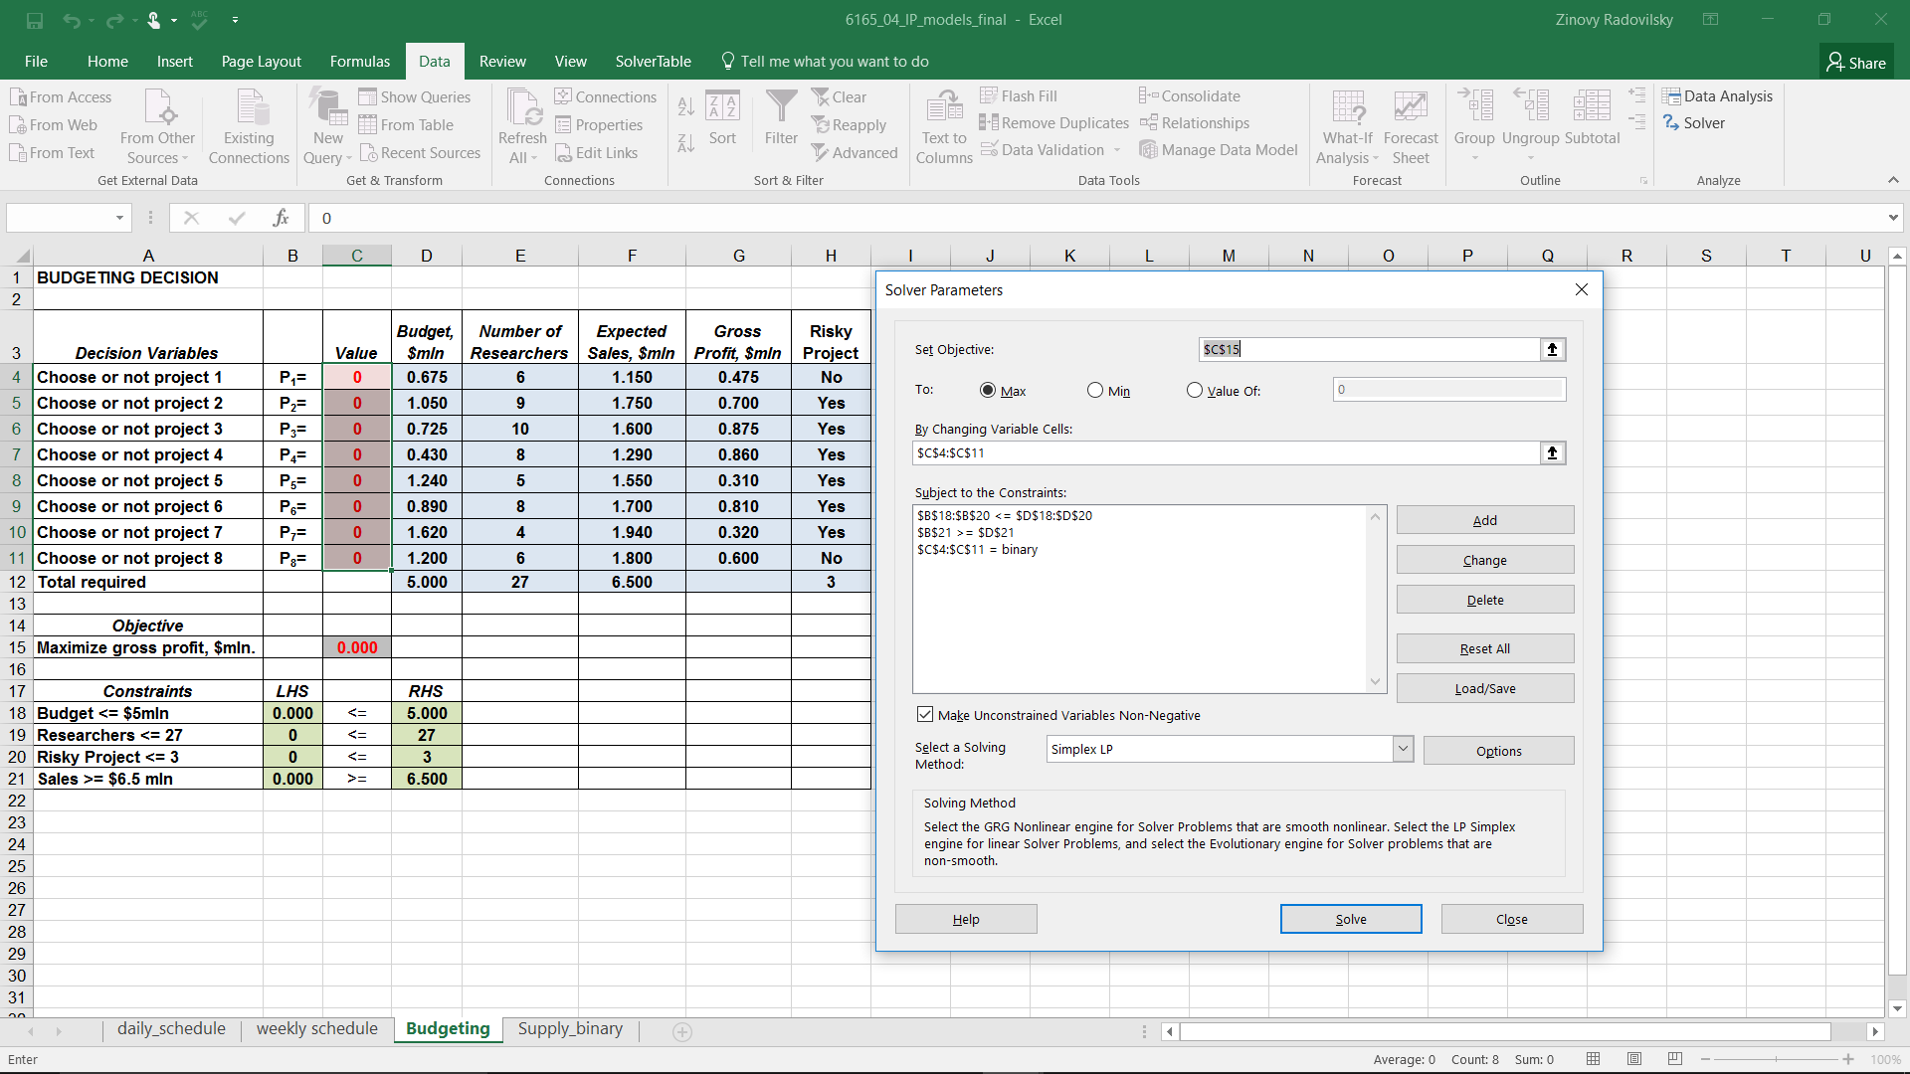
Spreadsheet Model and Solver Input

Slide 22
Solution Results

