Slide 1
Chapter 6: Continuous Probability Distribution

Slide 2

Uniform Probability Distribution
Uniform pdf
$f\left(x\right)=\left\{\begin{matrix}\frac{1}{b−a} & a≤x≤b \\ 0 & elsewhere\end{matrix}\right.$
$E\left(X\right)=\frac{a+b}{2}$
$Var\left(X\right)=\frac{{(b−a)}^{2}}{12}$

Slide 3
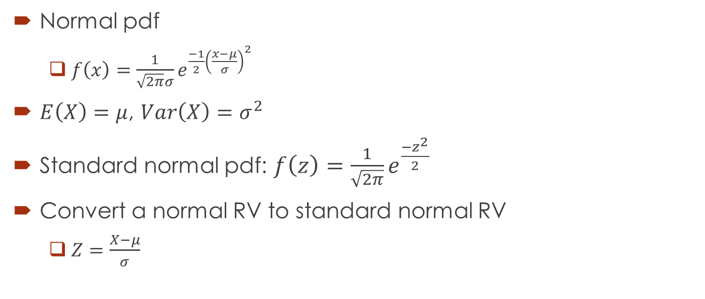
Normal Probability Distribution
Normal pdf
$f\left(x\right)=\frac{1}{\sqrt{2π}σ}e^{\frac{−1}{2}{\left(\frac{x−μ}{σ}\right)}^{2}}$
$E\left(X\right)=μ$, $Var\left(X\right)=σ^{2}$
Standard normal pdf: $f\left(z\right)=\frac{1}{\sqrt{2π}}e^{\frac{−z^{2}}{2}}$
Convert a normal RV to standard normal RV
$Z=\frac{X−μ}{σ}$

Slide 4

Normal Distribution
Binomial distribution can be approximated by a normal distribution when the number of trials n is sufficiently large.
Set $μ=np$ and $σ=\sqrt{np(1−p)}$.

Slide 5
Example
For borrowers with good credit scores, the mean debt for revolving and installment accounts is $15,015. Assume the standard deviation is $3540 and that debt amounts are normally distributed.
What is the probability that the debt for a borrower with good credit is more than $18,000?
What is the probability that the debt for a borrower with good credit is less than $10,000?
What is the probability that the debt for a borrower with good credit is between $12,000 and $18,000?
What is the probability that the debt for a borrower with good credit is no more than $14,000?
If a borrower is in the 85th percentile, what is the debt for this borrower?

Slide 6
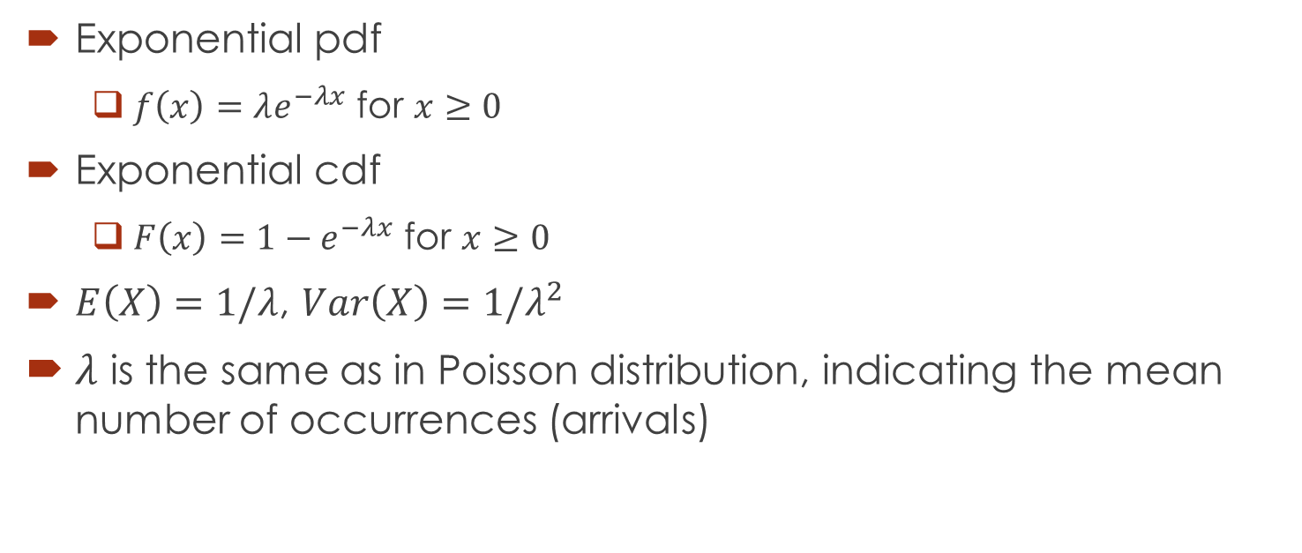
Exponential Probability Distribution
Exponential pdf
$f\left(x\right)=λe^{−λx}$ for $x≥0$
Exponential cdf
$F\left(x\right)=1−e^{−λx}$ for $x≥0$
$E\left(X\right)=1/λ$, $Var\left(X\right)={1/λ}^{2}$
$λ$ is the same as in Poisson distribution, indicating the mean number of occurrences (arrivals)

Slide 7
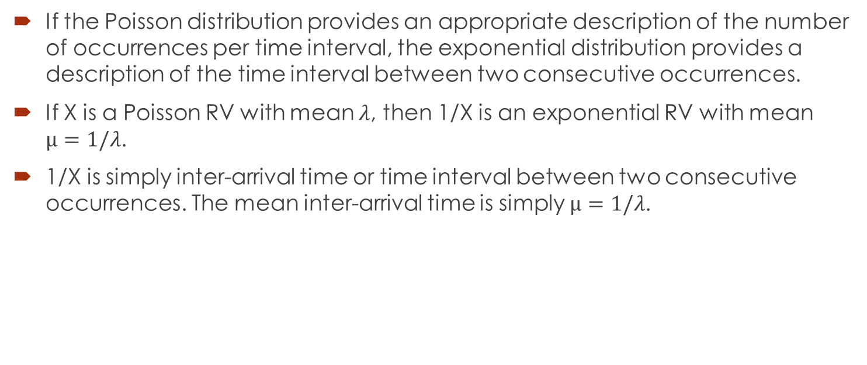
Relationship between Poisson and Exponential Distributions
If the Poisson distribution provides an appropriate description of the number of occurrences per time interval, the exponential distribution provides a description of the time interval between two consecutive occurrences.
If X is a Poisson RV with mean $λ$, then 1/X is an exponential RV with mean $μ=1/λ$.
1/X is simply inter-arrival time or time interval between two consecutive occurrences. The mean inter-arrival time is simply $μ=1/λ$.

Slide 8
Exponential Probability Distribution Example (Problem 37, page 294)
Wendy’s restaurant has been recognized for having the fastest average service time among fast food restaurants. In a benchmark study, Wendy’s average service time was 2.2 minutes. Assume that the service time for Wendy’s has an exponential distribution.
What is the probability that a service time is less than or equal to 1 minute?
What is the probability that a service time is between 30 seconds and 1 minute?
Suppose a manager of a Wendy’s is considering instituting a policy such that if the time it takes to serve you exceeds five minutes, your food is free. What is the probability that you will get your food for free?

